Slide 1
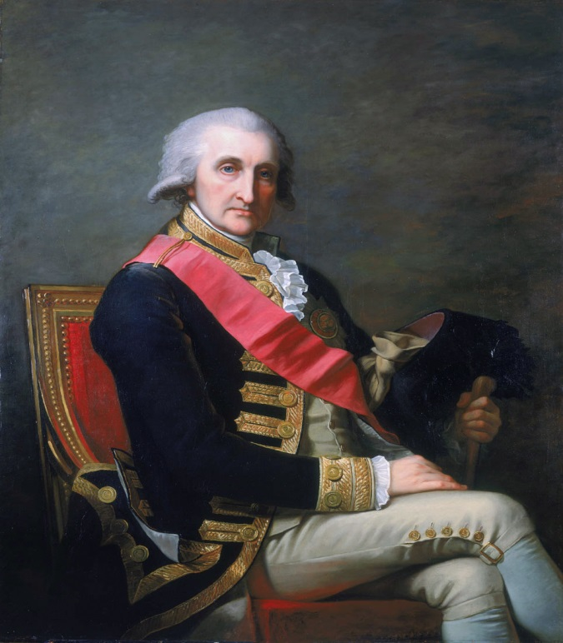
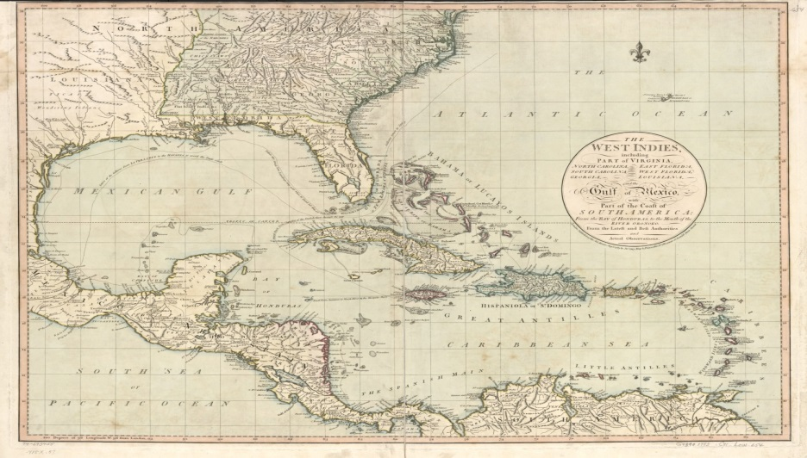
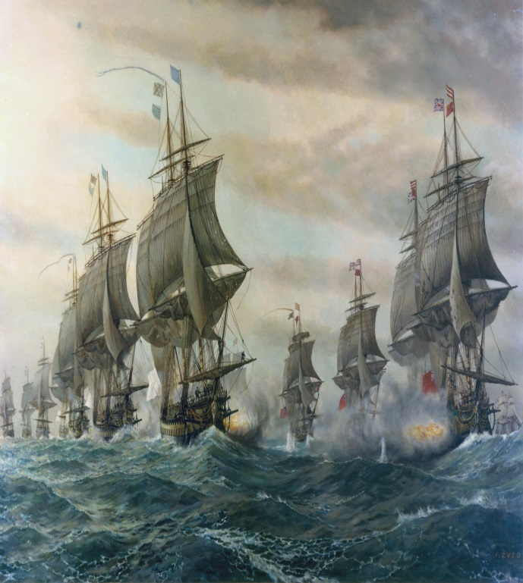
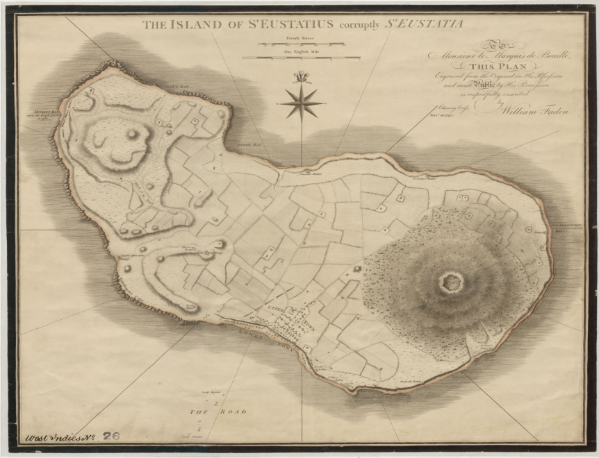
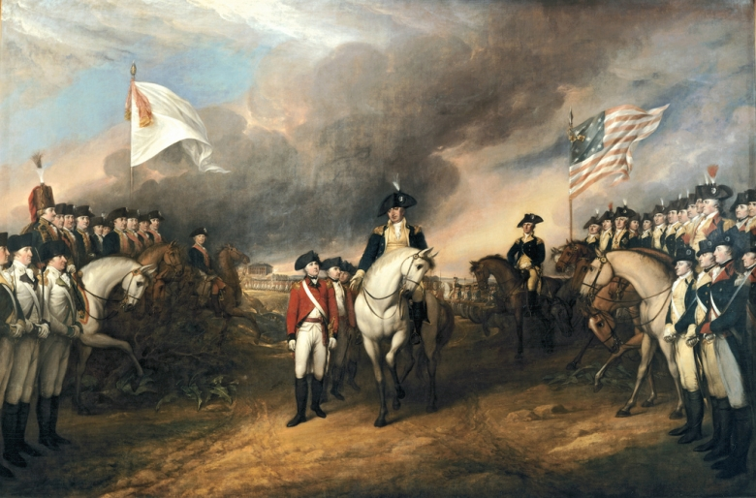
The Central Role of the Caribbean in the American Revolution
1781-1782: The actions in North America and the West Indies of the man who lost America (and helped create the British Empire)
(A Virginia Geographic Alliance project by Colin Baker, Blacksburg High School)

