Slide 1
Shooting Video
Camera Use
Camera Angle
Camera Movement

Slide 2
Camera Use
Selecting Your Shot
Subject
What’s the purpose?
If human, are they wearing the right clothes?, Are they in the right mood?, Are they in the right place?
Inanimate: What does it represent?, Should you show part of it or all of it?

Slide 3
Camera Use
Selecting Your Shot
Background
Think colors and textures
Does your subject show up against the background?

Slide 4
Camera Use
Selecting Your Shot
Light
As a rule, the light should be behind you NOT behind your subject (never stand your subject in front of a window)
Light has two purposes: to reveal and to create shadows, which hide. Make sure that whatever you want to show is bathed in plenty of bright light
Time of day and weather conditions
Best time of day: early morning and late afternoon

Slide 5
Camera Use
Selecting Your Shot
Follow the Rule of Thirds

Slide 6
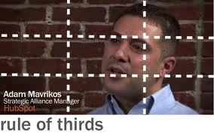

Slide 7
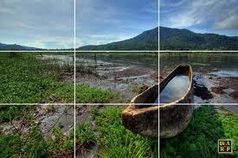

Slide 9
Camera Angles
Describing Shots
The framing or the length of shot
The Angle of the shot
If there is any movement involved

Slide 10
Camera Angles
Framing or Shot Length
Extreme long shot
Normally shows an exterior (outside of a building) or a landscape
Used to show scenes of thrilling action
Very little detail visible in the shot, it’s meant to give a general impression rather than specific information

Slide 11
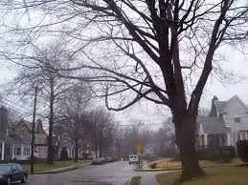
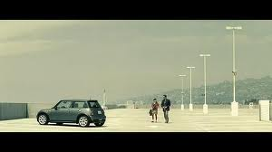
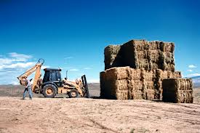

Slide 12
Camera Angles
Framing or Shot Length
Long shot
Shot that shows the image as “approximately” life size
This category includes the FULL SHOT showing the entire body
While the focus is on characters, plenty of background detail still emerges

Slide 13
Camera Angles
Framing or Shot Length
Medium Shot
Contains a figure from the knees or waist up
No more than 3 figures in this type of shot
Background detail is minimal
Lead into this shot with extreme long shot and long shot so the audience knows what the background is

Slide 14
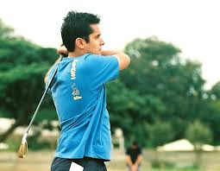
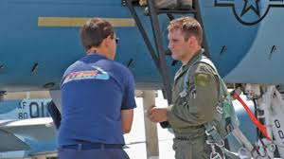

Slide 15
Camera Angles
Framing or Shot Length
Close-up
Shows very little background and concentrates on either a face, or a specific detail
Background is just a blur
Magnifies the object and shows the importance of things
Close up shot takes us into the mind of a character
Audience should feel extra comfortable or extremely uncomfortable
May have to use a zoom lens in order to get this shot

Slide 16
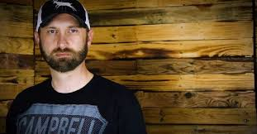
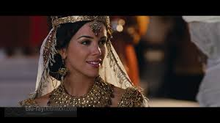
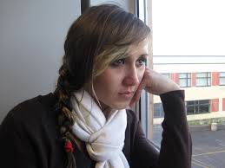

Slide 17
Camera Angles
Framing or Shot Length
Extreme Close-up
May only show the mouth or eyes or a person with no background at all
The camera must be very still and the lighting must be perfect

Slide 18
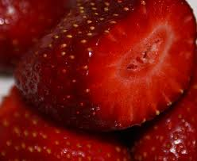
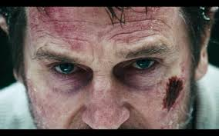
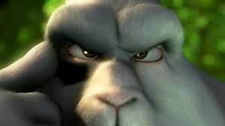
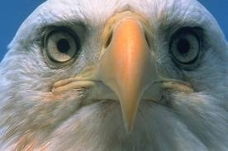

Slide 19
Camera Angles
The Bird’s Eye View
Shows a scene from directly overhead
Puts the audience in a godlike position

Slide 20
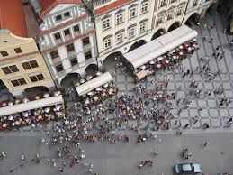

Slide 21
Camera Angles
High Angle
Not so extreme as a bird’s eye view
Camera is elevated above the action
Makes the object photographed seem smaller

Slide 22
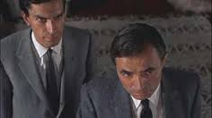
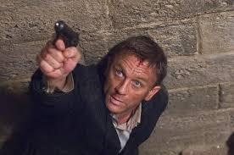
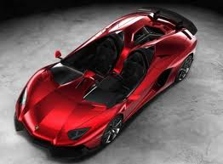

Slide 23
Camera Angles
Eye Level
Neutral shot
Camera is positioned as though it is a human actually observing a scene
Place the camera approximately 5-6 feet from the ground

Slide 24
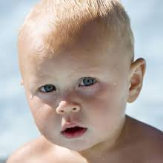
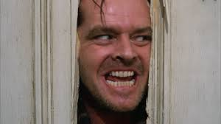
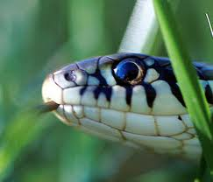

Slide 25
Camera Angles
Low Angle
These increase height (usually for short actors) and give a sense of speeded motion
Helps give a sense of confusion to a viewer
Background will tend to be just sky or ceiling
Added height of the object may make it inspire fear and insecurity in the viewer

Slide 26
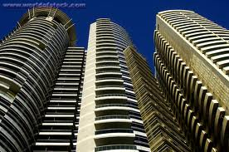
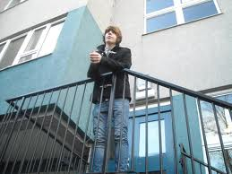
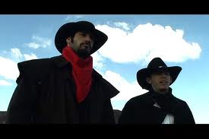

Slide 27
Camera Angles
Oblique/Canted Angle
Sometimes the camera is tilted to suggest imbalance, transition, and instability (very popular in horror movies)
Used to suggest point-of-view shots (when the camera becomes the ‘eyes’ of one particular character, seeing what they see

Slide 28
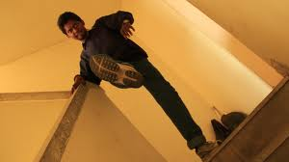
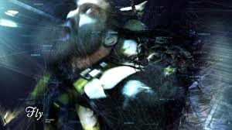
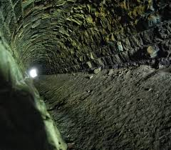
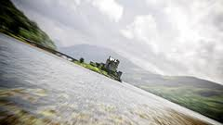

Slide 29
Camera Movement
Pans
A movement which scans a scene horizontally
Moving objects should be kept in the middle of the frame

Slide 30
Camera Movement
Tilts
A movement which scans a scene vertically, otherwise similar to a pan

Slide 31
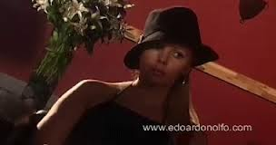

Slide 32
Camera Movement
Dolly Shots
Sometimes called TRUCKING or TRACKING
Camera is placed on a moving vehicle and moves alongside the action

Slide 33
Camera Movement
Hand-Held Shots
Shots taken with flip cameras, etc.
These are the shots you will be using

Slide 34
Camera Movement
Crane Shots
Similar to the Dolly Shots except in the air

Slide 35
Camera Movement
Zoom Lenses
Smash zoom—zoom in very quickly
Slow zoom
In both zooms the camera needs to be very still
Drawback is that zooming is hard to do while keeping your camera steady/still; do not want to be jerky
Zooming is not recommended!

Slide 36
Camera Movement
Aerial Shot
Usually taken with a helicopter
Often used at the beginning of a film in order to establish setting and movement

