Slide 1
Introduction to Law Briefing Cases
Sara Horatius, Esq.
"This work" is licensed under CC BY 4.0

Slide 2
Class Objectives
1) Students will learn how to brief a case
2) Will learn the various components that goes into briefing a legal case
3) Will do a case briefing exercise

Slide 3
What is a case brief?
case briefs concern one case and summarize everything important you need to know about a case.

Slide 4
What are the main components to a case brief
Case caption
Case citation
Procedural posture
Facts
Issue
Holding
Rationale
Dissenting/Concurring opinion

Slide 5
Let’s Break it down
“break-dance” by mathenge eric is licensed under CC BY 2.0

Slide 6
Case Caption
Case Caption is usually the title of the case
The title of the case is usually the parties to the suit.
The first name is usually the Plaintiff/petitioner/appellant (a person who brings a case against another in a court of law.)
The second name is usually the defendant/respondent/appellee (the person against whom the suit is brought is the defendant)
Example:
Jake vs. Jill
Notes:
Appeal-apply to a higher court for a reversal of the decision of a lower court.

Slide 7
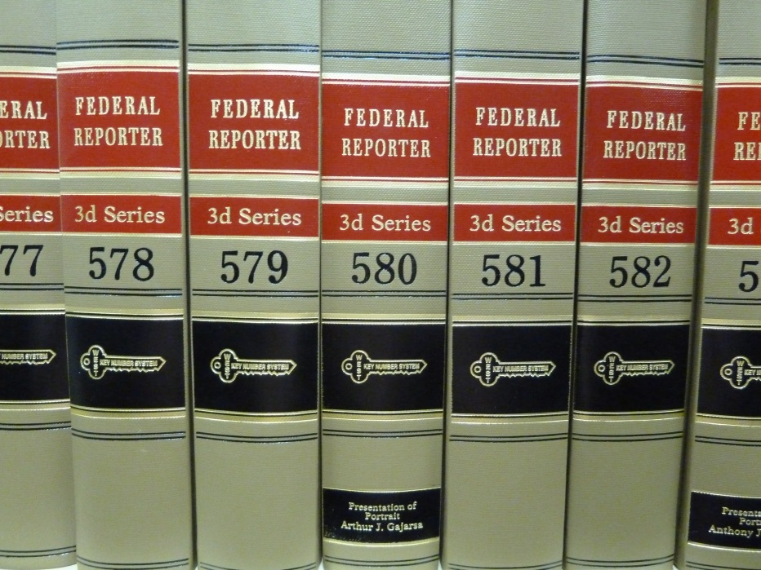
Case Citation
the section of the statute or the name of the case as well as the volume number, the report series and the page number of a case referred to in a brief, points and authorities, or other legal argument.
“Law library books” by Janet Lindenmuth is licensed under CC BY 2.0

Slide 8
Case Citation is an address
“Google maps” by Janet McKnight is licensed under CC BY 2.0

Slide 9
Case Citation Example
Case Name
(Parties to the suit)
Reporter
(U.S. Supreme Court)
Marbury v. Madison, 5 U.S. 137 (1803).
Volume
First page of the case
Year of decision

Slide 10
Procedural Posture
A brief statement of the courts in which the case was tried and to which it was appealed and the outcome of each court process.
ex. defendant found guilty after trial in Massachusetts state trial court;
convictions affirmed by Massachusetts Court of Appeals
and Massachusetts Supreme Court;
habeas corpus petition to federal district court in MA
writ of certiorari to Supreme Court of the United States
Notes:
Habeas corpus is a writ that is used to bring a party who has been criminally convicted in state court into federal court. Usually, writs of habeas corpus are used to review the legality of the party’s arrest, imprisonment, or detention.
The word certioari comes from Law Latin and means "to be more fully informed." A writ of certiorari orders a lower court to deliver its record in a case so that the higher court may review it. The U.S. Supreme Court uses certiorari to pick most of the cases that it hears.

Slide 11
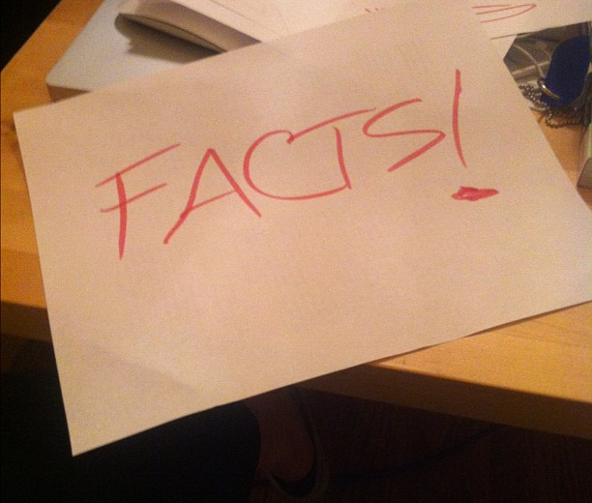
Facts of the case
A brief statement of the important facts of the case
“Only facts!” by Lindsay Eyink is licensed under CC BY 2.0

Slide 12
Issue
A concise statement of the constitutional question(s) at issue in the case
(ex. Must police have probable cause to perform an outer clothing pat-down of a suspect for weapons?) (Terry v. Ohio, 392 U.S. 1 (1968))

Slide 13
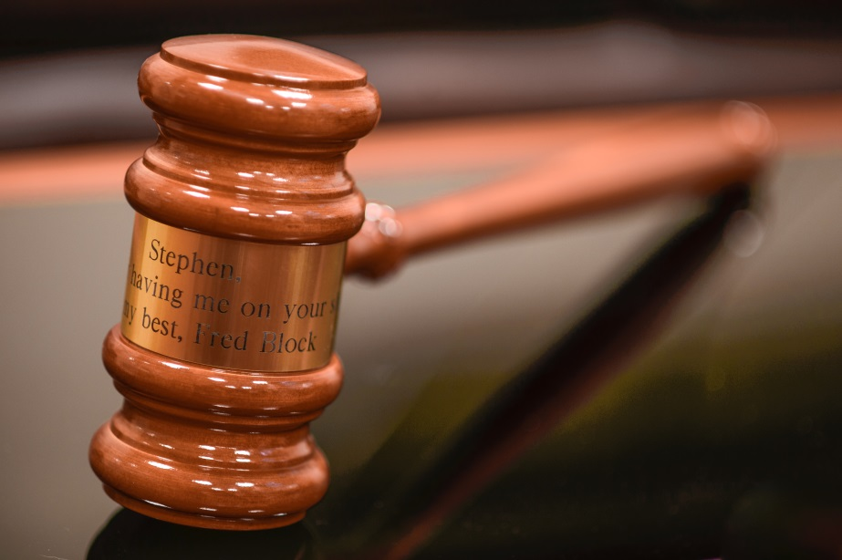
Holding
The answer to the issue question, without explanation.
(ex. No, the police may pat-down a suspect for weapons based on “reasonable or articulatable suspicion” which is less than probable cause.)
(Terry v. Ohio, 392 U.S. 1 (1968))
“Block Gavel” by Douglas Palmer is licensed under CC BY 2.0

Slide 14
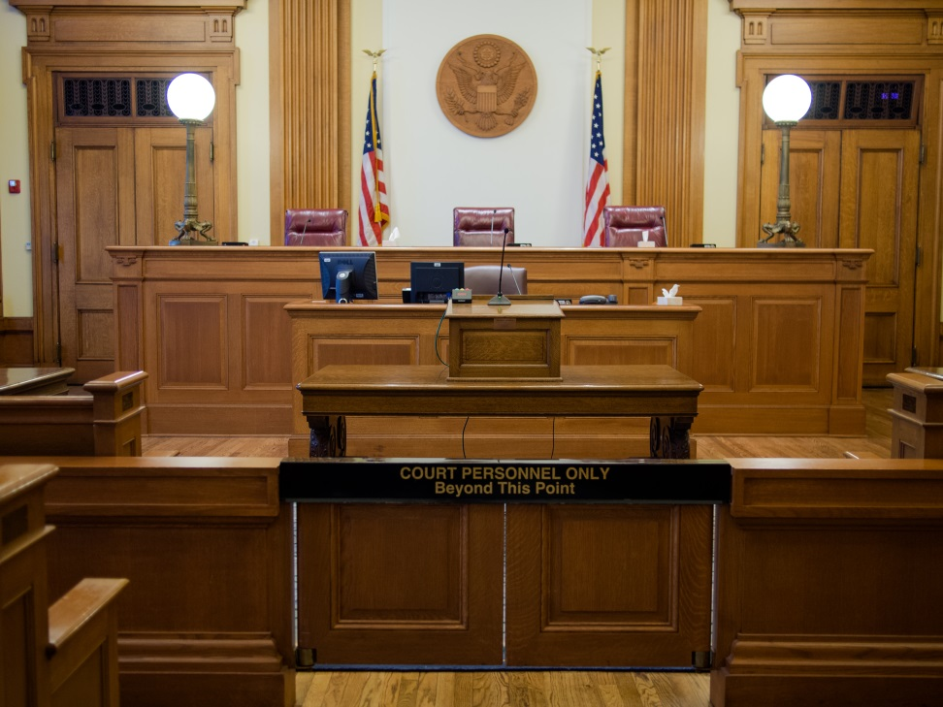
Rationale
The explanation the majority opinion of the Court gives for the holding. Should include seminal language and/or articulated standard.
(ex. in Griswald v. Connecticut, “the right to privacy is found in the penumbras and emanations of the Constitution”.)
“Courtroom” by Karen Neoh is licensed under CC BY 2.0

Slide 15
Dissenting/Concurring opinions
Dissenting opinion is when a judge disagrees with the majority view
Concurring opinion is when a judge agrees, but comes up with a different reason as to why he or she agrees.
Not every case will have a dissent or concurrence

Slide 16
