Slide 1
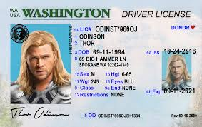
How to pass the driver’s licence
Part I. Road signs

Slide 4
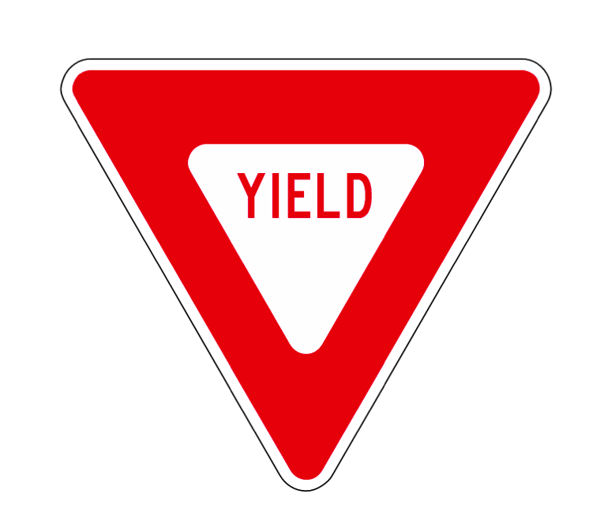

Slide 5
