Slide 1
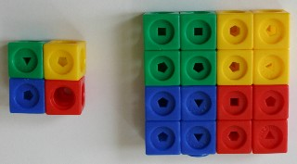
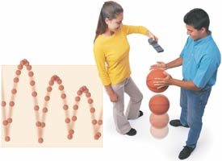
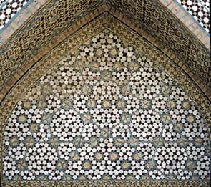
Patterns

Slide 2
?
How do these patterns change from term to term?

Slide 3
Continue the Pattern
Pert 1: Directions
Finish this pattern.
Build the 3rd, 4th terms.
Try many ways.
Record your patterns.
1 | 2 | 3 | 4 | Journal

Slide 4
Continue the Pattern
1 | 2 | 3 | 4 | Journal
Part2: Directions
Fold back the paper so that only 1,2,3 show.
Exchange papers with a different group.
Build the 4th term. Check your answer.
Fold

Slide 5
Journal Writing
Choose 1 pattern.
Draw the 5th term.
Write all about it.
Describe the 20th term.
1
2
3
4
Journal

Slide 6
Self-Peer Assessment
Self-Assessment
I CAN: | YES | NO
Builds patterns that someone else can predict.
Describe how the pattern changes from term to term, geometrically. (Can you describe more than 1 way?)
Describe how the pattern changes from term to term, numerically.
Predict the next term of the pattern.
Action Plan for Improvement: 1.___________________________________________________________ 2.___________________________________________________________ Peer-Assessment
My Friend CAN: | YES | NO
Builds patterns that someone else can predict.
Describe how the pattern changes from term to term, geometrically.
Describe how the pattern changes from term to term, numerically
Predict the next term of the pattern.
Suggestions for Improvement: 1.___________________________________________________________ 2.___________________________________________________________

Slide 7
Growth Patterns, the 20th Term

Slide 8
Assessment Tasks in a Worksheet
Draw the 4th term. | How is the pattern changing from term-term?
Describe the 20th term for #3 (geometrically and numerically)?
_________________________________________________________
Draw the 4th term. | How is the pattern changing from term-term?
How is this pattern different from the patterns in #1-3?
_______________________________________________________
Self-Assessment | Peer Assessment
Review each problem. Draw a face to show how much you understand the math. ☹ 😐 ☺ | Review your partner’s paper. Write 2 ways they might improve their understanding on their paper.

Slide 9
Connecting the Real World

Slide 10
Position, Term
POSITION | What do I see? | TERM, TOTAL TILES
1
2
3
4
5
…
20

Slide 11
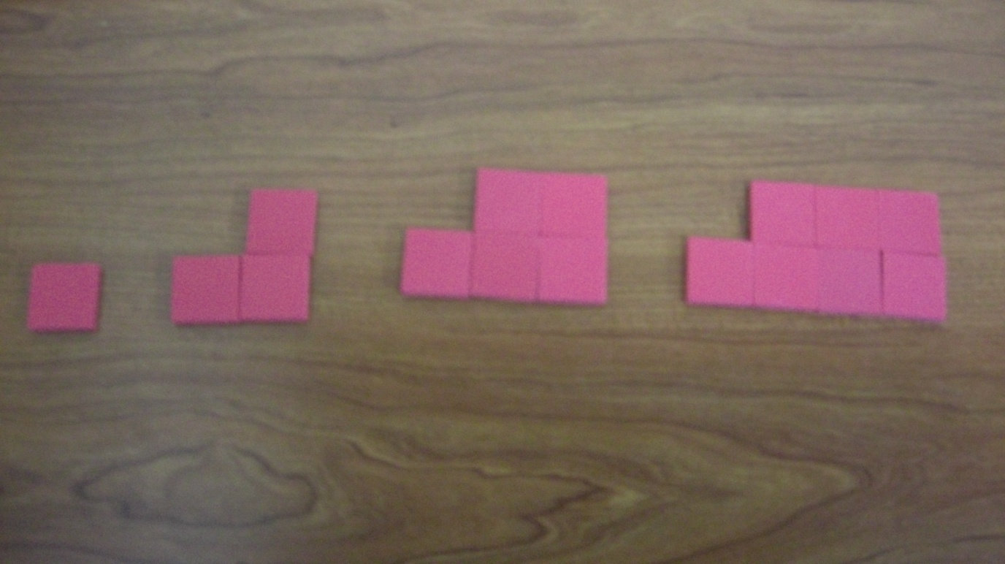
Position, Term
TERM
1
2
3
4
POSITION

Slide 12
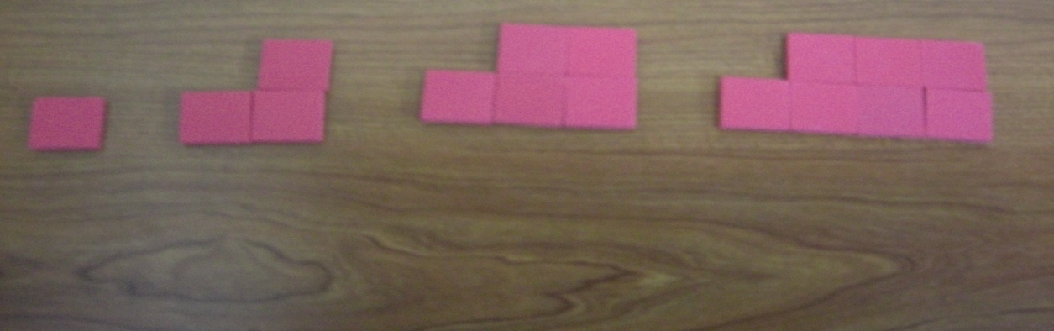
The 20th Term
1
2
3
4
20
POSITION | What do I see? | TERM, TOTAL TILES
1
2
3
4
5
…
20

Slide 13
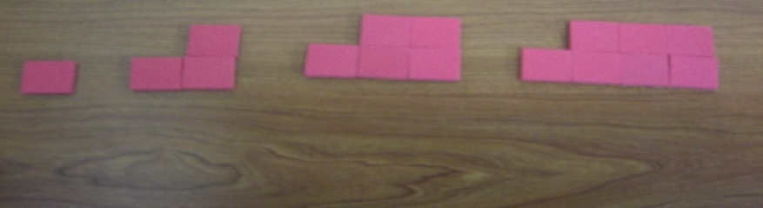
Finding Numeric Expressions, Activity
Continue building this pattern to the 5th term. Draw a picture to represent the sequence. Draw a diagram of the 20th term.
Make a table of numeric expressions for each term. Write numeric expressions to represent the 20th term.
1
2
3
4
20

Slide 14
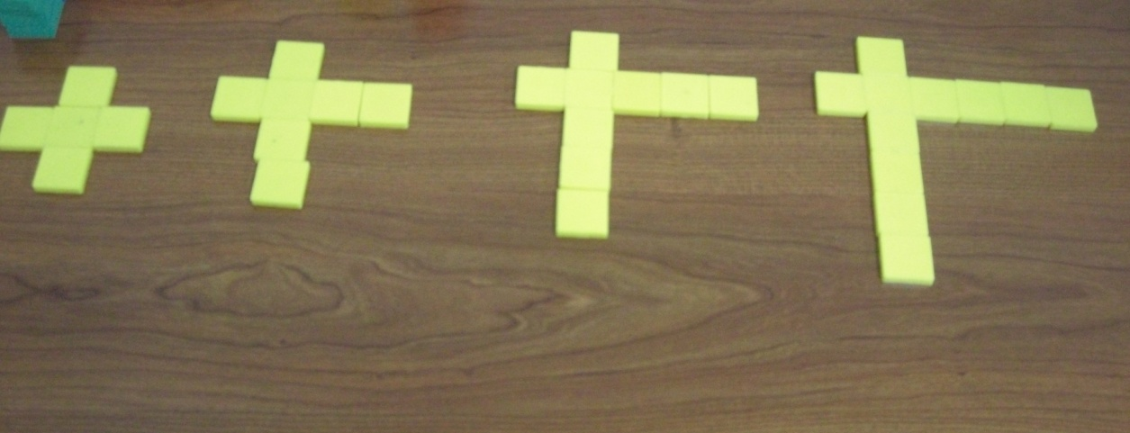
How are these the same? different?
1
2
3
4
20
20
1
2
3
4

Slide 15
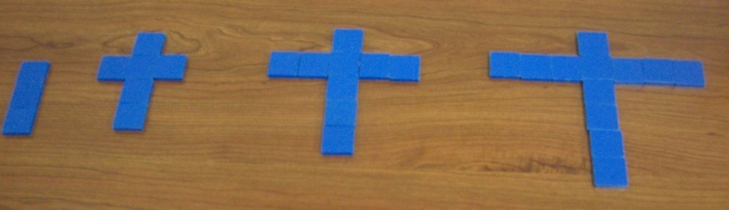
How are these the same? different?
1
2
3
20
4
1
2
3
4
20

Slide 16
20th Pile Numeric Expressions
GROUP | 1 | 2 | 3 | 4 | 5 | 6
Pattern #1
Pattern #2
Pattern #3
Pattern #4

Slide 17
Graphing the Patterns

