Slide 1

Online Learning
Common Core 3.0
Field Activities
Classroom Skill Building
Notes:
Sample: 2 second animated, branded Core 3.0 eLearning intro (can have simple sound effect)

Slide 2
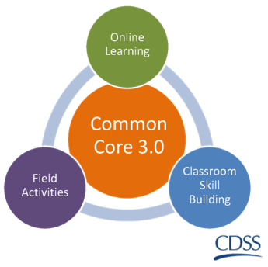

Child Maltreatment Identification
Skills Lab
California Common Core version 3.6| 2018

Slide 3
Overview of the Day
Welcome and Review of the Agenda
Learning Objectives
Using maltreatment indicators to identify child maltreatment
Cultural factors that affect child maltreatment identification
Sexual Abuse: motivation, credibility and information

Slide 4
Today’s Goals
Through the use of experiential activities, be able to identify child maltreatment in the context of the family’s culture and within child’s developmental stage of life.

Slide 5

Who are you?

Slide 6
Reminder: Penal Code
PC 11165.1 Sexual Abuse and Exploitation
PC 11165.2 Neglect and Severe Neglect
PC 11165.3 Willful harming and endangering
PC 11165.4 Unlawful corporal punishment
Notes:
PC 11165.1
Sexual Abuse and Exploitation – defines sexual abuse as sexual assault or exploitation including rape, statutory rape, incest, sodomy, oral copulation, sexual penetration, child molestation, commercial sexual exploitation, or lewd and lascivious acts
PC 11165.2
Neglect – defines neglect as the negligent maltreatment of a child by a parent or designated caregiver.
PC 11165.2
Severe neglect – defines severe neglect as withholding food/water on a prolonged, willful basis and / or failure to provide medical treatment which will result in permanent and/or severe illness or death.
PC 11165.3
Abuse – defines abuse as a situation in which any person willfully causes or permits any child to suffer unjustifiable physical pain or mental suffering or permits the child to be placed in a situation in which his or her person or health is endangered.
PC 11165.4
Physical Abuse – defines abuse as willfully inflicted cruel or inhuman corporal punishment or injury resulting in a traumatic condition.

Slide 7
Reminder: Welfare and Institutions Code
300(a) Physical harm/abuse
300(b) (1) General neglect
300(b) (2) Commercial sexual exploitation
300(c) Emotional abuse
300(d) Sexual abuse

Slide 8
Reminder: Welfare and Institutions Code
300(e) Severe physical abuse of a child under the age of 5
300(f) Death of Sibling
300(g) Caregiver absence
300(h) Relinquishment or termination of parental rights
300(i) Cruelty
300(j) Substantial risk based on substantiated abuse of a sibling

Slide 9
Reminder
Children with disabilities are more likely to experience maltreatment
Children who self-identify as “other” are at increased risk for child emotional abuse
Injuries that continue along curved parts of the body are suspicious for abuse
Symmetrical or patterned burns are suspicious for abuse
Bruising in pre-ambulatory children is rare
Sexual abuse victims are more likely than non-abused children to come from families with parental substance abuse problems
Notes:
Children with intellectual, developmental or physical disabilities are more likely to experience maltreatment.
Children who self-identify as “other” are at increased risk for child emotional abuse, compared to white, Black, and Hispanic children.
Injuries that continue along curved parts of the body (from the side to the back of the leg); Bruises on buttocks, genitalia and the top of the ear are suspicious for abuse
Symmetrical or patterned burns (from being burned with an object or dipping hands or feet into hot water) are suspicious for abuse
Bruising in pre-ambulatory children is rare, occurring in only approximately 1% to 2% of infants. Therefore, any bruises in children not yet cruising (i.e. walking with support) should raise suspicion for possible abuse.
Sexual abuse victims are more likely than non-abused children to come from families with parental substance abuse problems

Slide 10
Maltreatment Definition and Identification
1. Definition
2. Identification
Match each vignette with the correct maltreatment type
General Neglect
Physical Abuse
Sexual Abuse and Exploitation
Emotional Abuse
Identify which factors in the vignette lead to your conclusion
Write a statement justifying your conclusion (as if explaining how the vignette meets the identified definition of abuse to the family)

Slide 11
Identifying Maltreatment
One form of trauma is Traumatic Stress
experienced by those working in the field. TS is intensified by exposure to unexpected sensory images of trauma.
Stories and photos can be upsetting
Take time to process emotional responses now and in the field
Content Alert

Slide 12
Possible Physical Abuse
Female, 4 years old. Child was reported by daycare provider as having a large round bruise on her left buttock and bruising behind her right knee.

Slide 13
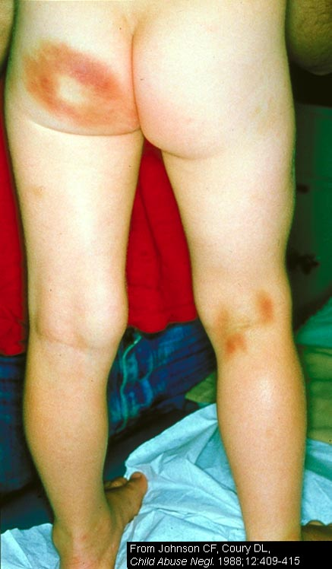

Slide 14
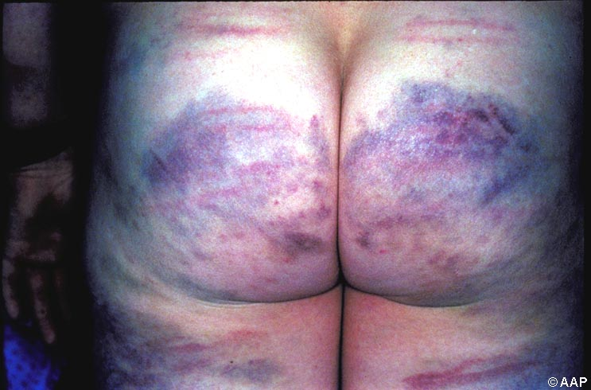
Notes:
Actual inflicted injuries often show specific patterns. The linear marks in this child’s injury provide evidence of repeated trauma with a straight, rigid instrument. This child was beaten with a plastic pipe.

Slide 15
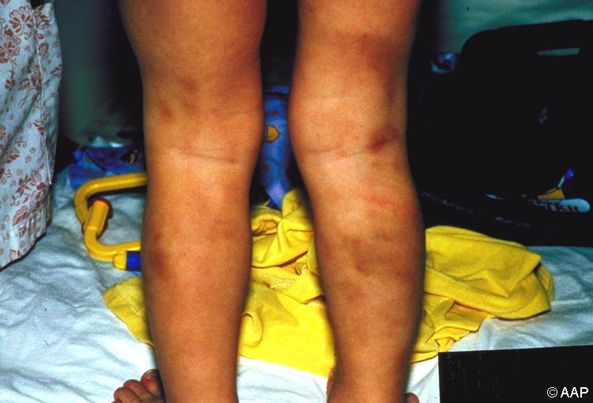
Notes:
Another example of an inflicted injury. Linear marks may be caused by a belt. The back of the legs is more suspicious in terms of location for nonaccidental injury.

Slide 16
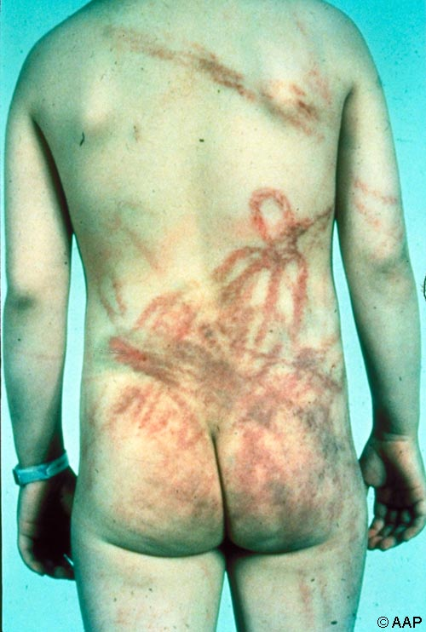
Notes:
Another example. In this case, scarring indicates old, healed abrasions. Braiding and looping are evidence that a piece of rope was used.

Slide 17
Physical Abuse or Possible Supervisory Neglect
Male, 2 years old. Brought to the emergency room with burn on lower leg.

Slide 18
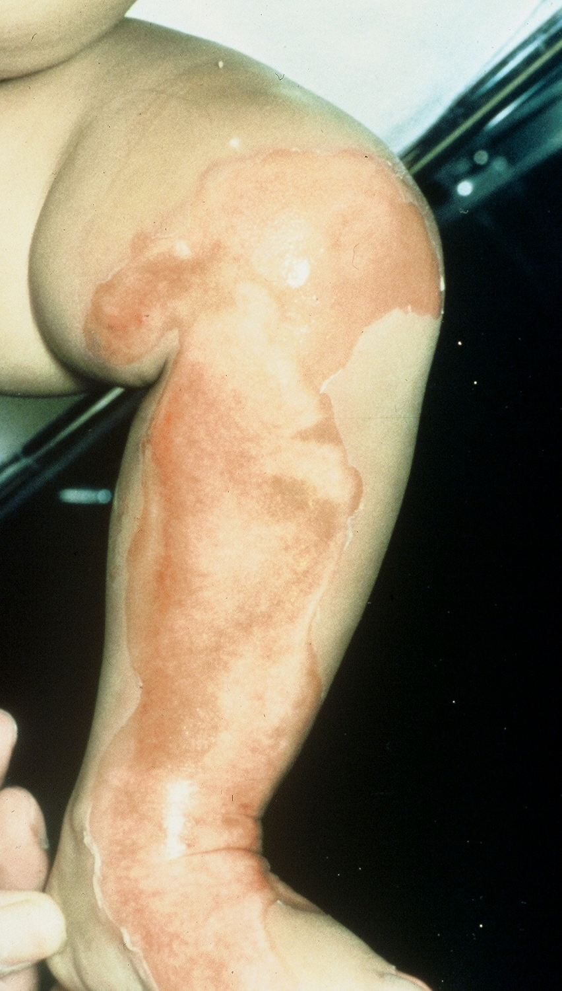

Slide 19
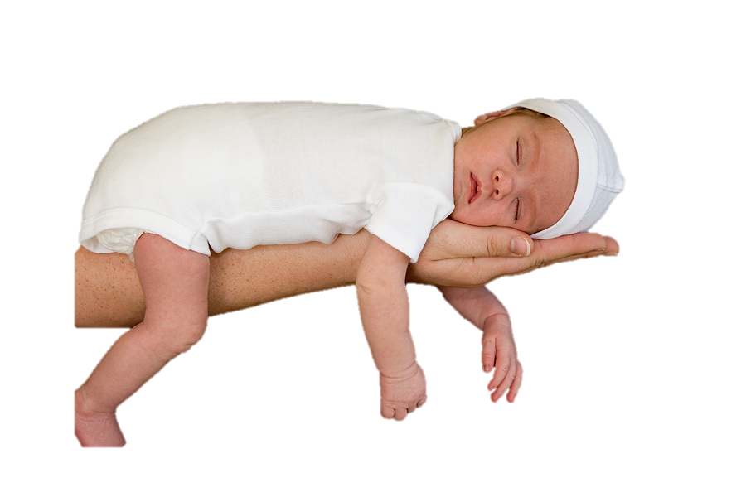
Failure to Thrive

Slide 20
Physical Injury
Male, 3 months old. Presenting in Emergency Room, with seizures. Grandmother states her son, Terry, 43 years old, brought the baby to her saying the baby had spit up after taking a bottle and was shaking like he was cold. Baby has linear bruise over left temple.

Slide 21
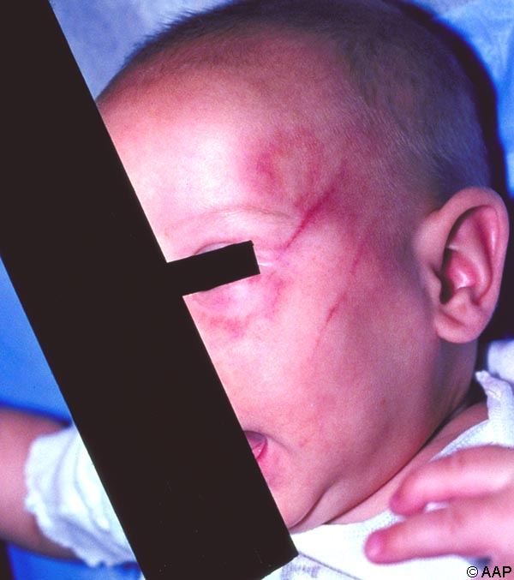

Slide 22
Possible Physical Abuse
Female, 18 months. Neighbor noticed multiple cigarette burns on the child.

Slide 23
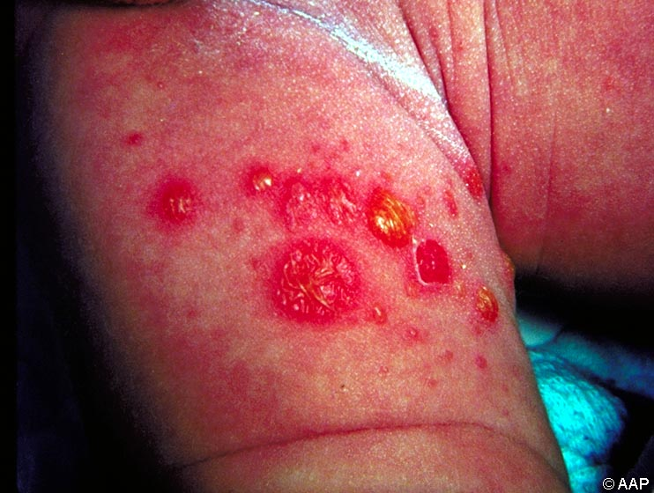

Slide 24
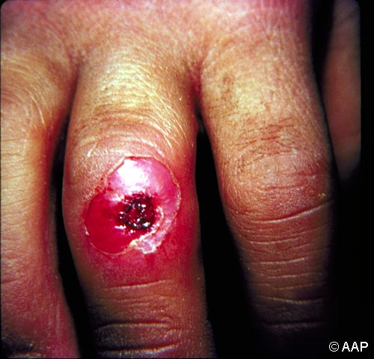
Notes:
Actual cigarette burns are circular and often appear in clusters. They show an inner circle of tissue which is more deeply burned than the peripheral mark.

Slide 25
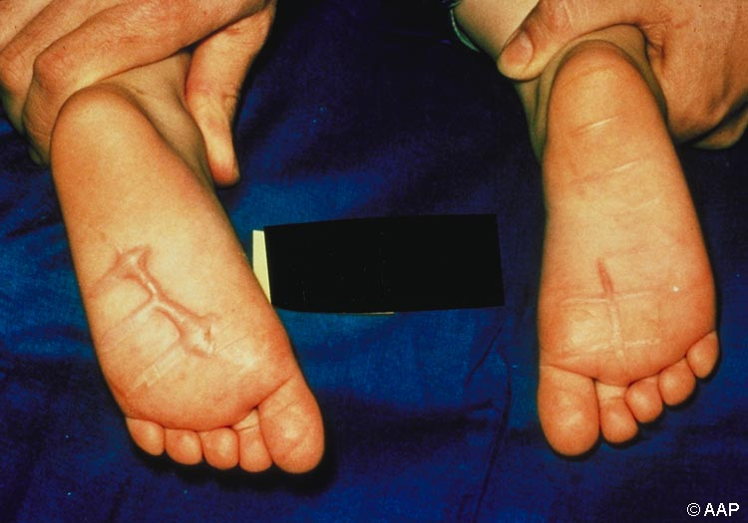
Notes:
In any injury, the history given must be compared with the actual injury to evaluate if abuse occurred. In this case, the history given was that this 2 year old child stepped on a floor gas heater with both feet. While burns to both feet are more suspicious, the child may have put the second foot down quickly to relieve the pain caused to the first foot when it came into contact with the heater.

Slide 26
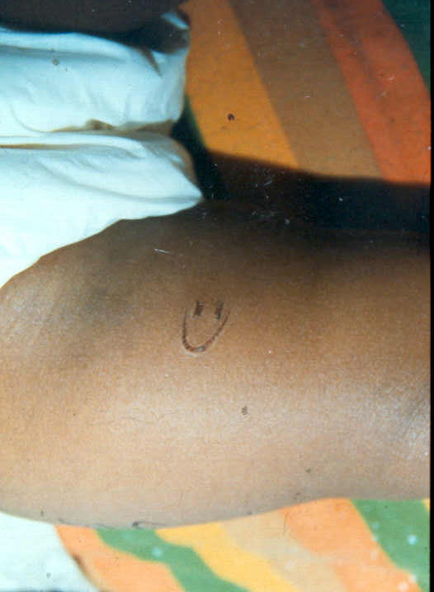
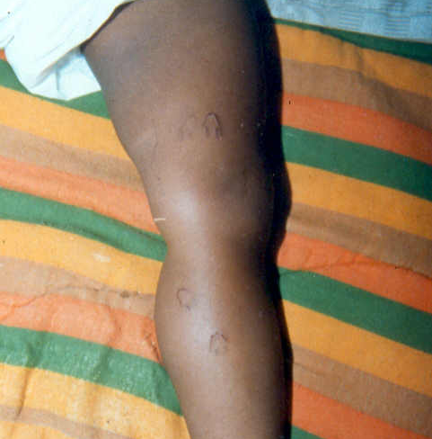
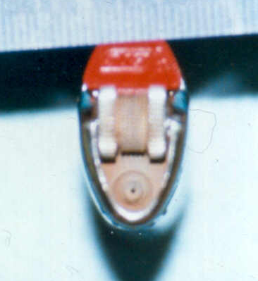
Notes:
Pattern burn with cigarette lighter “Smiley Face” distinctive. Dr. Ken Feldman slide

Slide 27
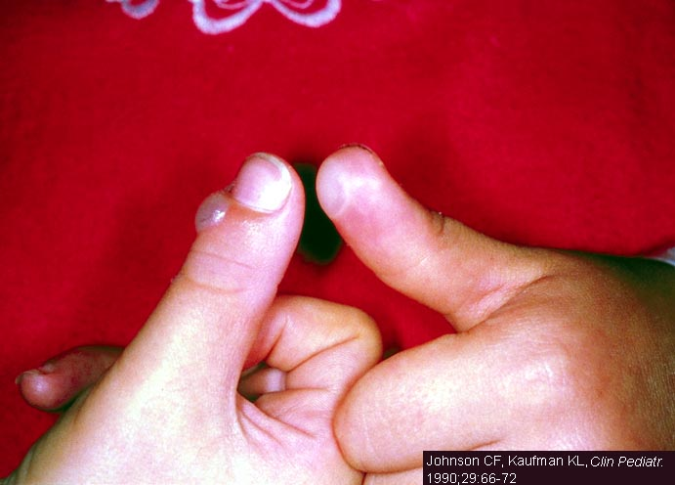
Notes:
Symmetrical burns are more suspicious for abuse. This child had both thumbs burned by a cigarette lighter to teach her not to suck her thumb.

Slide 28
Possible Physical Abuse
Female, 4 months old. Child was reported by daycare provider as having a large grab mark bruising on her right lower leg.

Slide 29
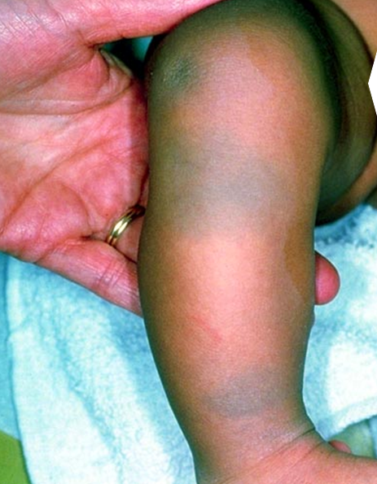

Slide 30
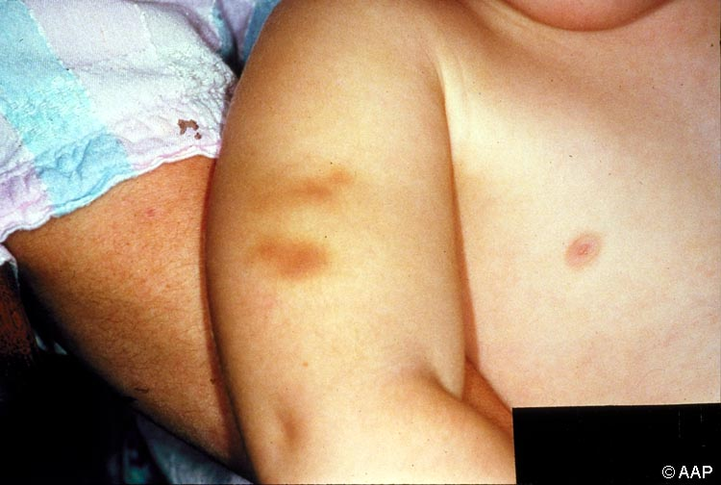
Notes:
A pinch or grab mark. Oval finger marks may be seen on the arms or trunk of an infant with abusive head trauma.

Slide 31
Possible Physical Abuse
Female, 2 years old. Child was reported neighbor as having open sores around her wrists. Concerned it could be from poor hygiene or from someone restraining the child.

Slide 32
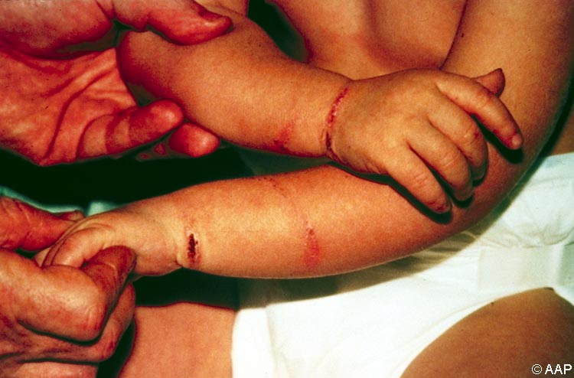
Notes:
Ligature marks around the wrists, ankles, or neck may indicate a child was restrained by being tied up.

Slide 33
Possible Physical Abuse
Male, 3 years old. Child was reported by daycare provider as having a large round mark on his thigh with bruising in the center.

Slide 34
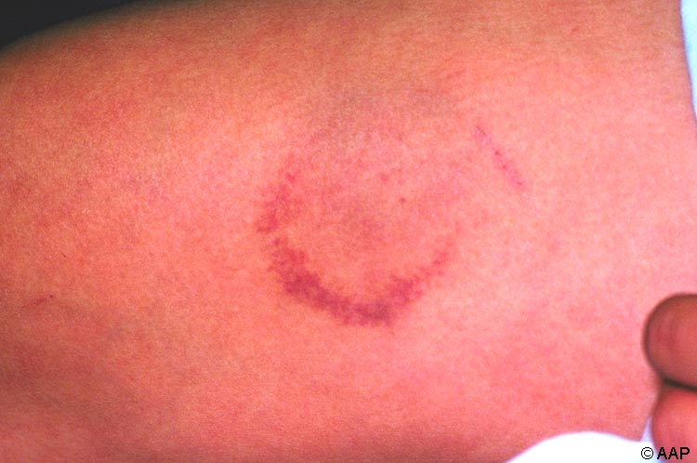
Notes:
3 elements to a human bite mark:
Horseshoe shape
Suction/discoloration within the bite
Point of tongue thrust will appear darker

Slide 35
Take a
minute to
BREATHE
Free Hugs Campaign
Mindfulness meditation exercise

Slide 36
Secondary Traumatic Stress
What can you do to increase your resiliency?
  Practice mindfulness about your inner experience—listen to your thoughts, judgments, beliefs, attitudes, and feelings
  Give yourself affirmations, praise yourself
  Identify comforting activities, objects, people, relationships, places and seek them out
  Allow yourself to cry
  Find things that make you laugh

Slide 37
Our culture includes implicit biases
We make biased decisions
Our brains use bias to facilitate decision-making

Slide 38
Culture, Bias, and Maltreatment Identification
Implicit bias: biases we all hold that we may not even be aware of
Confirmation bias: our tendency to quickly reach a conclusion and then seek out only evidence that supports that conclusion
Other errors in thinking: focusing on information that is easiest to obtain, information that is the most dramatic, or the first information we received

Slide 39
Culture, Bias, and Maltreatment Identification
How does bias impact our work?
What bias triggers can you identify in the vignette?
What can you do to separate possible bias from child maltreatment?
What other information do you need to determine if maltreatment occurred?

Slide 40
Sexual abuse can bring up strong emotions. Our own issues related to sexual abuse may cause us to be more controlled and legalistic in this assessment or may cause us to be overly emotional and identify closely with victims. It is important to identify this when it happens and move past it to be supportive to the family.

Slide 41
Assessing for Sexual Abuse
What additional information or follow-up do you need?
  Who should you talk to next?
  What information or follow-up would you want from the following sources:
    Medical
    Law enforcement
    Educational
    Mental health
    Family and friends
  How do you ensure you are following county protocol?

Slide 42
Indicators of Maltreatment: Neglect
Review the Judy, Ron, and Sarah vignette
Complete the Indicators of Maltreatment (Neglect) Worksheet

Slide 43
Indicators of Maltreatment: Emotional Abuse
Review the Nova, Kay and Winona vignette
Complete the Indicators of Maltreatment (Emotional Abuse) Worksheet

Slide 44
Indicators of Maltreatment: Physical Abuse
Review the Maliah, Dartanyan, and Elon vignette
Complete the Indicators of Maltreatment (Physical Abuse) Worksheet

Slide 45

Embedded Evaluation Activity

Slide 46

Preliminary Evaluation
Materials:
Informed Consent
ID code assignment instruction sheet
Demographics Survey
Generating Your Trainee ID code:
First 3 letters of MOTHER’S MAIDEN NAME (e.g., SMITH = SMI).
First 3 letters of MOTHER’S FIRST NAME (e.g., CAROLINA = CAR)
NUMERAL FOR THE DAY YOU WERE BORN
Example: May 9, 1970 = 09
The NUMERAL FOR THE YEAR YOU WERE BORN
Example: May 9, 1970 = 70
Trainee ID Code

Slide 47
CMI Embedded Evaluation
Materials:
Trainee Evaluation Booklet (includes “Toby” and “Vivienne and Milan” case scenarios and the 9 evaluation questions for each scenario)
Answer sheet 1 and 2, (for multiple choice questions and for written responses)
Black pen
Using Answer Sheet 1, bubble in your responses to the following set questions for each scenario:
  Q1: All of the elements that raise a concern for you about potential maltreatment.
  Q2: Could the injuries have been caused in the way they were reported?
  Q3: Would you want to gather additional information?
  Q4: You want to seek additional consultation?
  Q5: Based on the information provided in the scenario, did child maltreatment occur?
  Q6: If yes, identify the type of maltreatment you are concerned with.

Slide 48
CMI Embedded Evaluation Cont’d
Using Answer Sheet 2 write down your responses to questions 7-9.
  Q7: If you would like to gather additional information, what additional information would you like to know?
  Q8: If you would like to seek additional consultation, whom would you like to consult?
  Q9: What aspects/topics would you like consultation on?

