Slide 1
Online Learning
Common Core 3.0
Field Activities
Classroom Skill Building
Notes:
Sample: 2 second animated, branded Core 3.0 eLearning intro (can have simple sound effect)

Slide 2
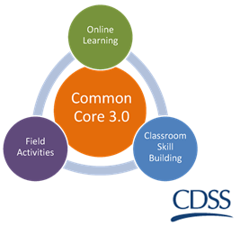
Assessing for Key Child Welfare Issues California Common Core December 31, 2018

Slide 3
Overview of the Day
Welcome and overview of the day:
Review of the Agenda
Learning Objectives
Interactive Activities
Wrap up

Slide 4
Today’s Goals
Gain an understanding about the impact of trauma.
Practice utilizing assessment skills when working with families who experience substance abuse, intimate partner violence, and/or mental health.

Slide 5
Group Agreements
Notes:
Be collaborative
Ask lots of questions – let us know what you think
Be open to trying new things
Be willing to make mistakes
Maintain confidentiality
Be responsible for your own learning

Slide 6
Assessing Child Safety in the Context of Violence
“Through Our Eyes: Children, Violence, and Trauma—Introduction”
https://www.youtube.com/watch?v=z8vZxDa2KPM
Notes:
Training Activity: Assessing child safety in the context of violence
Instructions:
Show video
Instruct each participant to introduce themselves and share one word that stands out from the video.
Video: Through Our Eyes: Children, Violence, and Trauma—Introduction
Office from Victims of Crimes
Published on Feb 27, 2013
This video discusses how violence and trauma affect children, including the serious and long-lasting consequences for their physical and mental health; signs that a child may be exposed to violence or trauma; and the staggering cost of child maltreatment to families, communities, and the Nation. Victims lend their voices to this video to provide first-hand accounts of how their exposure to violence as children affected them.
Show video: 7 min 53 seconds
https://www.youtube.com/watch?v=z8vZxDa2KPM

Slide 7
A Definition: Historical Trauma
Cumulative emotional and psychological wounding over the lifespan and across generations.
Historical unresolved grief is the associated affect that accompanies historical trauma.
This grief may be considered fixated, impaired, delayed, and/or disenfranchised.

Slide 8
Trauma and Assessment
Read the case study.
Take the quiz.

Slide 9
PRACTICE
Safety Assessment Tool: Torres Family – Introduction, Interviews with Children, Interviews with Parents
“Domestic Violence exists in the home and poses an imminent danger of serious physical and/or emotional harm to the child.”
Assessing Safety Threats and Household Strengths and Protective Actions

Slide 10
Are We Worried About?
Is there imminent danger of serious harm?
SAFE
NO
YES
Are caregivers able to take protective actions?
Safe With Plan
Create Safety Plan With Family
YES
UNSAFE
NO
Notes:
Here’s a graphic look at the presumptive decisions for the safety assessment. The assessment first asks the question: Is there imminent danger of serious harm? If the answer is no, the tool’s presumptive decision is “safe.” If the answer is yes, a second question is asked: Are caregivers able to take protective action to control the danger? If yes, a safety plan can be developed with the family and the tool’s decision is “safe with plan.” If no, the tool’s decision is “unsafe” and immediate action will be needed to protectively place the child or children.

Slide 11
Safety Goals
Behavioral statements about what the caregivers and extended network will be doing differently to address the danger statement
Demonstrated over time to show everyone involved that the children will be protected

Slide 12
What are the relevant details?
What are we
worried about?
What is
working well?
What needs to happen next?

Slide 13
Identifying Safety for the Torres Family
Harm | Danger | Risk | Needs/ Complicating factors
Past action by the caregiver that hurt the children physically, emotionally, or developmentally Is about the past | Is about the short term Is serious and imminent threat to a child Harm may occur in the next week or month Is related to safety | Is about the long term Probability that any child maltreatment will occur in the next one to two years | Conditions that are worrisome but not to the level of harm May include risks and needs

Slide 14
Communicating Harm, Danger, and Safety
Harm Statements
Danger Statements
Safety Goals

Slide 15
Safety House Instructions
Explain the process to the child.
Ask the child to help you fill in the sections to describe the Safety House.
Work through the sections of the house as follows: Inner Circle, Outer Semi Circle, Red Circle, Roof, Path.

Slide 16
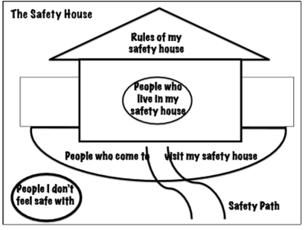

Slide 17
What did you find?
What was the risk level?
Were there any policy overrides?
What was the final risk level?
What is the planned action?
Promote to open case or not?

Slide 18
Discernment
Poverty?
Domestic Violence?
Mental Health?
Substance Abuse?
Notes:
Poverty: What do you need to know about the family to determine if this is neglect or impact of poverty?
Domestic Violence: What types of behavioral indicators would see in the children to determine if they’ve exposed to violence in the home?
Mental Health: What concerns do you have about Greg’s bipolar condition? How might this contribute to the home’s functioning?
Substance Abuse: How worried are you about Maria’s drug use? Are you worried this is going to continue or is this a one time “slip”?

Slide 19
Torres Family: continued
What’s behind Danny’s behavior?
Notes:
What might be the causes of Randy’s behavior?
Exposure to violence
Separation from parents
Separation from his sister, Monica
Unknown trauma
Rule out ADHD or other attention issue
Depression and/or anxiety

Slide 20
Wrap Up
What did you learn?
Any questions?
Next Steps

