Slide 1
PowerPoint 308
Can I eat it?
© Food – a fact of life 2007
Notes:
*

Slide 2
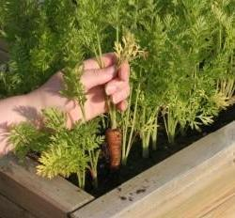
Can I eat this carrot?
© Food – a fact of life 2007
Notes:
*

Slide 3
Can I eat this carrot?
Not yet, it needs to be
washed.
© Food – a fact of life 2007
Notes:
*

Slide 4
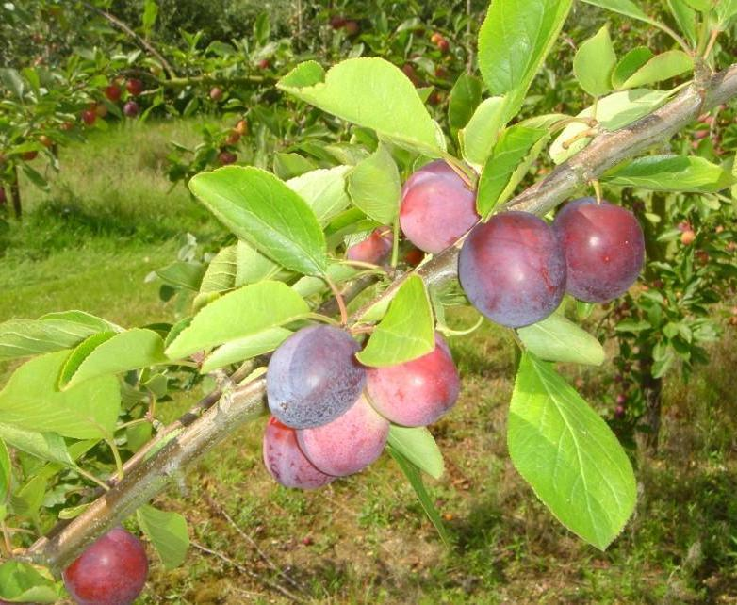
Can I eat these plums?
© Food – a fact of life 2007
Notes:
*

Slide 5
Can I eat these plums?
Not until they have been
picked and washed.
© Food – a fact of life 2007
Notes:
*

Slide 6
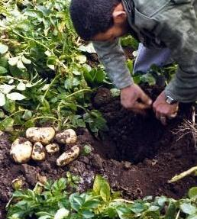
Can I eat these potatoes?
© Food – a fact of life 2007
Notes:
*

Slide 7
Can I eat these potatoes?
No, they need to be
washed and cooked.
© Food – a fact of life 2007
Notes:
*

Slide 8
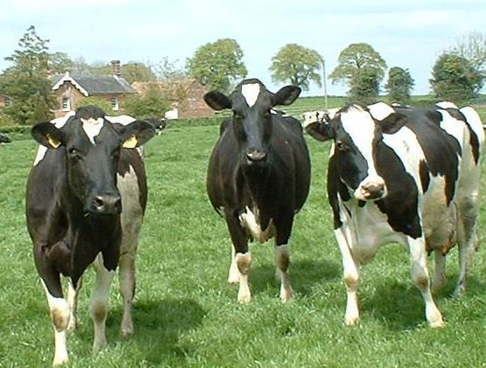
Can I have a glass of milk from here?
© Food – a fact of life 2007
Notes:
*

Slide 9
Can I have a glass of milk from here?
No, the cows have to be
milked.
Then the milk might be
heat treated.
© Food – a fact of life 2007
Notes:
*

Slide 10
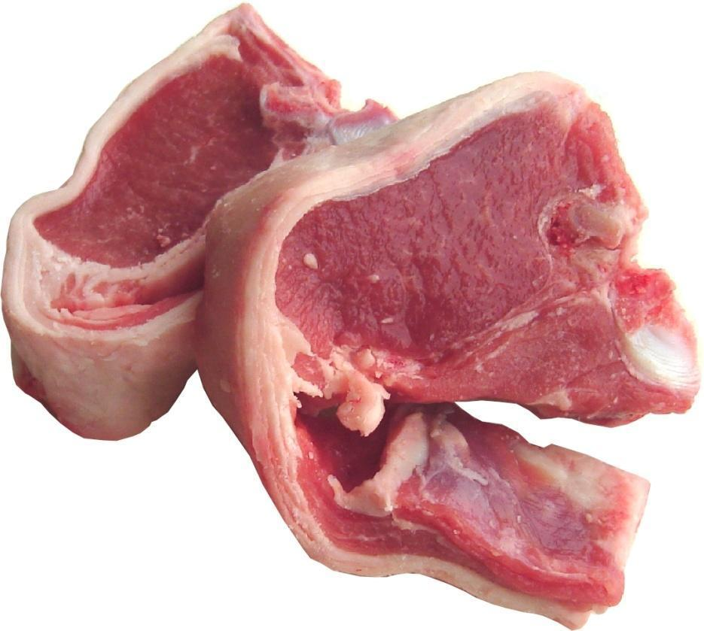
Can I eat these lamb chops?
© Food – a fact of life 2007
Notes:
*

Slide 11
Can I eat these lamb chops?
No, they need to be
cooked.
© Food – a fact of life 2007
Notes:
*

Slide 12
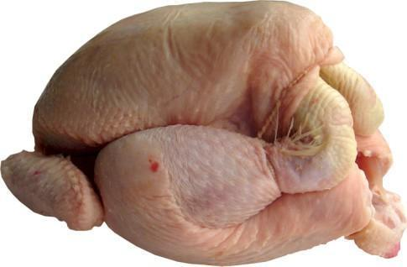
Can I eat this chicken?
© Food – a fact of life 2007
Notes:
*

Slide 13
Can I eat this chicken?
No, it needs to be
cooked and carved.
© Food – a fact of life 2007
Notes:
*

Slide 14
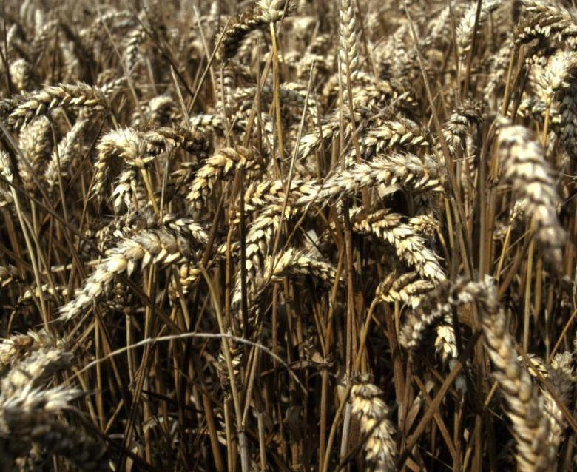
Can I eat this wheat?
© Food – a fact of life 2007
Notes:
*

Slide 15
Can I eat this wheat?
Not yet, it needs to be
harvested, milled, made into a food and cooked.
© Food – a fact of life 2007
Notes:
*

Slide 16
All food has to be prepared before we can eat it.
Pick
Sometimes this just means a small change.
Wash
© Food – a fact of life 2007
Notes:
*

Slide 17
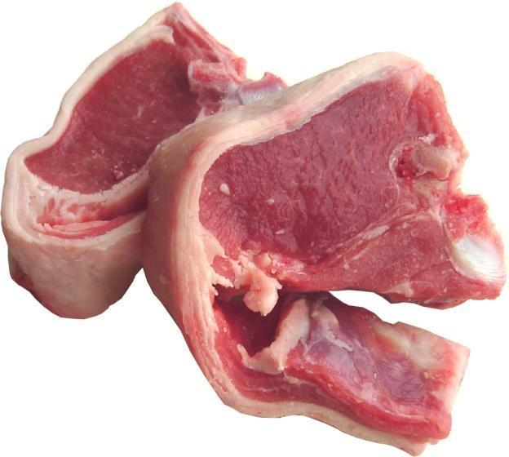
All food has to be prepared before we can eat it.
Heat treat
Sometimes this means a bigger change.
Cook
© Food – a fact of life 2007
Notes:
*

