Slide 1
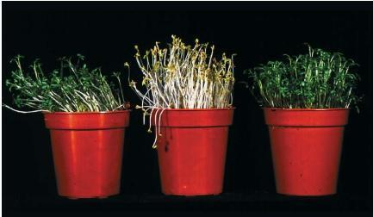
How are these different?
Why might it be taller?

Slide 2
The middle plant has had limited light.
The plant is growing tall to try and find light
One plant has had light from one side.

Slide 3
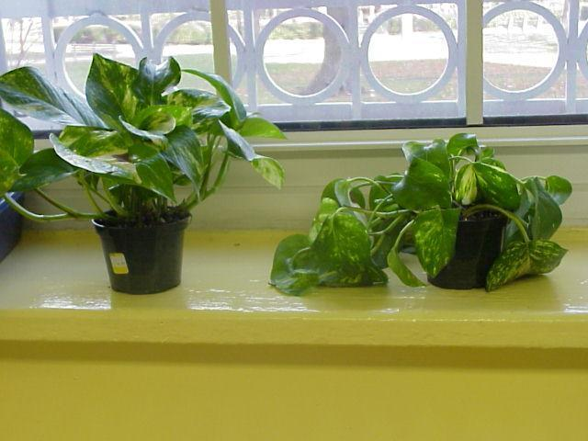
Which one has had no water?

Slide 4
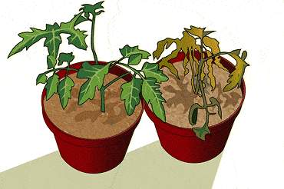
What happens to a plant that is lacking minerals?

Slide 5
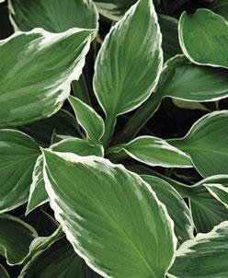
What’s wrong with these leaves?

Slide 6
Nothing, they’re variegated or multi-colored

Slide 7
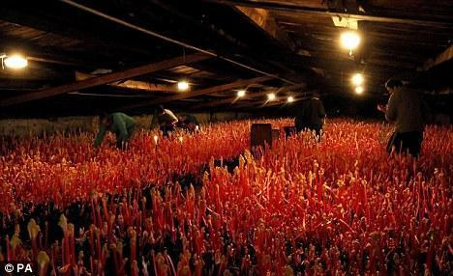
Why are some plants grown in the dark?

Slide 8
It grows faster as it is ‘trying’ to find the light.
The absence of light prevents tough parts of the plant from developing, so plants like rhubarb are softer and sweeter.

