Slide 1
SOIL & COMPOST

Slide 2
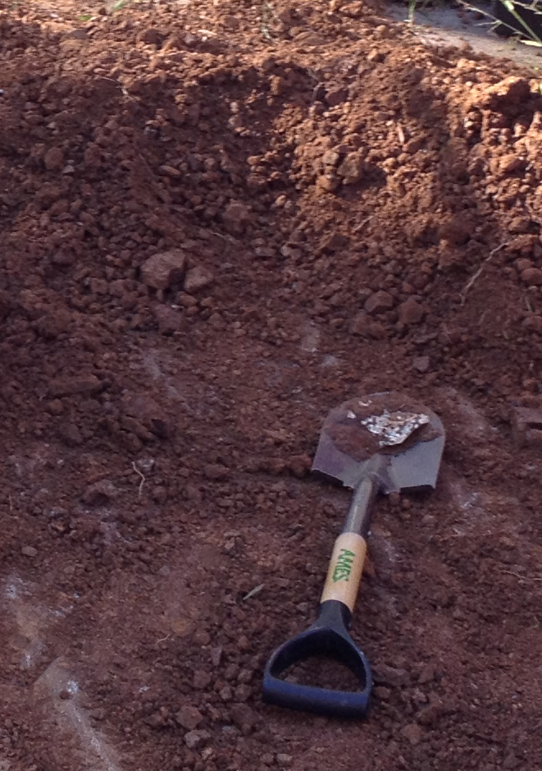
LET’S TALK DIRT!
What make’s the soil, dirt, so good for our growing plant?
Nutrients
Where do these nutrients come from?
They are recycled from decomposed materials

Slide 3
WHAT IS COMPOSTING?
It’s the Earth’s way of recycling!
Kitchen Scraps
Garden Clippings
Dried Leaves
Air
Coffee Grounds
Compost
Water

Slide 4
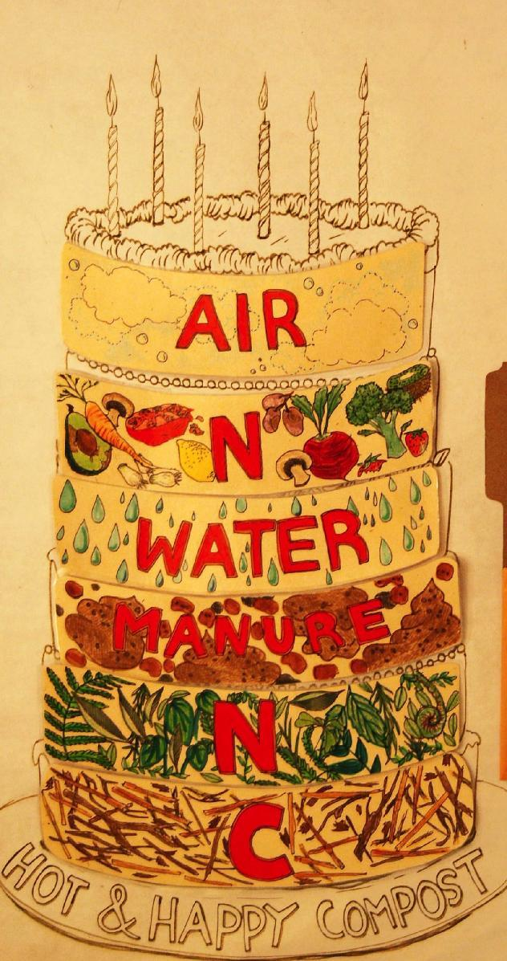
COMPOST INGREDIENTS
Like making a great cake, compost needs all the right ingredients.
Too much or too little of something can change the way something decomposes.

Slide 5
COMPOST INGREDIENTS
Nitrogen
[Greens]
Nitrogen
[Greens]
Carbon [Browns]
Oxygen
Carbon [Browns]
Compost
H2O

Slide 6
WHAT SHOULD WE COMPOST?

Slide 7
COMPOST INGREDIENTS
Some other key ingredients are like secret agents which help the entire master plan.
Decomposers, like Fungus (F), Bacteria (B), and Invertebrates (I), aid in the decomposing of materials.
Invertebrates are also known as Detritivores.

Slide 9
WHAT HAPPENS TO THE COMPOST?
Let’s Find Out Together!

