Slide 1
Mutual Commitment to Supporting Families
Motivational Interviewing
By Ed Pieczenik, L.C.S.W.

Slide 2
Objectives
Participants will
Understand principles of change process
Learn and identify motivators for change
Learn the stages of change model
Understand principles of motivational interviewing
Learn and practice techniques to support change through the use of motivational interviewing

Slide 3
Class Exercise
Participants will visualize a change they’ve made in their own lives. In dyads, they will share with a partner:
The change they made
What factors motivated this change
The possible obstacles they faced in making this change
The current outcome of the change

Slide 4
Change Principles
Change is a process, not a discrete event
Every person goes at their own pace through the change process
People will change when the person is ready and determined to change
A person’s readiness to change can be stimulated by increasing motivation
Confrontation can increase resistance and non-cooperation
Change effects feelings, thoughts, behaviors and relationships

Slide 5
Factors of Change
MULTIDIMENSIONAL
DYNAMIC AND FLUCTUATING
INFLUENCED BY SOCIAL INTERACTION
READINESS FOR CHANGE
MOTIVATION CAN BE MODIFIED
RESISTANCE TO CHANGE IS NATURAL
AMBIVALENCE ABOUT CHANGE IS NATURAL

Slide 6
What is Motivation?
“Motivation is a state of readiness or eagerness to change which may fluctuate from one time to another….it is an internal state influenced by external factors.”
“Motivation can be defined as the probability that a person will enter into, continue and adhere to a specific change strategy.”
– William Miller and Stephen Rollnick, 1991

Slide 7
Elements that can Stimulate Motivation
Anxiety or distress
Significant life events
Cognitive re-evaluation
Positive external incentives
Recognizing negative consequences
Expression of empathy in social context

Slide 8
Worker Approaches
Myth of Education: a degree doesn’t mean you have the ability to help motivate
Myth of Experience: not having been in the same situation doesn’t mean you can’t be helpful in the change process
Helping the “unwilling” to become “willing”
“Sitting in the parent’s perspective” helps make the connection through empathy

Slide 9
APPROACHES
ONE-UP: worker is the expert/authority
ONE-DOWN: parent has “control”
ONE-ONE: worker and parent are equals

Slide 10
Class Exercise
Participants are divided into groups and each group is assigned an “element” that stimulates change. Each group brainstorms the ways in which the element might stimulate change
Class reconvenes and each group shares their ideas with all class participants

Slide 11
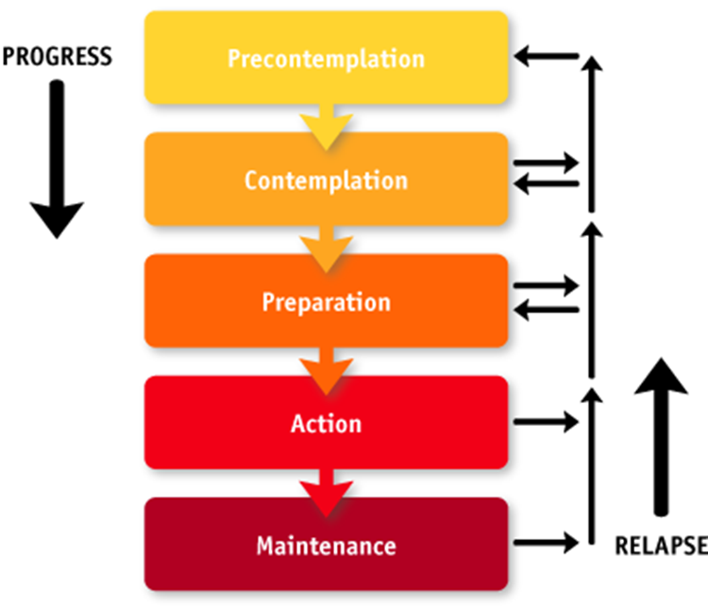
STAGES OF CHANGE

Slide 12
PRE-CONTEMPLATION “What problem?”
Partly or completely unaware that a problem exists
Flashes of awareness that “something may not be right
Unaware that changes are needed
May feel discouraged or resistant to change

Slide 13
CONTEMPLATION “There may be a problem.”
Growing awareness that a problem exists
Growing perception and feeling of concern that problem will necessitate change
Evaluation of their own behaviors
Ambivalence and resistance is natural
Think about the positive and negative reasons for making the change

Slide 14
PREPARATION “I am getting ready to deal.”
Perceive change as advantageous
Recognize the adverse effects of continuing the same behaviors
Begin to do specific planning for change
Examine their capabilities or capacity for change
Aware of possible barriers to change and find strategies to overcome the barriers

Slide 15
ACTION “ I am dealing with the problem.”
Choose definite strategies for the change
Actively modifies their thoughts and behaviors
Face specific barriers or challenges that may be obstacles to change
Re-evaluate their self-concept and self-esteem as this relates to the change
Alter strategies that are not working

Slide 16
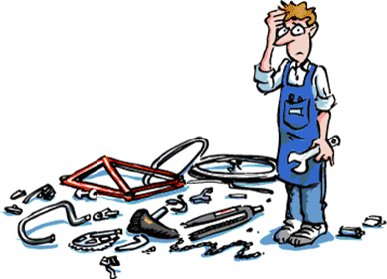
MAINTENANCE “I continue to deal with the problem.”
Efforts continue to sustain the changes made in the action stage
Continued assessment of the environment to avoid obstacles for continued success
Learn to detect and guard against “triggers” that may cause relapse
Recognize that the process is not over but continues

Slide 17
RELAPSE “Oops, I did it again.”
Identified as “temporary” and a normal part of human behavior
Viewed as a “slip” and that one can re-establish the initial change process
May go back to stages of contemplation, preparation, and action again
Re-evaluation of “causes” contributing to the relapse
Strategize about avoiding “triggers” in future

Slide 18
Class Exercise
Participants are asked to think of themselves in one of the stages of the change process related to a change they are making or have made. Physically line up across the room based on which stage of change they chose for this exercise. Group together in the various stages, and each person will state how their thoughts, feelings or behaviors fit the specific stage they have chosen.

Slide 19
Techniques of Motivational Interviewing

Slide 20
Goals of Motivational Interviewing
Prepare parent to make a change
Reduce resistance to change
Increase motivation for change
Increase behavioral actions toward change

Slide 21
Motivational Interviewing Principles
Does not assume that the parent is motivated
Does not require the parent to comply, be aware or agree
Employs specific strategies to build problem awareness and change motivation
Supports parent’s self-reliance
Focus is on motivating change instead of on solutions

Slide 22
Empathy through Reflective Listening
Communicates respect
Accepts of parent’s feelings and thoughts
Encourages a non-judgmental collaborative relationship
Allows parent-partner to be a supportive yet knowledgeable consultant
Empathizing with the negative parts is harder

Slide 23
Developing Discrepancies
Between parent’s goals and the current behaviors
Focus on how current behaviors can not achieve the parent’s goals
Separate the behavior from the person
Connect what changes might enable parent to achieve the goals
Use the “on the one hand…on the other hand” statement to describe discrepancy

Slide 24
Avoid Arguments and Direct Confrontation
Arguments and confrontation do not enhance motivation
View defensiveness and resistance as the parent’s differing perspective
Feedback regarding patterns and problems are given without judgment
Suggestions, advice or shared knowledge are geared towards promoting change
Increase belief in parent’s capacity to change

Slide 25
“Roll” with Resistance Rather than Opposing It
View resistance as the opportunity to respond in a new manner
Use techniques of:
Reflection
Shifting Focus
Reframing
Admiring the Negative
Eliciting Change Talk
“Ruler of Readiness” Scale

Slide 26
Change Talk Listen for & Remark on Parent’s:
Recognition of the problem
Concern about the current situation
Statements of desire for change
Expressions of optimism about change
Recognition or elaboration of ambivalence
Degree of willingness to change
Confidence level towards making change
Willingness to envision or experiment with change outcome
Diminishment of fear towards change process
Resolution of ambivalence or discrepancies

Slide 27
Questions that Promote Change Talk
Do you remember a time things were going well? What was it like? What changed?
What’s the worst thing that could happen if you stay this way?
If you could make things turn out the way you’d like, what would be different?
In what ways does this concern you?
What would be the advantage of making a change? Staying the way things are now?
If you decided to make a change, what would it look like in the future?
I sense you’re feeling stuck. What needs to change?

Slide 28
Ruler of Readiness Scale
Use a rating scale of 0 to 10 to determine the “importance” of the change or the parent’s “confidence” level for change.
How important is this change to you?
How confident are you about changing?
Importance/Confidence Continuum
______________________________
0 1 2 3 4 5 6 7 8 9 10

Slide 29
Ruler of Readiness Scale Continued
Reinforce the parent’s focus on their response by inquiring:
Straight question: “Why 5?”
Backward question: “Why 5 & not 2?”
Forward question: “What would need to happen in order to move you from 5 to 7 or 8?”
Summarize responses using the parent’s explicit words

Slide 30
Class Exercise
Participants are divided into groups and given scenarios. A participant role plays the parent and another the parent partner. All participants in the group develop statements they could verbalize based on the motivational interviewing techniques.
The parent partner uses the statements developed in the mock encounter.
Class reconvenes and processes the exercise.

Slide 31
Parent Partner Tasks for Each Stage of Change

Slide 32
Pre-Contemplation
Raise doubt about the behavior
Increase knowledge related to the risks and problems with the current behaviors
Assure the parent that the behaviors can be changed
Avoid power struggles over defining the problem
Link the behaviors as a contributing factor to what distresses the parent

Slide 33
Contemplation
Give reasons to change by listing the pros & cons of changing or not changing
Recognize the parent’s ambivalence about not changing
Instill realistic hope for change
Strengthen the parent’s belief that they can change
Provide information about negative consequences should change not occur

Slide 34
Preparation
Itemize required steps that it would take to make the change
Provide information about community and professional help to make the change
Help parent identify barriers to change
Help parent develop strategies to overcome those barriers to change
Help parent come up with the best course of action to achieve the desired change

Slide 35
Action
Support the parent to implement the necessary steps to make the change
Help the parent confront the barriers that appear
Constant validation and encouragement of parent’s movement towards change
Help the parent re-evaluate that steps are producing the desired result

Slide 36
Maintenance
Help parent recognize that process is not over
Help parent determine what strategies will help continue the new behaviors
Help parent to expand their abilities to identify and overcome potential barriers
Help parent anticipate risks that could lead to relapse and how to prevent relapse

Slide 37
Relapse
Identify this situation as temporary and sometimes as a part of changing behaviors
Help parent go back through the stages of contemplation, preparation and action
Help prevent the parent from becoming demoralized with high levels of support and encouragement
Help the parent reevaluate what barriers were overlooked & how to avoid in future

Slide 38
Tailoring Interventions from the Ruler of Readiness Scale
If parent places self on scale at 0 to 3:
1. Raise awareness of risks
2. Elicit change talk
3. Encourage exploration of pros
4. Ask permission to give feedback
5. Acknowledge difficulty in making decisions
6. Emphasize that there are choices

Slide 39
Useful Questions
What would need to happen for you to think about change?
How can I help you look at the different options for change?
What might need to be different in your life for you to consider making this change in the future?

Slide 40
Parent places self 4 to 6
Explore the parent’s ambivalence
Elicit change talk
Build readiness
Give information as appropriate related to pros and cons of change
Ask about next steps

Slide 41
Useful Questions
What are some reasons you would want things to stay the same?
What are some reasons for making the change at this time? Or sooner rather than later?
What do you like about ____________?
What do you not like about ___________?
What could help you move to the next step for this change?

Slide 42
Parent places self on scale: 7 to 10
Strengthen commitment to change
Continue to elicit change talk
Help parent set specific and achievable goals
Help parent identify a strategy or plan
Reinforce chosen options for the plan
Help parent identify possible barriers and ways to avoid ‘slips’ or relapse

Slide 43
Useful Questions
How might your life be different if you made this change?
What is your strongest reason for the change?
What would be your first step in the change process?
What barriers might you encounter when making the change?
How might you work around the barriers?

Slide 44
Closing an Encounter with Confidence Statements
Genuine
Succinct
Realistic
Support Self-Reliance

Slide 45
Confidence Statement Examples
I am confident that should you chose to change ____, you will develop a plan to suit your situation.
I feel certain that as you think about this change more, you’ll figure out an approach that is workable for you.
I feel positive that you will find a strategy in order to change _______.
It appears that you are determined to begin working on the plans to change _______.

Slide 46
Traps to Avoid
“Expert” role
Unsolicited advice or trying to fix the parent
Prematurely focusing on a topic or stage of change
Question and answer sessions
Confrontation, arguing, blaming or labeling
Close-ended questions

Slide 47
Class Exercise
Class is divided in half and each side takes turns in identifying which “stage of change” corresponds with a specific statement or idea that can be used in motivational interviewing techniques. Conducted like a game show, so if one side is not able to identify the correct stage of change, then other side gets a chance to do so.

Slide 48
Thank you for attending!
Have a great day!

