Slide 1
Special Issues for Families in Need of Child Welfare Services
Mental Health and Mental Illness
By Edward Pieczenik, L.C.S.W.

Slide 2
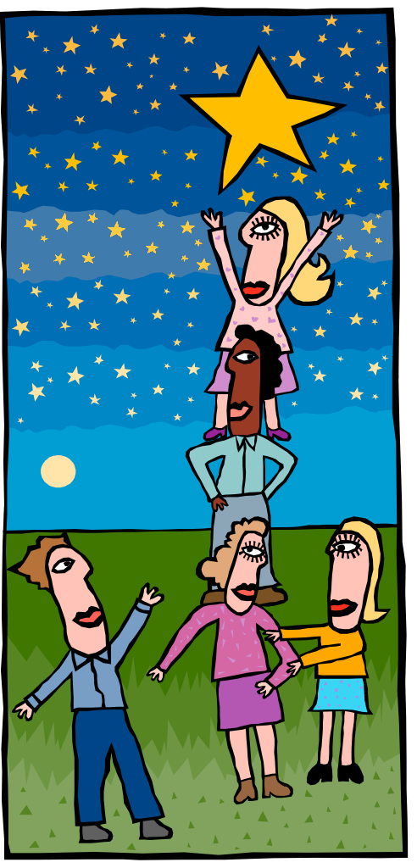
Learning Objectives
Knowledge
K1: Trainee will be able to recognize how various mental disorders can affect a person’s ability to parent.
K2:Trainee will be able to recognize the difference between chronic and acute symptoms and the potential prognosis of commonly found mental health disorders.
K3: Trainee will be able to identify the cultural implications surrounding mental health issues.
K4: Trainee will be able to identify common case plan interventions that are most often used by child welfare workers to assist children, adolescents, and caregivers suffering from a mental disorder.

Slide 3
Learning Objectives
Skills
S1: Utilizing a case scenario, the trainee will be able to identify possible symptoms, warning signs, and behaviors that could indicate a mental health concern.
S2: Utilizing a case scenario, the trainee will be able to describe the potential impact on parenting, risk, and permanency of symptoms and behaviors associated with mental health diagnoses of a parent or child.
S3: Using a case scenario, the trainee will be able to analyze and articulate how cultural factors influence behavior and how this behavior can be misconstrued as symptomatic of a mental disorder.

Slide 4
Learning Objectives
Values
V1: Trainee will value the child welfare worker’s role in educating families, collaterals, service providers, and colleagues about common misperceptions associated with certain mental disorders.
V2: Trainee will value the cultural differences among families and the need for sensitivity when working with families with mental health issues.
V3: Trainee will value the importance of seeking out clinical case consultations and thinking critically when working with children, youth and families who have a mental health diagnosis.

Slide 5
Agenda
Definition of Mental Health & Mental Illness
Stigma & Prejudice
Understanding Mental Health from a Lifespan Perspective
Culture & Mental Health
DSM
Anxiety Disorders
Mood Disorders
Personality Disorders
Psychosis
Dual Diagnosis
Factitious Disorders
Dissociative Disorders
Eating Disorders
Working with Family Members
Resources & referrals

Slide 6
Definition of Mental Health and Mental Illness
Mental health must also always be understood within a cultural context.
Definition of Mental Illness by the individual’s culture
Religious Practices
Mental health: refers to successful performance of mental. functions, resulting in productive activities, fulfilling relationships with other people, and the ability to adapt to change and to cope with adversity.
Mental disorders: health conditions that are characterized by alterations of thinking, mood, or behavior (or some combination) associated with distress and/or impaired functioning.

Slide 7
Risk Factors
STIGMA:
Literally means “damage to a reputation”
Refers to shame & marginalization society places on mental health disorders
Produces prejudice, rejection, & discrimination
Can keep people with mental disorders “in the closet” and secretive
Influences the degree & kind of funding for services and research

Slide 8
Stigma and Prejudice
Throughout history, there has been prejudice and discrimination practiced against those people living with mental illness.
While some progress has been made in the understanding of mental illness, misperceptions continue.
Stigma can impede those with mental disorders in accessing resources: such as employment, housing, and health care.
It is estimated that 2/3 of people who have diagnosable mental disorders do not seek treatment. This number is even higher for people-of-color.

Slide 9
Stigma : What the Worker Can Do.
The worker can be helpful in many ways in addressing stigma
Encouraging the client to get help for their diagnosis.
Act as a mediator or advocate between the individual and the resources they need.
Educate the family members, other professionals, and the client about getting assistance for their condition.

Slide 10
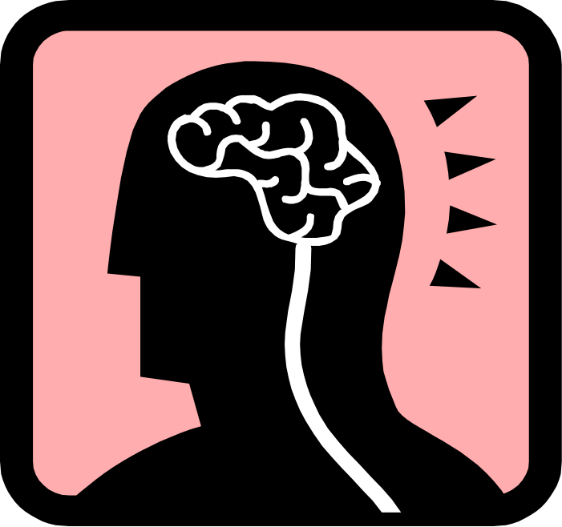
Protective Influences
Some areas of strengths include :
Internal Coping Resources
Hardy “personality” traits
Social Support
Individual’s ability to incorporate others’ perspectives, insights and ideas
Compliance with treatment plans and medication
Installation of hope

Slide 11
Understanding Mental Health From a Lifespan Perspective
Almost everyone experiences stress & other risk factors at some point in their lives.
One in five Americans experiences a mental health disorder in the course of a year.
Approximately 15% of all adults who have a mental disorder have a co-occurring substance abuse disorder (Dual Diagnosis).
Some mental disorders appear more commonly among children and youth (i.e. ADHD, Autism Spectrum Disorders).

Slide 12
Developmental and Environmental Influences
And an individual’s symptoms and signs, will be influenced by environmental factors. These can enhance or impede an individual’s functioning.
Existing social supports,
Socioeconomic conditions,
Impact of racism or prejudice

Slide 13
Interaction of Biological, Psychological, and Social Factors
Biopsychosocial context
Myth that it is either nature or nurture that determines our developmental trajectories but a combination of both.
Biology, psychology, sociology, and culture interplay during different phases of the lifespan.
Assisting clients with a mental disorder might entail referrals to a variety of sources which captures this biopsychosocial context. (i.e. physician, Medi-Cal, psychologist)

Slide 14
Culture and Mental Health
There are four major components of cultural formulation.
Cultural identity of the individual;
Cultural factors related to the individual's psychosocial environment and level of functioning;
Cultural elements of the relationship between the individual and the worker;
Cultural explanation of the individual’s illness;

Slide 15
Culture and Mental Health
Evaluate mental health issues in their cultural context.
Minority groups may evidence paranoia, which in fact is based upon real experiences of prejudice, discrimination, or even persecution.
If you are not a member of that minority group, it is important to have some working knowledge about what the history has been.
Don’t assume you know an individual’s experience. Let them tell you and maintain an attitude of respect and interest.

Slide 16
Culturally Sanctioned Psychotic Behavior
There are some cultural rituals that involve seemingly psychotic behaviors such as:
Hallucinations,
Speaking in tongues,
Altered states of consciousness.
The Navajo have a ritual called “moth craziness” and the idiom “runs amok” derives from the religious ceremony of “amok”
Mal ojo or “evil eye”
Rituals of voodoo
Curses or spells

Slide 17
Culture and Mental Health : How the Worker Can Help
Call upon some of their client' s unique cultural resources and systems of supports.
Show that a certain behavior is not considered a sign of mental illness in their client’s culture.
Demonstrate respect for the person’s culture, tackling any institutional racism that exists in the plan.

Slide 18
DSM Today
The DSM was released in 1994.
A greater number of experts were involved in the development.
A more stringent review was undertaken.
The DSM also took into account cultural diversity. Culture/ethnicity, age, sexual preference, and gender features were incorporated in diagnostic categories.

Slide 19
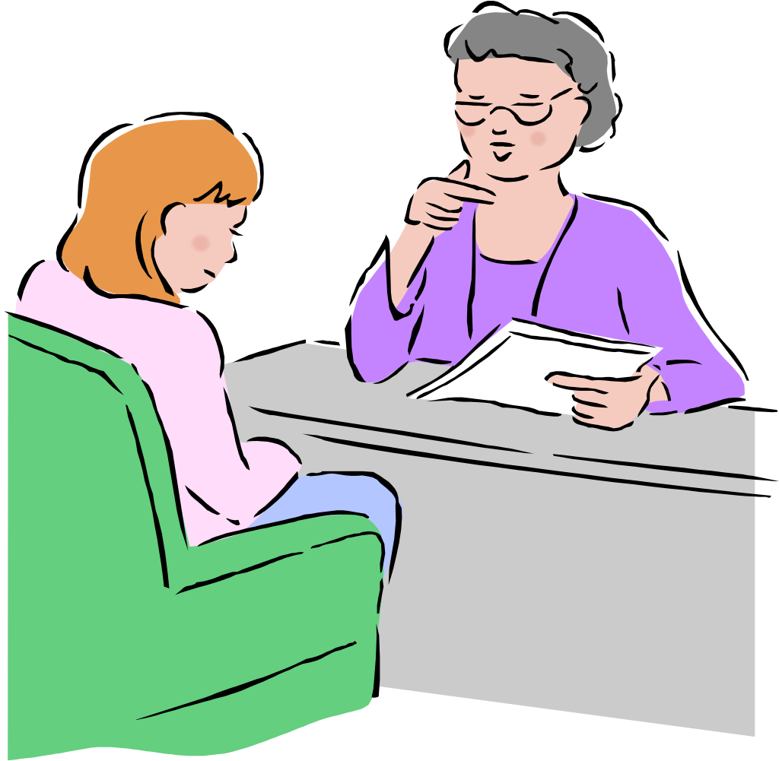
DSM-V
Workers engaged in child welfare services are not responsible for diagnosing mental disorders.
Becoming familiar with the DSM V allows you to:
Respond to the needs of the client for referrals.
Recognize & identify signs of mental health issues.
Advocate for the client.
Communicate with other mental health personnel.

Slide 20
Diagnostic Structure of the DSM-V
DSM-V is a criteria-based, hierarchical diagnostic system.
Diagnostic criteria are rules that describe or define the disorder.
Type, intensity, duration, and effect of the various behaviors and symptoms.
Hierarchical refers to some diagnoses having precedence over others.

Slide 21
DSM V-Common Definitions
Sign is "an objective manifestation”.
Signs are observed by the examiner rather than reported by the “affected individual.”
Symptom is "a subjective manifestation”.
Symptoms are reported by the affected individual rather than “observed by the examiner.”
Criteria set for a particular diagnosis is determined by the grouping or syndrome of "signs and symptoms.”
Syndrome is a grouping of signs and symptoms.

Slide 22
The Multiaxial System
Axis I is used for reporting all the various mental disorders or conditions except for Personality Disorders and Mental Retardation.
Axis II Personality Disorders and Mental Retardation are coded on Axis II.
Axis III notes current general medical conditions that are potentially relevant to the understanding and management of the individual's mental disorder.
Axis IV is for reporting psychosocial and environmental problems.

Slide 23
DSM Continued
Axis V provides for an impression of the clinician's judgment of the individual's overall functioning at the time of evaluation. The GAF scale is located in the DSM.
The DSM-V also includes ten appendices. Two appendices for workers engaged in child welfare services are:
Appendix C: Glossary of Technical Terms. Definition of selected terms used in mental health are included.
Appendix I: Glossary of Cultural Bound Syndromes. This particular appendix includes a glossary of culture bound syndromes and an outline of cultural formulation.

Slide 24
Limitations of the DSM V
Describes signs and symptoms of mental disorders.
Does NOT encompass all conditions that may be a legitimate focus of clinical attention or research.
Primary focus is on mental disorders occurring in individuals rather than in families, groups, or society.
Many symptoms may overlap categories and there may be a combination of conditions co-existing in an individual.

Slide 25
Anxiety Disorders
Anxiety disorders are considered to be very common.
In a given year, 13.3% of the population in the United States suffers from an anxiety disorder.
Characterized by a heightened state of arousal or fear in relation to stressful events or feelings.
The frequent experience of anxiety, worry, and apprehension is more intense and lasts for a longer period of time than the anxiety experienced by a person in everyday life.

Slide 26
Anxiety Disorders
Cognitive symptoms can include worries, intrusive thoughts, obsessions, dissociation, and/or psychic numbing.
Emotional symptoms can include fears, apprehension, nervousness, heightened state of physical arousal, alertness, hypersensitivity.
Somatic symptoms can include motor tension, the startle response, autonomic hyper-arousal, rapid shallow breathing, increased heart rate, muscle tension, sweating, trembling, and/or other physical sensations or complaints.
Behavioral symptoms can include hypervigilance, avoidance of evocative stimuli, absorption, compulsions, rituals, and/or compensatory behavior.

Slide 27
Common anxiety disorders that workers encounter include:
Anxiety Disorder: a general state of apprehension without any trigger, precipitant, or apparent logical reason.
Panic Disorder: sudden, unpredictable but intense periods of anxiety that flood the individual to the point of immobilization.
Posttraumatic Stress Disorder: cognitive, emotional, and behavioral disturbances that develop after an extra-ordinary stressor that would tax the person’s coping abilities (i.e. rape, physical assault, accidents, death, tragedies).

Slide 28
Posttraumatic Stress Disorder
Existence of a recognizable stressor that would evoke significant distress due to it’s extraordinary impact .
Re-experiencing of the trauma through nightmares, flashbacks, recurrent dream, intrusive recollections of the event.
Numbing of responsiveness, emotions, being easily startled, irritability, and/or being easily distracted.
Marked diminishment of interest in one or more significant activities.
Feelings of detachment or estrangement from others.
Constricted range of affect.
Other symptoms that were not present prior to the traumatic event.

Slide 29
Obsessive Compulsive Disorder
Anxiety disorder with obsessions and compulsions.
Obsessions: inappropriate, recurrent, and persistent thoughts experienced as intrusive and inappropriate to the individual’s conscious thought process.
Compulsions: inappropriate, recurrent and repetitive behaviors or rituals that the person feels driven to perform.
Adults recognize that these obsessions and compulsions are excessive or unreasonable. Children do not realize this.
Obsessions and Compulsions take up substantial time and interfere with one’s work, social relationships, or other areas of functioning.

Slide 30
CASE VIGNETTE
Carla, age 50, is a single mother of two children, John, age 12 and Susan, age 10. CWS was contacted by the school due to excessive absences of both children from school and mother not responding to school authorities when they asked her to come to a hearing on the issue. When asked why the children didn’t go to school, Carla stated that she was fearful that her ex-husband would learn of their whereabouts should he see the children and follow them home. She disclosed that she had been so fearful that he would find them, she has not left the home except at night sometimes. She claims the husband threatened to kill her should she leave him during several domestic abuse episodes. Carla claims that the children study on their own and that “their presence calms her nerves”. She admits to difficulty sleeping and eating as well as feeling agitated.

Slide 31
Questions to answer
Are there signs and symptoms present that would impact parenting and the ability to protect?
What strengths can be noted and how would you engage the client based on these strengths?
What might be described as chronic vs. acute in the situation?
What might be some case plan interventions that you would make given the signs and symptoms identified?
What referrals might be helpful?

Slide 32
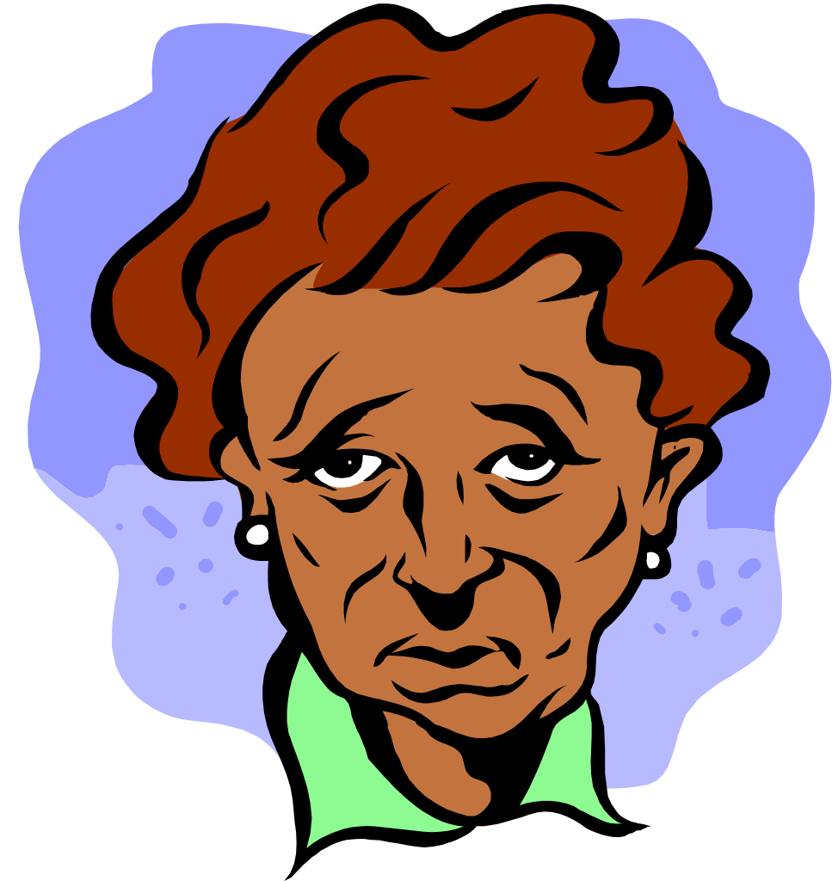
Mood Disorders
Noticeable disruption of mood that is outside the bounds of normal mood fluctuations.
Characterized by some form of depression, mania, or both conditions in an alternating fashion.
In children this can manifest as irritability, disinterest in usual activities, anger, somatization, or distractibility/inattention.
One-year preva1ence rate in the United States: 2.5% of children, 8.3% of adolescents, and 9.5% of adults.

Slide 33
Depression
Major Depressive Episode: Over 2 Week Period, 5 of the following symptoms including ongoing depressed mood:
depressed mood most of the day, every day
in children and adolescents, the predominant mood may be irritability and anger
diminished interest and pleasure in everyday activities
weight loss or gain
insomnia or desire to sleep continuously
agitation or psychomotor retardation
lack of energy
feelings of worthlessness or guilt
difficulty in concentration and decision making
preoccupation with death, self-mutilation, or suicidal ideation

Slide 34
Common mood disorders workers encounter:
Major Depressive Disorder
Major depressive disorder is characterized by one or more significant major depressive episodes.
Referral to a psychiatrist or physician for a medication evaluation is essential.
Psychotherapy and medication is considered the treatment of choice.
“High risk” diagnosis for suicidal ideation or intent.

Slide 35
Depression
Dysthymic Disorder
Report a low-grade depression that has been occurring for at least two years for adults and one year for children and adolescents.
These individuals may also benefit from a medication evaluation as well as psychotherapy.
“Double Depression”: This is defined as someone who has a dysthymic condition with major depressive episodes that are superimposed.

Slide 36
Bipolar Disorder
Bipolar Disorder is characterized by dramatic mood swings, from mania to depression, with periods of normal mood in between.
Bipolar I has Manic Episodes whereas Bipolar II has Hypomanic Episodes.
Hypomania is a less severe form of mania.
This diagnosis necessitates consultation with a psychiatrist for a medication evaluation.

Slide 37
Manic Episode
Manic episodes are characterized by :
an unusual and persistent elevated, expansive or irritable mood with inflated self-esteem, self-concept or grandiosity
decreased need for sleep
excessive talking
flight of ideas or delusional thinking
distractibility and lack of focus
psychomotor agitation, inappropriate goal-directed activity, or risk-taking behavior

Slide 38
CASE VIGNETTE
Anna, age 35, speaks very rapidly and displays energy and enthusiasm. She relates that she is excited because she will soon be an internationally recognized chemist since she is working on a special project for cleaning carpets which will revolutionize the industry. She rambles on that she is very busy and has been unable to get much sleep. She claims she does the best she can to watch her 3 year old son but since he is active, it is only natural that he might fall & hurt himself. Anna relates she doesn’t understand why the M.D. contacted CWS since she did eventually bring her son to the doctor when he had a fever of 104. Anna seems preoccupied and doesn’t directly answer the worker’s questions. She also doesn’t interact with her son who is playing by himself and when he comes up to her, she will often redirect him to go play again.

Slide 39
Questions to answer
Are there signs and symptoms present that would impact parenting and the ability to protect?
What strengths can be noted and how would you engage the client based on these strengths?
What might be described as chronic vs. acute in the situation?
What might be some case plan interventions that you would make given the signs and symptoms identified?
What referrals might be helpful?

Slide 40
Personality Disorders
“An enduring pattern of inner experience, and behavior that deviates markedly from the expectation of the individual’s culture, is pervasive and inflexible, has an onset in adolescence or early adulthood, is stable over time, and leads to distress or impairment in functioning.”
There are 3 Clusters coded on Axis II
Cluster A : Paranoid, Schizoid, and Schizotypal
Cluster B : Antisocial, Borderline, Histrionic, and Narcissistic
Cluster C : Avoidant, Dependent, and Obsessive-Compulsive

Slide 41
Borderline Personality Disorder
Symptoms of Borderline Personality Disorder (BPD) :
Instability in mood, thinking, behavior, self image
Easily depressed
Cannot bear to be alone/constant demand for attention
Quick to take offense
Makes unreasonable demands
Engages in provocative behavior
Chronically angry
Claim they are “bored”, “life is empty”
Suicide threats
Self-destructive, impulsive behavior

Slide 42
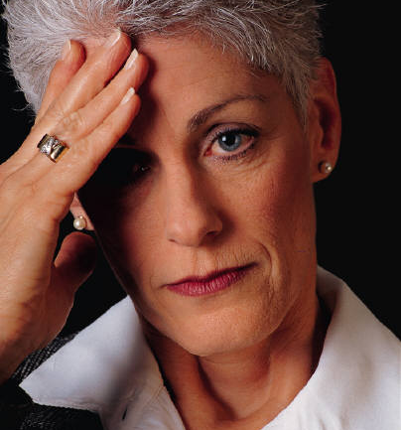
More Facts on BPD – from www.narsad.org
Borderline Personality Disorder occurs in roughly 2-3% of the general population.
About 25% of patients with BPD also have PTSD.
Current consensus is that childhood abuse may be important in some cases but is not a necessary cause of Borderline Personality Disorder.
BPD occurs three times more often in women as in men.

Slide 43
CASE VIGNETTE
Juan, age 33, has custody of his 4 children because his ex-wife has an addiction to amphetamines. He had also been using but now claims he is not and has been clean for several years since he took custody. He wasn’t continuously working when he took over the custody of the 4 children and entered the CalWORKs program. He had been recently sanctioned by the program because Juan tried to “make a few bucks under the table” and it was discovered by CalWORKs. CWS was contacted by neighbors who report that the children have been left unsupervised and appear disheveled and hungry. Juan becomes angry and defensive saying that the government has no right to restrict him from trying to earn a living. He remarks “what is he supposed to do now that CalWORKs won’t provide childcare & he has to put food on the table and a roof over their heads”? He says they should give him what he is entitled to get as a citizen and that CWS should stay out of his business.

Slide 44
Questions to answer
Are there signs and symptoms present that would impact parenting and the ability to protect?
What strengths can be noted and how would you engage the client based on these strengths?
What might be described as chronic vs. acute in the situation?
What might be some case plan interventions that you would make given the signs and symptoms identified?
What referrals might be helpful?

Slide 45
Schizophrenia
Symptoms include:
Hallucinations: hearing internal voices or experiencing other sensations not connected to an obvious source
Delusions: a false belief generated within the person’s mind in which the individual assigns unusual significance or meaning to normal events, or holds fixed false beliefs
Illusions: the distortion of perception or sensation when there is a real external stimulus
Disorganized speech, babbling, inarticulation
Incoherence: loose mental associations or tangential thinking which is illogical
Loss of ego boundaries
Grossly disorganized or catatonic behavior
Bizarre behaviors: peculiar or unusual actions or behaviors
Flat, inappropriate or bizarre affect: facial gestures or expression that does not fit with real life situations
Mood disturbances: fluctuations of emotions or complete withdrawal without a trigger or apparent reason
Impaired functioning: individuals may demonstrate marked lack of interest, motivation or initiative for their personal care, in their social relations, and in their responsibilities

Slide 46
Induced Psychosis
Organicity: the reduced ability to maintain one’s functioning due to disease process, acute or chronic toxicity, or injury/damage to the brain resulting in brain dysfunction:
Biorhythm disturbance: negative effects on wake-sleep cycle
Disorientation: inability to recognize the current day, time, place or person
Disorganized thought process: impairment in memory, judgment, decision-making, comprehension, logic, abstractions, rationality
Perceptual problems: misinterpretation, illusion, delusion
Personality changes
Language impairments: slurred speech, inarticulation

Slide 47
Case Vignette
An anonymous caller had concerns about physical abuse of a sibling group. There are 5 children ages 6-16. The caller said “there are often screams from the children in the home.” The father had his first psychotic break a number of years ago believing that everyone was against him. He will live apart from the family for the time being. He was physically abusive to the two older boys in the past. While you are there, you notice the eight year old girl has a huge bruise on her arm. This girl also appears withdrawn. Mother seems bright and loving but overwhelmed. Mother states she’s doing the best she can with a sick husband and 5 children to care for.
1. What are the strengths in this family and how could you use these in case planning?
2. What referrals would you make that might be helpful?

Slide 48
Substance-Related Disorders
Between 80-90% of child welfare cases are involved in drugs/alcohol.
Many symptoms and behaviors of individuals abusing substances are similar to other mental disorders.
Maladaptive use or dependence on one or more substances.
Use of one or more substances can occur through ingesting, injecting, or inhaling and can result in adverse social, behavioral, psychological, and physiological effects.
Maladaptive symptoms may include delusions, hallucinations, depression, excitation, irritability, anxiety, euphoria, mania, restlessness, sleep problems, and cognitive disturbances.

Slide 49
Dual Diagnosis
Dual Diagnosis refers to having a mental disorder as well as a substance abuse disorder.
This occurs in roughly 15 % of all adults.
This poses a challenge to the mental health system which often has specialty in either disorder but not both.
Currently, there is an active and concerted attempt to train mental health providers in this area.

Slide 50
Factitious Disorders
The individual attempts to assume the role of a sick person, who is in need of help, by intentionally producing physical and/or psychological symptoms.
The motivation is a psychological need to assume the sick role. Factitious disorders are distinguished from acts of malingering:
In malingering, the goal is to avoid environmental circumstances through intentionally producing physical or psychological symptoms.

Slide 51
Factitious Disorder by Proxy (or Munchausen by Proxy)
In this disorder an individual is deliberately faking or producing illness in another person who is under the care of the individual. In this situation, the individual is satisfying his or her needs at the expense of another person.
Prevalence: According to the DSM-IV it is a rarely reported diagnosis and often may not be recognized.

Slide 52
Dissociative Disorders
A disturbance of one’s sense of personal continuity due to a disruption of the normal integrative functions of memory, consciousness, sense of personal identity and/or perception of reality.
The ability to separate off certain mental contents from the usual flow of consciousness.
This disorder has been associated with individuals who are overwhelmed by intense pain and trauma.
Dissociation used as a means to protect themselves from their distressing thoughts, feelings, and memories.

Slide 53
Dissociative Disorders Continued
The nature and severity of dissociative symptoms can vary from person to person.
Five essential dissociative symptoms identified are:
Amnesia (loss of memories of personal information or events of a specific time period),
Depersonalization (feelings of detachment from oneself),
De-realization (feeling of detachment from one's surroundings, including people in one’s environment),
Identity confusion (a feeling of puzz1ement, confusion or inner conflict about one's sense of identity) and
Identity alteration (an organized shift in the characteristic way in which one perceives, thinks about, and relates to others and the world at large).

Slide 54
Eating Disorders
Eating disorders are characterized by a severe disturbance in eating behavior and body image.
Individuals with an eating disorder may excessively restrict food intake or engage in binge eating.
This is usually followed by compensatory behavior that includes excessive exercise, purging through self-induced vomiting, or the misuse of laxatives or diuretics.
This disorder can be life threatening.

Slide 55
Eating Disorders
The majority of eating disorders (90%) occur in adolescent and young adult women
Obsessive concern about becoming overweight or fat
Distorted body image
Inability to appropriately control food intake to maintain a health body weight
Fluctuation of self-evaluation that is dependent on perceived body shape or weight

Slide 56
Working With Families
Work in tandem with other professionals, don’t isolate yourself.
Know and understand the various systems in which you are working.
Develop relationships with different agency personnel.
Assure someone is assigned the case manager role.
Set up measurable goals and have clearly written contracts between the family and you.
View families from a strengths perspective.

Slide 57
SUPPORT REASSURANCE CLARIFICATION OF ISSUES CONCRETE INFORMATION DECREASE THEIR ANXIETY INSTALLATION OF HOPE

Slide 58
Resources and Treatment
Linkage with services that the person requires is often the first step in stabilizing an individual with a mental health disorder.
Here are a few examples;
Community Mental Health-Psychiatrist, Mental Health Personnel, Case Management
Day Treatment Services
Board and Care Facilities
Private Insurance
Medi-Cal, Medicare, AFDC etc.
Non-profits in the area

Slide 59
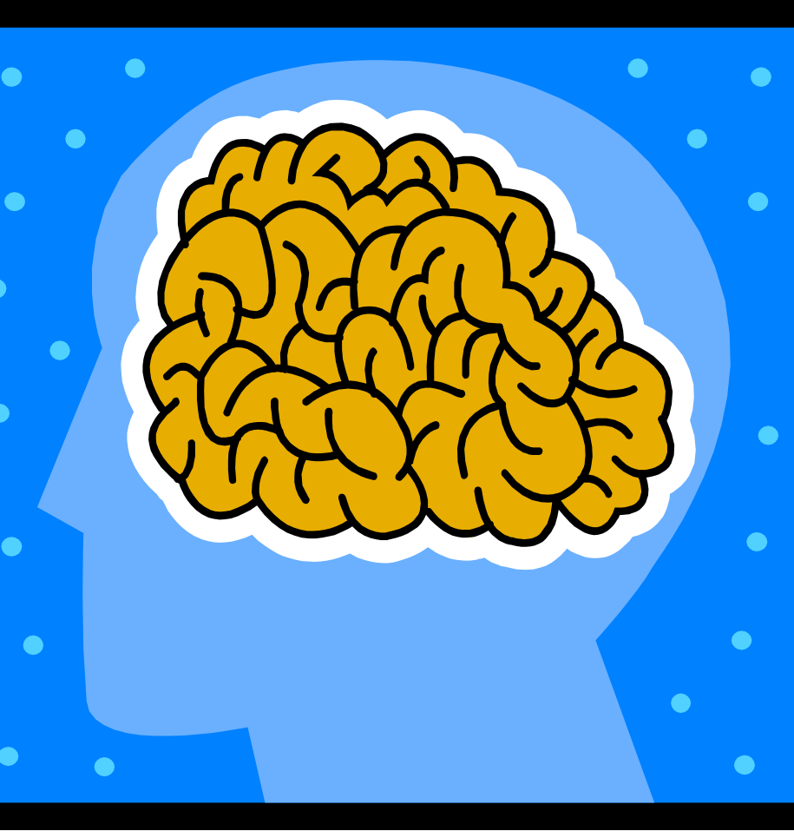
Working With Other Professionals
Work collaboratively with other professionals or paraprofessionals.
Some of these individuals may be :
Psychiatrist, Psychologist, LCSW, MFT, or other Mental Health professional
Case manager
Teachers
Employers
Mentors
What other professionals have you had to connect with?

Slide 60
Referrals to Mental Health and Community Resources
Inform mental health about the reason for the referral
Use a client release form
Include appropriate client contact information
List other agencies and professionals involved in the case
Clearly state your agency’s expectations for the referral outcome

Slide 61
Guidelines for making a Referral
Disorientation to person, place, time, or date
Preoccupation with specific thoughts or ideas
Denial of severity or that problem exists
Flashbacks or hallucinations, delusions
Feelings of disconnectedness, unreality, numbness, dissociation
Difficulty carrying out basic life functions
Bizarre, self-mutilating or assaultive behavior
Emotional hysteria or emotional withdrawal
Unfocused agitation, ritualistic or uncontrollable behaviors

Slide 62
Questions to answer
Are there signs and symptoms present that would impact parenting and the ability to protect?
What strengths can be noted and how would you engage the client based on these strengths?
What might be described as chronic vs. acute in the situation?
What might be some case plan interventions that you would make given the signs and symptoms identified?
What referrals might be helpful?

Slide 63
Additional Instructions
At your table, please discuss what might change in your answers if this case was about:
African-American woman & Asian friend
Hispanic woman & Native American friend
The women were not just friends but lovers
Would you engage them any differently?
What would you need to consider in terms of cultural issues?

Slide 64
Thank You
Ed Pieczenik, LCSW

