Slide 1
Online Learning
Common Core 3.0
Field Activities
Classroom Skill Building
Notes:
Sample: 2 second animated, branded Core 3.0 eLearning intro (can have simple sound effect)

Slide 2
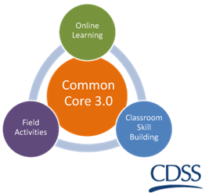
Trauma-Informed Practice
California Common Core
December 31, 2018

Slide 3
Introductions
You have been exiled to a deserted island for a year. In addition to the essentials, you may take one movie, one book, and a luxury item to carry with you (but not a boat to leave the island!).
What would you take with you and why?

Slide 4
Today’s Agenda
Review Learning Objectives
Adverse Childhood Experiences
Historical Trauma and Culture
Child Welfare’s Response to Trauma
Self-Care
Evaluation Post-Test

Slide 5
Goals for Today
Understand how trauma impacts children and adults.
Develop strategies for how to help children and families heal from trauma.
Understand how trauma impacts professionals.

Slide 6
Learning Objectives
Review the Learning Objectives
Identify and underline one Learning Objective that you feel you already understand well.
Identify and circle one Learning Objective that you want to prioritize today.

Slide 7
Learning Objectives
K1. The trainee will be able to describe the relationship between a person’s culture, experiences of individual, familial and/or historic trauma, and his or her behaviors or responses.
K2. The trainee will be able to identify behaviors of children and parents in response to trauma or trauma triggers and ways to support positive adjustment.
K3. The trainee will be able to describe how child traumatic stress is exacerbated by ongoing stressors in a child’s environment and within the child welfare system.

Slide 8
Learning Objectives
K4. The trainee will be able to identify three things social workers can do to mitigate the impact of and heal trauma for children and families.
K5. The trainee will be able to describe the effect of personal trauma history and secondary traumatic stress on social workers and their responses to families and children.

Slide 9
Learning Objectives
S1. Using a case example, the trainee will be able to recognize, identify, and assess symptoms of traumatic stress within a developmental and cultural context.
S2. Using a case example, the trainee will be able to demonstrate three things social workers can do to mitigate the impact of and heal trauma for children and families.

Slide 10
Learning Objectives
V1. The trainee will value referring children with a trauma history for a thorough trauma assessment and specific trauma-related mental health services.
V2. The trainee will value working to prevent or mitigate the impact of traumatic stress by using trauma-informed responses.
V3. The trainee will value the different roles for social workers and mental health providers in providing trauma-informed services.

Slide 11
Activity: Stress and Associated Feelings
Very Hot
Very uncomfortable
Extremely stressed out and anxious
Need to get out of here now
Hot
Moderately uncomfortable
Stressed and anxious
Distracted and edgy
Warm
Mildly uncomfortable
Slightly stressed and anxious
Losing my focus
Just Right
Comfortable
Not stressed or anxious
Focused and engaged
Cool
A little bored
Losing my focus
Ice cold
Totally bored
Not focused or engaged
Planning my escape

Slide 12
Activity: Matching Game

Slide 13
Video: ReMoved
Notes:
(12:47 minutes)
While they are watching the video, ask Trainee’s to note Trauma’s experienced prior to removal, during removal and things that the SW could have done to minimize system trauma.
Note: Learning Objectives K5. The trainee will be able to describe how child traumatic stress is exacerbated by ongoing stressors in a child’s environment and within the child welfare system, and V2. The trainee will value working to prevent or mitigate the impact of traumatic stress by using trauma informed responses.

Slide 14
Investigation
Removal
Placement / Placement Changes
Transition Home or to a Permanent Plan
Case Closure

Slide 15
How can social workers help children and families AND minimize any possible harm as a result of the agency’s involvement?
Investigation
Removal
Placement/placement changes
Transition home or to permanent plan
Case closure

Slide 16
How can a social worker help?
Let child know they can talk about experiences or fears if they want to.
Listen carefully when they do talk.
Notice behaviors.
Give the child choices and some sense of control.
If you have any questions, ask for help from Supervisor.
Know where to refer.
Notes:
Consult with your Supervisor or Mental Health Staff. Know how the referral system in your agency works. Look online for information.
K6. The trainee will be able to identify three things social workers can do to minimize and heal trauma
S2. Using a case example, the trainee will be able to demonstrate three things social workers can do to minimize and heal trauma.
V2. The trainee will value working to prevent or mitigate the impact of traumatic stress by using trauma informed responses

Slide 17
Services to Consider When Trauma Is Identified
The social worker can make referrals for services to:
Behavioral Health Services
Trauma-Focused Therapy
Public Health Nurse or Physician
Special Activities
Educational Staff or Programs
Notes:
K6. The trainee will be able to identify three things social workers can do to minimize and heal trauma
S2. Using a case example, the trainee will be able to demonstrate three things social workers can do to minimize and heal trauma.
V1. The trainee will value referring children with a trauma history for a thorough trauma assessment and specific trauma related mental health services.
V2. The trainee will value working to prevent or mitigate the impact of traumatic stress by using trauma informed responses
V3. The trainee will value the different roles for social workers and mental health providers in providing trauma informed services.

Slide 18
Just for Fun!
https://youtu.be/5MDxFKxbqTw

Slide 19
Adverse Childhood Experiences
https://www.ted.com/talks/nadine_burke_harris_how_childhood_trauma_affects_health_across_a_lifetime?language=en

Slide 20
How can Birth/Resource Parents support children with ACEs?
DOs
Be nurturing/comforting
Be flexible
Be honest – even if it’s difficult
Be patient – the effects of trauma can be long-lasting with a long process for recovery
Provide a consistent pattern for the child’s day
Discuss behavioral expectations/discipline
Talk and share info with the SW and MH clinician
DON’Ts
Don’t be afraid to talk about the trauma if the child wants to, and listen if they do – follow the child’s cues
Don’t over-react
Don’t underestimate how important it is for children to know their caregivers are “in control”
Don’t be afraid to ask for help

Slide 21
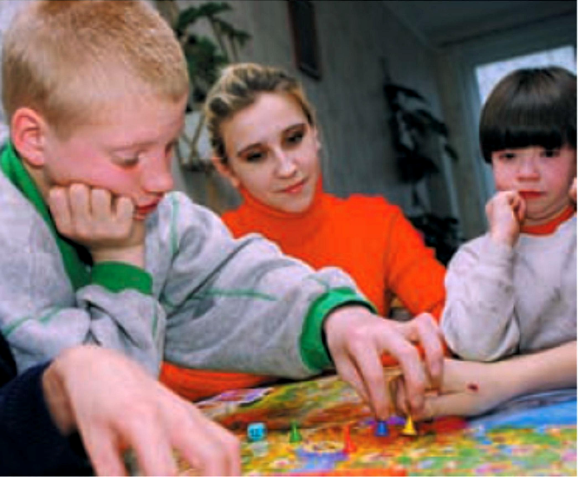
Parents’ Trauma History
Many parents of children in foster care have histories of adult and/or childhood trauma
What this means…
Parents’ past or present trauma can make it difficult for them to work effectively with case workers and resource parents towards reunification with their children.

Slide 22
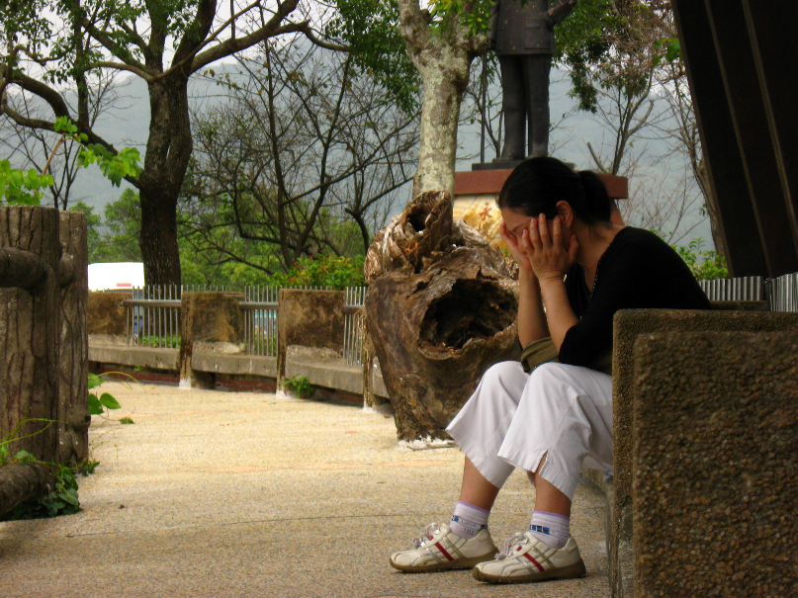
How Trauma Can Affect Birth Parents
Compromise parents’ ability to make judgments about safety
Harder for parents to form and maintain secure and trusting relationships
Impair their capacity to regulate emotions
Low self-esteem and lack of coping strategies can impair a parent’s decision-making ability
Make the parent more vulnerable to other life stressors

Slide 23
Activity
Review “How Can Trauma Affect Parents?” in Birth Parents with Trauma Histories and the Child Welfare System: A Guide for Child Welfare Staff.

Slide 24
How can social workers help parents heal
Understand parent’s anger, fear, resentment, or avoidance as reactions to past trauma
Assess parent’s trauma history
Understand that traumatized parents are not bad and do not judge or blame them
Build on parent’s desires to care for their child
Help parents understand impact of their own past trauma
Refer parents to trauma-informed services

Slide 25
Cultural Trauma
Social and cultural realities strongly influence children’s risk for—and experience of—trauma.
Children and adolescents from minority backgrounds are at increased risk for trauma exposure and subsequent development of PTSD.
In addition, children’s, families’, and communities’ responses to trauma vary by group.

Slide 26
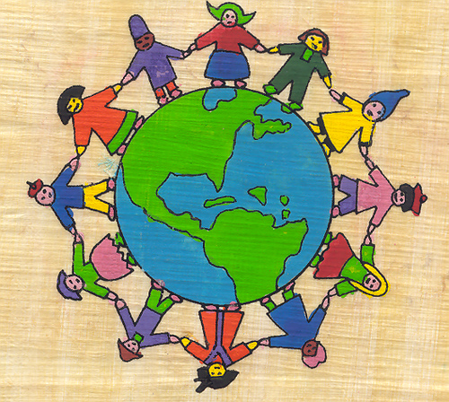
The Influence of Culture
Variance of trauma responses
Strong cultural identity and community/ family connections
Shame

Slide 27
Eight Components of Shame Lisa Aronson Fontes
Responsibility for the abuse
Failure to protect
Fate
Damaged goods
Virginity
Predictions of a shameful future
Revictimization
Layers of shame

Slide 28
Video: Importance of Culture
Georgetown University Center for Human Development

Slide 29
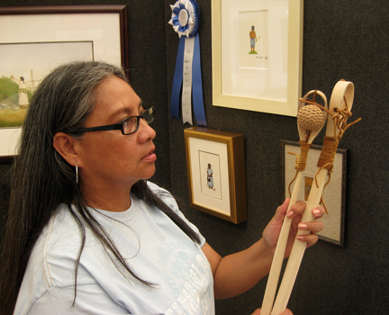
Cultural Trauma Activity
Discuss and chart in your table groups what factors may contribute to Cultural Trauma and what types of trauma responses you may see.

Slide 30
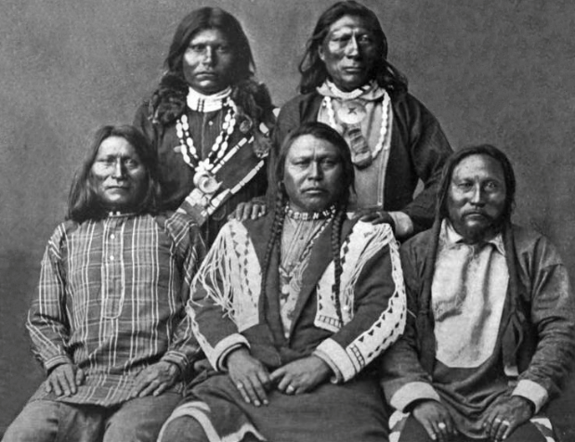
Historical Trauma
Historical Unresolved Grief
Disenfranchised Grief
Internalized Oppression
Multigenerational Trauma
The population of Native Americans in North America decreased by 95% between the time Columbus came to America in 1492 and the establishment of the United States in 1776.

Slide 31
Historical Trauma Response
Historical and current trauma of a group
Cumulative emotional and psychological wounding
Depression, self-destructive behavior, anxiety
Self-medicating to avoid painful feelings
Pass on trauma, e.g., substance abuse to next generation

Slide 32
Negative Effects of Cultural/Historical Trauma
Community
-Loss of tradition
-Loss of resources and knowledge for self-sufficiency
-Loss of cultural practices
-Loss of rites of passage
-High rates of substance abuse
-High rates of violence
-High rates of physical illness
-Distrust of larger society and those within the community
Family
-Impaired family communication
-Loss of extended family relationships
-Loss of traditional child rearing practices and knowledge
-Increased rates of child abuse
-Increased rates of domestic violence
Individual
-Lack of belief in a just world/lack of trust
-Depression
-Self-hatred
-Self destructive behaviors
-Survivor guilt
-Disassociation
-Hopelessness/ loss of meaning
-PTSD
Notes:
Historical Trauma Response-defined by Maria Yellow Horse Brave Heart as a constellation of features in reaction to massive group trauma.
important in terms of child welfare- how these traumas have effected child rearing in tribal communities over many generations.
For example the increased incidences of child abuse are often attributable to the parents own wounding and the learning of negative child rearing practices in boarding schools.
Parents interacting with the system, due to distrust etc. For example, for some parents the hopelessness and sense of powerlessness can interfere with reunification if a parent believes that once a child is removed they will never come home again, This belief would be supported as community knowledge from past historical experiences.

Slide 33
Native Resiliency: Other Responses To Trauma
Revitalization of cultural practices and languages
Belief in self, community, and family resiliency due to survival
Politicization and resistance
Return to traditional kinship networks
Return to traditional child rearing practices and rites of passage
Founding of organizations and services to help families and communities
Notes:
In our communities we also see resilient responses to the traumas that have occurred.
Flower Dance
World Renewal for the Wiyots
Many local tribes have language programs and they are taught at public schools
These are also important opportunities for healing from trauma and reconnecting to the community for many of those families involved with child welfare who might have been disconnected by the historically traumatic events.
-Narratives of survival/power of the people and the community
-fights against termination, right to self determination, where I am from strong fights for fishing rights.
-Flower dance, baby baskets
UIHS for example founded as grassroots organization that provides for many of the individual and community needs where I come from.

Slide 34
Video: Case Study – Historical Loss

Slide 35
Activity: What can you do?
What are some ways that social workers can discuss traumatic events and safety concerns with families while taking into consideration the family’s culture?

Slide 36
Pathways to Mental Health Services (formerly known as “Katie A.”)
What is it?:
Class-action lawsuit in California that further delineates and holds accountable the roles of Child Welfare Workers and Behavioral Health clinicians in supporting the mental/behavioral health needs of children and youth

Slide 37
Katie A. Settlement Agreement
A child or youth is a “class” member, and eligible for services, if:
the youth is in foster care or is at imminent risk of foster care placement,
the youth has a mental illness or condition, and
the youth needs individualized behavioral health services (e.g., professional assessment, behavioral support and case management services, family support, crisis support, therapeutic foster care, and other medically necessary services in the home or in a home-like setting).

Slide 38
Implications for Child Welfare Practice
Utilization of Child and Family Teams for planning and monitoring mental/behavioral health services
Intersects with the mandate for Child and Family Teams under the Continuum of Care Reform

Slide 39
Pathways to Mental Health Services: Screening
MUST SCREEN children and youth for behavioral health needs at intake and every year thereafter.
How is this handled in your county?

Slide 40
Pathways to Mental Health Services: Assessment
REFER children/youth to trauma-informed and evidence-based behavioral health services available in their communities.
The behavioral health clinician will conduct a comprehensive mental health assessment.

Slide 41
Pathways to Mental Health Services: Collaboration
MUST COLLABORATE through CHILD AND FAMILY TEAMS (CFTs).
The CFT is comprised of the youth, family, child welfare social worker and behavioral health clinician, care and service providers, and natural supports as identified by the family.

Slide 42
Pathways to Mental Health Services: Service Planning in Child & Family Teams
Team members work together to articulate strengths and needs and to develop a service plan with identified goals, resources, and natural supports.
All team members participate in the individualized care plan and are responsible for supporting the child/youth and family in attaining their goals.
Families and youth are empowered as full partners, and their preferences are prioritized.

Slide 43
Pathways to Mental Health Services: Monitoring & Adapting
MONITOR services. Collectively, team members monitor the progress of the care plan, and make adjustments as needed to meet goals.

Slide 44
Pathways to Mental Health Services: Transition
As developmental functioning and well-being are improved, the team plans for a transition from formal services to reliance on informal, community supports
Check with your supervisor for more county-specific details!

Slide 45
Additional Services for Intensive Mental Health Needs
The following Medi-Cal Specialty Mental Health Services (SMHS) are available for children/youth with intensive mental health needs:
Intensive Care Coordination (ICC)
Intensive Home-Based Services (IHBS)
Therapeutic Foster Care (TFC)

Slide 46
Essential Elements of Trauma-Informed Child Welfare Practice
Maximize the child’s sense of safety.
Assist children in reducing overwhelming emotion.
Help children make new meaning of their trauma history and current experiences.
Address the impact of trauma and subsequent changes in the child’s behavior, development, and relationships.
Coordinate services with other agencies.
Notes:
46

Slide 47
Essential Elements of
Trauma-Informed Child Welfare Practice (cont’d)
Utilize comprehensive assessment of the child’s trauma experiences and their impact on the child’s development and behavior to guide services.
Support and promote positive and stable relationships in the life of the child.
Provide support and guidance to child’s family and caregivers.
Manage professional and personal stress.

Slide 48
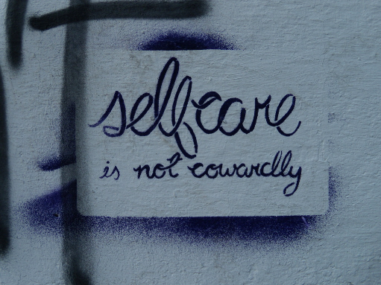
Quote
“The expectation that we can be immersed in suffering and loss daily and not be touched by it is as unrealistic as expecting to be able to walk through water without getting wet.”
- Rachel Remen, Kitchen Table Wisdom

Slide 49
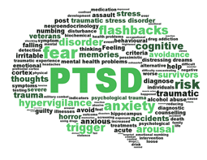
Secondary Traumatic Stress
Distress that results when an individual hears about the firsthand trauma experiences of another. Symptoms mimic those of PTSD:
Re-experiencing personal trauma;
Changes in memory/perception;
Depletion of personal resources;
Disruption in perception of safety, trust, independence.

Slide 50
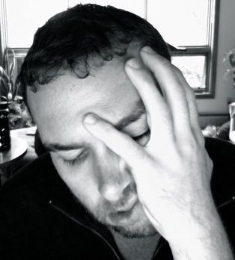
Sources of Secondary Traumatic Stress
Child or family member death on an active or recently closed case
Investigating abuse and neglect
Working in violent communities
Working with families with extensive abuse histories
Removing a child under distressing circumstances
System frustrations
Verbal or physical assault by parents or community members

Slide 51
Compassion Fatigue Self-Test: An Assessment
Cynicism and anger
Anxiety, fearfulness
Emotional detachment
Hopelessness and guilt
Sleep disturbance
Social withdrawal
Diminished self-care
Physical ailments

Slide 52
Coping
Understand and accept one’s vulnerability
Learn to balance the needs of the client, the agency, and oneself
Utilize supervision to recognize and address
Recognize when one’s self-care system is not working
Recognize negative and positive coping behaviors
Consider offering and asking for peer support

Slide 53
Frontline: Social Work Short Film (3:07)
https://youtu.be/84bE1M6Usz0?list=PLoEqrtSDwqBf4O1mxQ60Vi4vEXA06Lqmn

Slide 54
Trauma Training Post-Test

Slide 55
Wrap-up

