Slide 1
Online Learning
Common Core 3.0
Field Activities
Classroom Skill Building
Notes:
Sample: 2 second animated, branded Core 3.0 eLearning intro (can have simple sound effect) dun

Slide 2
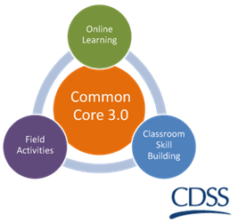
Key Issues in Child Welfare Practice: Social Worker as Practitioner Day 1 California Common Core December 31, 2108

Slide 3
Overview of the Day
Introduction
Role of the Practitioner
Intersection of Key Issues
Key Issues Facing Youth
Motivation and Stages of Change

Slide 4
Group Agreements
Be collaborative
Ask lots of questions – let us know what you think
Be open to trying new things
Be willing to make mistakes
Maintain confidentiality
Be responsible for your own learning

Slide 5
Recall Activity
Think about some of the key concepts from the e-Learning modules
In your group, read the card prompt and discuss the answers

Slide 6
Pendulum Activity

Slide 7
Activity
Reflect on what assumptions, feelings, and possible biases may be present based on your response to each statement.
What are some ways that this could impact your work with families?

Slide 8
Common Errors in Child Welfare
Making a decision with insufficient information
Remembering either the very first information or the most recent
Selectively remembering information
Being reluctant to change one’s own mind
Focusing in on one explanation

Slide 9
How do we avoid these errors?
WE can…
Gather information
Consider alternative explanations
Utilize family team meetings
Utilize assessment tools
Use trauma-informed practices
Examine own feelings and biases
Consult with your supervisors

Slide 10
Strength-based Practice
Identify family strengths and resources that can be used in providing services and supporting a family.
Use family strengths as benchmarks to assess the status of a family over the course of time.
Use community-wide strengths to develop resources in the community.
“The goal of strength-based practice is to activate an individual’s sense of responsibility for his or her actions…through a focus on potential rather than pathology.” (Clark, 2001).

Slide 11
Building on Strengths
All families have strengths.
When families and their resources are involved in decision-making, outcomes can improve.
The family’s culture is a source of strength.
Building on functional strengths already present in families results in more lasting changes in the family after the child welfare intervention is over.

Slide 12
Benefits of Focusing on Strengths
A strengths-based approach helps families:
Feel the social worker is interested in their success
Think the relationship they are developing with the social worker is important
Feel more optimistic
Feel more able to make positive changes in their lives
(from Redko et al., 2007)

Slide 13
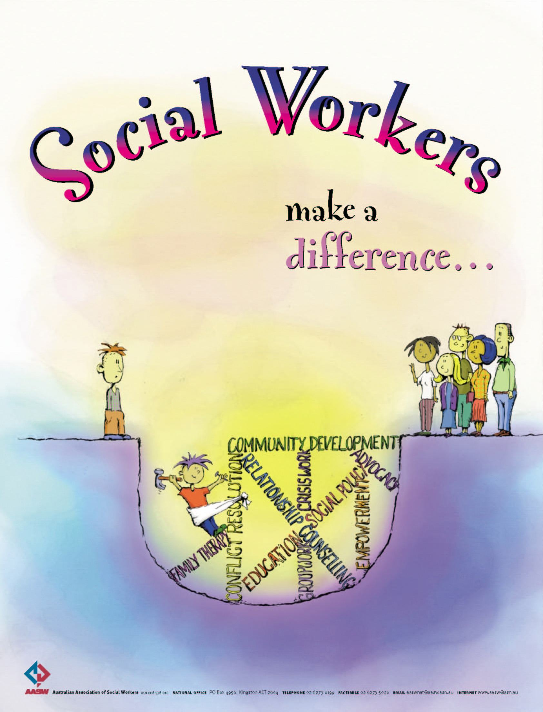

Slide 14
Casework Components: Practice Behaviors Activity
Using your assigned Casework Component review the practice behaviors associated with the component:
Identify the CPM practice behaviors associated with assessment and support for families where substance use disorders, intimate partner violence, and/or behavioral health issues are present.

Slide 15
Task for Activity: Design a Poster
There are 4 rules:
The group can only use the page of chart paper.
Only pictures can be used (graphics, symbols, icons, or diagrams are okay; no letters, words, or numbers).
All team members must participate.
The group will have 10 minutes to make their poster.

Slide 16
Intersection of Key Issues: What to Consider…
Substance Use Disorder
Intimate Partner Violence
Behavioral Health

Slide 17
Substance Use Disorders Key Concepts
Substance abuse is an issue that affects all of us.
There is always an underlying reason.
Most individuals with serious substance use issues begin using in adolescence. Chronic use can cause fundamental and permanent changes in the brain.
Primary classifications: Uppers, Downers, and All Arounders
There is a continuum: Mild – Moderate – Severe
Impact on children
Formal and informal treatment options

Slide 18
Intimate Partner Violence Key Concepts
Safety first for adult survivors and children
Hold the person who batters accountable
Child being a witness is a traumatic and serious event
IPV is a learned behavior
Family violence is an equal opportunity
It’s about power and control
Acknowledge survivor’s right to choice
Advocate
Safety Planning

Slide 19
Effects of Dating Violence
Symptoms of depression and anxiety
Engagement in unhealthy behaviors, such as tobacco and drug use, and alcohol
Involvement in antisocial behaviors
Thoughts about suicide

Slide 20
Teen Dating Violence Key Concepts
Notes:
https://www.youtube.com/watch?v=IjDpQfSPB4A

Slide 21
Behavioral Health Key Concepts
Behavioral Health impacts everyone!
Co-occurring: 4% of those with behavioral health diagnoses also have addictive disorders (9.2 million adults)
Children, teens, and adults are affected
Use of psychotropic medication
Parenting with a disorder

Slide 22
Role of Psychotropic Medication
PROS
CONS
Psychotropic medications are drugs that target the brain and affect a person’s mind, emotions, moods, and behaviors. Studies have found them to be effective for specific conditions.
There are potential serious side effects to many psychotropic medications
Monitoring of medications is not always well coordinated across all individuals involved in youth’s treatment.

Slide 23
Meet Julie, Charles, Kathy, and Joey

Slide 24
Now what?
How do these issues intersect with each other?
How will you be able to identify the core issue(s) for each parent?
What is the impact on the child(ren)?
How is the caregiver’s action impacting the child’s safety?

Slide 25
Characteristics of a Case Plan
Collaborative
Developmentally appropriate
Includes youth and family voice
Incorporate formal and informal supports and services
Least restrictive setting and modalities
Strength based, child centered, family focused, culturally relevant and trauma informed

Slide 26
Closing
Share 3 specific new ideas, tools, or strategies that I might use in my work.
Share 2 specific things I learned or was reminded about my own challenges with bias.
Share 1 lingering question about the concepts or content from today.

Slide 27
See you tomorrow at 9:00am!
Preview of Day 2
Stages of Change
Role of the Social Worker
“If there’s breath, there’s hope.”

Slide 28
Key Issues in Child Welfare Practice: Social Worker as Practitioner Day 2 California Common Core December 31, 2108

Slide 29
Overview of Day 2
Welcome back activity
Stages of Change
Role of the Social Worker
Where there is breath, there is hope

Slide 30
Activity
Commonality
noun com·mon·al·i·ty \ˌkä-mə-ˈna-lə-tē\
Simple Definition of commonality
: the fact of sharing features or qualities
: a shared feature or quality
Source: Merriam-Webster's Learner's Dictionary

Slide 31
“If there is a fundamental challenge within these stories, it is simply to change our lurking suspicion that some lives matter less than other lives.”
― Gregory J. Boyle, Tattoos on the Heart: The Power of Boundless Compassion

Slide 32
Adverse Childhood Experiences

Slide 33
Healing Neen

Slide 34
“Where there is breath, there is hope.” ―Tonier Cain

Slide 35
Assume Good Intentions!
Most parents want to be good parents and, when adequately supported, they have the strength and capacity to care for their children and keep them safe.
Parents want what is best for their children.

Slide 36
Building the Relationship
“Here is what we seek: a compassion that can stand in awe at what the [families we work with] have to carry rather than stand in judgment at how they carry it.”
What can you do to demonstrate:
Empathy?
Respect?
Genuineness?
Think about how this may be different for parents, youth, and children.
― Gregory J. Boyle,
Tattoos on the Heart:
The Power of Boundless
Compassion
Child Protective Services:
A Guide for Caseworkers, 2003

Slide 37
Ways to Build Rapport
Be open-minded
Find out what is important to the family
Use mirroring
Listen to the family’s explanation of the situation without correcting or arguing
Ask questions
Child Protective Services: A Guide for Caseworkers, 2003

Slide 38
Ways to Build Rapport (cont’d)
Clarify expectations and purposes
Clarify commitment and obligations to the working relationship
Acknowledge difficult feelings, and encourage open and honest discussion of feelings
Be consistent, persistent, and follow through
Promote participatory decision-making (team meetings)
Child Protective Services: A Guide for Caseworkers, 2003

Slide 39
Stages of Change
Precontemplation
Contemplation
Decision to Change/ Preparation
Action
Maintenance
Child Protective Services: A Guide for Caseworkers, 2003
Notes:
https://www.youtube.com/watch?v=oO80XyBDrl0

Slide 40
Walk-about Activity
Think of one way that YOU can support a parent or youth in each stage of change.
Be Specific!
Visit each chart and write your idea.

Slide 41
What about relapse?
Lapse vs. relapse
Relapse can be an opportunity to enhance recovery
Try a trauma-informed response vs. punitive response
What happened?
What were you thinking of at the time?
What have you thought about since?
Who has been affected by what you have done? In what way?
What do you think you need to do to make things right?
http://www.iirp.edu/news/1976-time-to-think-using-restorative-questions

Slide 42
The Role of the Social Worker
Key take-aways:
You are not expected to be an expert – consult with your supervisor or other agency/community partner who has expertise in substance use disorder, intimate partner violence, and/or behavioral health disorders.
You can’t create a plan with just the people you are worried about.
Safety is paramount.

Slide 43
What are some resources available to you in your county?

Slide 44
In-Home Safety Assessment
Indicators of possible substance use:
A report of substance use is included in the CPS call or report
Drug paraphernalia (e.g., a syringe kit, charred spoons, a large number of liquor or beer bottles)
The scent of alcohol or drugs
A child or other family member reports alcohol or drug use by a parent
A parent appears to be under the influence of a substance, admits to having a substance use disorder, or shows other signs of addiction or abuse (e.g., needle marks)

Slide 45
Social Worker Safety
Review General Home Visit Safety Tips

Slide 46
How do Intimate Partner Violence, Substance Use Disorders, and Behavioral Health intersect?
When IPV is experienced, it is related with depression, suicidality, generalized anxiety disorder, and PTSD.
IPV is associated with increased substance use, and increased substance use is associated with an increased risk of IPV.
It is recommended that interventions for IPV, substance use disorder, and behavioral health be integrated and trauma informed.
Development of strong social networks have been reported to be helpful.

Slide 47
Let’s Practice

Slide 48
Transfer of Learning

Slide 49
Wrap Up
Thank you for attending the training!

