Slide 1
Mobile Scavenger Hunt
Amanda McCroskey
Mobile Sprint
February 2019

Slide 2
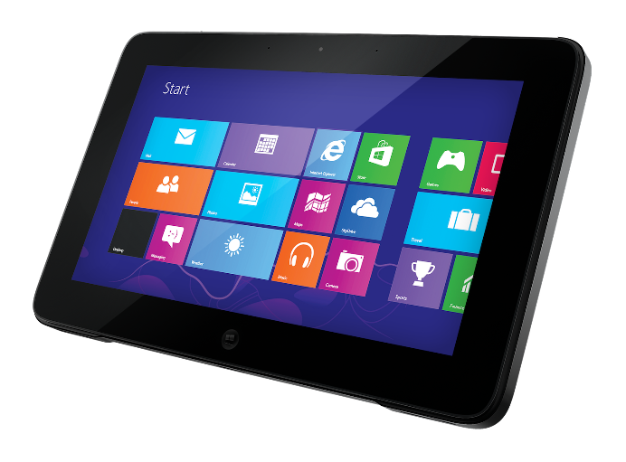
Here’s your assignment…
Are you ready?!
Let’s begin!!
You need:
OR
Paper & Pencil
Smartphone OR Tablet

Slide 3
For this assignment, you will be using these on your mobile device.
Camera
Facebook App

Slide 4
On a piece of paper, make a list of 3 types of information in your personal or school life that you have needed to know more about or questions you needed help answering.
NOTE: Examples on the next page. Please use your own ideas. The examples are there to help you.

Slide 5
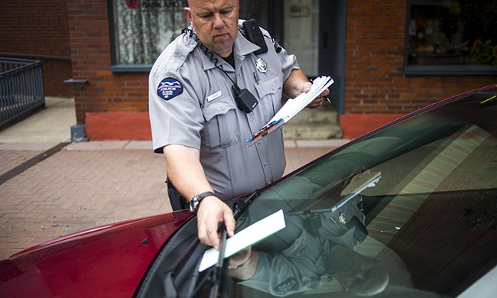
Here are some examples:
Now make YOUR list.
Do I need to take my sick child to the doctor?
How do I pay for this ticket?
How do I check my grades online?

Slide 6
Pick ONE thing from your list that you want to use for THIS assignment because…
WE’RE GOING ON A SCAVENGER HUNT!!!

Slide 7
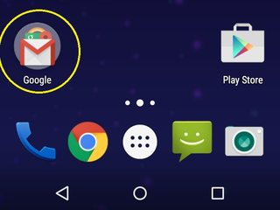
Find the camera icon on your device.
It’s usually on your home screen.

Slide 8
Find something in your home that represents that ONE thing from your list you want to know more information about.
Now take a photo!
Reminder:
You will be sharing this photo with the class online in our class Facebook group so please make sure it is class-appropriate.

Slide 9
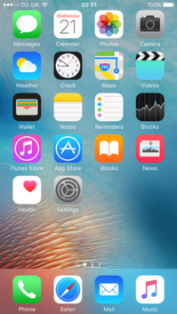
NOTE: You can find Facebook in your apps folder or app store.
Find and open the Facebook app on your device.
Android
Facebook App
Apple

Slide 10
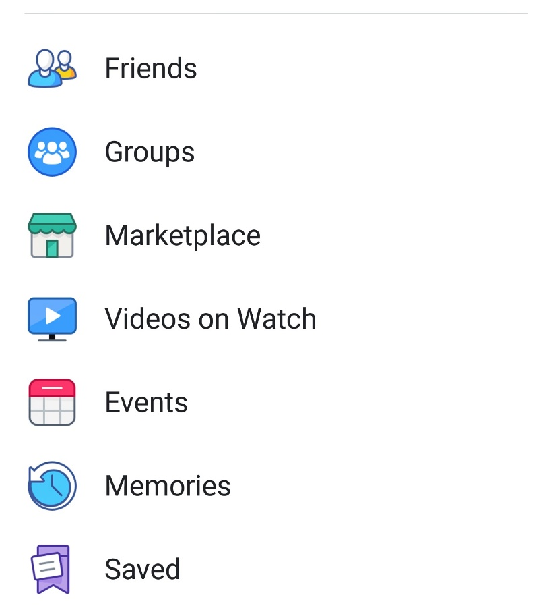
Follow these steps to find the class group on Facebook.
Click “Menu” icon.
2. Click “Groups.”

Slide 11
In the class group, follow the steps below and on the next page to share the photo.
1. Click this box on the group page.

Slide 12
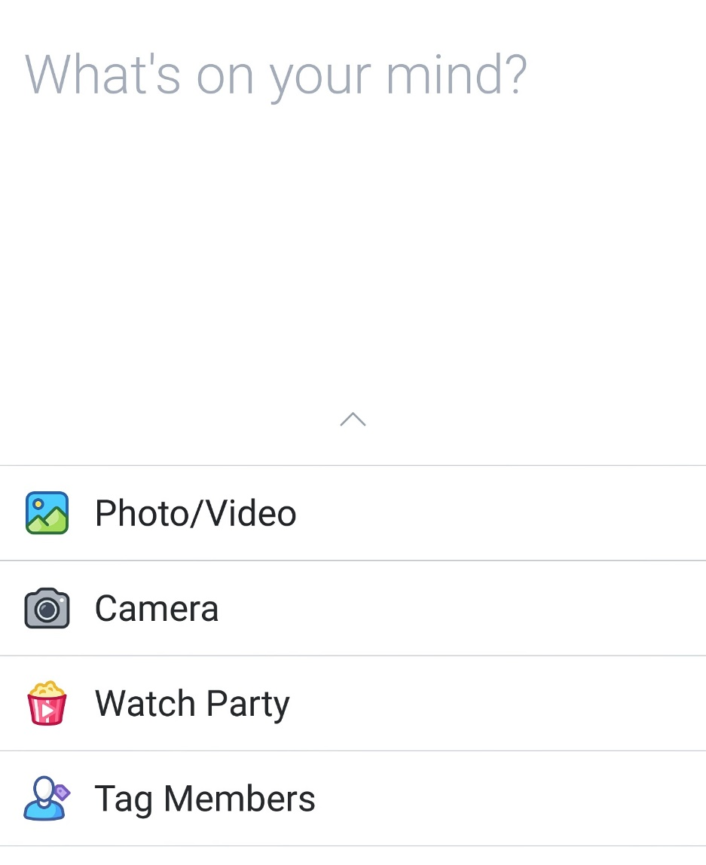
3. Click in the box that says “What’s on your mind?” Add a brief description of the photo. Click “post.”
Follow Step 2 and then Step 3.
2. Click the camera icon then pick the photo you took from the photo gallery.

Slide 13
Scroll through everyone’s photos in the group.
Think about how their posts are similar or different.
Leave a comment on someone else’s post if you’d like.
Please keep it positive!
…or give their post a LIKE!

Slide 14
Next week, bring your list of things you want to know more about to class.
We will be using them in class.
Questions to think about BEFORE next week:
Why do you want to know more information about the things you put on your list?
Where can you find more information about those topics or ideas?
How could learning more about those topics or ideas help you in your personal or school life?

Slide 15
Nice work!
Mission Complete.

