Slide 1
Online Learning
Common Core 3.0
Field Activities
Classroom Skill Building

Slide 2
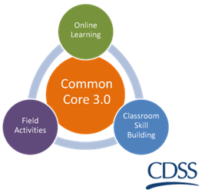
Managing the Plan California Common Core December 31, 2018

Slide 3
Overview of the Day
Welcome and Review of the Agenda
Learning Objectives

Slide 4
Group Agreements
Be collaborative
Ask lots of questions – let us know what you think
Be open to trying new things
Be willing to make mistakes
Maintain confidentiality
Be responsible for your own learning

Slide 5
Let’s connect your on line learning to our time here in this classroom!
Recall the mandates to engage and assess families, to monitor and
adapt plans, and to safely promote permanency.
What would we consider in our case planning
to support safety, stability, and well-being?
Let’s get ready to stretch our thinking.

Slide 6
Let’s Create Groups!
On a scale of 1 – 10, how much experience do you have updating case plans (1=very little, 10 = a great deal)?
Place yourself along the scale.
Count off to form groups.

Slide 7
Gaining Knowledge and Understanding
Individual Readiness Assurance Test
Purpose: To facilitate critical thinking around key concepts learned in the e-learnings and other content learned in Core
Have fun with the process and get ready to put your thinking caps on!

Slide 8
Share Your Answers with Your Group Members
As a group, decide on what your “team” answer will be for each question.
Use a penny and scratch off the corresponding letter on the answer cards.
Keep answering the question until you find the “star”.
Record your team’s first answer on the card.
Record how many points your teams gets!

Slide 9
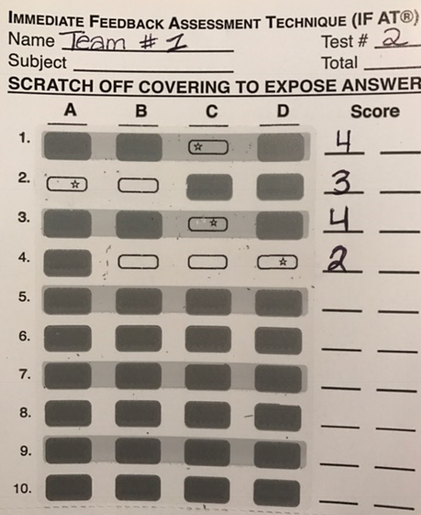
Column One
Scoring
1st=4
2nd=3
3rd=2
4th=1
Column Two
Record your first answer (was it “A”?)
Use Form D031

Slide 10
Test Debriefing: What did your group decide?
Have your letter cards ready!
Share your group answers and reasons for choosing your first answer.

Slide 11
Phases of Case Planning
Assess child & family
Develop case plan
Implement case plan
Support child, parents, caregivers
Assess services/ progress w/ case plan
Prepare for judicial review & permanency
Adapted from Florida’s Center for Child Welfare_OAP_PPT_ Retrieved April, 2016
http://centerforchildwelfare.fmhi.usf.edu/preservice/FLTrainingCurr.shtml

Slide 12
Purpose of Case Manager Contact
Support the family towards reunification
Continue to carry out case plan objectives
Monitor child’s safety & well-being
child/parent interaction
appearance, development
child’s condition
Observe & Document:

Slide 13
Ongoing Assessment Tasks
Plan/implement
tasks/services for child’s safety, permanence, & well-being
services for parents/caregivers
Conduct interviews (every 30 days) with the child, parents, & caregivers.
Document visitation between siblings, child(ren), & parents.
Communicate with providers to assess service effectiveness.
Assess progress with case plan tasks before judicial review.

Slide 14
BREAK 15 minutes

Slide 15
Meet the Wilson Family
Read the Case Vignette
Review the Original Case Plan

Slide 16
Developing collaborative partnerships
Early identification of Native American families
Respectful use of power and authority
Move slowly
Relationship development
Awareness of historical trauma
Commitment to:
Kinship placements
Supporting extended family systems
Maintaining children’s cultural and Tribal connections

Slide 17
How to organize all of this information
Collaborative Practice
Cultural Humility
Appreciative Inquiry
Solution Focused Questions
Structured Decision Making
Trauma-Informed Practice

Slide 18
Ask the three questions…
What are we worried about (past)?
What is working well?
What are we worried about (future)?
What needs to happen next?
Three Questions, Solution Focused Approach; Insoo Kim Berg, Steve de Shazer

Slide 19
Barriers to Successful Progress
Attitudes & Behaviors
Lack of specific, concrete skills
Relationships
Setbacks
Systemic Barriers
Adapted from Florida’s Center for Child Welfare_OAP_PPT_ Retrieved April, 2016 http://centerforchildwelfare.fmhi.usf.edu/preservice/FLTrainingCurr.shtml

Slide 20
Activity
These are specific sources of assessment information relevant to the Wilson family.
Collateral Reports
Visitation Log
Structured Decision Making/SDM Tools
Family Interviews

Slide 21
Let’s Review Wilson Family Progress
Collateral Reports
Visitation Log
Structured Decision Making/SDM Tools
Family Interviews

Slide 22
When reading the assessment information, ask yourself: Think…
What do you want to know from this assessment source?
What are you looking for to help with the updated case plan?
What questions do you want answered?

Slide 23
Small Group Activity
First
Each group will read instructions on all four assessment sources found on page 28 of the Trainee Guide.
Each person in the group will review and synthesize a specific information source, and report back to the group.
Then
Document the worries / what's working well for each information source on the Assessment information worksheet.
The group will consider all the assessment information presented and use it to update the case plan.

Slide 24
LUNCH 60 minutes

Slide 25
Updating the Wilson family Case Plan
Has the case plan goal changed?
If so, What is it?
Priority Needs
Family Strengths
Contributing Factors
Case Plan
Complete the SDM Reunification Reassessment Tool (pages 48-50).

Slide 26
Small Group Activity
Develop one new/revised objective for the updated case plan for mother, Alana Wilson.
CHART ON FLIP CHART PAPER
Be sure your objectives are S.M.A.R.T
Specific/measurable/ achievable/relevant/ time-limited

Slide 27
Example of a S.M.A.R.T. Objective
CWS/CMS drop-down menu: Protect child from physical abuse
Revised case plan objective: Alana agrees to show she will not permit others to physically abuse her child.
Alana agrees to list in detail the warning signs, triggers, and/or things that led to her child getting hurt and/or prevented her from protecting her child from abuse in the past.
Alana agrees to describe and demonstrate at least five things she will do to protect her child if the person who may have abused her child is around the child and is starting to get upset with him.
Alana agrees to call a member of her local support network at a moment’s notice if she or another member of the household starts to get upset with Omar and feels triggered or overwhelmed. One of these people will come over immediately to safely care for Omar and Alejandro.

Slide 28
Wilson family placement plan
Priority needs
Best practices
Impact of trauma
Placement Plan

Slide 29
Large Group Discussion
Read the
“Wilson vignette part 3”
What are your top 3 worries / things working well for the family based on the updated information?

Slide 30
BREAK 15 minutes

Slide 31
Ongoing Assessment Questions
Is there progress toward child’s safety & well-being?
Is the case plan leading toward change?
Are case plan objectives (outcomes) being met?
Is the permanency goal still appropriate?
Has the case plan been implemented?
Adapted from Florida’s Center for Child Welfare_OAP_PPT_ Retrieved April, 2016
http://centerforchildwelfare.fmhi.usf.edu/preservice/FLTrainingCurr.shtml

Slide 32
Outcomes
Are parent behaviors increasing child safety?
Are your attitudes and behaviors affecting your ability to engage with the family?
Are parents meeting the children’s needs?
How much progress has been made towards outcomes?
Are desired outcomes being achieved?
Adapted from Florida’s Center for Child Welfare_OAP_PPT_ Retrieved April, 2016
http://centerforchildwelfare.fmhi.usf.edu/preservice/FLTrainingCurr.shtml

Slide 33
Is the Permanency Goal still Appropriate?
What issues might impact the children’s safety and well-being?
How did you address these issues?
Adapted from Florida’s Center for Child Welfare_OAP_PPT_ Retrieved April, 2016
http://centerforchildwelfare.fmhi.usf.edu/preservice/FLTrainingCurr.shtml

Slide 34
Small Group Activity
First
Consider the top 3 worries and what’s working well based on the updated vignette.
Use the following handouts:
1. Wilson Placement Plan
2. Placement Protocol
3. Impact of separation chart
Then
The group will consider all resource handouts and updated case information presented and will use it to update the placement plan.
Answer the questions on the “Wilson Placement Plan” worksheet as a group.

Slide 35
Large Group Report Out
Identify a member of your team to share your group answers.
What was important?
What were the key topics of conversation? What was challenging to answer?

Slide 36
Putting It All Together: Personal Learning Plans
Turn to Personal Learning Plan in Trainee Guide
Individually complete your Personal Learning Plan
Get into your small groups and discuss your answers

Slide 37
Wrapping UP….What are you excited to do?
What did you learn today that you are most excited about implementing when you get back to the office?
What worries you about returning to the office?

Slide 38
Please complete your evaluations

