Slide 1
Online Learning
Common Core 3.0
Classroom Skill Building
Field Activities

Slide 2
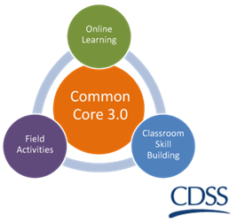
Fairness and Equity California Common Core December 31, 2018

Slide 3
Overview of the Day
Welcome and Review of the Agenda
Learning Objectives
What is Fairness & Equity?
Disproportionality and Disparity in Child Welfare
Cultural Humility
Practice Scenario
Wrap-Up/Participant Satisfaction Survey

Slide 4
Learning Objectives
Trainee Guide, pg. 6

Slide 5
Group Agreements
Be collaborative
Ask lots of questions–let us know what you think
Be open to trying new things
Be willing to make mistakes
Maintain confidentiality
Be responsible for your own learning

Slide 6
What is Fairness and Equity?

Slide 7
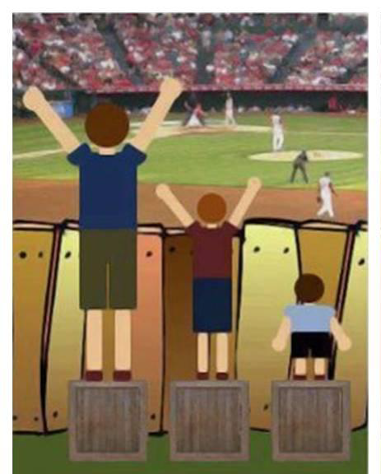
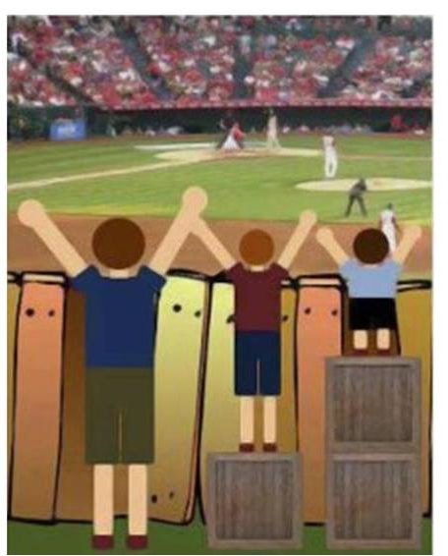
What is Fairness and Equity?
Introduction to Environmental, Justice, Equity and Health. Lesson Plan 3 How are Equality and Equity Different? Retrieved 6/6/2016 from justhealthaction.org/resources/jha-curriculum-material/

Slide 8
What is Fairness and Equity?
Equity and equality are not the same.
Equity doesn’t strive for sameness; it strives for fairness.
Fairness is achieved by treating everyone in a way that recognizes who they are and what their needs are.
Everyone’s needs are met according to their circumstances (i.e., barriers and opportunities).
Excerpt from "The School That Equity Built“, An Equitable Classroom Environment. Elementary Teacher’s Federation of Ontario, 2000, Ontario, Canada.

Slide 9
“Equity is the process and equality is an outcome.”
Education reform. Equity. (2016, April 21) Retrieved 6/6/2016 URL http://edglossary.org/equity/

Slide 10
A Band-Aid Approach
Review the description of your injury.
Imagine the level of treatment needed.
The E.R. doctor will be around to provide treatment.
Friedman, Lisa, Teaching Fairness vs. Equality. Band-Aid Activity. Retrieved 6/6/2016 URL http://jewishspecialneeds.blogspot.com/2013/12/teaching-difference-between-fairness.html
Notes:
You got a paper cut filling out ER documents for your partner. You were playing baseball, got hit in the head with the ball and have a mild concussion. You were slicing vegetables with a sharp knife, sliced the tip of your finger and it is completely severed. You were bike riding, a car hit you, ran over your leg and your femur bone is crushed. You scraped your knee roller blading.

Slide 11
Are Child Welfare Services fair and equitable?
Yes or No

Slide 12
Disparity And Disproportionality
DISPARITY is the disparate or inequitable treatment or services provided in non-dominant groups (i.e., non-White, LGBTQ, rural) compared to those provided to similarly situated (e.g., socio-economic status) children from dominant groups.
DISPROPORTIONALITY is the over- or under-representation of children in foster care and child welfare, based on membership in certain groups, as compared to their representation in the general population
Orange County Children and Family Services, Eliminating Racial Disparity and Disproportionality Retrieved 6/6/16 URL: https://cms.ocgov.com/gov/ssa/adopt/oc4kids/ff/strategy/workgroups/erdd/default.asp

Slide 13
Examples of Equitable Practice in Child Welfare
Active Efforts vs. Reasonable Efforts
Structured Decision Making Tools
Risk Assessment Tool
Very High/High = Promote
Very High/High = Weekly face-to-face contact
Visitation Policy
Infants vs. Teens

Slide 14
LGBTQ & Gender Non-Conforming System-Impacted Youth in the United States
1.6% of U.S. adults identify as gay or lesbian (CDC, July 2014)
0.7% of U.S. adults identify as bisexual (CDC, July 2014)
0.3% of U.S. adults identify as transgender (The Williams Institute, 2011)
19% of youth in foster care in L.A. identify as lesbian, gay, bisexual, transgendered, or queer (Wilson et al., 2014)
30% of LGBQ youth in detention facilities were previously removed from their homes by child welfare, compared to 11% of heterosexual youth (Irvine & Canfield, 2016)
35% of gender non-conforming or transgender youth in detention facilities were previously removed from their homes by child welfare, compared to 10% of gender-conforming youth (Irvine & Canfield, 2016)

Slide 15
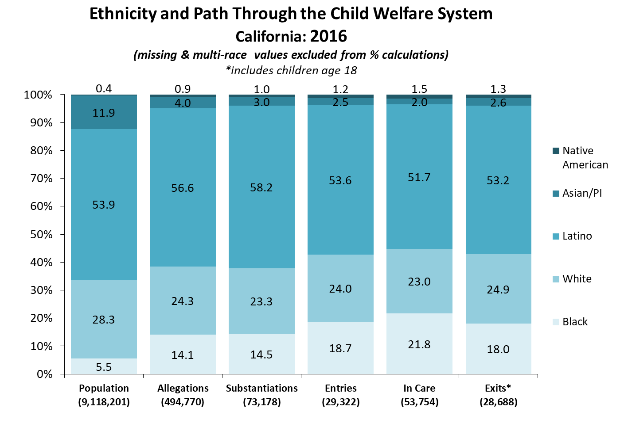
Notes:
Q1_2017
Allegation and Substantiation Rates Reports which includes Entries
http://cssr.berkeley.edu/ucb_childwelfare/RefRates.aspx
In Care Rates Report
http://cssr.berkeley.edu/ucb_childwelfare/InCareRates.aspx
Exit Report
http://cssr.berkeley.edu/ucb_childwelfare/Exits.aspx

Slide 16
Examples of Inequitable Practice in Child Welfare
White families are more likely to receive services that allow the children to remain in the home, while families of color are more likely to have their children placed in out-of-home care (Derezotes & Poertner, 2005).
In the second round of CFSRs, only 19 states received a positive rating on the item regarding state efforts to recruit and retain resource parents who reflect the racial and ethnic diversity of the foster care population in that state (Children’s Bureau, 2011). For California, this item was designated as an “Area Needing Improvement (ANI)” (Children’s Bureau, 2008).
African American and Native American children enter the foster care system at a disproportionately high rate. Once they have been removed from their homes, they are more likely to remain in care and less likely to be reunited with their families than are White children (Child Welfare Information Gateway, January 2011).
Working with fathers and research into father’s relatives are not always a standard part of Child Welfare practices (National AIA Resource Center, November 2015).
25.7% of L.A. County LGBTQ youth in foster care live in a group home, as compared to 10.1% of non-LGBTQ foster youth (Williams Institute, August 2014).
Notes:
Federal Child and Family Services Reviews Aggregate Report, Round 2, Fiscal Years 2007-2010, US Department of Health & Human Services, Children’s Bureau, December 16, 2011, pp. 38, 44, 45. Retrieved 8/1/17 from: https://www.acf.hhs.gov/sites/default/files/cb/fcfsr_report.pdf
Administration for Children and Families, Administration on Children, Youth and Families, Children’s Bureau (2008, July). California Child and Family Services Review, Final Report: Executive Summary, pp. 18, 23. Retrieved 8/1/17 from
http://www.childsworld.ca.gov/res/pdf/CFSRExecSummary2008.pdf
Child Welfare Information Gateway. (2011, January). Addressing Racial Disproportionality in Child Welfare. Retrieved 6/6/2016 from https://www.childwelfare.gov/pubPDFs/racial_disproportionality.pdf

Slide 17
Notes:
Q1_2017
Using this example for “Entries,” note how the Disparity Index is calculated by referring to the right side of the slide.

Slide 18
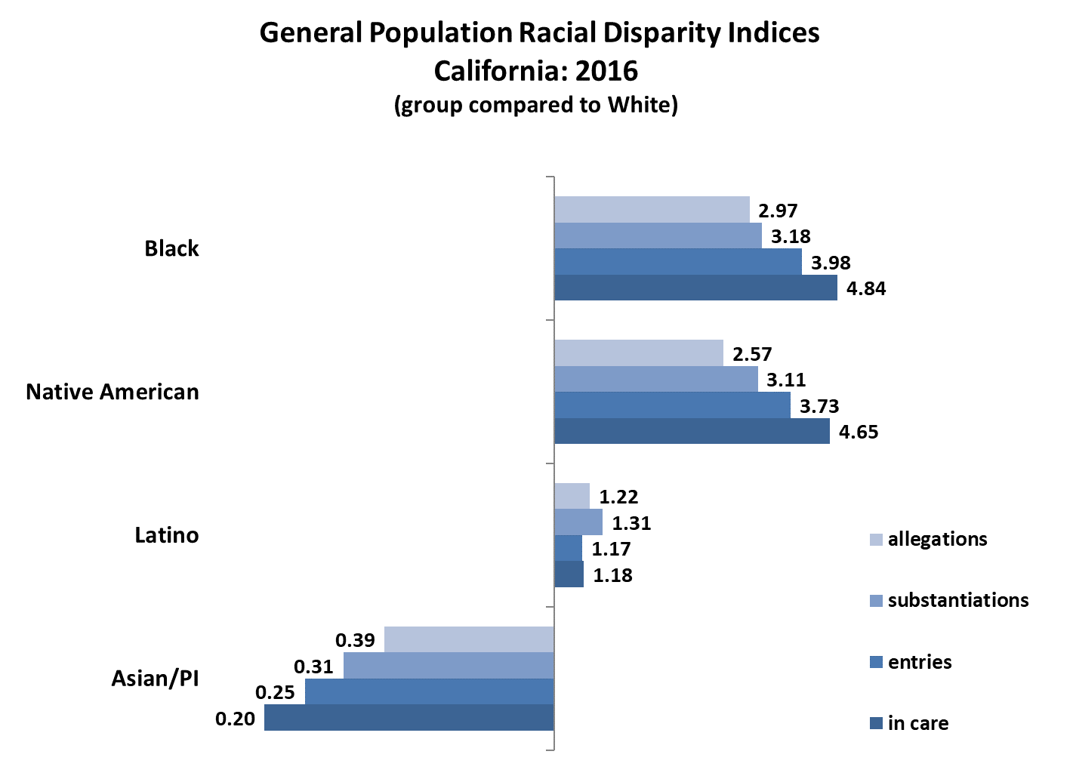
Notes:
Q1_2017
Disparity exists across all child welfare outcomes, especially for Black and Native American children.
Disparity gets worse for Black and Native American children as they progress through the system.
http://cssr.berkeley.edu/ucb_childwelfare/DisparityIndices.aspx

Slide 19
Proposed Explanations
Disproportionate and disparate need of children and families of color
Geographic context (i.e., region of country, region of state, urbanicity and/or neighborhood characteristics)
Racial bias and discrimination in the child welfare system
Child Welfare system processes and resources
The Alliance for Racial Equity in Child Welfare: Disparities and Disproportionality in Child Welfare: Analysis of the Research, 2011
Notes:
Disparities and Disproportionality in Child Welfare: Analysis of the Research

Slide 20
Legalize Democracy (Video)
(2013, October 17). Legalize Democracy [Video file]. Retrieved from
https://calswec-hosting.s3.amazonaws.com/CC3/classroom/videos/foundation_block/Legalize_Democracy.mp4
Notes:
[Acronym TV]. (2013, October 17). Legalize Democracy [Video file].
https://calswec-hosting.s3.amazonaws.com/CC3/classroom/videos/foundation_block/Legalize_Democracy.mp4

Slide 21
Fair and Equitable Practice
Acknowledges that an accurate assessment is predicated on understanding the present day impact of historical oppression and resulting social stratification on an individual’s and/or family’s positionality (i.e., access to barriers and opportunities) in the community and society in which they belong.
Notes:
Once maltreatment has been substantiated, White families are more likely to receive in-home services (Derezotes & Poertner, 2005).
Only 14 out of 41 states received a favorable rating in efforts to recruit and retain resource parents who reflect the racial and ethnic diversity of the foster care population in that State.
Risk characteristics that disproportionately effect families such as poverty, incarceration (Hines, Lemon, Wyatt, & Merdinger, 2004).

Slide 22
A.D.D.R.E.S.S.I.N.G. Difference…
Age and generational differences
Developmental disabilities
Disabilities (seen and unseen)
Religion and spiritual orientation
Ethnic and racial identity
Socioeconomic status
Sexual/affectional orientation
Indigenous heritage (within my ethnicity)
National origin
Gender
Hays, P.A. (2013). Connecting Across Cultures: The Helper's Toolkit. Thousand Oaks, CA: SAGE, pp. 15-16. Original version published in Hays, P.A. (2008). Addressing cultural complexities in practice: Assessment, diagnosis, and therapy. Washington, D.C.: APA
Notes:
Read the list. Give yourself one point for each item if it applies to you.

Slide 23
Activities…
‘Privilege Walk’ AND
‘Shooting for Success’

Slide 24
Fair and Equitable Practice
Acknowledges that one’s social position affords advantage and disadvantage to some more than others based on a complex and multidimensional intersection of social identities that include race, class, gender, sexuality, faith, and other differences.

Slide 25
Fair and Equitable Practice
Requires a cultural awareness of ourselves and others while continuously acknowledging and examining our own biases, prejudices and privileges, and the ways in which both our actions and our inactions consciously or unconsciously perpetuate inequality.
Excerpt from "The School That Equity Built“, An Equitable Classroom Environment. Elementary Teacher’s Federation of Ontario, 2000, Ontario, Canada.

Slide 26
Fair and Equitable Practice
When such practices and attitudes become normalized in a system such as child welfare, the problem is termed systemic (i.e., structural) because it is embedded in the policies and decision making processes and it is perpetuated at an unconscious level.
Excerpt from "The School That Equity Built“, An Equitable Classroom Environment. Elementary Teacher’s Federation of Ontario, 2000, Ontario, Canada.

Slide 27
Cultural Humility
A cultural humility perspective challenges us to learn from the people with whom we interact, reserve judgment, and bridge the cultural divide between our perspectives, in order to facilitate well-being, and promote improved quality of life. Such a perspective frees the observer from having to possess expert knowledge in order to maintain knowledge-based power, control and authority over matters about which diverse populations are far more knowledgeable.
Tervalon, M. and Murray-Garcia, J. (1998).
Source: National CW Workforce Institute. Faller, Kathleen L. (Professor) & Ortega, Robert M. (Associate Professor).(2013, July 31). Leadership Academy for Middle Managers, Cultural Humility and Management in Child Welfare Services. [Video file] . Retrieved 6/6/2016 from https://vimeo.com/71440920
Notes:
Have someone read

Slide 28
Cultural Humility (cont‘d)
Cultural Humility promotes…..
Continuous engagement in self-reflection and self-critique as life-long learners and reflective practitioners.
Checking the power imbalances that exist in the professional-client relationship.
Mutual respect, partnership, and advocacy with communities on behalf of the clients served and in which clients are embedded.
Source: National CW Workforce Institute. Faller, Kathleen L. (Professor) & Ortega, Robert M. (Associate Professor).(2013, July 31). Leadership Academy for Middle Managers, Cultural Humility and Management in Child Welfare Services. [Video file] . Retrieved 6/6/2016 from https://vimeo.com/71440920

Slide 29
Revisit A.D.D.R.E.S.S.I.N.G. Difference…
Age and generational differences
Developmental disabilities
Disabilities (seen and unseen)
Religion and spiritual orientation
Ethnic and racial identity
Socioeconomic status
Sexual/affectional Orientation
Indigenous heritage (within my ethnicity)
National origin
Gender
Hays, P.A. (2013). Connecting Across Cultures: The Helper's Toolkit. Thousand Oaks, CA: SAGE, pp. 15-16. Original version published in Hays, P.A. (2008). Addressing cultural complexities in practice: Assessment, diagnosis, and therapy. Washington DC: APA
Notes:
Read the list. Give yourself one point for each item if it applies to you.

Slide 30
Mini-Scenarios at Your Table Groups
Individually, read the scenario given to your table group (A, B, C or D).
As a table group, answer the questions.
Debrief with larger group.

Slide 31
Let’s Practice… “Lizbeth” (Optional)
Read the scenario.
Discuss and list your responses at your tables.
Create three to four different questions.

Slide 32
Reflections……..
What’s one thing you heard today that you value and makes sense to you?
What are you already doing to put that into action in your work?
What else would you like to do to “land it” even more in your work with families?

Slide 33
Questions or Comments?
Thank you!

