Slide 1
Online Learning
Common Core 3.0
Field Activities
Classroom Skill Building
Notes:
Sample: 2 second animated, branded Core 3.0 eLearning intro (can have simple sound effect)

Slide 2
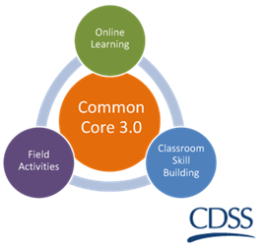
Values and Ethics in Child Welfare Practice: The Foundation of Decision Making California Common Core December 31, 2018

Slide 3
Overview of the Day
Welcome and Review of the Agenda
Learning Objectives
Overview of materials
Ethical Codes Relating to Clients
Ethical Codes Relating to Colleagues
Case scenarios

Slide 4
Group Agreements

Slide 5
Values v. Ethics
Defined
Values pertain to ‘beliefs’ and ‘attitudes’ that provide direction to everyday living, whereas
Ethics pertain to the beliefs we hold about what constitutes right conduct

Slide 6
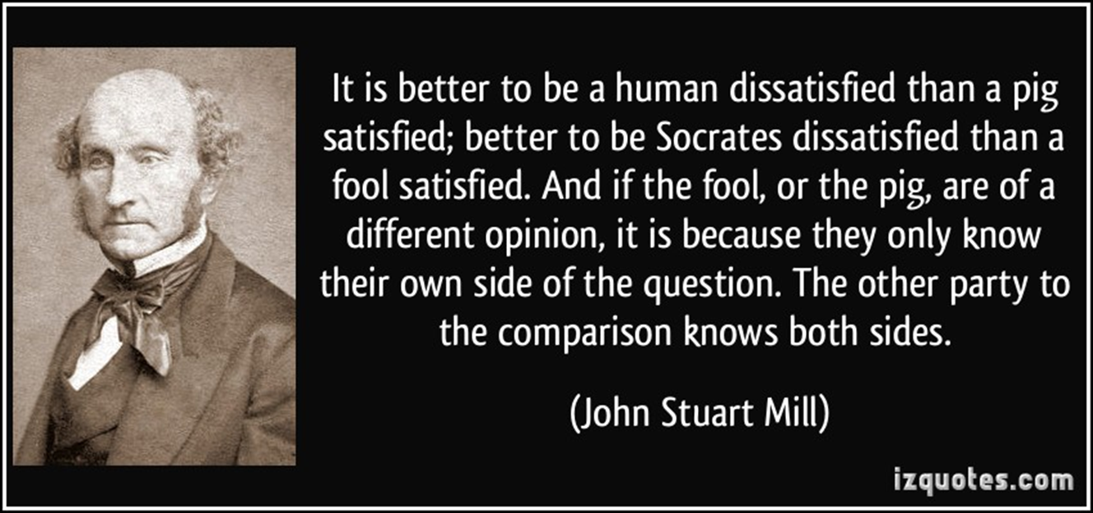
Schools of Ethical Behavior
Utilitarianism: Ethical behavior requires a calculation by weighing the interests of the relevant parties and deciding which outcome benefits most.
Deontological: Ethical behavior is about identifying the right rule and following it.
Virtue Ethics: Ethical Behavior is a reflection of a person’s set of values, which we call “character”.

Slide 7
Core Social Work Values
Service
Social Justice
Respect for persons
Protection of children and preservation of families
Integrity
Client self determination

Slide 8
How do values translate into right conduct or decision making?
Professions have adopted ethical standards and codes of conduct with common frameworks to guide the use of discretion.
Medicine
Law
Psychology
Social work

Slide 9
What are Professional Ethics?
Professional ethics are codes of conduct developed within a professional field of work and developed by the professional organizations.

Slide 10
Sources of Social Work Ethics
There are three Ethics Codes that we will be reviewing and using today during this class:
NASW Code of Ethics: Values, Principles, and Standards
NASW Standards for Social Work Practice in Child Welfare (NASWCW)
Standards and Values for Public Child Welfare Practice in California (CASV)

Slide 11
NASW – Purpose & Application
Use of language in NASW
What does “client” mean?
Therapeutic relationship vs. public child welfare
Role of the supervisor
Liability and governmental immunity

Slide 12
Ethics: Responsibilities to Children and Families
NASW 1.01
Commitment to Clients
NASW 1.02
Self Determination

Slide 13
Ethics: Informed Consent, Privacy, and Confidentiality
NASW 1.03
SW should provide services only upon valid informed consent; capacity must be determined; scope of consent must be explained.
NASW 1.07
Clients’ right to privacy must be respected.
Confidentiality of information applies regardless of format.
Transmission of private information must be protected.

Slide 14
Ethics: Communication and Making Good Decisions
NASW 1.05
Cultural Awareness & Social Diversity
Narrative: SW should understand culture and its function in human behavior and society, recognizing the strengths that exist in all cultures.

Slide 15
Ethics: Conflicts of Interest
NASW 1.06
Conflicts of Interest and Dual Relationships
NASW 1.09
Sexual Relationships

Slide 16
How does bias fit in with values or ethics?
Is bias the same as a value or sincerely held belief?
Does bias affect everyday decisions?
Do I recognize bias in my personal life?
Do I recognize bias in my professional life? School?
Do I have biases?

Slide 17
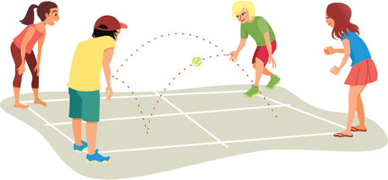
Four Groups
Group 1
Commitment to Clients
Self-Determination
Group 2
Informed Consent
Privacy and Confidentiality
Group 3
Cultural Awareness and Social Diversity
Termination of Services
Group 4
Conflicts of Interest and Dual Relationships
Sexual Relationships

Slide 18
Group Report Outs
Which standards did you research?
How is each standard beneficial to social workers?
How is each standard beneficial to clients?
Provide an example of how the standards are demonstrated in practice.

Slide 19
Ethics as they Apply to Colleagues
NASW 2.01 Respect
NASW 2.02 Confidentiality
NASW 2.03 Interdisciplinary Collaboration
NASW 2.04 Disputes Involving Colleagues
NASW 2.05 Consultation
NASW 1.16 Referral for Services

Slide 20
Ethical Challenges with Colleagues
NASW 2.08
Impairment of Colleagues
NASW 2.09
Incompetence of Colleagues
NASW 2.10
Unethical Conduct of Colleagues

Slide 21
What about Conflicts with my Supervisor or Coworkers?
Role of the supervisor
Role of the program manager
Supporting my colleagues
Duty to the public at large
Duty to the maintain the standards and ethics of the profession

Slide 22
Whistleblowing
What does this mean and how does it apply in child welfare systems?
Where are the ethical ‘bright lights” in child welfare?
(See NASW 1.07(a), 2.09, 2.10, 2.11)
Child Welfare HOTLINE
SW can report concerns regarding a county child welfare agency practices, policies or procedures that endanger the health, safety or wellbeing or children.
Welfare and Institutions Code 10605.5(a) (1)
TOLL FREE 1-844-796-6283

Slide 23
Case Scenarios Exercise
Individually review the Case Scenario assigned to your group
As a group:
Use the Trainee’s Guide to identify the codes within the NASW Code of Ethics that apply to this scenario.
Identify any standards that you find are in conflict with one another in the context of this case.
Be prepared to provide a group response to the questions in a brief presentation to the class.

Slide 24
Case Scenario 1
Melinda

Slide 25
Case Scenario 2
Sandra

Slide 26
Case Scenario 3
Joe

Slide 27
Case Scenario 4
Johnny

Slide 28
Large Group Scenario
Juan

Slide 29
Thanks for attending!

