Slide 1

Online Learning
Common Core 3.0
Field Activities
Classroom Skill Building
Notes:
Sample: 2 second animated, branded Core 3.0 eLearning intro (can have simple sound effect)

Slide 2
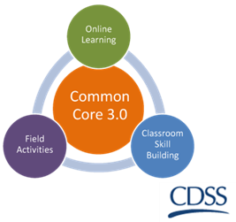
Teaming, Collaboration and Transparency
California Common Core
December 31, 2018

Slide 3

Overview of the Day
Welcome and Introduction
Purpose of Teaming
Creating the Optimal Team Environment
Meeting Facilitation
Types of Teams
Shared Accountability
Wrap-up and Transfer of Learning

Slide 4

Group Agreements
Be collaborative
Ask lots of questions – let us know what you think
Be open to trying new things
Be willing to make mistakes
Maintain confidentiality
Be responsible for your own learning

Slide 5
Learning Objectives
Knowledge
K1. The trainee will be able to identify the benefits of engagement and teaming.
K2. The trainee will be able to describe key elements of collaboration, such as: circles of support, teaming values, family involvement, community involvement, and families as partners.
K3. The trainee will be able to describe strategies to support the family, caregivers, and team members in shifting from a focus on the family’s deficits to their strengths to meet their child’s needs.
K4. The trainee will be able to recognize the need to work collaboratively to formulate case plan objectives.
K5. The trainee will be able to describe the assessment processes that drive decisions about reunification and permanency planning to a child and family team.

Slide 6
Learning Objectives
Skills
S1. Given a case scenario, the trainee will be able to identify key participants for a team meeting and how meeting outcomes support case planning and long-term success for the family.
S2. Given a case scenario, the trainee will be able to use strength-based language to describe safety concerns.

Slide 7
Learning Objectives
Values
V1. The trainee will value engaging families, youth, and communities in a participatory decision-making process that especially includes families, youth, and communities as experts in identifying strengths, needs, and resources.
V2. The trainee will value collaboration with children, youth, non-minor dependents, families, family support networks, and other professionals to access local resources and improve outcomes related to safety, permanency, and well-being.
V3. Trainees will value working in partnership with Foster Care Public Health Nurses and other health care providers to promote well-being for children and youth involved in the child welfare system.
V4. The trainee will value the use of teams to make case planning and placement decisions with families.
V5. The trainee will value the family as the experts on themselves.
V6. The trainee will value the role of the community in case planning and decision making.

Slide 8
Snowball Toss!
Early and frequent sharing of information
Family, cultural, and tribal connections as team members
Explore how culture might affect the development of the team
Consensus-building toward the goal of shared decision making
Help team members work through conflict
Support person or peer advocate as part of the team
Explore how team members can strengthen child safety and support the family
Develop shared understanding about safety, permanency, and well-being
Help the team adapt to changing team member roles

Slide 9
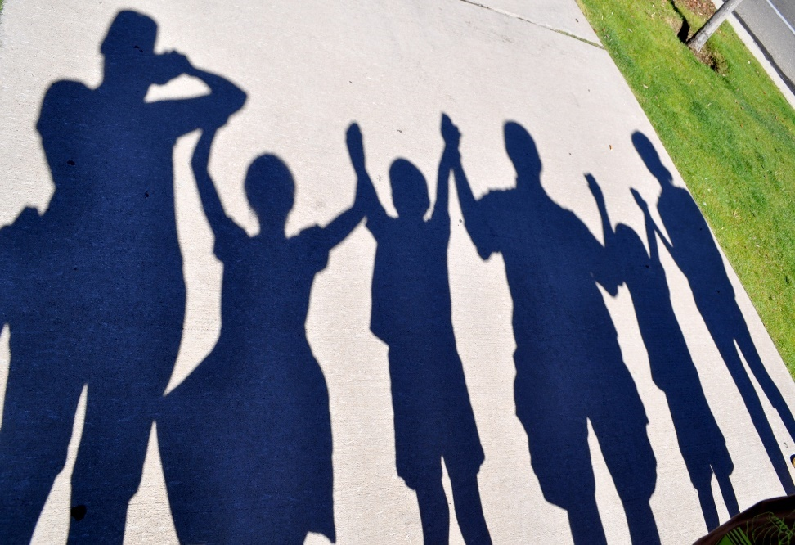
Coming up with a definition for…
Teaming
Collaboration
Transparency

Slide 10

Teaming in Child Welfare
Practice of collaboration and partnership with a family, youth, and community
Development of ongoing, collaborative relationships
Promote the safety, permanency, and well-being of children and families
Ensures that interventions and proposed solutions are customized for the family, their culture, community, and Tribes

Slide 11

Teaming is a Process!
TEAMING
MEETINGS

Slide 12
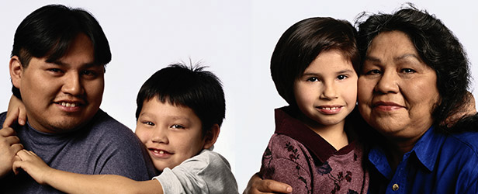
Working Together
The purpose of Family Team Meetings is to keep children safe, promote children's well-being, and support families.
Teaming can also ensure that interventions and proposed solutions are customized for family, their culture, community, and Tribe.
Notes:
Lecture: Family meetings strive to maximize a family’s strengths. The basic assumption is that all families can harness their strengths and capabilities to enter into partnership with formal child welfare agencies and courts in order to make decisions that protect and nurture their children. Prior to the advent of family meetings, child welfare agencies often made decisions about children and families with little or no input from the families. However, when key family and community members, formal and informal supports, and child welfare agency representatives join together in mutual respect, better decisions and integrated plans for families result.

Slide 13

Transparency
Transparent:
  Able to be seen through
  Easy to notice or understand
  Honest and open: not secretive
What does transparency mean in child welfare practice?

Slide 14
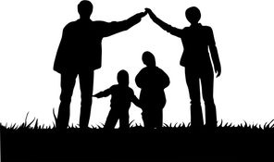
Common Values and Beliefs
All families have strengths
Families define their own members
Outcomes improve when families are involved in the decision making

Slide 15

What kind of teaming opportunities are there?
Emergency Response
Voluntary Family Maintenance
Family Reunification
Family Maintenance
Permanency Planning
After 18

Slide 16

Who is part of the team?

Slide 17
Tools for Social Workers
Safety Circle
Genogram
Eco-map
Safety House

Slide 18

At the Table with Giselle
Notes:
http://www.hunter.cuny.edu/socwork/nrcfcpp/pass/digital-stories/
Facilitate a large group discussion regarding the ways that Giselle was supported by her “team.” What are the benefits, short term and long term?

Slide 19

Benefits

Slide 20

Creating the Optimal Environment

Slide 21

Language Reflects Thinking

Slide 22
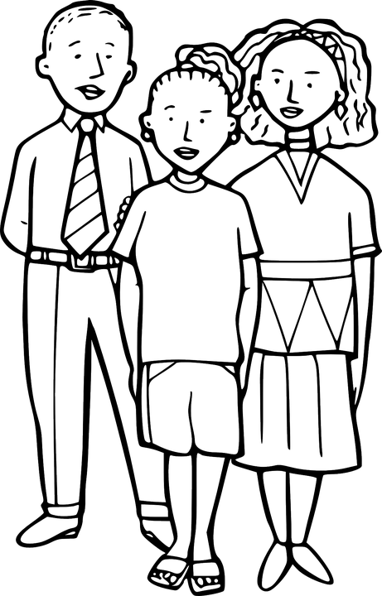
Structure
Create an environment for open and honest communication with the family and the family’s team about:
  Child safety
  Permanency
  Court time frames
  Planning and decision making that
  is informed, relevant, and timely

Slide 23

Set the Structure
Establish and refer to ground rules/group agreements
Identify the purpose of the meeting
Introductions
Discussion of roles
Exploring what’s working well and the worries
Brainstorming/ideas
Developing and recording plan (safety plan, case plan, action items, next steps, etc.)
When will the team meet again?
Reflections about the meeting

Slide 24

At the Table with Natalie
Purpose and goal of the meeting
Who should be at the table?
How should the team be identified?
How should the meeting “feel”? How can we create a comfortable and supportive environment?
Notes:
At each table, distribute Natalie’s vignette. Instruct trainees to read the vignette and identify the following:
Purpose and goal of the meeting
Who should be at the table?
How should team be identified?
How should the meeting “feel”? How can we accomplish our environment?
Facilitate and chart answers. In particular focus on #4. How can the meeting “feel” comfortable?

Slide 25

Tips for Effective Meetings
Come prepared with information about the family and situation (review the case file)
Invite the right people
Be on time
Schedule adequate time for yourself
Be respectful
Be clear on the goal of the meeting
Be honest and fair in what you say
Assist the group in staying focused on the meeting goal
Invite others to share information

Slide 26

3 Questions
What’s working well?
What are we worried about?
What should be the next steps?

Slide 27
Let’s Practice!

Slide 28
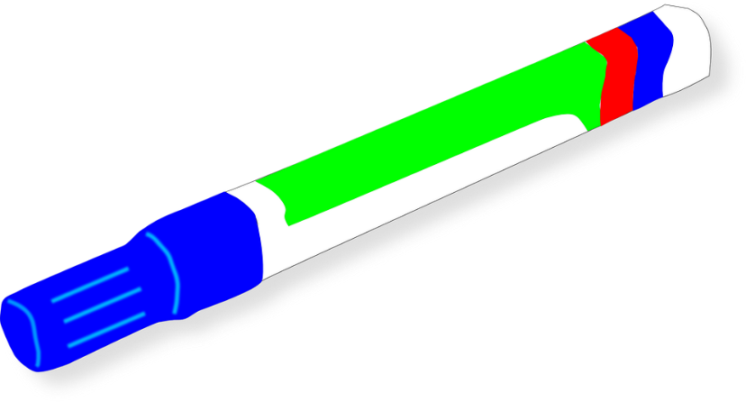
Charting
Helps meeting members participate – 50% learn by listening; 50% learn by reading
Keeps meeting members focused
Allows meeting members to see what they have accomplished and what is left to do
Provides an opportunity for the family to see that they have strengths and things that are going well in addition to areas that people are worried about and need to be addressed for the child’s safety
Promotes participation

Slide 29

Charting
Encourages enlarged thinking
  Thinking “outside of the box”
Generates solutions in a focused, forward thinking manner within a deliberate structure
Provides a visual structure
Helps members see others’ ideas and build upon them
Provides families and others with visual affirmation that they have been heard

Slide 30

The Team
Notes:
Velasco Consulting on behalf of CSULA CCW

Slide 31

Measuring Teamwork
The degree to which:
  The “right people” have formed a team that meets, talks, and plans together
  The team has the skills, family knowledge, and abilities to define strengths and needs to organize effective services
  Members of the team collectively function as a unified team in planning services and evaluating results
  The decisions and actions of the team reflect a pattern of effective teamwork and problem-solving that builds on strengths and needs to benefit the family
Adapted from Quality Service Review for a Child and Family (Version 2.2B), Human Systems and Outcomes, Inc., October 2010

Slide 32
How Does the Team Function?
The team has the abilities and cultural competence to design effective supports and services to meet the needs of the family
Team flexibility to adjust as the family’s needs change
Uses collaborative problem-solving
Only emergency decisions are made outside of the team
Adapted from Quality Service Review for a Child and Family (Version 2.2B), Human Systems and Outcomes, Inc., October 2010

Slide 33

Optimal Teamwork

Slide 34
Effective Facilitation
Active Listening Clarifying Collaborating Confronting Crediting Empathizing Encouraging Establishing Rapport Harmonizing Interpreting Verbal Statements Interpreting Nonverbal Cues | Linking Negotiating Paraphrasing Reality Testing Reflecting/Mirroring Relieving Tension Silence Strength-Based Interviewing Summarizing Supporting

Slide 35

Try It On!
Practice some of the skills you just discussed – think about trying out one of the skills that you identified as being the most challenging (if it applies).
Using the statement, rewrite them to reframe the comment, develop a clarifying question, or write a reflective statement.

Slide 36
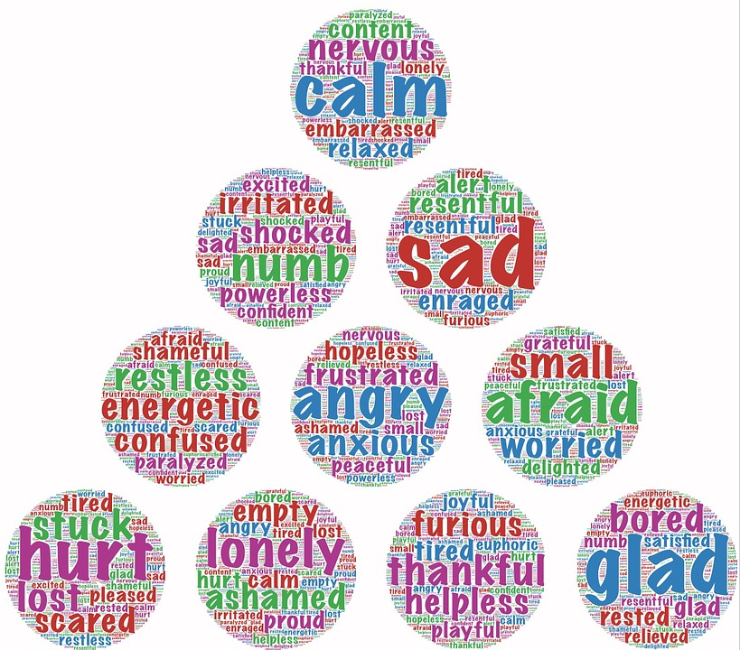
Managing Difficult Emotions
Conflict is normal and healthy
Healthy conflict is one of the five elements of healthy team functioning
Can be seen as “danger” or “opportunity”

Slide 37
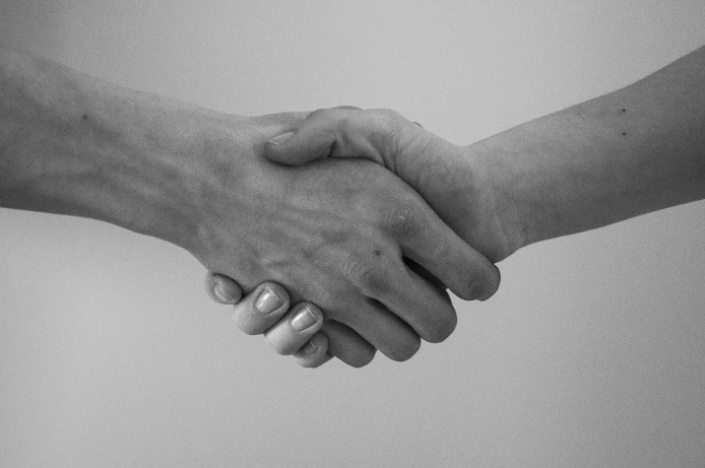
Conflict Resolution: Steps and Strategies
Agree to Negotiate
Gather Points of View
Focus on Interests
Create Win/Win Options
Evaluate Options
Create Agreement

Slide 38

Role Play

Slide 39
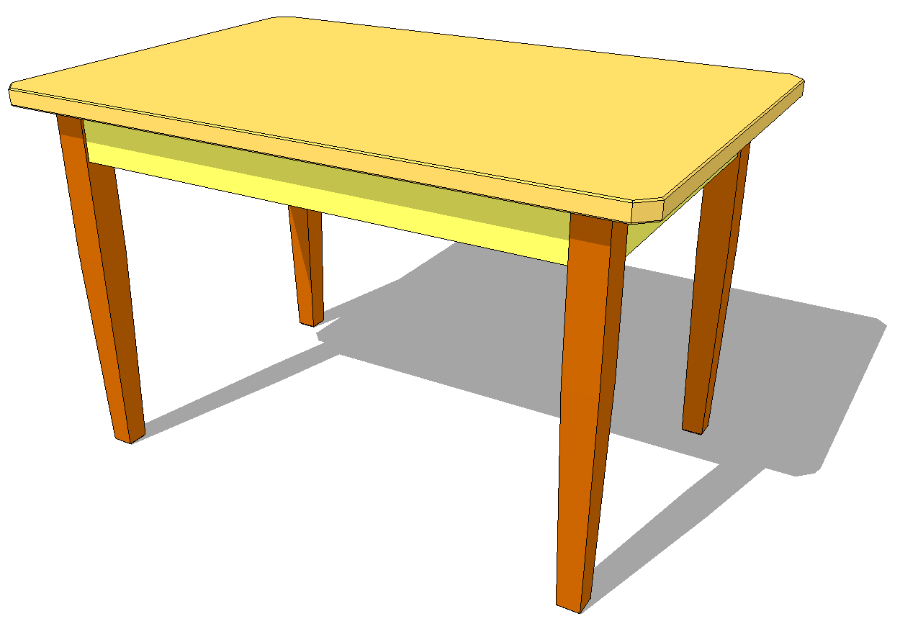
At the Table with Natalie
Notes:
Instructions: Distribute Natalie’s vignette and allow participants read. At each table, instruct participants to work together and complete “Conflict Resolution” worksheet.
Facilitate group discussion on “What did we learn?”

Slide 40

The Team

Slide 41
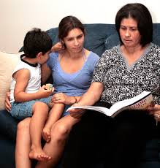
Your Role in Preparing the Team
Establishing trusting, helping relationship
Demonstrate genuine interest
Acknowledge strengths and culture
Provide overview of teaming
Gain information
Decide contact information and process
Ensure that the right people are at the table

Slide 42
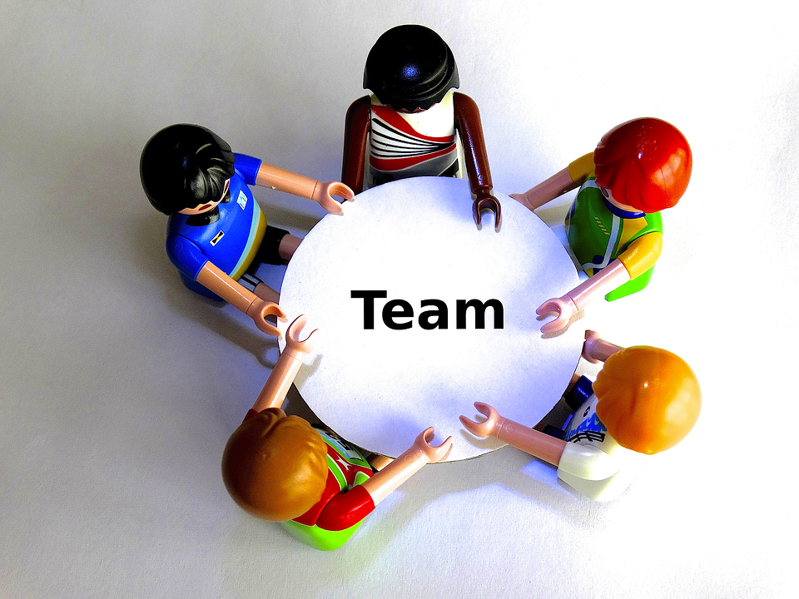
Preparing Natalie’s Team
What are some questions you (as the social worker) would ask the participant as you are preparing for the meeting?
What is some information that would be important to share with this participant?
What would be important to discuss with the team before the meeting?

Slide 43

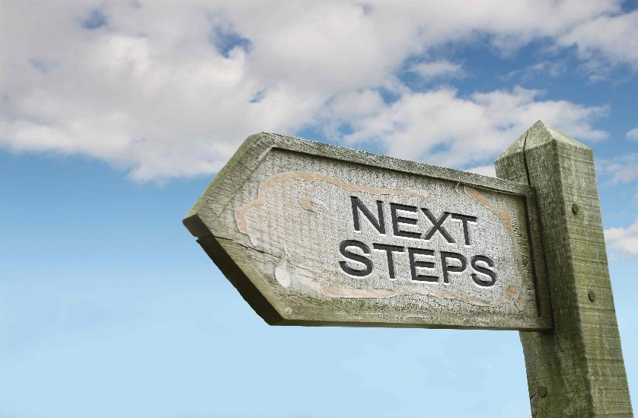
Ideas and Next Steps
Notes:
When people disagree about how to attain the common goal, there are some facilitation strategies that can be helpful.
Velasco Consulting on behalf of CSULA CCW

Slide 44
Tips for Developing Ideas
DO
Encourage creative, innovative thoughts
List all ideas
Include everyone
DON’T
Leave someone out
Evaluate ideas (you’ll do this when you get to next steps)

Slide 45

Tips for developing ideas
If the Family Strengths and Needs Assessment has been completed, use this as a guide for prioritizing the needs and developing ideas to address those needs.

Slide 46

Tips for Developing a Plan and Identifying Next Steps
Incorporate safety concerns first
Reflect the family’s goals and needs
Incorporate strengths and cultural considerations
Identify formal and informal support
Be specific – Who? What? By when? How to monitor?
How will we know? – Desired outcome and method for measuring success

Slide 47
Building Consensus
Reality test
  Least restrictive?
  Does it provide safety?
  Is it do-able?
Ensure everyone has a chance to speak and be heard
Check for agreement
Be attentive to family members’ feelings and responses
Be specific

Slide 48
Building Consensus
Ask team members who can’t agree what it would take to support the idea.
Combine suggestions to come up with a mutually agreed upon solution.
Be sure that the plan complies with court orders (if applicable).

Slide 49
Review the Plan/Next Steps
Read the plan back to the group
Check for understanding
Ask if there are any questions
Provide copy of the plan/next steps to the team (if appropriate)
Ensure emotions/responses are addressed
Set any further meeting dates

Slide 50
Let’s Practice!

Slide 51
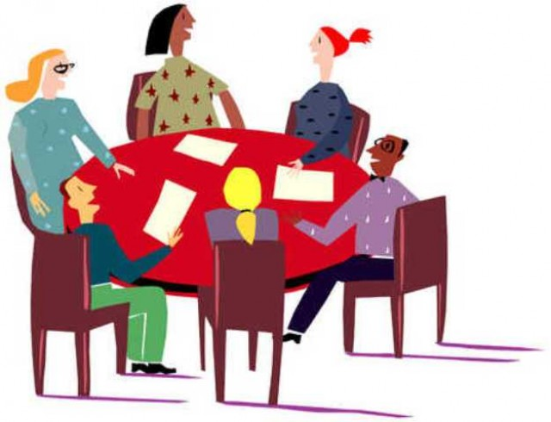
Try It On!
Think about what was identified as “What should happen next?”
Using the ideas that were developed and charted, create two action items at your table that will provide safety for Natalie

Slide 52

More Practice!

Slide 53
Teaming in the Office
Warm hand-off when changing social workers
Involving the family’s team in transition planning
Working with your supervisor or others in your unit to provide support for families if you are out of the office
Demonstrate teamwork with your peers!

Slide 54

Teamwork

Slide 55

Wrap-up and
Transfer of Learning
Complete the “My Teaming Reflections” Worksheet” on page 29 of the Trainee Guide.

Slide 56

Thank you!
Please complete the Participant Satisfaction Survey

