Slide 1

Online Learning
Common Core 3.0
Field Activities
Classroom Skill Building
Notes:
Sample: 2 second animated, branded Core 3.0 eLearning intro (can have simple sound effect)

Slide 2
Orientation to Child Welfare Practice and Common Core 3.0
December 31, 2018

Slide 3
Overview of the Training
Welcome and Review of the Agenda
Learning Objectives
CC 3.0 Training
Child Welfare Practice in California
Wrap-up

Slide 4

Group Agreements

Slide 5

Icebreaker Activity!
Super Social Worker

Slide 6
Learning Objectives
Pick 2 Learning Objectives for which you feel you have a really good understanding.
  Circle them.
Pick 2 Learning Objectives that you need to learn the most about.
  Underline them.

Slide 7
Re-Imagining Core Training
Focus on Practice Areas as a framework for the training
Sequencing content to reinforce training after some time in the field
Use of multiple training modalities
  Online knowledge-based training
  Classroom-based learning
  Field learning

Slide 8
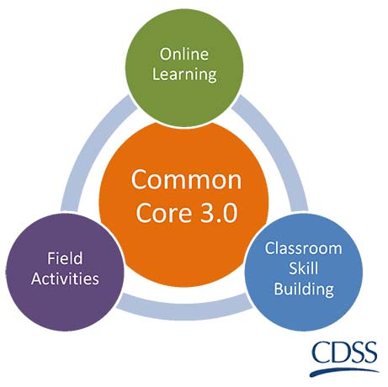
Modalities
On-line knowledge based training
Classroom-based learning
Field learning

Slide 9
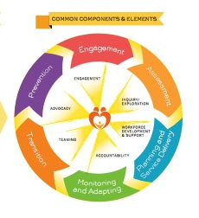
Training Blocks
Practice Areas
  Foundation
  Engagement
  Assessment
  Case Planning and Service Delivery
  Monitoring and Adapting
  Transition

Slide 10

Sequenced Content
100 level
  eLearning
  Classroom
  Field Activity completion
200 level
Classroom
eLearning
Field
200 level

Slide 11
Evaluation Overview
What does evaluation in CC 3.0 mean for me?
  Demographic survey
  eLearning post-test
  Post-test to assess knowledge acquisition
  Embedded evaluation
  Field Activity survey
The evaluation data is not about individual results, but rather, assessing the effectiveness of the curriculum.

Slide 12
Adult Learning – what we know
Spaced learning
  Shown to be a more effective way for people to learn, practice, and transfer what they have learned
Blended learning
Coaching
Skill-based interactive in-person training
Skill practice

Slide 13

Activity

Slide 14
California Child Welfare Practice
  Federal Laws
      Adoption and Safe Families Act (ASFA)
      Child Abuse Prevention and Treatment Act (CAPTA)
      Child and Family Services Review (CFSR)
  State Laws
      Welfare & Institutions Code, AB 636
  Rules and Regulations
      Federal--ICWA, eligibility
      State--Division 31
      County --Policies and Procedures
  California Child Welfare Core Practice Model (CPM)
  National Association of Social Workers (NASW) Code of Ethics

Slide 15
Adoption and Safe Families Act (ASFA) 1997
Four Provisions:
  Moving children promptly to permanent families
  Ensuring that safety is a paramount concern
  Elevating well-being as a major focus of child welfare system efforts
  Improving innovation and accountability throughout the Child Welfare System
SAFETY
PERMANENCY
WELL-BEING
Intentions and Results: A look Back at the Adoption and Safe Families Act, 2009, Center for the Study of Social Policy and Urban Institute

Slide 16
Child and Family Services Review (CFSR)
Created by the federal government in 1994 refined in response to the 1997 Adoption and Safe Families Act (ASFA)
CFSR is an assessment of a state’s performance related to child welfare goals
  Safety
  Permanency
  Well-being

Slide 17
Common Core for New Child Welfare Workers in California
Background
  Developed as part of the first CFSR/PIP process
  The PIP included two key requirements for Common Core:
    Must be statewide standardized training for all new social workers
    Must be evaluated to show that it is effective
  The first version of Common Core to be widely implemented was launched in 2005.

Slide 18
Child Welfare System Improvement and Accountability Act
AB 636
What would the outcome be if this goal is met? | How does a social worker support families to get to this outcome?

Slide 19
State Regulations
State regulations require that sections of the Core be completed within 1 year of hire and the entire Core be completed within 2 years of hire.
Common Core must satisfy the federal requirements as outlined in the CFSR and the Program Improvement Plans completed by California in 2004 and 2009.
WIC 16206 identifies the training topics and requirements for evaluation.

Slide 20
NASW Code of Ethics
“The mission of the social work profession is rooted in a set of core values. These core values, embraced by social workers throughout the profession’s history, are the foundation of social work’s unique purpose and perspective: service, social justice, dignity and worth of the person, importance of human relationships, integrity, [and] competence.” (NASW, 2008)

Slide 21
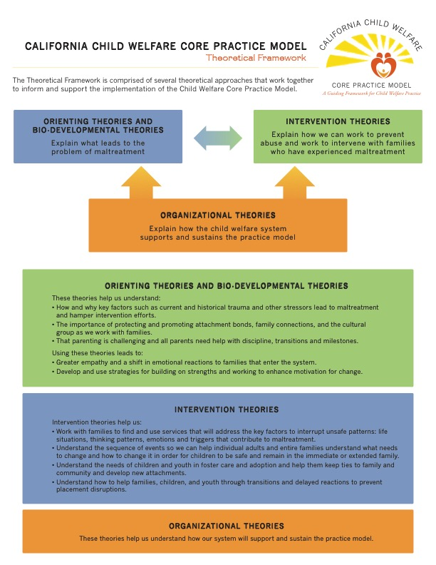
The California Child Welfare Core Practice Model (CPM)
Theoretical Framework
Values
Casework components
Practice Elements
Practice Behaviors

Slide 22

We Believe

Slide 23
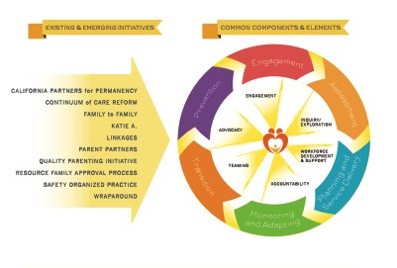
The California Child Welfare Core Practice Model

Slide 24
The California Child Welfare Core Practice Model (CPM)
Practice Elements – How we do it
  Engagement
  Inquiry/exploration
  Advocacy
  Teaming
  Accountability
  Workforce development and support

Slide 25
Practice Behaviors
Action-oriented
Clearly describe the interactions between social workers and families, children, youth, young adults, communities, and Tribes
Provide guidance to social worker about how they will practice social work using the Practice Model
Notes:
CC3.0 field activities will model these identified practice behaviors and give social workers an opportunity to practice new skills that promote safety permanency, and well-being for children, youth, and families.
For additional information and to review the core practice model behaviors, please click on the link/document.
NOTE: Provide a link to the CPM practice behaviors on the CalSWEC website or have a link to the document.

Slide 26

Developing a Learning Plan

Slide 27

Wrap-Up

Slide 28

Thank you!
Please complete the Participant Satisfaction Survey.

