Slide 1
Chapter 6 THE NORMAL DISTRIBUTION
This presentation is based on material and graphs from Open Stax and is copyrighted by Open Stax and Georgia Highlands College.

Slide 2
Normal Distribution
The normal distribution has two parameters (two numerical descriptive measures),
the mean (μ) and the standard deviation (σ).
If X is a quantity to be measured that has a normal distribution with mean (μ) and standard deviation (σ), we designate this by writing
X~N (µ,σ)

Slide 3
Key Concept
This section presents methods for working with normal distributions that are not standard (NON-STANDARD). That is the mean, μ, is not 0 or the standard deviation, σ is not 1 or both.
The key concept is that we transform the original variable, x, to a standard normal distribution by using the following formula:

Slide 4
Conversion Formula

Slide 5
Converting to Standard Normal Distribution
x - μ
z =
σ
P
P
μ
x
0
z
(a)
(b)
Notes:
Tell students to round z score answers to two decimal places if using Table A-2 from the text.

Slide 6
Using the z-score
Suppose X ~ N(5, 6).
This says that x is a normally distributed random variable with mean μ = 5 and standard deviation= 6.
Suppose x= 17. Find the z-score and interpret what it means.
Suppose x = 1. Find the z-score and interpret what it means.

Slide 7
Using the z-score
For x = 17, the z-score is 2 so it is two standard deviations (2σ) above or to the right of the mean μ = 5. The standard deviation isσ= 6.
Notice that: 5 + (2)(6) = 17 (The pattern is μ+zσ=x)
For x= 1, the z-score is –0.67 (rounded to two decimal places)
This means that x = 1 is 0.67 standard deviations (–0.67σ) below or to the left of the mean μ = 5. Notice that:5 + (–0.67)(6) is approximately equal to one (This has the pattern μ+ (–0.67)σ = 1)

Slide 8
Empirical Rule
*The area in pink equals 68% (1 standard deviation from the mean)
*The area in red and pink equals 95% (2 standard deviations from the mean)
*The area in blue, red, and pink equals 99.7% (3 standard deviations from the mean)
*The rest is the remaining .3 % to make the distribution equal 100%

Slide 9
Using the Empirical Rule
Use the z-score or (standard score) = $\frac{x− μ}{σ}$ to solve these problems
If the mean is 500, standard deviation is 100, what percentage are less than 300? You solved and got (300-500)/100 = -2. (Use the Z-score formula)
This means -2 in below the mean so you add up all the percentages below -2.
0.15% + 2.35% = 2.5%

Slide 10
Using the Empirical Rule continued
If the question said the percentage above 300, then you would add the percentages above -2.
13.5% + 34% + 34% + 13.5% + 2.35% + 0.15% = 97.5%
or 100% - 2.5% = 97.5%
If the question said the percentage between 300 and 700, then you would add the percentages between -2 and 2
(300-500)/100 = -2 and (700 – 500)/100 = 2
13.5% + 34% + 34% + 13.5% = 95% which the theorem supports.

Slide 11
More Empirical Rule Practice
The mean is 79 and the standard deviation is 10. You want to find the percentage below 69.
Solve it using the z-score and find the percentage.

Slide 12
More Empirical Rule Practice Answer
Using the z-score, (69-79)/10 = -1.
Use the graph above, add all the percentage below -1.
0.15% + 2.35% + 13.5% = 16%

Slide 13
Cautions!!!!
Choose the correct (left/right) of the graph
Negative z-score implies it is located to the left of the mean
Positive z-score implies it is located to the right of the mean
Area less than 50% is to the left, while area more than 50% is to the right
Areas (or probabilities) are positive or zero values, but they are never negative

Slide 14
Four scenarios
To the left of z = below, under
To the right of z = above, over
Between two z’s = between
Tails scenario = To the left of one z and to the right of another z

Slide 15
Using the calculator to get the probabilities
(HINT Mean and Standard Deviation will be given)
Scenario Calculator
For area to the left Normalcdf (-1E99, X-value, mean, standard deviation)
For area to the right Normalcdf(X-value, 1E99, mean, standard deviation)
Between two areas Normalcdf(Lower X-value, Upper X-value, mean, standard deviation)
Tails 1- Normalcdf(Lower X-value, Upper X-value, mean, standard deviation)

Slide 16
Standard Normal Distribution
The STANDARD normal distribution is a bell-shaped, symmetric, and continuous probability distribution with a population mean, μ, of 0 and a population standard deviation, σ, of 1
To calculate the area under the standard normal distribution (aka the probability), you need to know the lower and upper boundaries as well as the population mean and population standard deviation

Slide 17
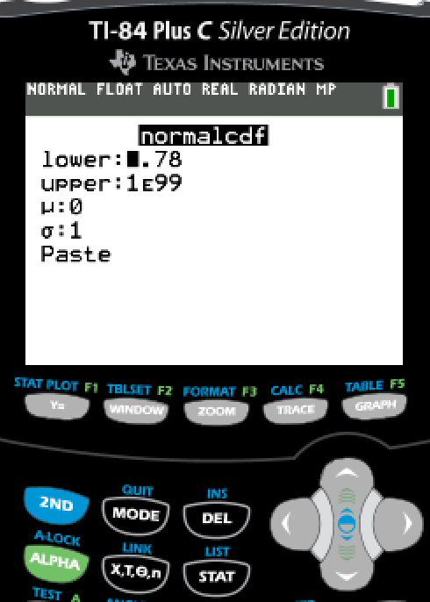
Four Basic Scenarios—Find the area under the standard normal distribution
Scenario #1 Between z = 1.23 and z = 1.90 or P(1.23 < z < 1.90)
Choose Option 2: normalcdf( and Enter
Go to DISTR-- press

Slide 18
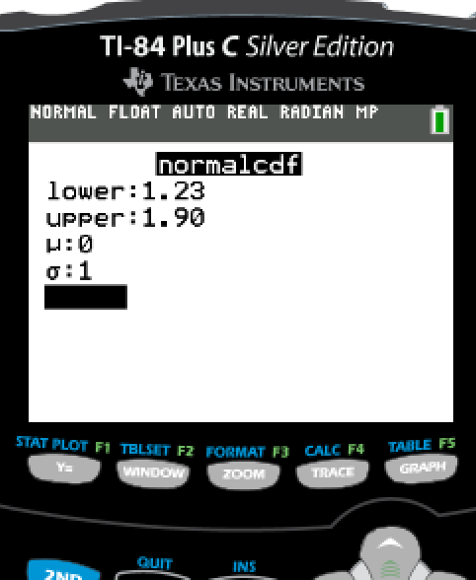
Enter requested information
Highlight “PASTE” when finished and enter
Lower: lowest possible value = 1.23
Upper: highest possible value= 1.90
μ: population mean = 0
σ: population standard deviation = 1

Slide 19
On older versions of the TI-83/84, the requested information is simply entered separated by commas.
Answer appears on screen. Round final answer to 4 decimal places
Final answer is 0.0806
Press Enter a second time to get final result

Slide 20
Four Basic Scenarios—Find the area under the standard normal distribution
Scenario #2 To the right of z = 1.10 or P(z > 1.10)
Choose Option 2: normalcdf( and Enter
Go to DISTR-- press

Slide 21
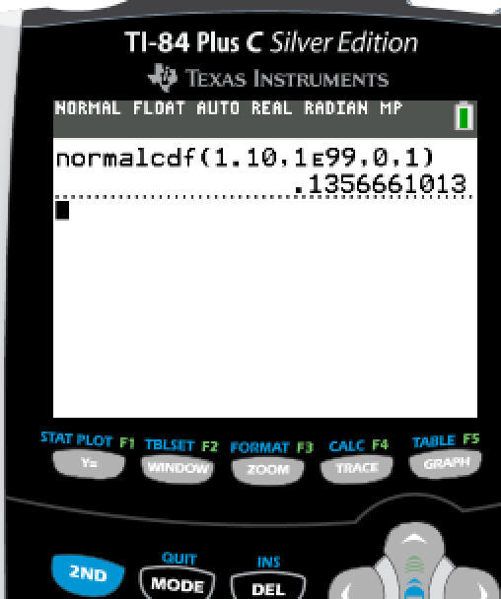
Highlight “PASTE” when finished and enter twice
Final Answer is 0.1357
Enter requested information
Lower: lowest possible value = 1.10
Upper: highest possible value= INFINITY, since it is a continuous distribution, 1E99
Press
μ: population mean = 0
σ: population standard deviation = 1

Slide 22
Four Basic Scenarios—Find the area under the standard normal distribution
Scenario #3 To the left of z = - 0.23 or P(z < -0.23)
Choose Option 2: normalcdf( and Enter
Go to DISTR-- press

Slide 23
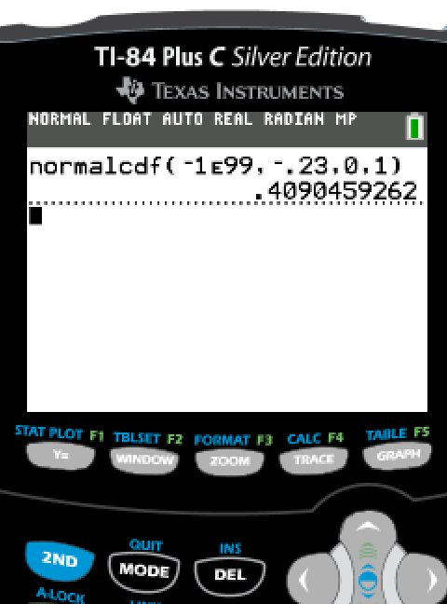
Enter requested information
Highlight “PASTE” when finished and enter twice
Final Answer is 0.4090
Lower: lowest possible value = Negative Infinity, since it is a continuous distribution, -1E99
Press
Upper: highest possible value= - 0.23
μ: population mean = 0
σ: population standard deviation = 1

Slide 24
Four Basic Scenarios—Find the area under the standard normal distribution
Scenario #4 To the left of z = -2.15 or to the right of z = 1.62
Choose Option 2: normalcdf( and Enter
Go to DISTR-- press

Slide 25
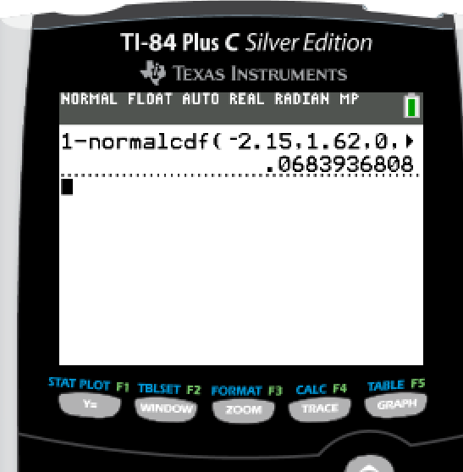
Enter 1 – normalcdf(lower, upper, mean, std dev)
Enter 1 - Enter requested information
Highlight “PASTE” when finished and enter twice
Final Answer is 0.0684
Lower: lowest possible value = -2.15
Upper: highest possible value= - 1.62
μ: population mean = 0
σ: population standard deviation = 1

Slide 26
Percentiles
If you have a problem where you are given the percentile, mean, and standard deviation:
Put it in the calculator this way: InvNorm (area, mean, standard deviation)
Area will equal the percentile.
70th percentile = top 30% = .70 for the area
90th percentile = top 10% = .90 for the area

Slide 27
Using the calculator
To find the value of a normally distributed random variable (aka cutoff score), you use a different calculator command.
To use the invNorm command on the calculator, you must know the distribution is normal or approximately normal, the population mean, the population standard deviation, and the area to the LEFT of the cutoff score.

Slide 28
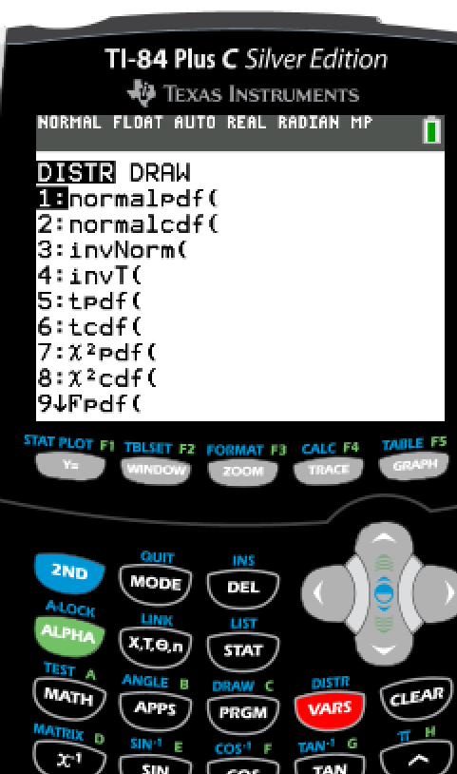
Example #1
Go to DISTRIBUTION
Press
Suppose ACT Composite scores are normally distributed with a population mean of 21.3 and a population standard deviation of 5.1. A university plans to award scholarships to students whose scores are in the top 5%. What is the minimum score required for the scholarship?

Slide 29
Choose Option 3: invNorm(

Slide 30
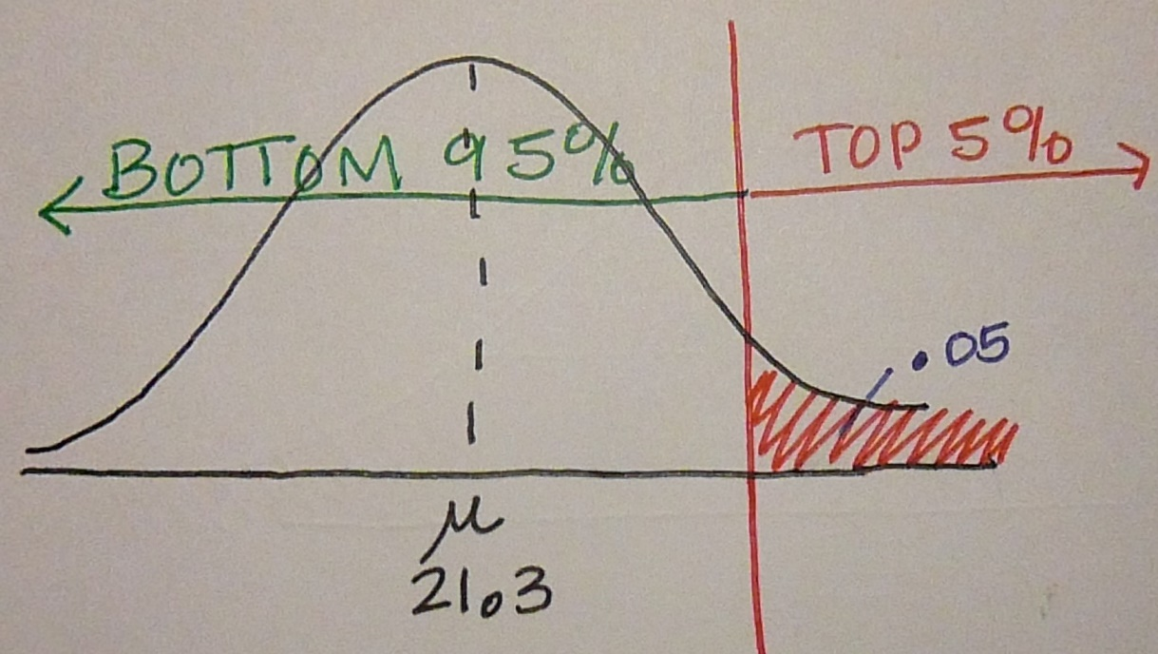
Enter the requested information
Drawing a picture may help
Example
Area: area to the LEFT of the cutoff score, should be between 0 and 1 = 0.95
Population mean, μ = 21.3
Population standard deviation, σ = 5.1
Suppose ACT Composite scores are normally distributed with a population mean of 21.3 and a population standard deviation of 5.1. A university plans to award scholarships to students whose scores are in the top 5%. What is the minimum score required for the scholarship?
NOTE: TOP 5% is on the right; therefore, the bottom 95% is on the left

Slide 31
Highlight “paste” and enter
On older versions of the TI-83/84, the requested information is simply entered separated by commas.

Slide 32
Press enter again. Result will appear in window.
The minimum score of the ACT Composite is 29.7.

Slide 33
Example #2
Go to DISTRIBUTION
Press
The lengths of pregnancies are normally distributed with a population mean of 268 days and a population standard deviation of 15 days. If we stipulate that a baby is premature if the length of the pregnancy is in the lowest 4%, find the length that separates premature babies from those who are not premature. Premature babies often require special care, and this result could be helpful to hospital administrators in planning for that care

Slide 34
Choose Option 3: invNorm(

Slide 35
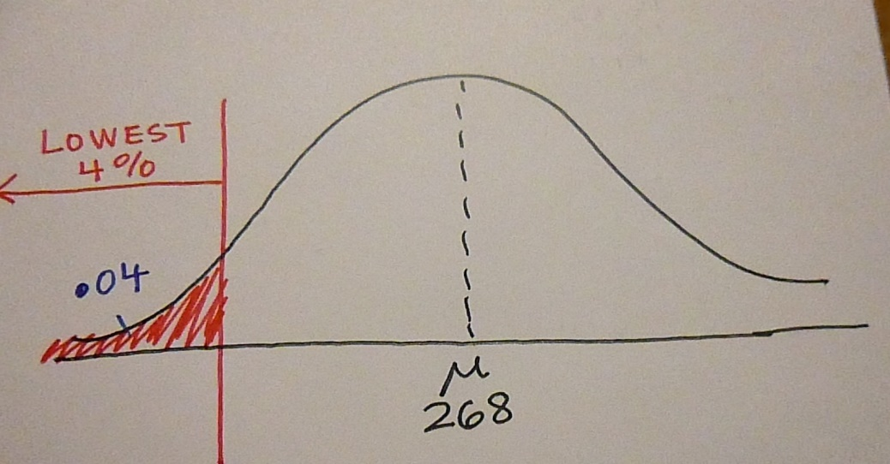
Enter the requested information
Drawing a picture may help
Example
Area: area to the LEFT of the cutoff score, should be between 0 and 1 = 0.04
Population mean, μ = 268
Population standard deviation, σ = 15
The lengths of pregnancies are normally distributed with a population mean of 268 days and a population standard deviation of 15 days. If we stipulate that a baby is premature if the length of the pregnancy is in the lowest 4%, find the length that separates premature babies from those who are not premature. Premature babies often require special care, and this result could be helpful to hospital administrators in planning for that care
NOTE: Lowest 4% is on the left; therefore, this is the area to the left.

Slide 36
Highlight “paste” and enter
On older versions of the TI-83/84, the requested information is simply entered separated by commas.

Slide 37
Press enter again. Result will appear in window.
The pregnancy length that separates premature babies from those who are not premature is 242 days.

Slide 38
Example #3
Go to DISTRIBUTION
Press
The diameters of bolts produced in a machine shop are normally distributed with a population mean of 5.21 millimeters and a population standard deviation of 0.03 millimeters. Find the two diameters that separate the bottom 6% and top 6%. These diameters could serve as the limits to identify which bolts should be rejected.

Slide 39
Choose Option 3: invNorm(

Slide 40
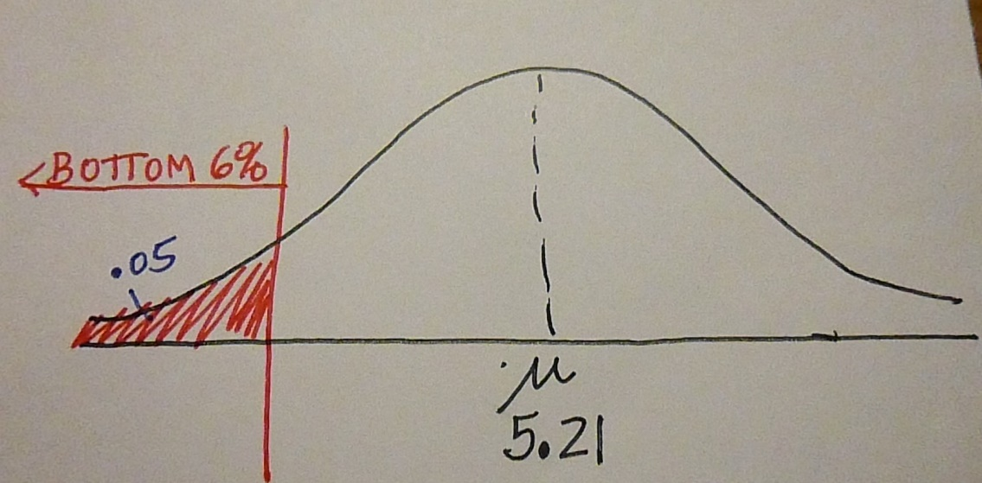
Enter the requested information
Drawing a picture may help—For lower end cutoff
Example
The diameters of bolts produced in a machine shop are normally distributed with a population mean of 5.21 millimeters and a population standard deviation of 0.03 millimeters. Find the two diameters that separate the bottom 6% and top 6%. These diameters could serve as the limits to identify which bolts should be rejected.
NOTE: Bottom 6% is on the left; therefore, this is the area to the left.
Area: area to the LEFT of the cutoff score, should be between 0 and 1 = 0.06
Population mean, μ = 5.21
Population standard deviation, σ = 0.03

Slide 41
Highlight “paste” and enter
On older versions of the TI-83/84, the requested information is simply entered separated by commas.

Slide 42
Press enter again. Result will appear in window.
The minimum (lowest) diameter for the bolts produced in the machine shop is 5.16 millimeters.

Slide 43
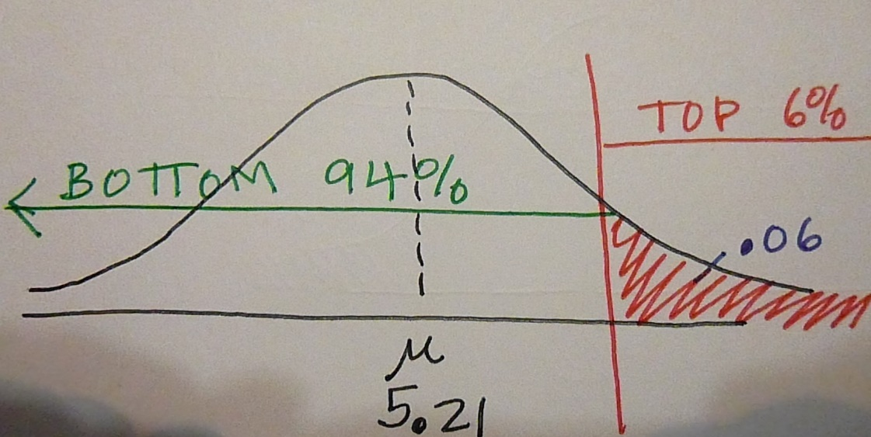
Enter the requested information
Drawing a picture may help—For upper end cutoff
Example
The diameters of bolts produced in a machine shop are normally distributed with a population mean of 5.21 millimeters and a population standard deviation of 0.03 millimeters. Find the two diameters that separate the bottom 6% and top 6%. These diameters could serve as the limits to identify which bolts should be rejected.
NOTE: Top 6% is on the right; therefore, the bottom 94% is on the left.
Area: area to the LEFT of the cutoff score, should be between 0 and 1 = 0.94
Population mean, μ = 5.21
Population standard deviation, σ = 0.03

Slide 44
Highlight “paste” and enter
On older versions of the TI-83/84, the requested information is simply entered separated by commas.

Slide 45
Press enter again. Result will appear in window.
The maximum (highest) diameter for the bolts produced in the machine shop is 5.26 millimeters.

Slide 46
Examples of percentiles
A citrus farmer who grows mandarin oranges finds that the diameters of mandarin oranges harvested on his farm follow a normal distribution with a mean diameter of 5.85 cm and a standard deviation of 0.24 cm.
a. Find the probability that a randomly selected mandarin orange from this farm has a diameter larger than 6.0 cm. Sketch the graph.
b. The middle 20% of mandarin oranges from this farm have diameters between ______ and ______.
c. Find the 90th percentile for the diameters of mandarin oranges, and interpret it in a complete sentence.

Slide 47
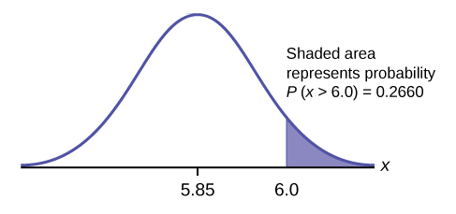
Examples of percentiles Answers
For a,

Slide 48
Examples of percentiles Answers
b. 1 – 0.20 = 0.80
The tails of the graph of the normal distribution each have an area of 0.40.
Find k1, the 40th percentile, and k2, the 60th percentile
(0.40 + 0.20 = 0.60).
k1= invNorm(0.40,5.85,0.24) = 5.79 cm
k2= invNorm(0.60,5.85,0.24) = 5.91 cm
c. 6.16: Ninety percent of the diameter of the mandarin oranges is at most 6.15 cm.

