Slide 1
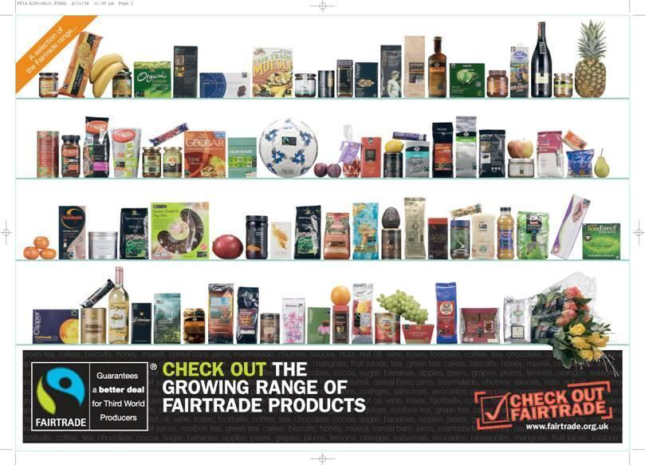
THE FAIRTRADE COMPANY
Can you see what this logo is a picture of?
Notes:
Lots of people do not immediately see the person with a hand raised in this logo...how many saw it? Do they know, or can they guess what fair trade is all about?
*

Slide 2
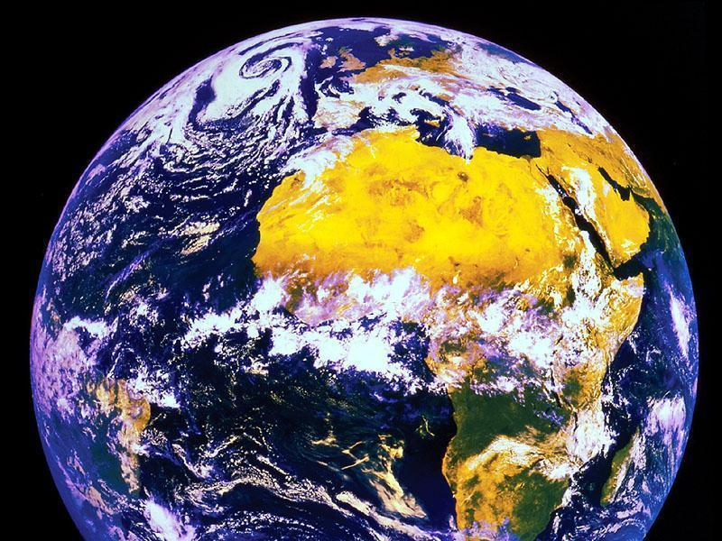
Notes:
*
Here is a clue

Slide 3
THE BANANA SPLIT
In the following activity we are going to decide who gets paid what in the banana chain.
Notes:
It is good to have some bananas here, one per group, they can then imagine that banana had eyes, who has it seen between being grown and right now.
*

Slide 4
PUT THE FOLLOWING INTO THE ORDER YOU THINK THEY TAKE IN THE BANANA CHAIN
Customer (Mom and Dad)
Transportation
Farmer
Factory
Grocery Store
Notes:
Students decide who comes first when producing a banana.
*

Slide 5
Farmer
Transportation
Grocery Store
Factory
Customer (Mom and Dad)
Notes:
*

Slide 6
On average, a single banana costs 25 cents.
Using the 1 cent pieces, decide out how much of the 25 cents goes to each part of the chain.
Notes:
*

Slide 7
Farmer 1c
Transportation 4c
Grocery Store 13c
Factory 7c
Customer (Mom and Dad) 0c
Notes:
*

Slide 8
BANANA FARMER
1 cents
EVERYONE ELSE
24 cents

Slide 9
A Nice Company trying to make sure farmers get the amount of money they deserve for their hard work.
Fairtrade are an organisation whose aim is to put a stop to the unfairness in the world and ensure the grower of crops receives what they rightly deserve!

Slide 10
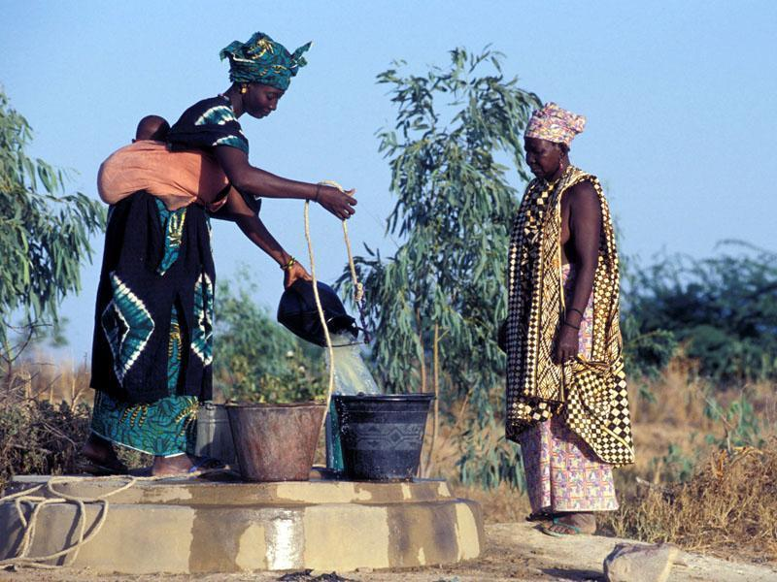

Slide 11
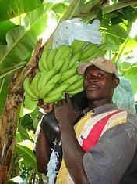

Slide 12
Farmer 12c
Transportation 2c
Grocery Store 6c
Factory 5c
Customer (Mom and Dad) 0c
Notes:
*

