Slide 1
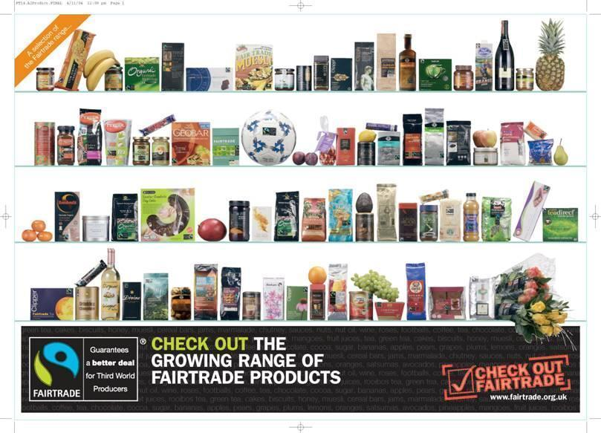
THE WORK OF FAIRTRADE
Can you see what this logo is a picture of?
Notes:
Lots of people do not immediately see the person with a hand raised in this logo...how many saw it? Do they know, or can they guess what fair trade is all about?
*

Slide 2
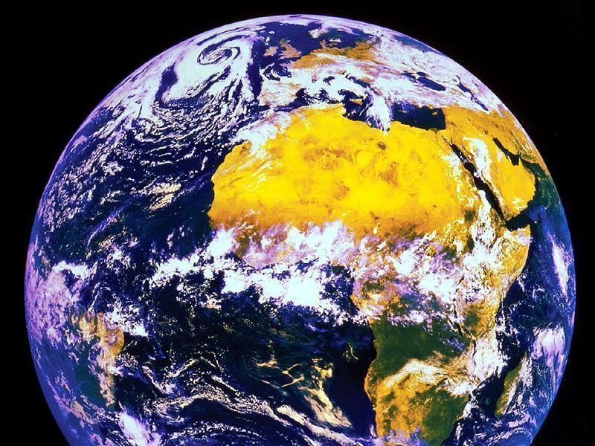
Notes:
*
Here is a clue

Slide 3
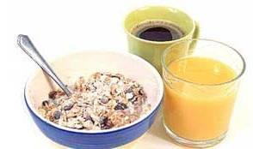
“We are indebted to half of the world before we finish breakfast.”
- Martin Luther King
Notes:
What did Martin Luther King mean by this? (Further Discussion – who was he?)
*

Slide 4
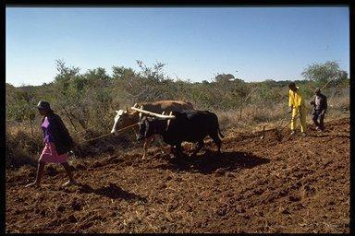

Slide 5
In the US we each spend $50 a year on chocolate.
Most cocoa farmers in Ghana earn $50 a year…
and have never tasted chocolate

Slide 6
Many people endure low pay, an unsafe working environment and poor living conditions.

Slide 7
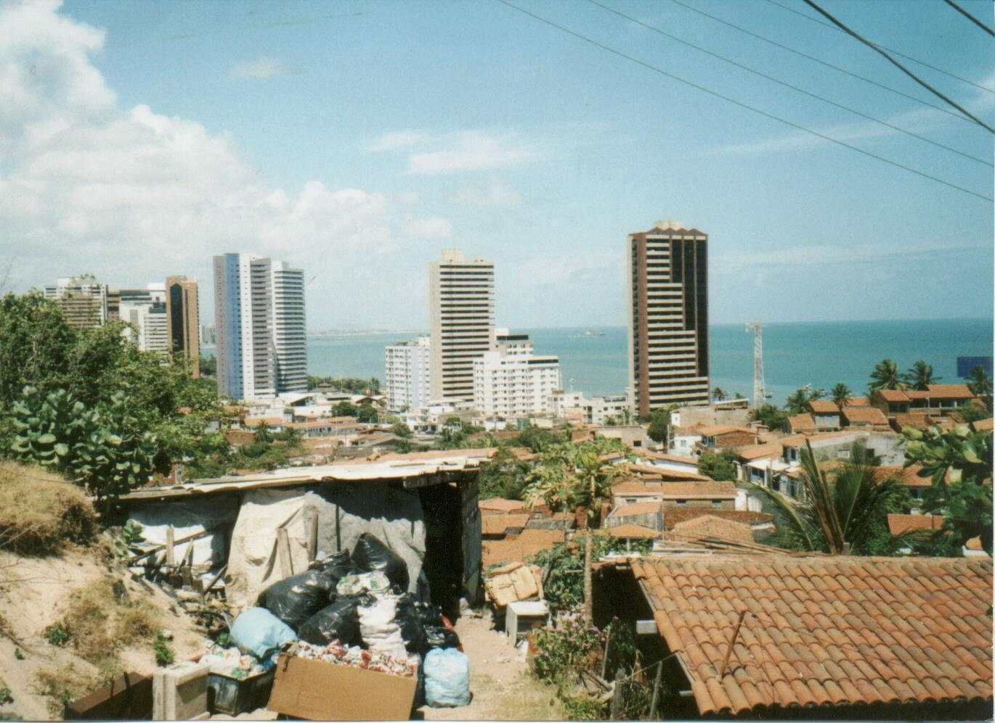

Slide 8
THE BANANA SPLIT
In the following activity your groups are going to work out who gets what in the banana chain.
Notes:
It is good to have some bananas here, one per group, they can then imagine that banana had eyes, who has it seen between being grown and right now.
*

Slide 9
PUT THE FOLLOWING INTO THE ORDER YOU THINK THEY TAKE IN THE BANANA CHAIN
SHIPPER
BUYER
RIPNER
WHOLESALER/IMPORTER
GROWER
RETAILER
PLANTATION OWNER
Notes:
Students decide who comes first when producing a banana. Print out these roles from other "roles' doc, give to the groups to cut and paste onto plastic cups, then put in order
*

Slide 10
GROWER
PLANTATION OWNER
WHOLESALER/IMPORTER
SHIPPER
RIPNER
RETAILER
BUYER
Notes:
*

Slide 11
On average, a single banana costs 30 cents.
Using the 1 cent pieces, decide how much of the 30 cents goes to each part of the chain.
Notes:
Students place the 30 pennies in each 'Role Cup', showing how much each person should get.
*

Slide 12
GROWER
PLANTATION OWNER
1c
5c
WHOLESALER/IMPORTER
SHIPPER
4c
3c
RIPNER
4c
RETAILER
BUYER
13c
0c
Notes:
Were they correct? Is this fair?
*

Slide 13
BANANA GROWER
1 cents
EVERYONE ELSE
29 cents

Slide 14
What is Fairtrade?
A growing international movement which ensures that producers get:
Fair price for their goods (that covers the cost of production and guarantees a living income)
Long term contracts which provide real security
Support to gain the knowledge and skills they need to develop their businesses and increase sales

Slide 15
Fairtrade organizations aim to stop the unfairness in the world and ensure the grower of crops receives what they rightly deserve!
You can identify a Fairtrade product because it carries the FAIRTRADE Mark.

Slide 16
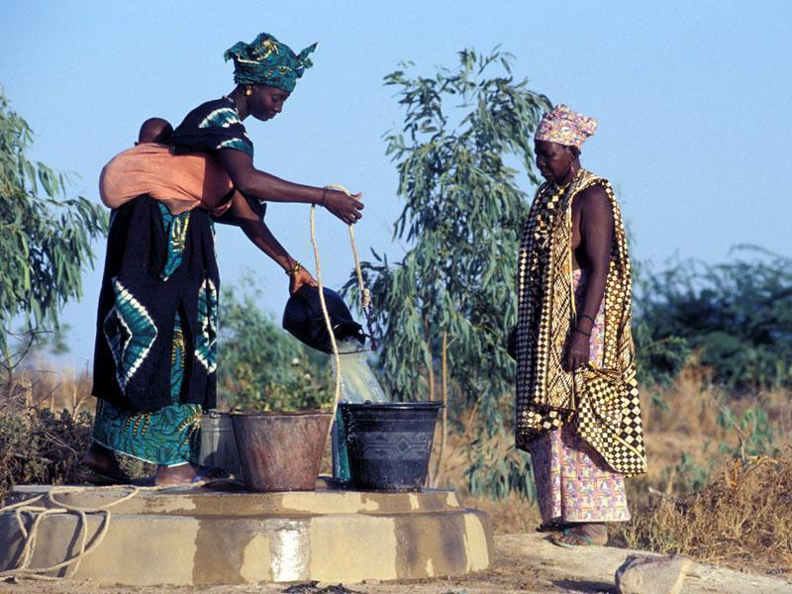

Slide 17
Benefits of Fairtrade for the farmer:
Regular income
Fair pay and working conditions
Cleaner environment
New housing
Improved health and sanitation
Increased efficiency

Slide 18
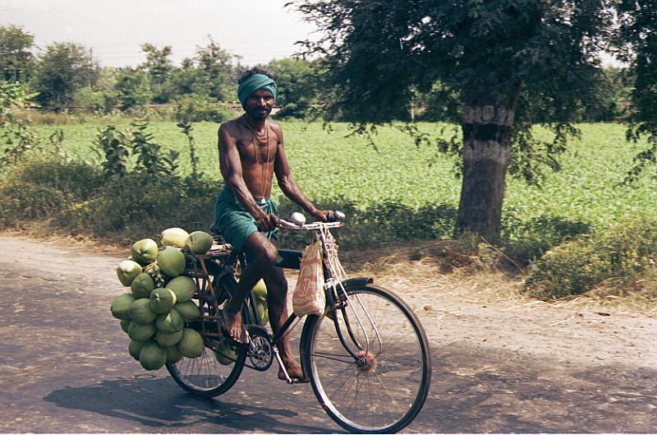

Slide 19
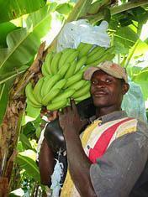

Slide 20
Benefits for you?
You are actually doing something to change this situation
Lots of different foods from different countries
Raises awareness of fairtrade
Tastes pretty good too!

Slide 21
GROWER
PLANTATION OWNER
15c
2c
WHOLESALER/IMPORTER
SHIPPER
2c
3c
RIPNER
2c
RETAILER
BUYER
6c
0c
Notes:
*

Slide 22
What difference does it really make?

Slide 23
“I have been able to fix the roof of my house, there is money for food and I can buy new shoes if I want to…but the most important contribution of Fairtrade is that our dignity as human beings is recovered.”

Slide 24
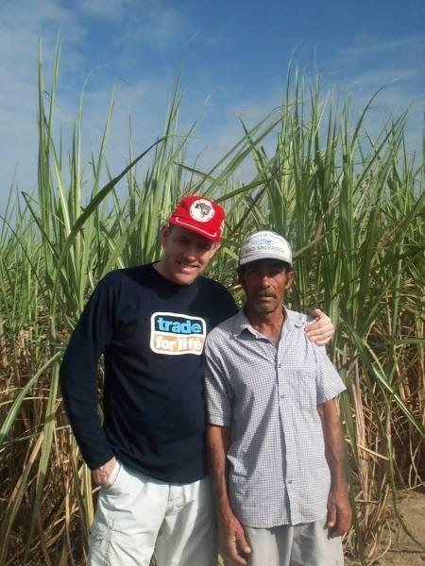

Slide 26
You can identify a Fairtrade product because it carries the FAIRTRADE Mark.

Slide 27
Homework task
Go into your local supermarket (Safeway, Albertsons. Lucky's etc) and make a list of all the Fairtrade products they sell.

