Slide 1
Engineering
Design
Process

Slide 2
What is it?
A PROBLEM SOLVING method!
Technologists and engineers use design processes to find solutions to technological problems.
Most products were probably developed using process like this one.

Slide 3
Solution could be an...
Innovation
Improving upon an existing process or product
Invention
Creation of a product or process for the first time

Slide 4
6 STEPS arranged in a loop
It is likely that you will move through the loop several times before solving a problem in
the best way.

Slide 5
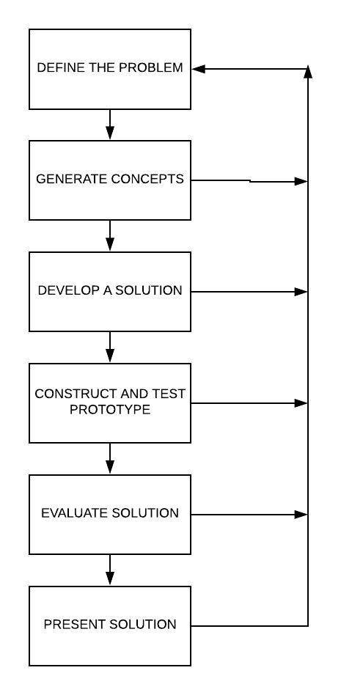

Slide 6
1
DEFINE THE PROBLEM

Slide 7
DESIGN BRIEF
STEP 1:DEFINE THE PROBLEM
A design brief is a written plan that identifies a problem to be solved, its criteria (desired specifications), and its constraints (limitations).

Slide 8
STEP 1:DEFINE THE PROBLEM
Gather information
Research how we can solve the problem.
May want to consult an expert in the field or resources: library, books, magazines, articles, web sites, encyclopedias, research reports, etc.

Slide 9
Make a written record of all the information gathered and cite the sources!
STEP 1:DEFINE THE PROBLEM

Slide 10
2
GENERATE CONCEPTS

Slide 11
STEP 2: GENERATE CONCEPTS
ALL ideas should be written down, even the ones that seem unrealistic
Ideas need to be down on paper in some way so they are not forgotten
written words
sketcheS
drawings

Slide 12
3
DEVELOP A SOLUTION

Slide 13
STEP 3: DEVELOP A SOLUTION
Narrow down your list of ideas
Choose the best option to pursue
Use a decision matrix to choose a final solution
Create a drawing, bill of materials, and detailed assembly directions

Slide 14
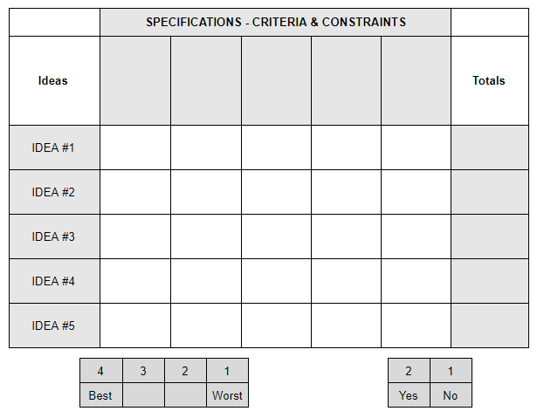
DECISION MATRIX
A tool used to compare ideas against one another using specific criteria
STEP 3: DEVELOP A SOLUTION

Slide 15
STEP 3: DEVELOP A SOLUTION
 | SPECIFICATIONS - CRITERIA & CONSTRAINTS
Ideas |  |  |  |  |  | Totals
IDEA #1
IDEA #2
IDEA #3
IDEA #4
IDEA #5
4 | 3 | 2 | 1 |  | 2 | 1
Best |  |  | Worst |  | Yes | No

Slide 16
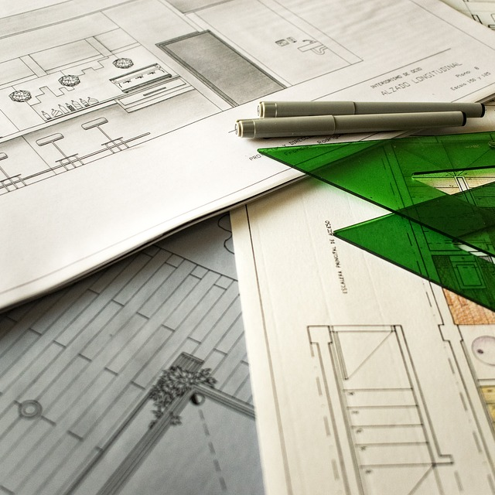
STEP 3: DEVELOP A SOLUTION
A good way to design the solution is to create a series of sketches that increase in detail.
Thumbnail Sketches
Rough Sketches
Comprehensive Drawings
Technical Drawings

Slide 17
BILL OF MATERIALS
list of materials needed to construct the solution
(material, quantity, unit)

Slide 18
Directions for Assembly
Allows the product to be created to the proper specifications of the final design

Slide 19
4
CONSTRUCT & TEST PROTOTYPE

Slide 20
STEP 4: CONSTRUCT & TEST PROTOTYPE
PROTOTYPE
Full-scale
Fully-functioning
Example of the final product
It is built to undergo testing before the product goes into full production.

Slide 21
STEP 4: CONSTRUCT & TEST PROTOTYPE
MODEL
Looks like the final product
NOT full-scale
NOT functional

Slide 22
STEP 4: CONSTRUCT & TEST PROTOTYPE
TEST the solution!
Record results

Slide 23
5
EVALUATE SOLUTION

Slide 24
STEP 5: EVALUATE SOLUTION
Evaluate the results
What changes need to be made?
Pursue an entirely different solution?
Make minor change?

Slide 25
Focus on making your solution
BETTER

Slide 26
6
PRESENT SOLUTION

Slide 27
STEP 6: PRESENT SOLUTION
Formal Report
Slideshow Presentation
Video
Can vary based on audience

