Slide 1
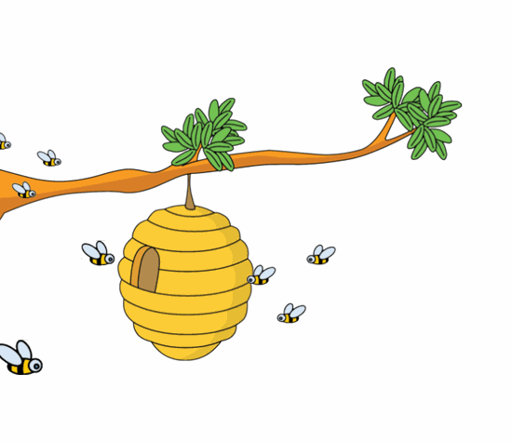
Honey, Colonies, and Collapse OH MY!

Slide 2
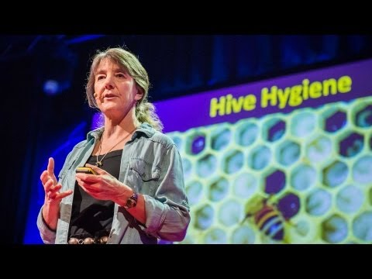
Colony Collapse

Slide 3
What is the impact of the declining bee population on the world’s resources?

Slide 4
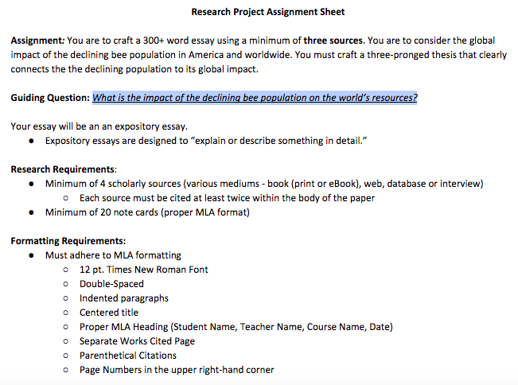

Slide 5
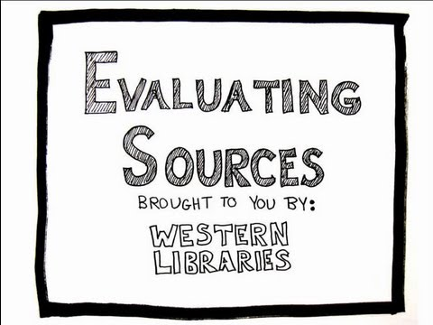
How do I know if my resources are valid?

Slide 6
Where can I go to find valid resources?
Google Scholar can be a convenient starting place, but it is not a comprehensive "one-stop shop."
How do I search and view items in Google Scholar?
Searching is as easy as searching in regular Google. Head to scholar.google.com and begin searching!
A final word of wisdom...
Keep in mind that Google Scholar is not perfect. For more precise searching, more search features, and more content, check out your library’s resources, as well.
What is Google Scholar?
Google Scholar is a Web search engine that specifically searches scholarly literature and academic resources.
But my teacher said not to use Google! How is "Google Scholar" different from "Google"?
Google searches public Web content. Google Scholar is different. It searches the same kinds of scholarly books, articles, and documents that you search in the Library's catalog and databases.
Adapted from https://library.shsu.edu/research/guides/tutorials/googlescholar/index.html

Slide 7
How do I cite my sources once I’ve found them?
What you need to find/record:
Author and/or editor names (if available); last names first.
"Article name in quotation marks."
Title of the website, project, or book in italics.
Any version numbers available, including editions (ed.), revisions, posting dates, volumes (vol.), or issue numbers (no.).
Publisher information, including the publisher name and publishing date.
URL (without the https://) DOI or permalink.
Date you accessed the material (Date Accessed)
Use the following format:
Author. Title. Title of container (self contained if book), Other contributors (translators or editors), Version (edition), Number (vol. and/or no.), Publisher, Publication Date, Location (pages, paragraphs and/or URL, DOI or permalink). 2ndcontainer’s title, Other contributors, Version, Number, Publisher, Publication date, Location, Date of Access (if applicable).
You will be citing all sources in MLA format. Visit https://owl.purdue.edu/owl/research_and_citation/mla_style/mla_formatting_and_style_guide/mla_works_cited_page_basic_format.html for more specific instructions.

Slide 8
Where do I put all of these sources?
You will be creating a works cited page in which you will list all of your sources in alphabetical order.
There is very specific formatting for this portion of your paper. You can again consult the Purdue OWL website linked on the previous slide.
The next slide contains a sample works cited page for you to use as a reference.
Quick Tips:
Your centered title on this page should be “Works Cited”
Put all entries in alphabetical order according to the first word of the entry (if the first word of the entry is “a, an, or the” move to the second word to determine order).
All entries must be formatted with a hanging indent (the second and subsequent lines will be indented, but the first line will stay against the left margin).
All individual entries must be formatted according to the regulations on the previous slide.

Slide 9
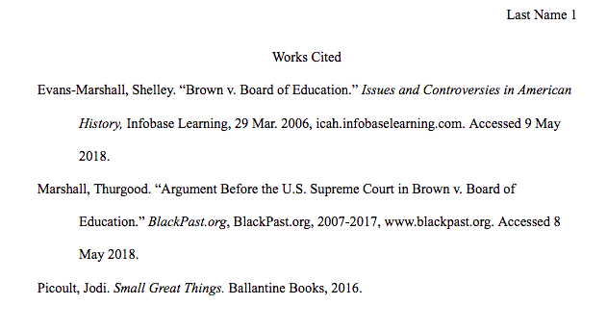
Sample Works Cited Page

Slide 10
How do I format my research paper?
Your research paper must be formatted according to MLA regulations. Be sure to complete the following steps:
1” Margins all around
Times New Roman, Size 12 Font
Include your MLA Heading (Your name, Teacher Name, Course Name, Due Date in international format)
Set up a header with your last name and automatic page numbering.
Center your title in the line directly under your heading. Titles do not get any special font formatting.
Paragraphs should be left aligned, and the first line of each paragraph should be indented ½”
Do not include any extra line spaces. Only hit return once at the completion of a paragraph.
Consult the sample on the next page to see what a paper should look like.

Slide 11
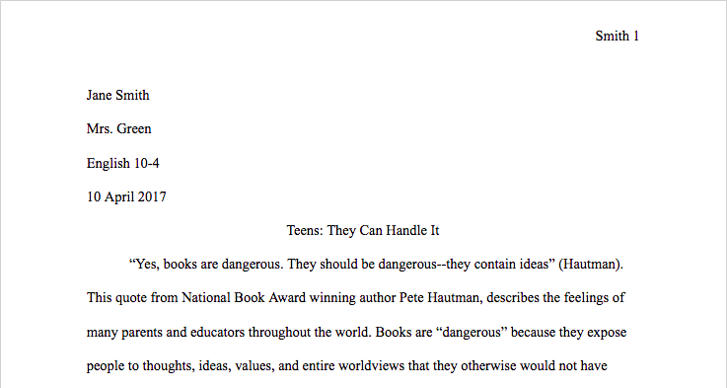
Sample Paper in MLA Format

Slide 12
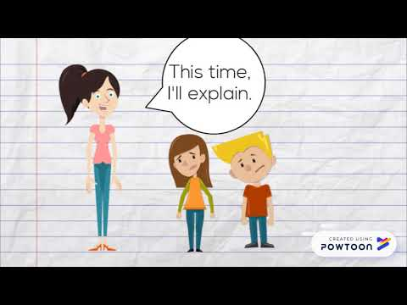
How do I make sure my paper is perfect?
Every student should revise and edit his or her papers.
There are no exceptions.
Be sure to have a minimum of one person read and markup your paper before making changes and submitting it.

