Slide 1
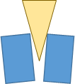
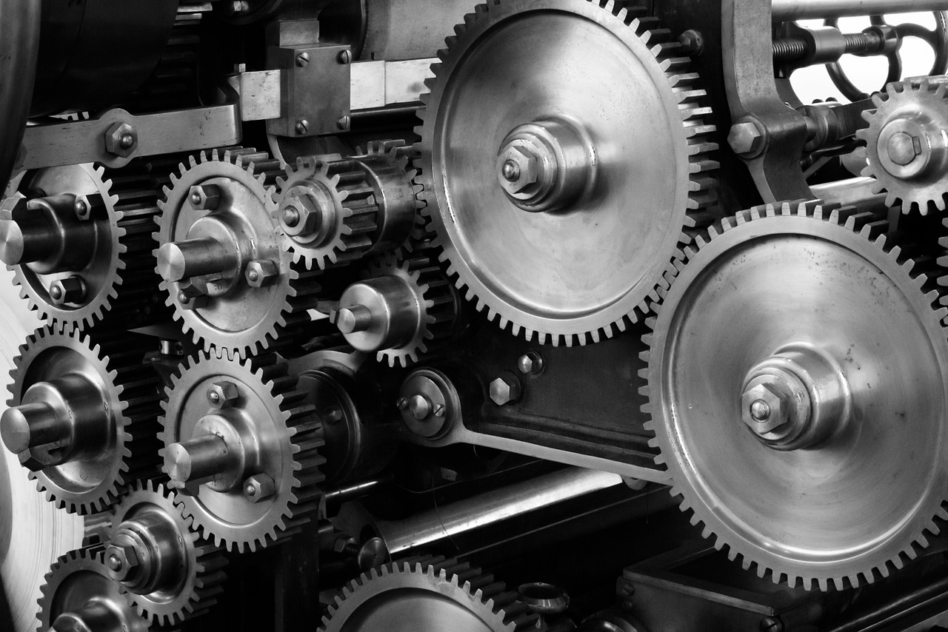
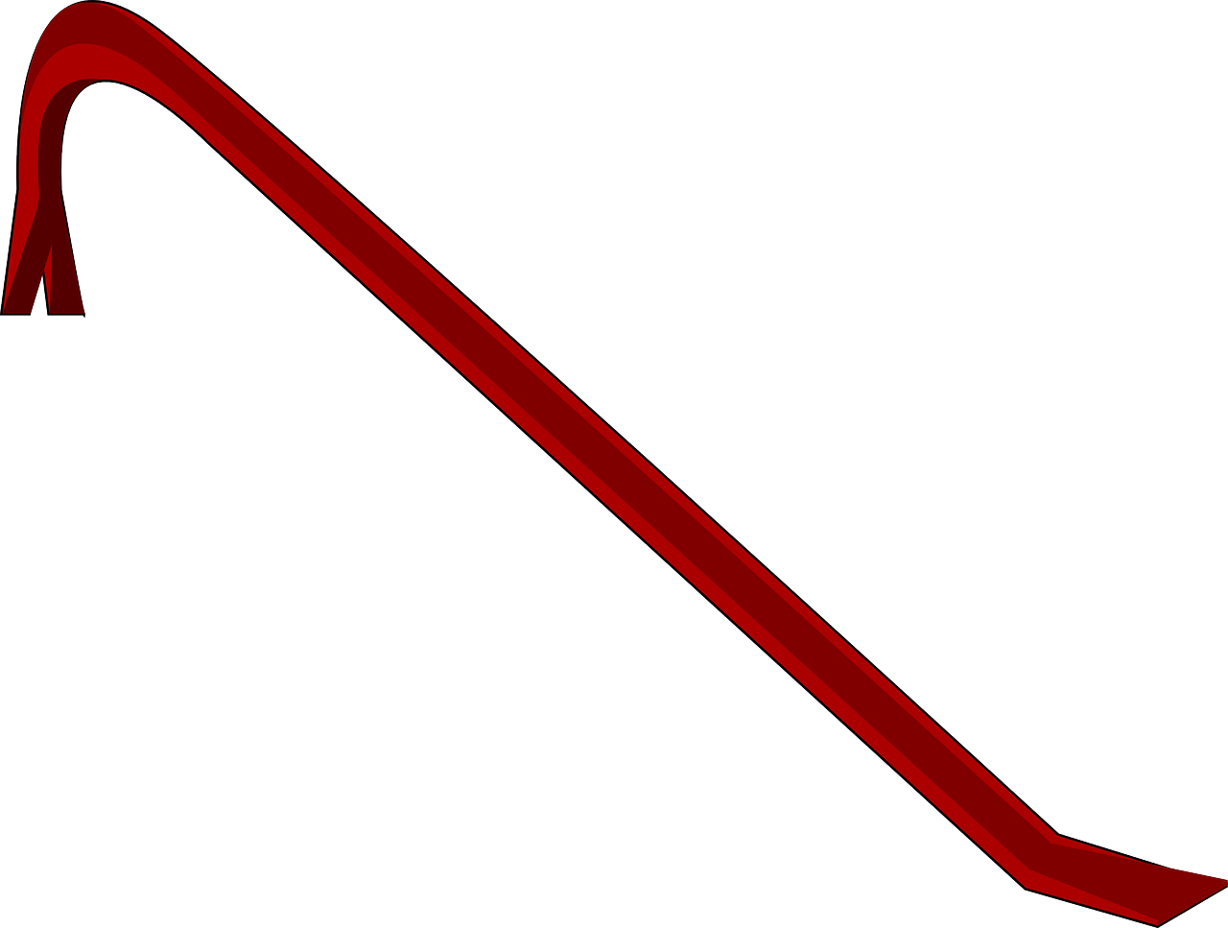
Simple Machines
‹#›

Slide 2
What is work?
In science, the word work has a different meaning than you may be familiar with.
The scientific definition of work is: using a force to move an object a distance (when both the force and the motion of the object are in the same direction.)
‹#›

Slide 3
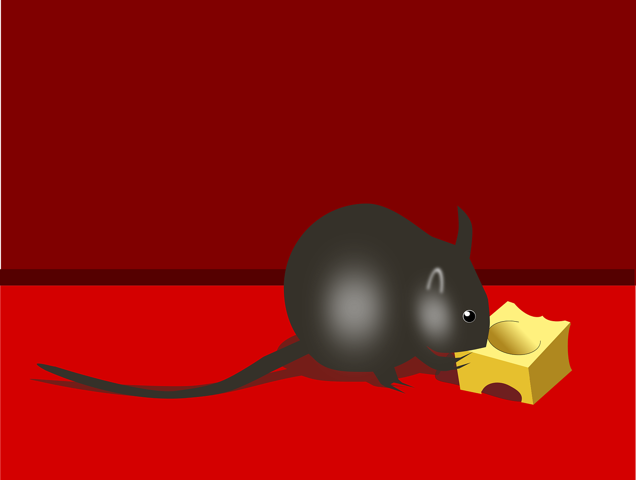
Work or Not?
According to the scientific definition, what is work and what is not?
a teacher lecturing their class
a mouse pushing a piece of cheese with its nose across the floor
‹#›

Slide 4
The mouse is using a force to move the cheese a distance; both force and motion are in the same direction
MOTION
FORCE
‹#›

Slide 5
Formula for Work
Work = Force x Distance
The unit of force is newtons
The unit of distance is meters
The unit of work is newton-meters
One newton-meter is equal to one joule
So, the unit of work is a joule
‹#›

Slide 6
Simple Machines
Ancient people invented simple machines that would help them overcome resistive forces and allow them to do the desired work against those forces.
‹#›

Slide 7
Why Use Simple Machines?
For the mechanical advantage…
Making something easier to do, but it takes a little longer to do it
For example, going up a longer flight of stairs instead of going straight up a ladder

Slide 8
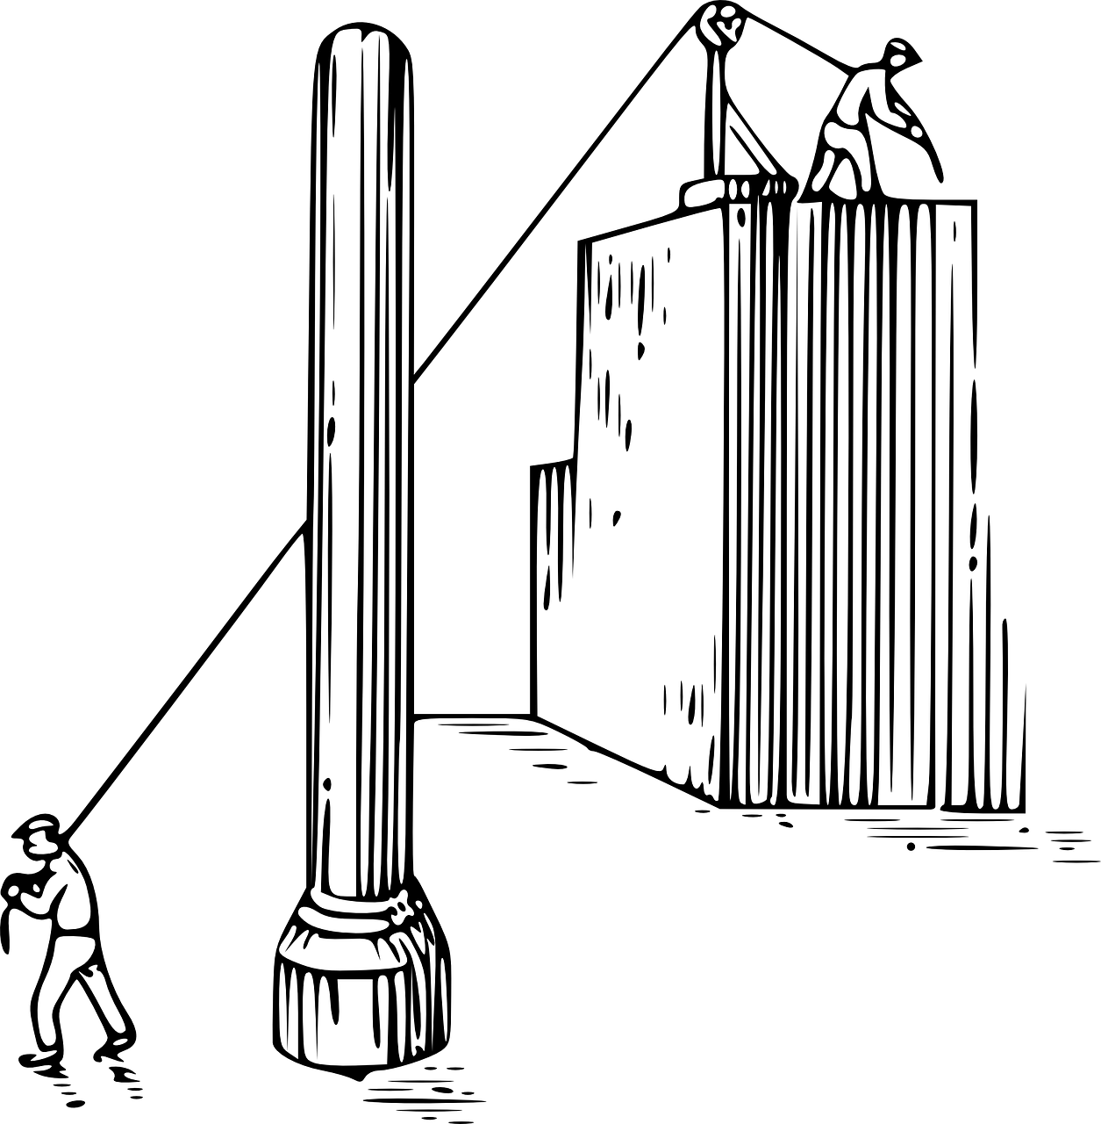
What is a Simple Machine?
Simple machines are smaller parts of complex machines that perform different types of work using mechanical energy.

Slide 9
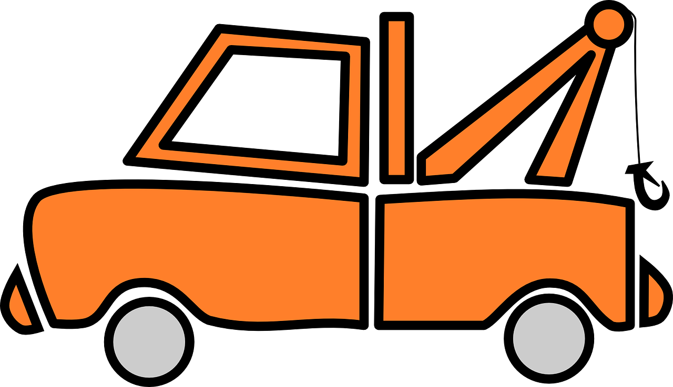
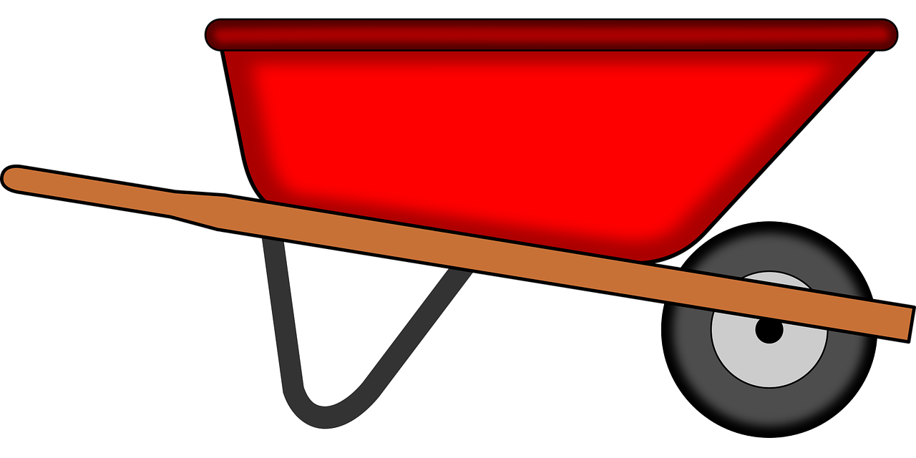
Complex Machines
Combining two or more simple machines to work together
Examples:
Car jack combines wedge and screw
Crane or tow truck combines lever and pulley
Wheelbarrow combines wheel and axle with a lever

Slide 10
The 6 Simple Machines
1. Inclined Plane
2. Screw
3. Wedge
4. Wheel and Axle
5. Pulley
6. Lever

Slide 11
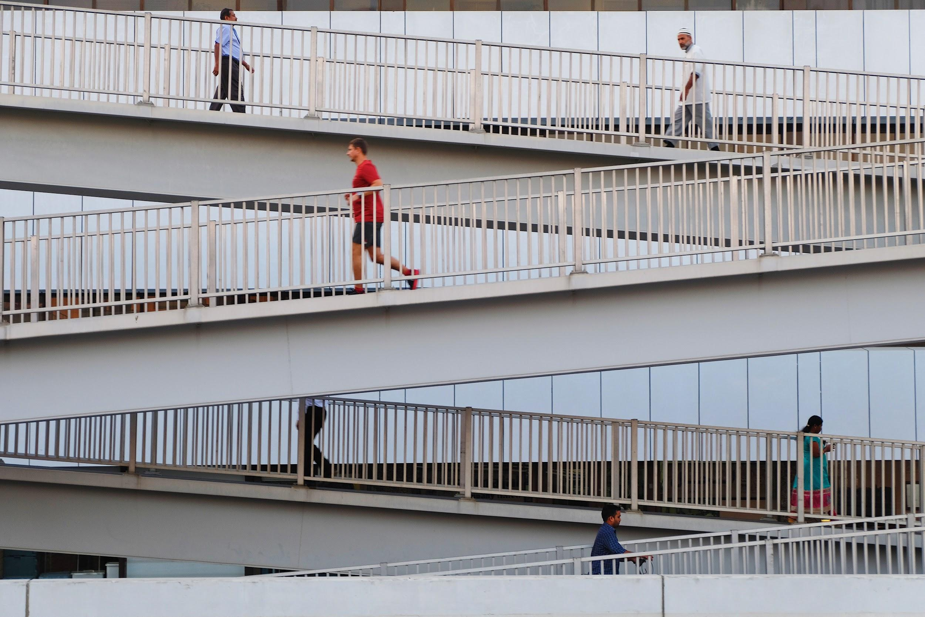
Inclined Plane
A simple machine that makes use of sloping surfaces.
The inclined plane makes it easier to move a weight from a lower to higher elevation.
Photo by Franzie Allen Miranda on Unsplash

Slide 12
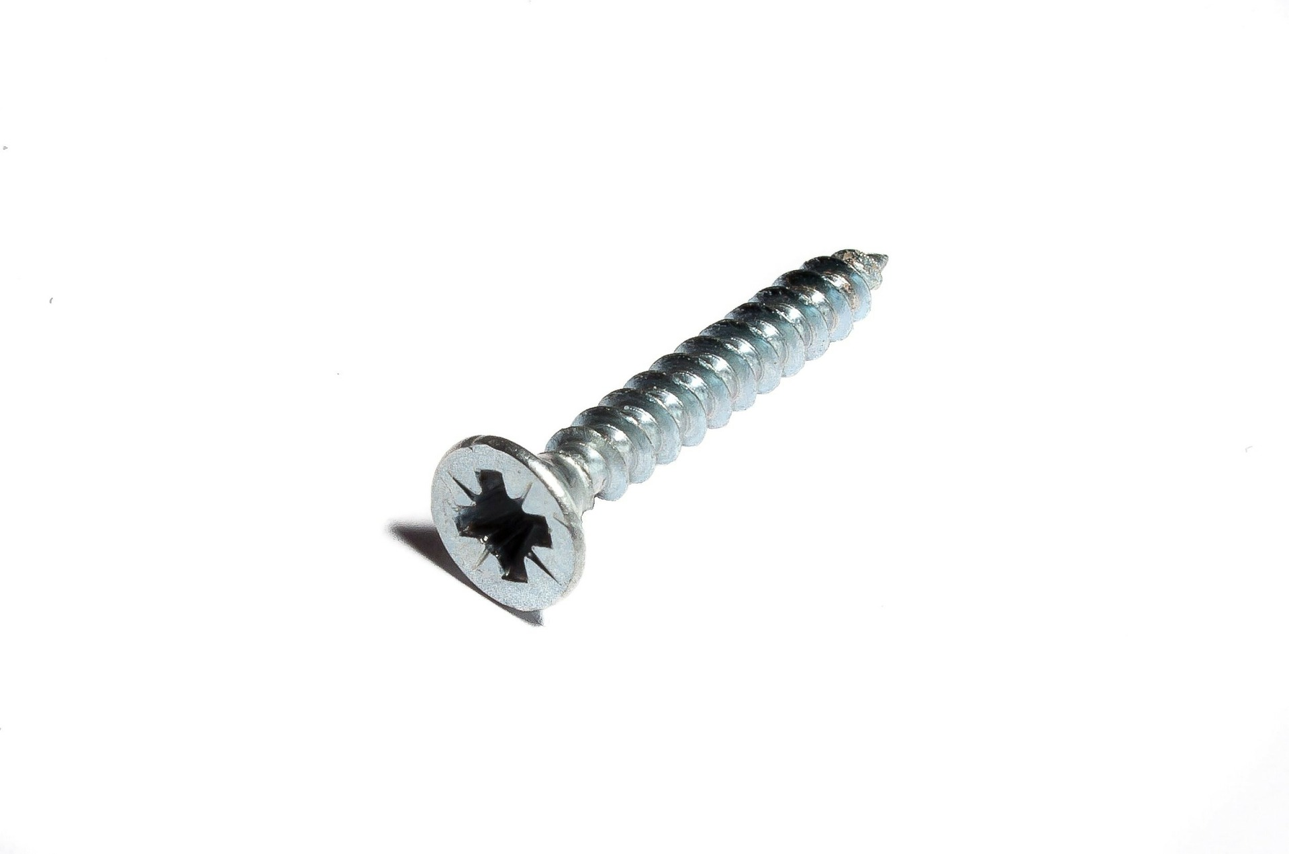
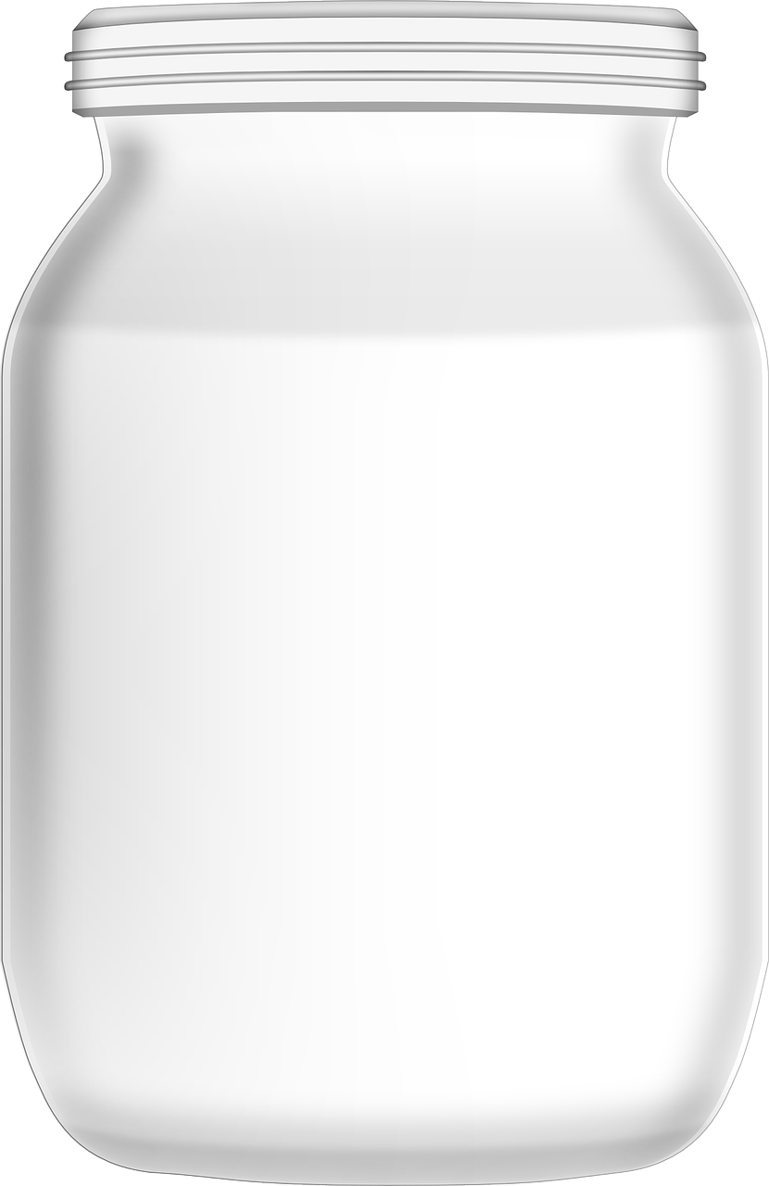
Screw
A Simple Machine consisting of a very long inclined plane wrapped around a cylinder
Turns rotation into lengthwise movement
Takes many twists to go a short distance
Holds things together

Slide 13
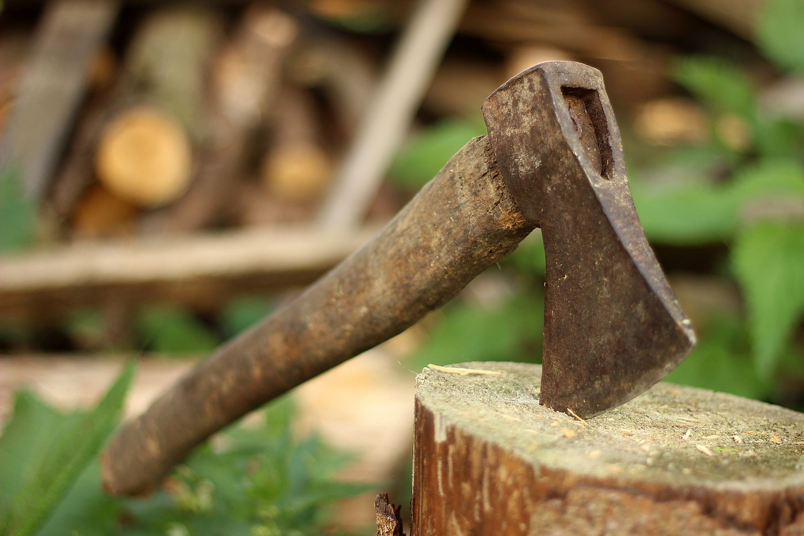
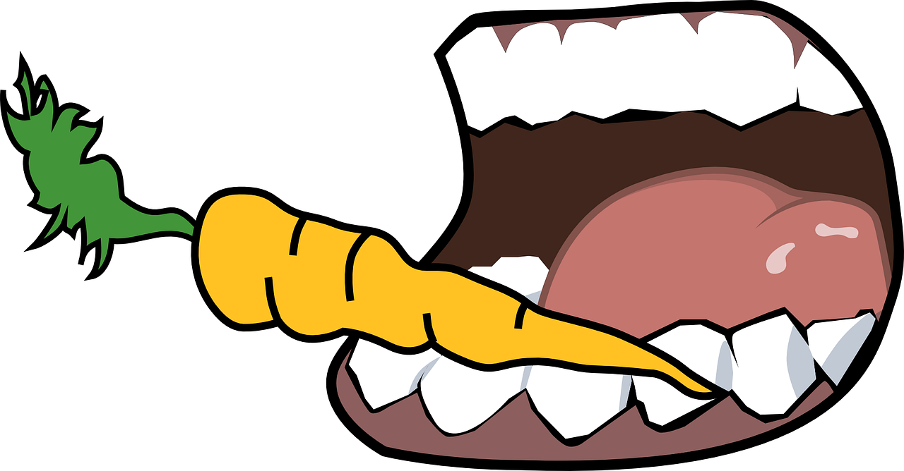
Wedge
An object with at least one slanting side ending in a sharp edge.
Pushes materials apart, cuts things.

Slide 14
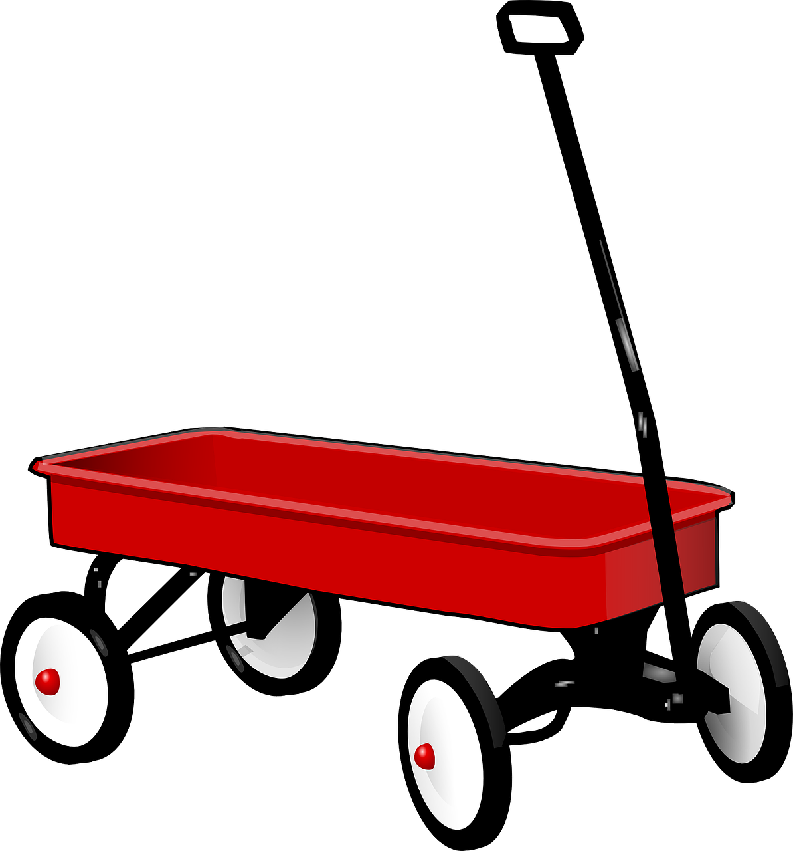
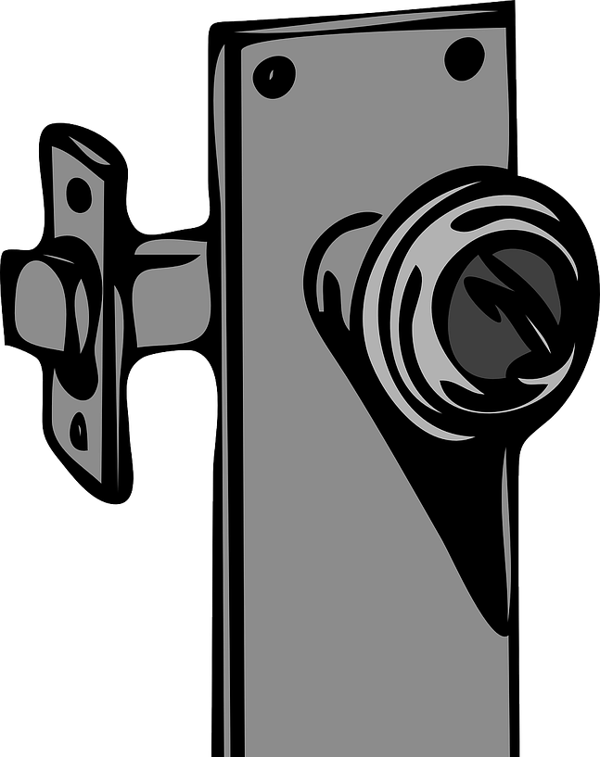
Wheel & Axle
A large diameter wheel and its small-diameter axle are attached to each other to move as one unit.
Makes it easy to move things by rolling them, and reducing friction

Slide 15
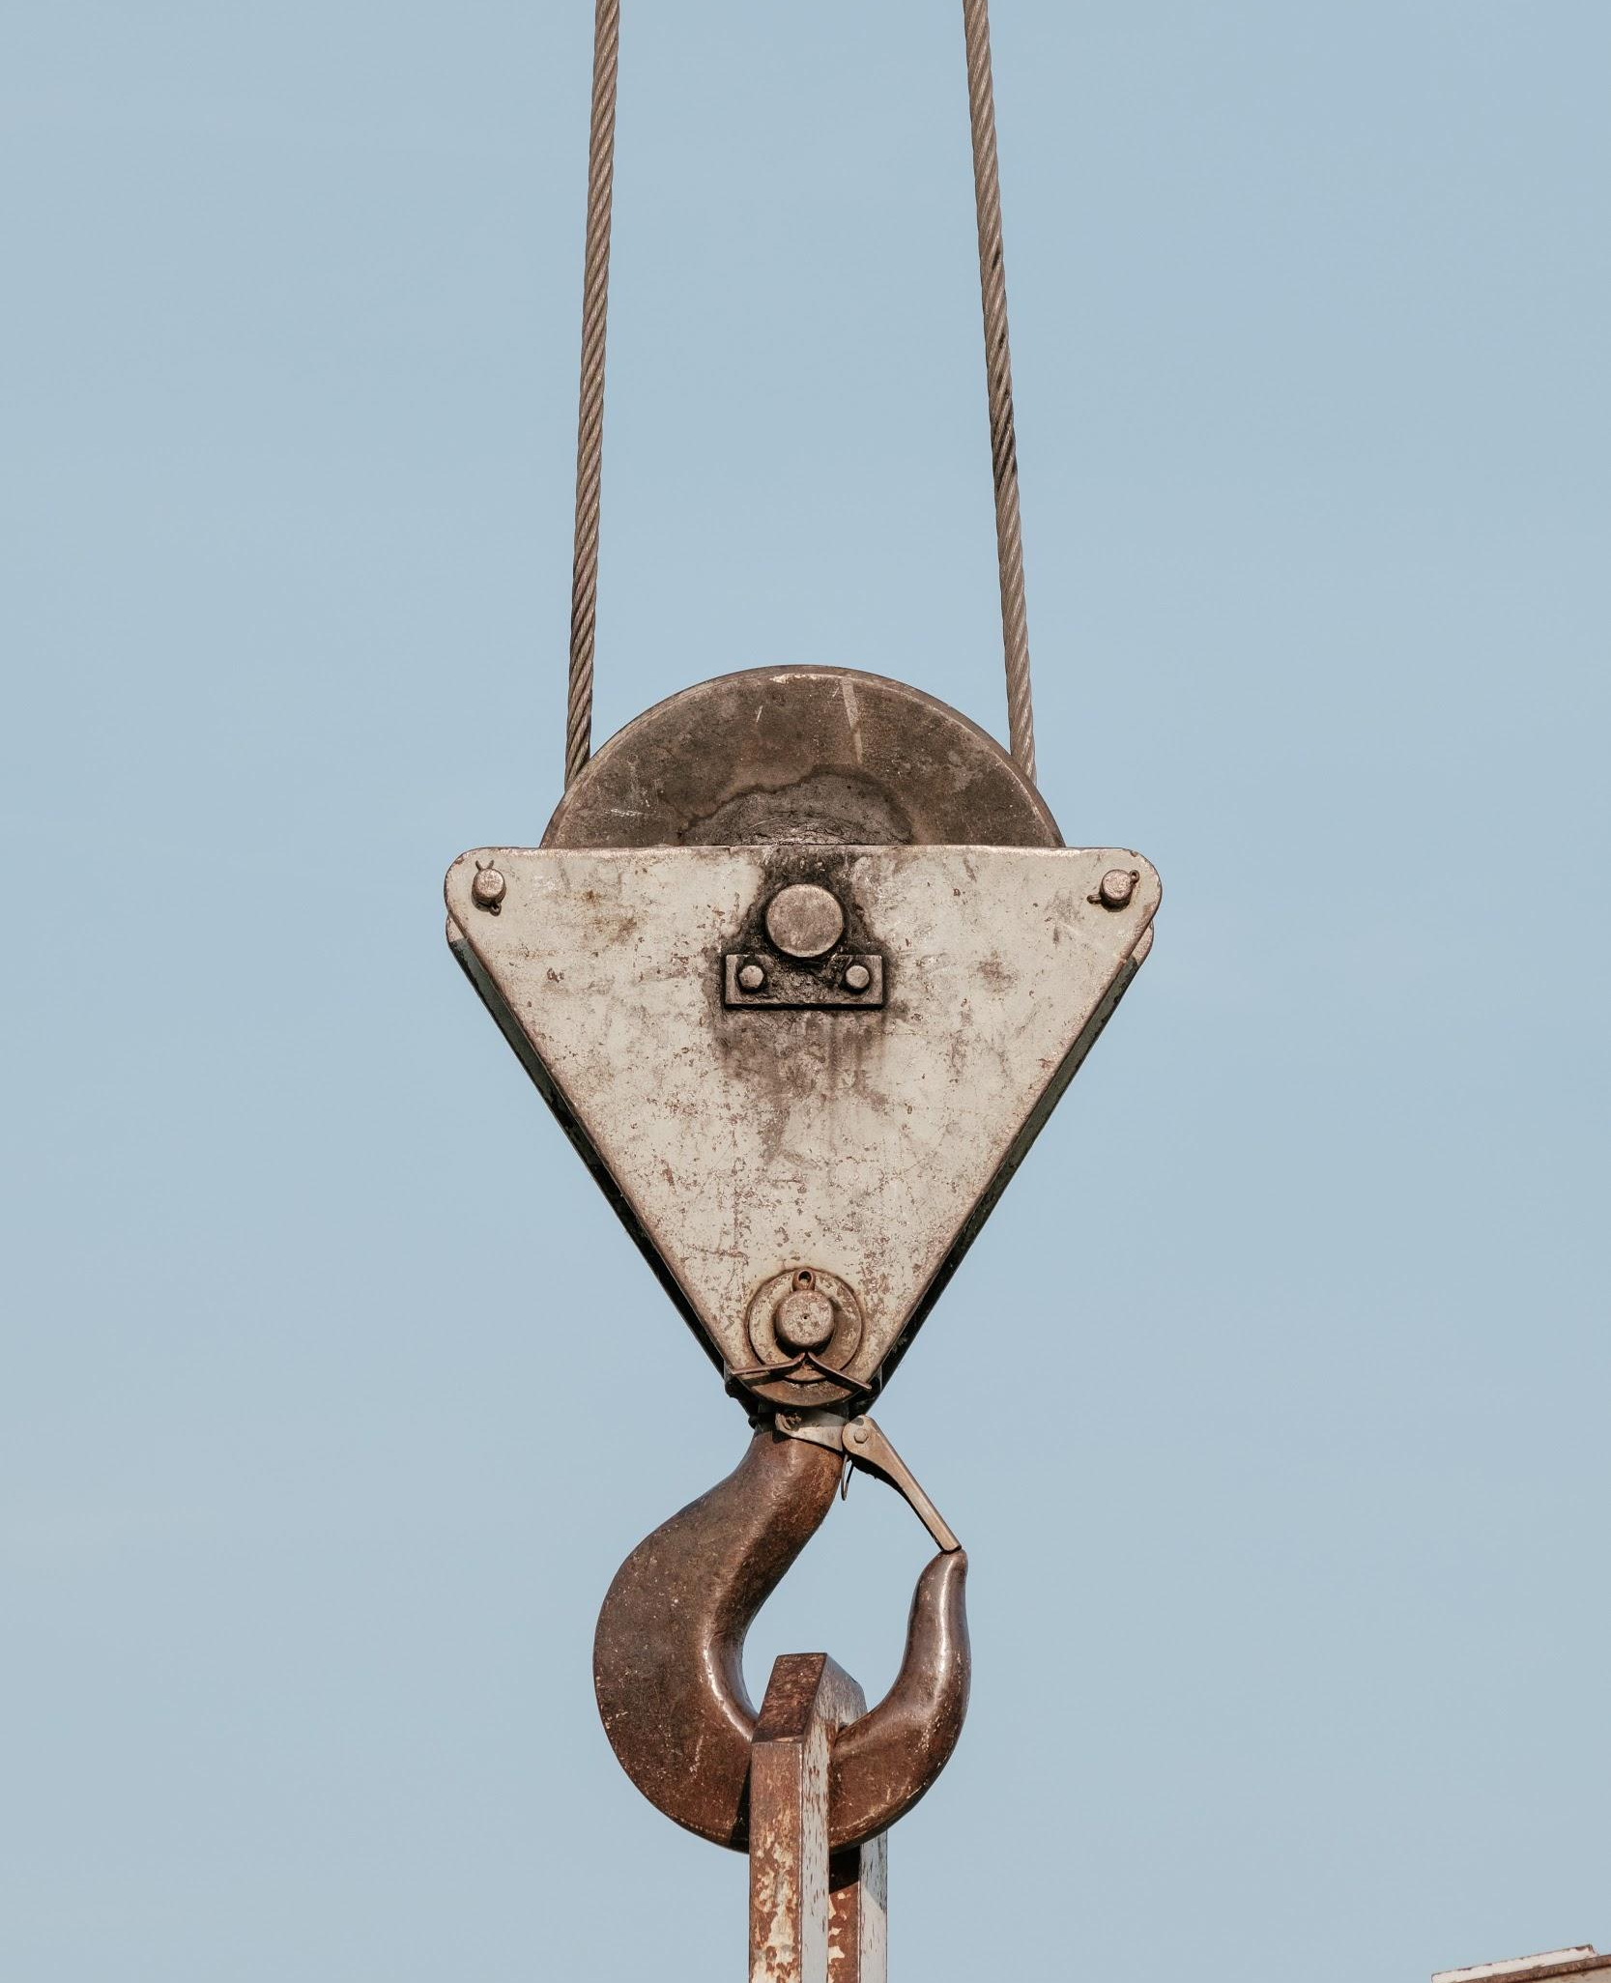
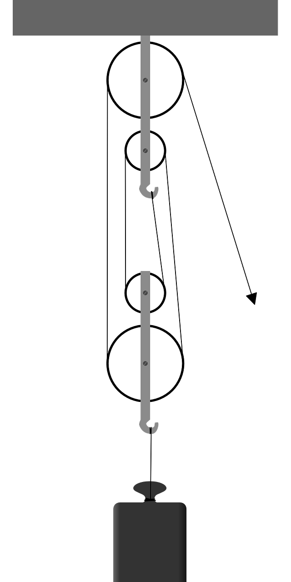
Pulley
Photo by Samuel Zeller on Unsplash
A solid disc that rotates around a center axis. It usually has a groove around the outside edge that allows ropes or belts to easily ride around them.
Pulleys are wheels and axles with a groove around the outside
Makes lifting things with a rope easier by redirecting force and the addition of additional pulleys

Slide 16
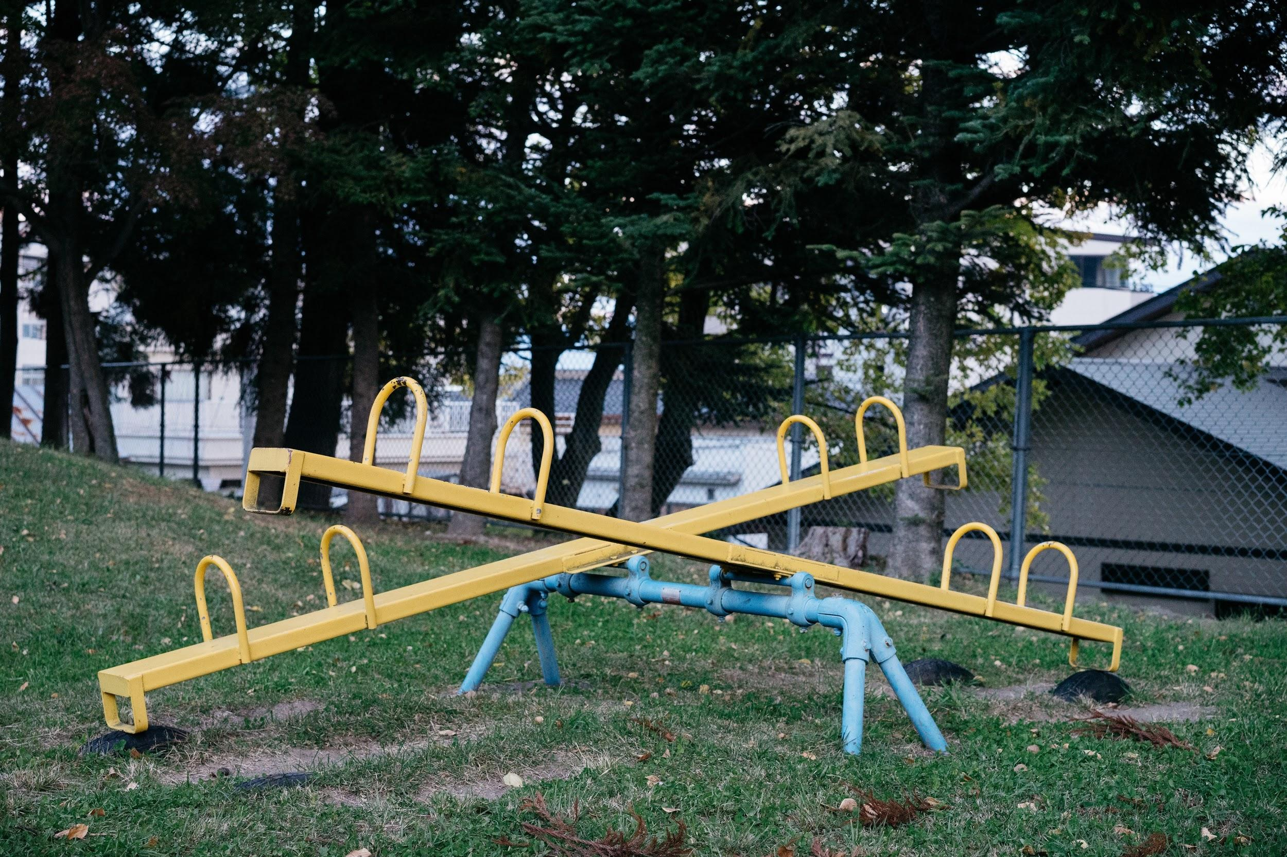
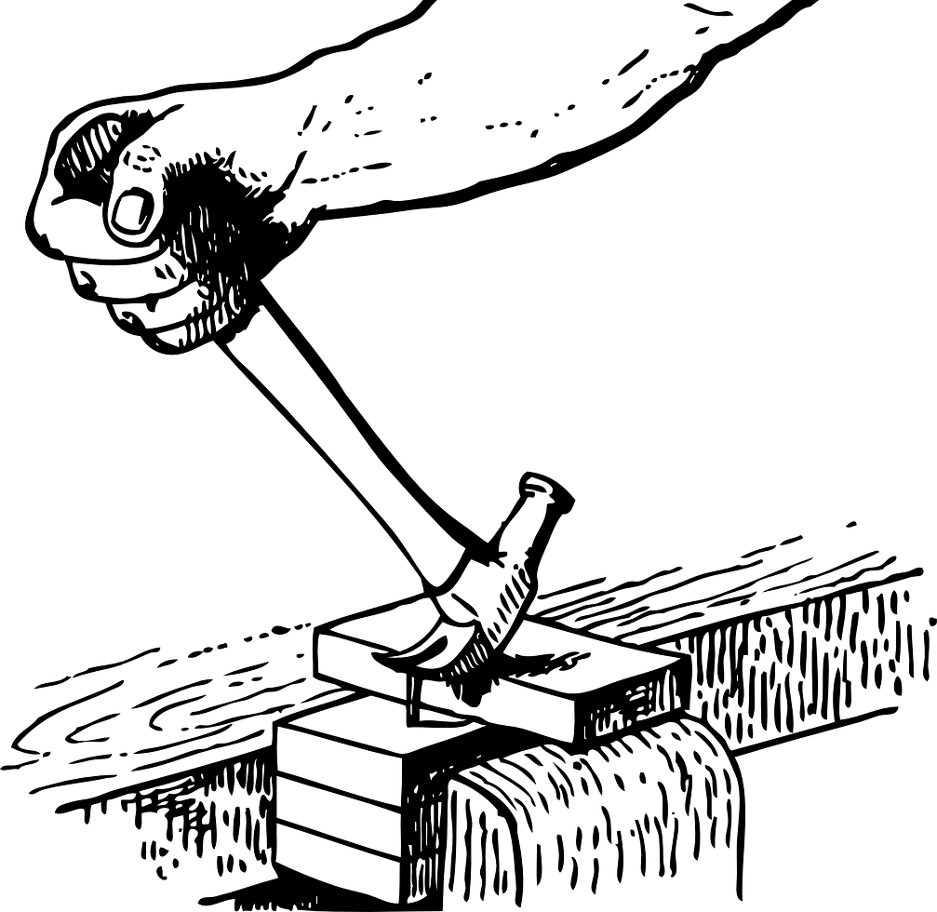
Lever
Photo by Markus Winkler on Unsplash
A simple machine that gives a mechanical advantage when given a fulcrum.
Makes lifting weight easier by using a fulcrum to redirect force over a longer distance
Moving the fulcrum changes the amount of force it takes to raise or move the load.

Slide 17
Learn more about Levers
from TEDed
Click Here

Slide 18
Lever
The Lever is made up of three parts.
Fulcrum:
The fixed point around which a lever rotates
Load:
An output that is the final goal of the power system.
Effort:
The force behind movement in a power system

Slide 19
Lever
First Class Lever: A lever that has the fulcrum positioned between the effort and the load.
Second Class Lever: A lever that has the load placed between the fulcrum and the effort.
Third Class Lever: A lever that has the effort positioned between the fulcrum and the load.

Slide 20
Summary
Wedge | Pushes material apart, cuts
Wheel and Axle | Makes it easy to move things by rolling them, and reducing friction
Lever | Helps lift heavy weights using longer distances
Inclined Plane | Makes it easier to move objects upward; a longer path, but easier lifting
Screw | Turns rotation into lengthwise movement
Pulley | Makes lifting heavy weights easier by redirecting force

