Slide 1
STEM CHALLENGE
Catapult

Slide 2
Scenario
There is a new type of satellite that must be launched into orbit. The satellite resembles a ping pong ball, but on a much larger scale. Your task is to design, build, test, then modify a catapult that will launch the satellite into orbit. Using the materials provided, create a design, submit your design, and then create the product. Once the catapult is assembled, you will be given a test period and more time to modify it. Official testing will take place, and the group with the furthest launch will be awarded the contract for the large, full scale mission.

Slide 3
The launch mechanism can take any form. It can be trebuchet style, slingshot, counter tension, traditional catapult, etc…

Slide 4
Day 1
Explore
Day 2/3
Design/Build
Day 4
Test day
Day 5
Launch day
Day 6
Analyze results

Slide 5
General Rules
All members of the group must participate – you will evaluate each other on your participation.
You can modify any and/or all of the items given to you any way you like, using only the materials provided and tools available to you in this room.
The catapult may only be ‘primed’ and launched using one finger. It cannot be braced to the table by hand (you may use materials to brace it to the table). Once launched, the catapult can move, but it cannot fall off the surface. You can put the satellite (ping-pong ball) on the launch mechanism using another hand once primed.
If you want or need more materials, they can be purchased. Materials that are purchased have a value that subtracts inches from your final launch height or length.
Have fun – and learn something!

Slide 6
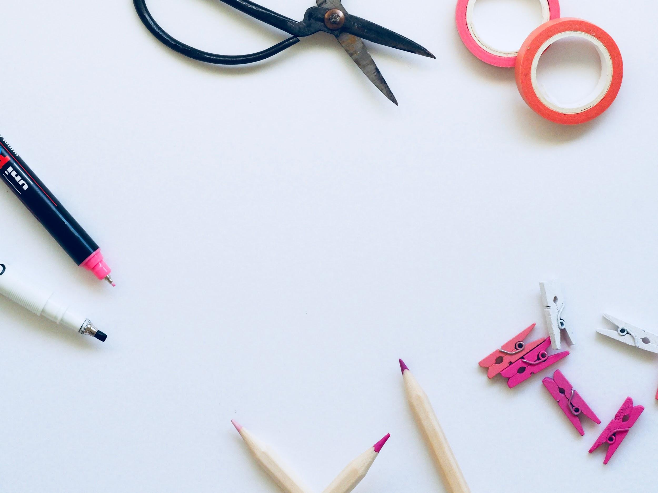
Supplies
12 Jumbo Popsicle sticks
8 Regular Popsicle sticks
6 Thin rubber bands
3 Medium rubber bands
1 glue stick
1 ping pong ball
1 plastic spoon and/or cup

Slide 7
Additional materials may be purchased – Distance will be subtracted from your furthest launch. The cost will vary based on multiple factors each day.

Slide 8
Additional materials may be awarded – these will be given at facilitator’s digression or by winning various contests that might be held throughout the design/build/test/modify process.

Slide 9
Grading
Teacher observation
End Result // Final Product
Self Evaluation
Peer Evaluation

Slide 10
Picture Resources
Photo by Joanna Kosinska on Unsplash
Photo by Kelly Sikkema on Unsplash
Photo by SpaceX on Unsplash
Photo by G. Crescoli on Unsplash
Photo by Kelly Sikkema on Unsplash
Photo by Plush Design Studio on Unsplash
Photo by Fabian Blank on Unsplash
Photo by Jason Leung on Unsplash
Photo by Kimberly Farmer on Unsplash

