Slide 1
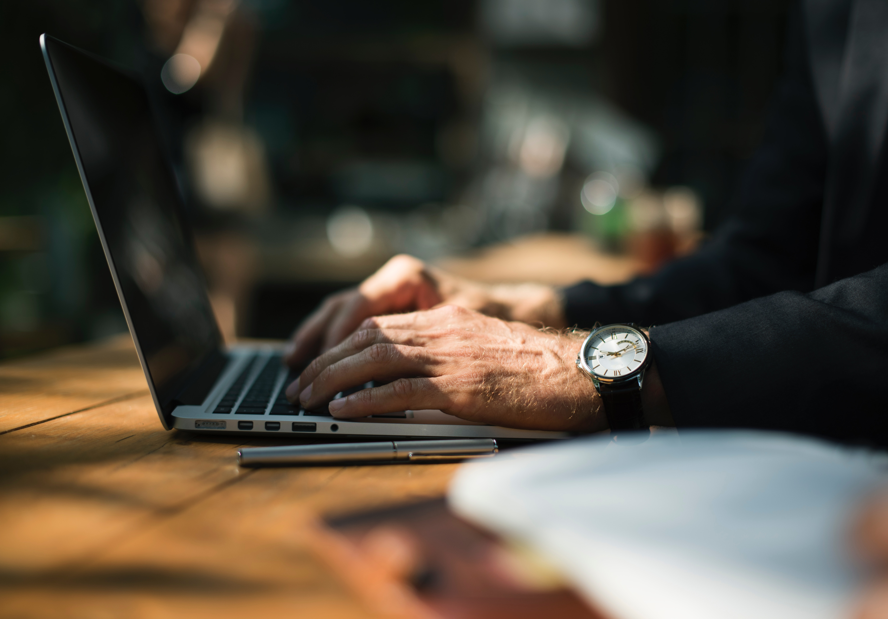
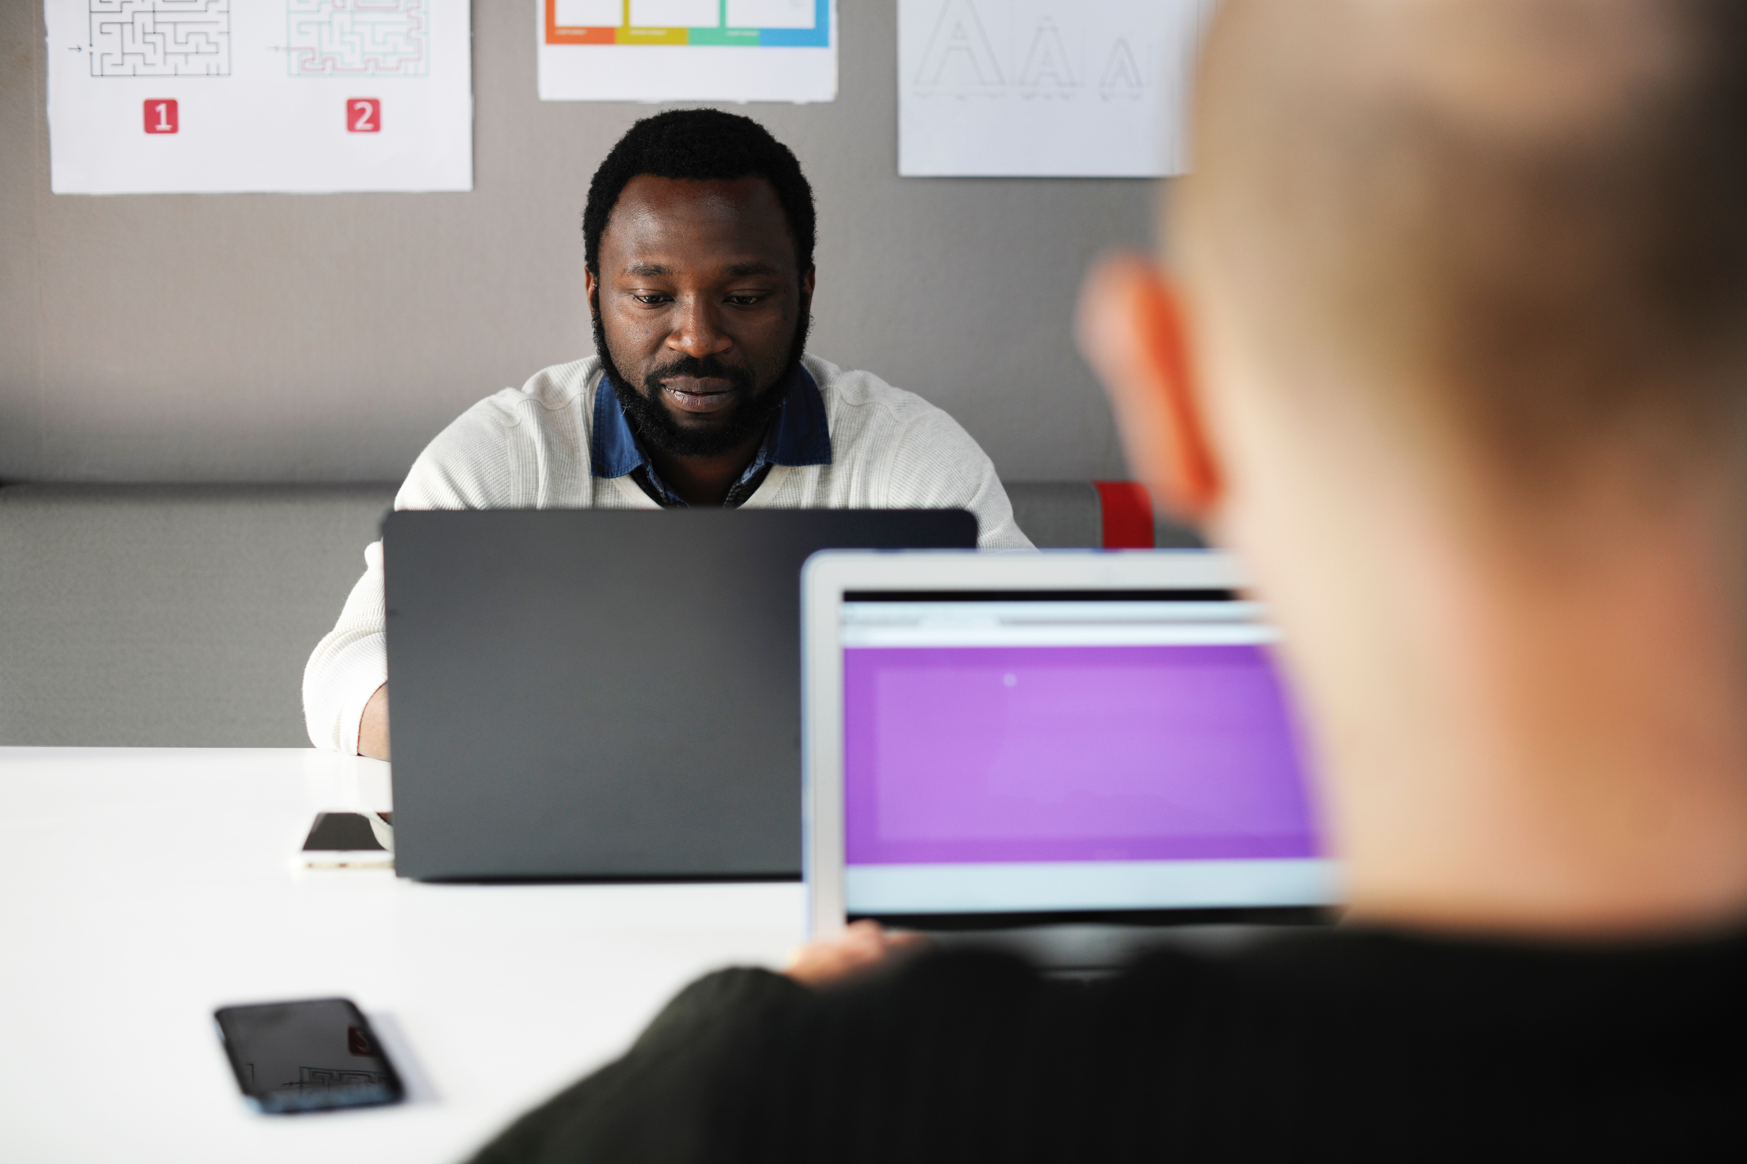
Creating Accessible Digital Content:
Equity for ALL
Maryland State Department of Education (MSDE) Division of Curriculum, Assessment and Accountability
Notes:
As educators, communicators, web, distance-learning and other specialists who work in public education, it is our legal obligation to create digital resources for young people and their families that are available to all in the most equitable ways possible. The following presentation gives a brief overview of these obligations and why they are important. Then I will share some best practices and when creating these documents.

Slide 2
What Is Accessibility?
Accessible means a person with a disability is afforded the same opportunity to acquire the same information, engage in the same interactions, and enjoy the same services as a person without a disability in an equally effective and equally integrated manner, with equivalent ease of use.
Notes:
Accessible means a person with a disability is afforded the same opportunity to acquire the same information, engage in the same interactions, and enjoy the same services as a person without a disability in an equally effective and equally integrated manner, with equivalent ease of use

Slide 3
Why Provide Equal Access?
Section 508: The Americans with Disabilities Act (ADA)
“Passed in 1990 and amended in 2008 and 2017, the ADA guarantees equal opportunity to people with disabilities regarding a wide range of public services, accommodations and programs.”
Notes:
Passed in 1990 and amended in 2008, the American’s with Disabilities Act guarantees equal opportunity to people with disabilities regarding a wide range of public services, accommodations and programs.

Slide 4
1 out of every 5 Americans have a disability *
That’s 19 % of the U.S. Population
Approximately 56.7 million people
*U.S. Census Bureau
Notes:
Some brief stats… 1 out of every 5 Americans have some form of disability. That’s 19% percent of the population or approximately 56 million people.

Slide 5
There are a lot of different types of disabilities
Visual (blindness, low-vision, color blindness)
Hearing (deafness and hard-of-hearing)
Motor (inability to use mouse, slow response time, limited fine motor control)
Cognitive (learning disabilities, distractibility, inability to remember or focus on large amounts of information)
Notes:
Disabilities take many different forms, including our ability to hear, see and speak, among others… but also, as we age, most everyone’s abilities change to some degree.

Slide 6
*What are some types of assistive devices & how are they used?
Computer software and hardware, such as voice recognition programs, screen readers, and screen enlargement applications, help people with mobility and sensory impairments use computer technology.
Closed captioning allows people with hearing impairments to enjoy movies and television programs.
In the classroom and elsewhere, assistive devices, such as automatic page-turners, book holders, and adapted pencil grips, allow learners with disabilities to participate in educational activities.
* US Department of Health and Human Services

Slide 7
Accessibility
If educators develop products with accessibility in mind, they can provide opportunities for independent access that students with disabilities may struggle to find.
Without these accessibility techniques, students with disabilities will continue to face barriers to access.

