Slide 1
Proficiency-Based Learning 101: A Vermont Primer
Vermont Agency of Education
2018
Notes:
Welcome to this Vermont Agency of Education primer on proficiency-based learning. Listen to the short voiceover on each slide, and click through the primer at your own pace

Slide 2
Table of Contents
Overview (2-4)
Proficiency-based Learning in a Personalized System (5-13)
Equity Focus (14-16)
Standards & Proficiencies (17-25)
Curriculum & Instruction (26-31)
Assessment & Reporting (32-40)
Structure, Organization & Scheduling (41-44)
Frequently Asked Questions (FAQs) (45)
Acronym Glossary & Resource Bibliography (46-47)
Notes:
As you can see, there are slide numbers attached to each section. While we recommend that you use this in a linear fashion, you can also move from section to section.

Slide 3
How and Why to Use this Resource
If you are a teacher, and you want to learn about proficiency-based learning in Vermont, review these slides. To learn more, access the resources and links.
If you are a principal, superintendent, or district-level staff, consider using this as a resource for faculty in your district.
Receiving professional development hours for reviewing this resource is a local decision. Contact your principal or district administration.
Notes:
This primer is designed for anyone who wants to learn more about proficiency-based learning, with a focus on new teachers and teachers new to the state.
There are a range of links throughout these slides. Please review the links, as they are a rich set of resources that supplement this primer.

Slide 4
Vermont Agency of Education: Education Quality Standards and Act 77
The Education Quality Standards (EQS) are the Vermont State Board of Education’s manual of requirements and expectations.
“Act 77 became law in July of 2013 and…fosters a system of public education in which every student graduates and every high school graduate is college and career ready.”
Act 77 is the driving force behind many of the current educational shifts in Vermont, including personalization, flexible pathways, and proficiency-based learning.
Notes:
The rules governing education, including content, assessment, and proficiency-based learning, are enshrined in EQS. The specific rules governing Act 77 can be found in the EQS 2120.2.

Slide 5
What is Proficiency-based Learning?
Proficiency-based learning (PBL) is any system of academic instruction, assessment, and reporting that is based on learners demonstrating proficiency in knowledge, skills, and abilities they are expected to learn before progressing to the next level or challenge.
Notes:
Click the link to visit the Agency of Education’s proficiency-based learning page, which has a range of resources, supporting organizations and Agency briefs.

Slide 6
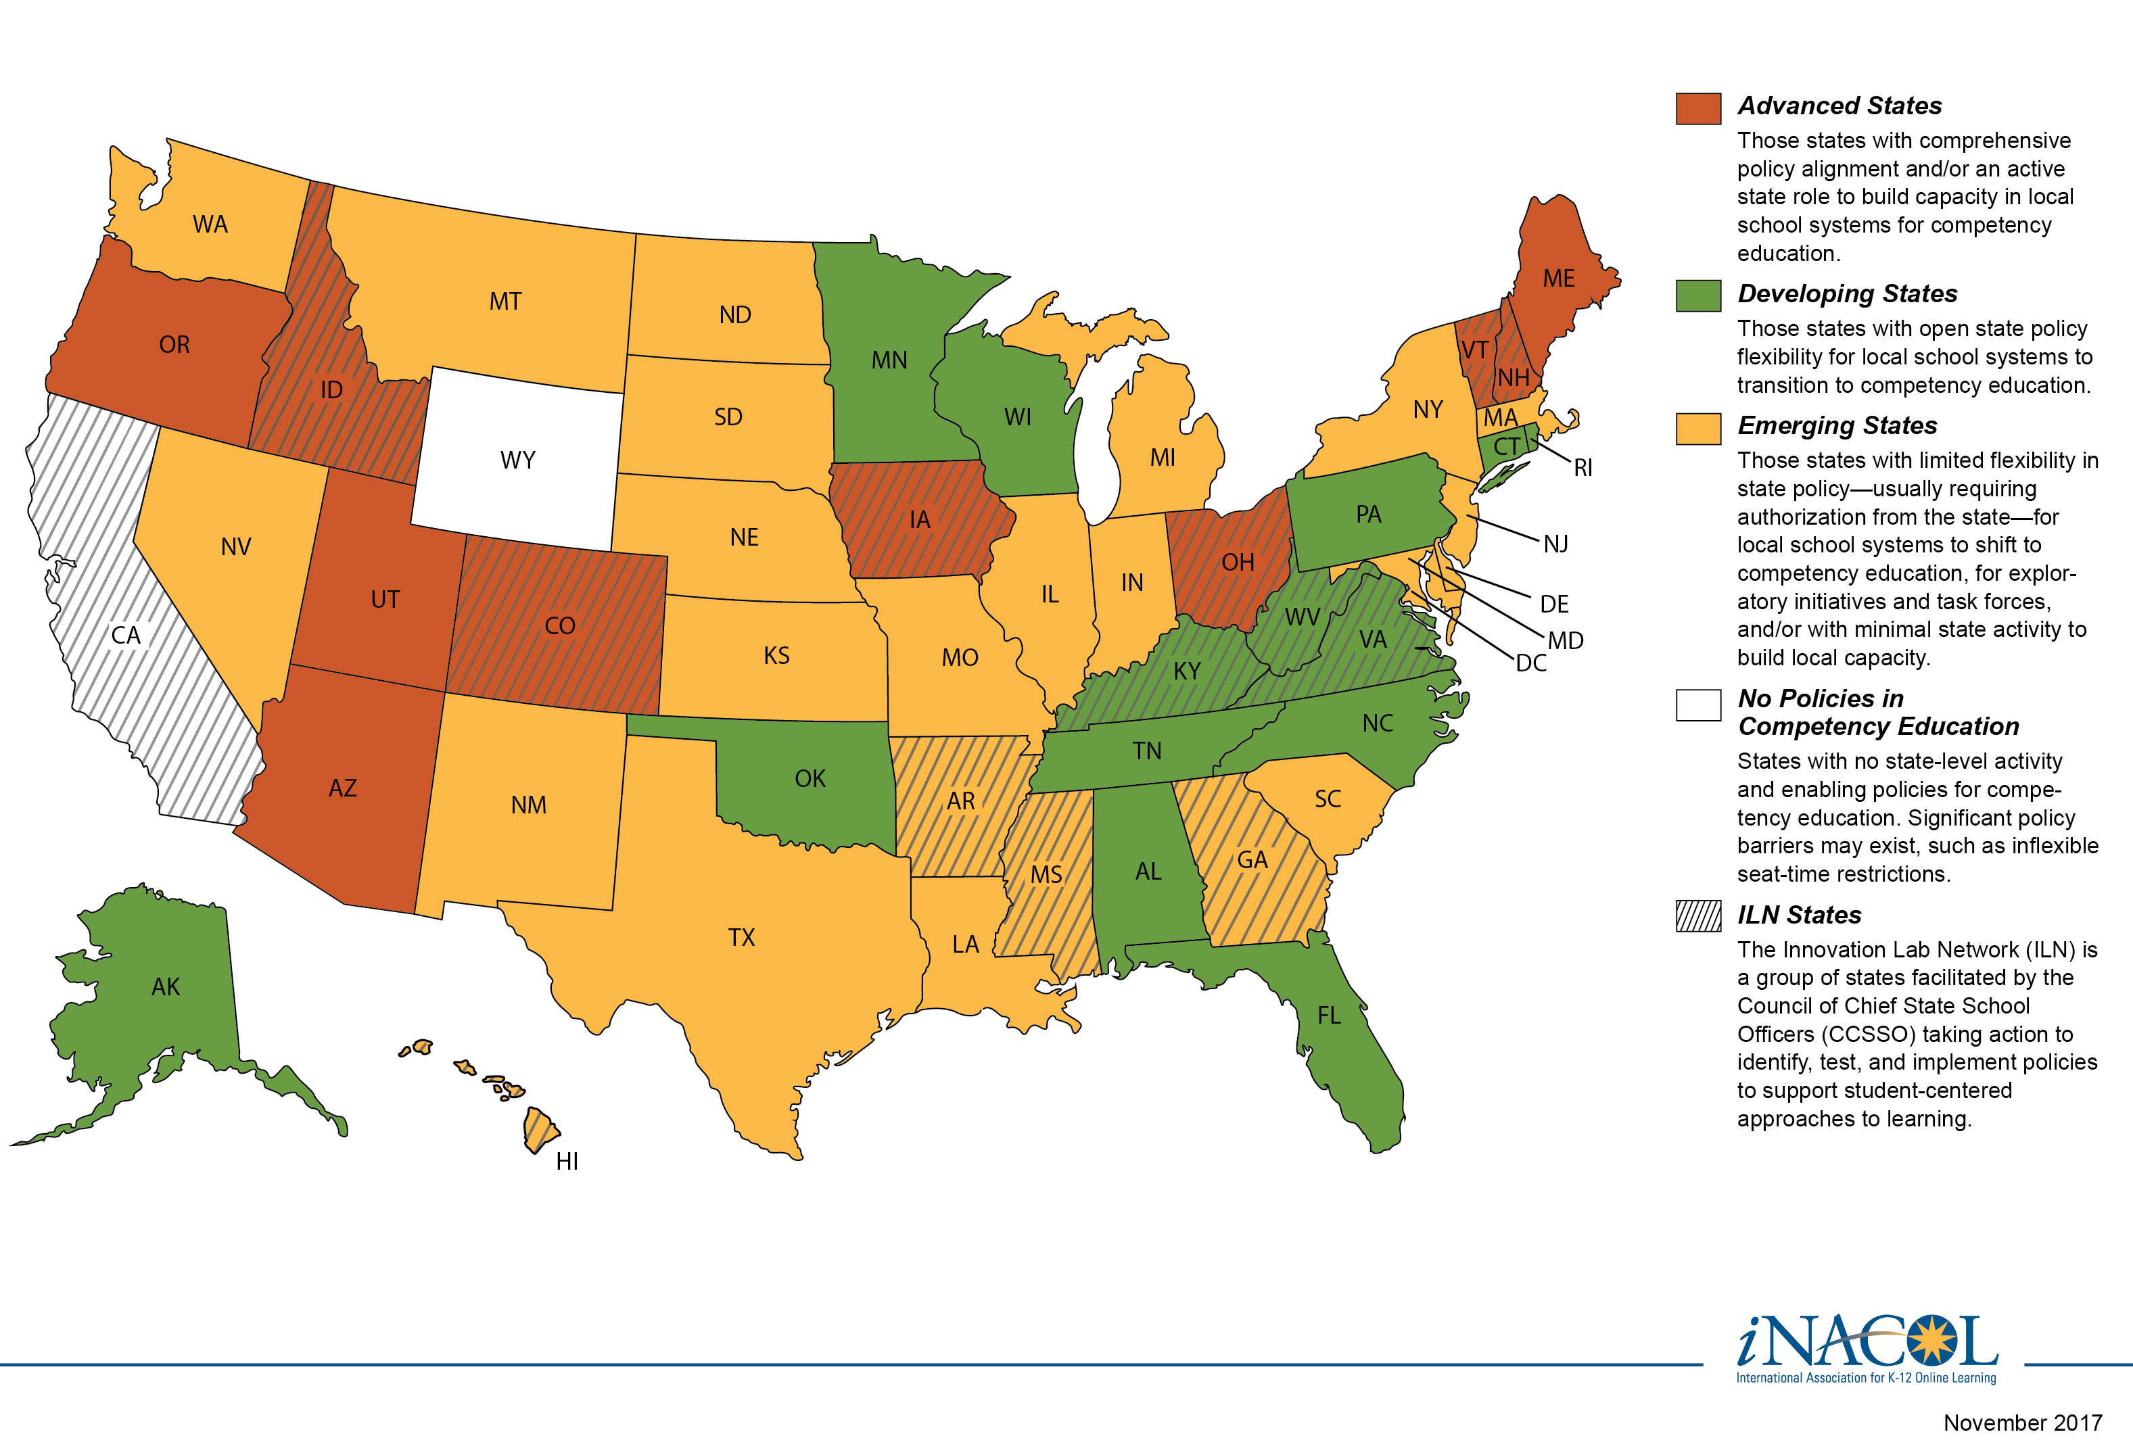
A Snapshot of K-12 Proficiency-based Learning
Notes:
As you can see, Vermont is only one of many states that is advancing toward proficiency-based learning. Note that the terms competency-based and mastery-based learning are also used around the country.

Slide 7
What is Personalized Learning?
Personalization is a “learning process in which schools help students assess their own talents and aspirations, plan a pathway toward their own purposes, work cooperatively with others in challenging tasks, maintain a record of explorations, and demonstrate their learning against clear standards in a wide variety of media, all with the close support of adult mentors and guides.” – National Association of Secondary School Principals
Notes:
Personalized learning is also part of Act 77 and is deeply aligned with proficiency-based learning.

Slide 8
Personalized Learning Plans, Expanded Learning, and Flexible Pathways
Personalized learning plans, expanded learning, and flexible pathways are all part of a personalized system.
Learn more about these different components on the next slides.
Notes:
(no voiceover) Learn more about the components of a personalized system.

Slide 9
What are Personalized Learning Plans?
Personalized Learning Plans (PLPs) are plans that reflect a student’s goals, abilities, aspirations and interests.
They are created by the student, parent/guardians, and teachers, and outline learning opportunities to support the student’s path.
PLPs are required by EQS, starting in the seventh grade.
Notes:
Personalized Learning Plans are a major focus of the work currently being done in Vermont schools. Each supervisory union and/or district makes their own decisions about how to create and implement PLPs.

Slide 10
What is Expanded Learning?
What is Expanded Learning?
High quality programs within communities and schools designed to serve learners on a regular basis by providing unique opportunities for academic growth, hands-on learning, and personal development. Often these programs are provided by schools in collaboration with non-profit organizations, museums, and other local entities. These opportunities can occur beyond traditional school hours and outside of the school building.
Notes:
Expanded learning, created by Act 77, opens up a range of real-world learning experiences that acknowledge individual goals, learning styles, and abilities.

Slide 11
What are Flexible Pathways?
What are Flexible Pathways?
Any combination of high-quality expanded learning opportunities, including academic and experiential components, which build and assess attainment of identified proficiencies and lead to secondary school completion, civic engagement and postsecondary readiness. Flexible pathways allow students to apply their knowledge and skills to tasks of personal interest as part of the personalized learning planning process.
Notes:
Act 77’s flexible pathways are designed to increase rates of secondary school completion, as well as post-secondary readiness, for all Vermont students.

Slide 12
Flexible Pathways
Flexible Pathways
Vermont’s flexible pathways to graduation increase equity of access to college and careers. For example, the Dual Enrollment program includes up to two college courses for eligible Vermont high school students.
Click any box to learn more.
Dual Enrollment
Early College
Work-Based Learning
Virtual and Blended Learning
Career and Technical Education
Community-Based/Service Learning
Expanded Learning Opportunities
High School Completion Program
Notes:
Click any box to learn more about the variety of flexible pathways available to students in Vermont.

Slide 13
How do Personalization and Proficiency-based Learning Fit Together?
Proficiencies can be attained in various learning environments including expanded learning and flexible pathways.
These learning opportunities may include: work-based learning, internships, service learning, independent study, dual enrollment, early college, and more.
Notes:
Through Personalized Learning Plan development and flexible pathways, all Vermont students can attain the proficiencies necessary to graduate and to be college and career ready.

Slide 14
Equity Focus: Every Student Succeeds Act
Proficiency-based learning is designed to identify and address gaps to provide equitable learning opportunities for every student.
“A high priority for the Vermont Board of Education and our community is ensuring equitable outcomes for all of our students.” (Every Student Succeeds Act [ESSA] Vermont State Plan, page 69)
Notes:
Vermont’s plan for the Every Student Succeeds Act, adopted in 2017, has a focus on equity and inclusion.

Slide 15
Equity Focus: Multi-Tiered System of Supports
All Vermont schools use a Multi-Tiered System of Supports (MTSS) framework for academic, behavior, and social-emotional learning for all students.
The MTSS framework supports equitable access and engagement in core instruction, with supplemental supports as needed, for all students.
Notes:
Click the link to visit the Agency’s Multi-Tiered System of Supports page to learn more about how MTSS supports schools.

Slide 16
Equity Focus: Special Education
Vermont has a robust special education system, which places a great deal of emphasis on inclusion and equity for all students.
The goal of special education is for students with disabilities to access the general education curriculum to the greatest possible extent.
Notes:
It is important to understand that all students are part of a proficiency-based system. Click the link to learn more about Vermont’s special education resources and supports.

Slide 17
Standards and Proficiencies: What Are They?
Standards identify the essential knowledge, skills and behaviors that should be taught and learned in school at each grade level. They are not a curriculum, and are usually national in nature.
Proficiencies include explicit, measurable, learning objectives based on standards and measure a learner’s knowledge and skill demonstrated in a consistent manner, in various settings over time. Proficiencies are also referred to as competencies.
Notes:
Standards and proficiencies are distinct, yet connected, concepts.

Slide 18
Standards and Proficiencies: Vermont Content Standards
The following standards, adopted by the Vermont State Board of Education, are used by supervisory districts/supervisory unions to develop proficiency indicators.
Arts
Career and Technical Education
Driver Education
English Language Arts
Family and Consumer Sciences
Financial Literacy
Financial Literacy
Global Citizenship
Health Education
Mathematics
Physical Education
Science
Technology
Notes:
Click any link to learn more about Vermont’s adopted standards.

Slide 19
Standards and Proficiencies: Local Lens
Note that, because of Vermont’s strong tradition of local control, schools and supervisory unions/supervisory districts (SUs/SDs) approach proficiencies through different lenses.
You may see a range of terminologies and approaches as to how students attain content and skill proficiencies, as well as how they are measured and reported.
All of these variations are still based on the same, state-adopted standards.
Notes:
All supervisory unions and districts in Vermont use the same standards, but make local decisions about their implementation.

Slide 20
Standards and Proficiencies: Transferable Skills
Enshrined in the Education Quality Standards, transferable skills are the broad set of knowledge, skills, work habits, and character traits that are believed to be critically important to success in today’s world, particularly in collegiate programs and modern careers.
Transferable skills include communication, collaboration, creativity, innovation, inquiry, problem solving and the use of technology.
Notes:
The Education Quality Standards ensure that transferable skills, as well as content knowledge, are connected to the opportunities and challenges of a 21st century world.

Slide 21
Standards and Proficiencies: Transferable Skills
Students in Vermont are expected to become proficient in transferable skills.
Each SU/SD may define transferable skills that align with expectations in the Education Quality Standards.
You can review sample transferable skills here and here.
Notes:
Note that transferable skills may be organized in different ways, as shown in the two linked examples.

Slide 22
Standards and Proficiencies: Proficiency-based Graduation Requirements
These proficiency-based graduation requirements (PBGRs) are the “locally-delineated set of content knowledge and skills connected to state standards that, when supplemented with any additional locally-developed requirements, have been determined to qualify a student for earning a high school diploma.”
Notes:
Proficiency-based graduation requirements stand in contrast to traditional, credit-bearing graduation requirements. The way in which PBGRs are implemented is a local decision.

Slide 23
Standards and Proficiencies: Proficiency-based Graduation Requirements
Beginning with the class of 2020, all students in Vermont will graduate by demonstrating a range of proficiencies.
More information can be found in EQS, 2120.7, page 7.
Notes:
(no voiceover)

Slide 24
Standards and Proficiencies: Putting the Pieces Together
SUs/SDs use standards to determine what proficiencies students need to demonstrate for graduation. These “proficiency-based graduation requirements” include both content and transferable skills.
For example, a student must be proficient in math content as well as in communication skills in order to graduate.
Notes:
Standards drive local decisions about proficiency-based graduation requirements.

Slide 25
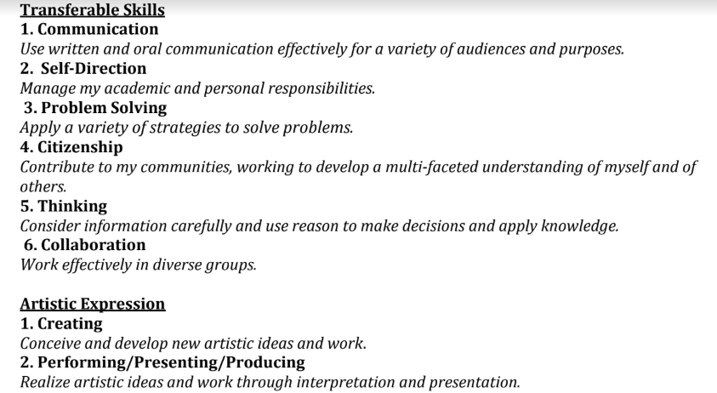
Standards and Proficiencies: Sample PBGRs
Snapshot of PBGRs from Franklin Northeast Supervisory Union
Notes:
Here is a sample proficiency-based graduation requirement from Franklin Northeast Supervisory Union that shows both content and transferable skills.

Slide 26
Curriculum and Instruction: Vermont’s Pedagogical Culture
Educators have high expectations for all students.
All students can attain proficiency.
An emphasis is placed on growth mindset for all learners, including students and educators.
More information can be found in 2120.6 of EQS, page 6.
Notes:
Vermont has a strong tradition of educational excellence, which includes high expectations for all learners.

Slide 27
Curriculum and Instruction: Vermont’s Pedagogical Culture
Curriculum is a collaboration between leaders, educators, and students.
Students, peers, and community members are viewed as sources of knowledge.
Learning is a social enterprise, and relationships are essential.
Education is culturally and socially relevant, and emphasizes real-world concepts and applications.
Notes:
Vermont’s pedagogical culture is shifting away from more traditional ideas about education.

Slide 28
Curriculum and Instruction: Vermont’s Pedagogical Culture
Students are encouraged to learn deeply and authentically within a content area. This is in contrast to traditional systems, where teachers are expected to cover a wide range of content in a specific amount of time.
Learning is the constant, time is the variable.
Universal Design for Learning (UDL) informs teaching and learning.
There is an emphasis on interdisciplinary learning.
Notes:
Here are more key shifts in Vermont’s pedagogical culture.

Slide 29
Curriculum and Instruction: The Students’ Role
Educators encourage deep learning through frequent feedback.
Students can work at different levels on proficiency progressions.
Student agency is valued, and drives instructional decisions and student learning.
Notes:
Student voice and choice is an integral part of learning in Vermont.

Slide 30
student agency
Curriculum and Instruction: Student Agency
Students take on an active role in designing, monitoring, and ensuring success of their learning experience. Students:
are active participants in defining their strengths, needs, and interests.
are active co-designers of their personalized learning plans.
take greater ownership over monitoring their progression through learning activities, identifying when to ask for help, and when they’re ready to demonstrate proficiency.
Notes:
Students are encouraged to take charge of their own learning.

Slide 31
student agency
Curriculum and Instruction: Student Agency
In addition, students:
make choices about what content to learn when, or what type of learning experience they want to engage in to practice a skill or to demonstrate proficiency.
communicate with teachers about their PLP and how to strengthen it.
build long-term self-regulation skills to keep themselves on track for learning because of their increased autonomy.
Notes:
(no voiceover)

Slide 32
Assessment
Assessment and reporting in Vermont focuses on content knowledge, skills, and understanding, as well as on transferable skills.
Assessment can take various forms, such as performance assessments, benchmarking, diagnostics, interim, summative, and formative assessments.
Notes:
Vermont takes a holistic view of assessment, incorporating but not solely relying on standardized tests. As required by law and determined by IEP teams, alternate assessments are provided for students who cannot participate in general assessments with accommodations.

Slide 33
Assessment
In a PBL system, feedback is frequent, timely, and used to inform student learning and instructional decisions.
Self-assessment is a key piece of proficiency-based learning. Students practice self-assessment and reflect on their learning.
Notes:
Authentic assessments, including feedback and reflection, are used to help learners progress through a proficiency-based system.

Slide 34
Assessment: State Summative Assessments
Vermont uses the Smarter Balanced yearly summative exams (SBAC) to report out on math and English.
Other state assessments include Vermont Physical Education Assessment and the Vermont Science Assessment.
Notes:
Click the links to learn more about specific state assessments. This range of assessments focuses on what we want our students to know and be able to do in order to thrive in civic and economic life.

Slide 35
Assessment: Local Comprehensive Assessments
SUs/SDs are expected to complement state assessments with their own K-12 local comprehensive assessment systems (LCAS).
These local systems will have a focus on performance- and curriculum-based assessments, as well as on practices to ensure that students know where they need to show growth.
Notes:
In addition to state assessments, supervisory unions and districts create complementary local systems of assessment.

Slide 36
Reporting
As required in 16 V.S.A. §165(a)(2), each school shall report student and system performance results to the community at least annually in a format selected by the school board.
In other words, reporting practices are a local decision.
Learn more about proficiency-based grading and reporting here.
Notes:
Click the link to learn more about reporting expectations in Vermont.

Slide 37
Reporting
PBL report cards/progress reports accurately reflect a student’s learning progress and achievement.
Content knowledge and understanding is assessed and reported separately from behavior or transferable skills.
Notes:
Reporting in a proficiency-based system gives an authentic picture of what a student knows, understands, and can do at a given point in the school year.

Slide 38
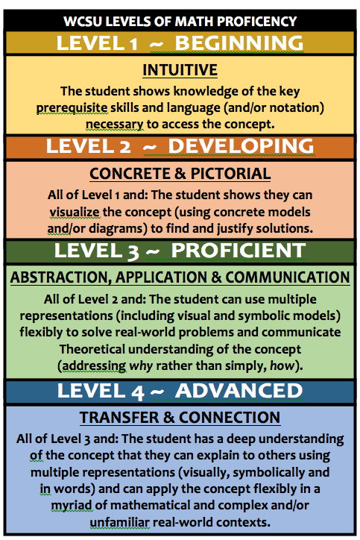
Reporting
Proficiency levels show where a student is, and where they need to grow.
On-going reporting allows students and families to track progress over time.
Here is a sample math proficiency level visual from Washington Central Supervisory Union.
Notes:
Click the image to learn more about how one Vermont supervisory union reports on proficiencies.

Slide 39
Reporting
College and universities are aware of the movement toward proficiency-based transcripts.
These transcripts should not impact a student’s admission prospects. Read more about proficiency-based transcripts and college.
Notes:
A common concern is how higher education will view proficiency-based transcripts. Learn more about how colleges and universities view these transcripts by clicking the link.

Slide 40
Reporting
“The cynicism of [these] college admission offices about grades is well-warranted, as grades do not typically represent student achievement but rather an amalgam of achievement, behavior, compliance, and test-taking skill.”
-“Gearing up for FAST Grading and Reporting,” Ken O’Connor, Lee Ann Jung, and Douglas Reeves
Notes:
Experts also report that higher education is moving toward an understanding of proficiency-based transcripts.

Slide 41
Structure, Organization, and Scheduling
Leaders support structural changes necessary for the success of a PBL system.
School day structures allow collaborative meeting time for educators.
Time is embedded during the school day for general and special educators to collaborate on instruction and assessment.
Notes:
A strong proficiency-based model requires a shift away from traditional school structures and scheduling.

Slide 42
Structure, Organization, and Scheduling
The school day should be scheduled so that students can access tiered levels of support.
Learning is the constant, time is the variable.
Classrooms are organized in a way that supports personalization of learning.
Technology is leveraged to support these changes.
Notes:
Click the link to learn more about specific examples of structure, organization and scheduling in a proficiency-based system.

Slide 43
Structure, Organization, and Scheduling
A range of technology platforms can support a PBL system.
These include personalized learning plan platforms, as well as assessment and reporting systems.
Notes:
Individual districts and supervisory unions make decisions about the technology they use to support proficiency-based learning and personalization.

Slide 44
Structure, Organization, and Scheduling
Professional learning for educators is personalized, relevant, active, collaborative, sustainable, and allows for feedback and reflection.
School systems may use a personalized learning plan format for educators’ professional learning.
Notes:
The key concepts enshrined in a proficiency-based system carry over into professional learning for educators as well.

Slide 45
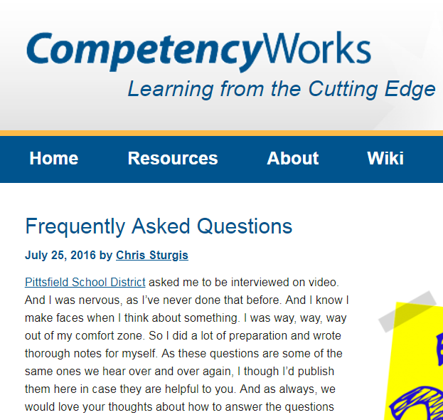
Frequently Asked Questions
Are there any misconceptions about proficiency-based learning (PBL)?
What are the advantages of PBL over traditional approaches?
What are the challenges of implementing PBL?
Notes:
There are many common questions and concerns regarding the shift to proficiency-based learning. Click the links to learn more.

Slide 46
Acronym Glossary
AOE (Agency of Education)
C3 (College, Career, and Civic Life Framework for Social Studies State Standards)
CCSS (Common Core State Standards for Math and English Language Arts)
CTE (Career and Technical Education)
ELO (Expanded Learning Opportunity)
ESSA (Every Student Succeeds Act)
LCAS (Local Comprehensive Assessment System)
MTSS (Multi-tiered Systems of Support)
NCAS (National Core Arts Standards)
NGSS (Next Generation Science Standards)
PBGR (Proficiency-based Graduation Requirements)
PBL (Proficiency-based Learning)
PLP (Personalized Learning Plan)
SBAC (Smarter Balanced Assessment Consortium)
SD/SU (Supervisory District, Supervisory Union)
SHAPE (Society of Health and Physical Educators Standards)
UDL (Universal Design for Learning)
Notes:
Vermont education uses many acronyms. This glossary can help you swim through the alphabet soup!

Slide 47
Resource Bibliography
Act 77
Education Quality Standards (EQS)
Flexible Pathways
Key Characteristics of a Proficiency-based System
Local Comprehensive Assessment Systems
Multi-tiered Systems of Support (MTSS)
Personalization Glossary
Personalized Learning
Personalized Learning Plan
Proficiency-based Graduation Requirements
Proficiency-based Learning
Proficiency-based Learning Glossary
Smarter Balanced State Assessments
Vermont Special Education
Universal Design for Learning
Vermont’s ESSA Plan
Notes:
Click any link to learn more.

Slide 48
Thank You
Acknowledging support received in the creation of this document from: Pat Fitzsimmons (Proficiency-based Learning Team Lead), Sigrid Olson (Personalized Learning Coordinator), John Spinney (Post-Secondary Transition Coordinator), Tracy Watterson (Multi-tiered System of Supports Program Manager), Susan Yesalonia (Health and Physical Education Specialist), and members of the Special Education, Proficiency-based Learning, Personalized Learning and Multi-tiered Systems of Supports Vermont Agency of Education teams .
A special thank you to Franklin Northeast and Washington Central Supervisory Unions for the use of their resources.
.
Sarah Birgé (English Language Arts Specialist) and Martha Deiss (Global Citizenship Specialist)
Notes:
A sincere thanks to those who helped with the creation of this primer: Pat Fitzsimmons, Sigrid Olson, John Spinney, Tracy Watterson, Susan Yesalonia, and members of the Special Education, Proficiency-based Learning, Personalized Learning and Multi-tiered Systems of Supports Agency of Education teams, as well as the teams at Franklin Northeast and Washington Central Supervisory Unions.

