Slide 1
AMERICAN GOVERNMENT
Chapter 1 AMERICAN GOVERNMENT AND CIVIC ENGAGEMENT

Slide 2
THIS IS AMERICA… KEEp it FREE!
View this image, created during WW2.
What idea is it promoting? Who is and isn’t included in this messaging?
Notes:
(credit: modification of work by the National Archives and Records Administration)
View the image. What is this message trying to convey?
It was created during World War II, and depicts voting as an important part of
the fight to keep the United States free.
“Belong to all people equally” was certainly not true at the time. The use of terms servant and master is especially tone deaf, considering.

Slide 3
THIS IS AMERICA… KEEp it FREE!
It depicts voting as an important part of the fight to keep the United States free.
“Belong to all people equally” was certainly not true at the time.
The use of terms servant and master is especially tone deaf, considering this is pre-civil rights era.
Notes:
(credit: modification of work by the National Archives and Records Administration)
View the image. What is this message trying to convey?
It was created during World War II, and depicts voting as an important part of
the fight to keep the United States free.
“Belong to all people equally” was certainly not true at the time. The use of terms servant and master is especially tone deaf, considering.

Slide 4
THIS IS AMERICA… KEEp it FREE!
A functioning democracy relies on citizen participation
Engagement ensures that “We The People” influence our government.
But who is allowed to participate has changed drastically since the founding.
Notes:
(credit: modification of work by the National Archives and Records Administration)
We rely on citizen participation.
Many Americans have fought and died for the right to vote, from the revolution through the Civil War and the civil rights era

Slide 5
What this chapter Covers
What does government do to serve the people?
What different forms of government exist?
How do they differ?
How can citizens best engage with and participate in the crucial process of governing the nation?
Notes:
(credit: modification of work by the National Archives and Records Administration)

Slide 6
What does government do to serve the people?
Government affects all aspects of our lives
Approving food labeling
Maintaining roads
Providing educational grants and loans
Emergency medical services, fire departments, and police departments all provide their services without charge
The list is long and pervasive
Notes:
What we eat, where we go to school, what kind of education we receive, how our tax money is spent, and what we do in our free time are all affected by government.
Americans are often unaware of the pervasiveness of government in their everyday lives, and
many are unsure precisely what it does.
A fire department ambulance rushes to the rescue in Chicago. (photo credit: Tony Webster)

Slide 7
What does government do to serve the people?
What is government?
Government is the means by which a society organizes itself and allocates authority in order to accomplish collective goals and provide benefits that the society as a whole needs.
Governmental goals include
economic prosperity for the nation,
secure national borders, and
the safety and well-being of citizens

Slide 8
What does government do to serve the people?
The benefits of government differ around the world, but often include
education,
health care, and
an infrastructure for transportation

Slide 9
What does government do to serve the people?
What is politics?
politics is the process of gaining and exercising control within a government for the purpose of setting and achieving particular goals, especially those related to the division of resources within a nation
Or as Harold Lasswell said, politics is who gets what, when, and how

Slide 10
Government versus Economic systems
Sometimes governmental systems are confused with economic systems because some are more closely related to each other or developed together.
For example, capitalism (an economic system) developed at roughly the same time as ideas about democratic republics, self-government, and natural rights

Slide 11
Political Philosophy
Liberty became an important concept at that time.
John Locke, an English political philosopher of the seventeenth century, thought people have natural rights to life, liberty, and property.
Does this phrase sound familiar?

Slide 12
Political Philosophy
The idea was that people should be free to consent to being governed.
That people should govern themselves through elected representatives and not a king
Only those representatives chosen by the people had the right to make laws to govern them.
Imagine how radical this was at a time when most people believed Kings and Queens were chosen by God to rule them!

Slide 13
Political Philosophy
Adam Smith thought people should be free to acquire property in any way that they wished.
Instead of being controlled by government, business, and industry, Smith argued, people should be allowed to operate as they wish and keep the proceeds of their work.
Competition would ensure that prices remained low and faulty goods disappeared from the market

Slide 14
Political Philosophy
He imagined a system where
business would reap profits,
consumers would have their needs satisfied, and
society as a whole would prosper.
This is the basis of industrial capitalism

Slide 15
Political Philosophy
Representative government and capitalism developed together in the United States, and many Americans tend to equate democracy, a political system in which people govern themselves, with the economic system of capitalism.
One might argue that a capitalist economic system might be bad for democracy in some respects.

Slide 16
Political Philosophy
Smith theorized that capitalism would lead to prosperity for all
Do you believe this has been realized in our society?
Great gaps in wealth exist between the owners of major businesses, industries, and financial institutions and those who work for them
Great wealth may give a small minority more influence over the government

Slide 17
Political Philosophy
Socialism is an alternative economic system. In socialist societies, factories, large farms, and banks, are owned by the government
The government accumulates wealth and then redistributes it to citizens in the form of social programs providing free or inexpensive health care, education, and childcare.

Slide 18
Political Philosophy
In socialist countries, the government usually owns utilities, transportation systems, and telecommunications systems.
In many socialist countries the government is an oligarchy: only members of a certain political party or ruling elite can participate in government.

Slide 19
Political Philosophy
Socialist countries can also have democratic forms of government
Examples: Norway, Sweden, Denmark, the Netherlands,
Many Americans associate socialism with tyranny and a loss of individual liberties,
This is not always the case

Slide 20
Our system
Our democratic government works closely with its capitalist economic system.
This interconnectedness affects how goods and services are distributed.
Private goods are goods and services provided by for profit private businesses (food, clothing, and housing)
Those who live in poverty cannot always afford to buy these goods, or what they can afford is of inferior quality.

Slide 21
Our system
The market cannot provide everything (in enough quantity or at low enough costs) in order to meet everyone’s needs.
Some goods are therefore provided by the government.
Public goods are goods or services that are available to all without charge.
Examples: national security and education.

Slide 22
Our system
Public schools provide education for all children in the United States, regardless of religion, race or ethnicity, socioeconomic class, or level of academic ability
Private schools provide an alternative education (some with annual tuition equivalent to that of a private college)
If private schools were the only option, who would be left out?

Slide 23
Our system
Toll goods (like private schools) are available but only to those who can pay the price.
They are a middle ground between public and private goods.
Many people believe everyone in the nation benefits from the educated voters and workers produced by the public school system.

Slide 24
Our system
What other public goods does government provide?
Stability and security (military, police and fire departments)
Public education
Public transportation
Food, housing, and health care for the poor
Do all Americans experience these services (paid for by the tax base) in the same way?

Slide 25
Our system
Government also protects common goods : goods used free of charge of limited supply (fish in the sea or clean drinking water)
Because everyone can use these goods, they must be protected so a few people do not take everything that is available and leave others with nothing.

Slide 26
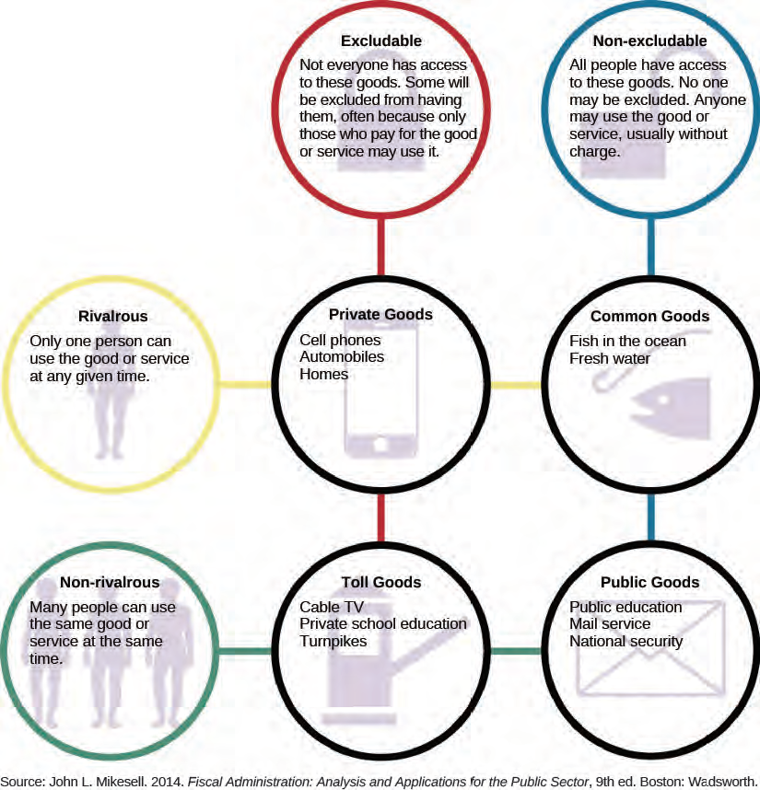
Goods differentiate by WHO has access:
Excludable vs. non-excludable
and HOW MANY people can access the good at the same time
Rivalrous vs. non-rivalrous
Notes:
This chart depicts different kinds of goods

Slide 27
Our system
Fish are one of the many common goods the government regulates to ensure that certain species are not fished into extinction
Environmentalists want to set strict fishing limits on a variety of species.
Commercial fishers resist these limits, claiming they are unnecessary and, if enforced, would drive them out of business
Notes:
Fishing provides income, as well as food, for many Americans. However, without government restrictions on the kinds and number of fish that can be caught, the fish population would decline and certain species could become instinct. This would ultimately lead to the loss of jobs and income as well as a valuable source of nourishment. (credit: Michael L. Baird)

Slide 28
Our system
Fishing limits are set by a combination of scientists, politicians, local resource managers, and groups representing the interests of fishers.
Should the government regulate fishing?
Is it right to interfere with people’s ability to earn money today in order to protect the access of future generations to the nation’s common goods?
Notes:
(credit: Michael L. Baird)

Slide 29
Our system
Government also creates a structure by which goods and services can be made available to the people.
We elect representatives to city councils, state legislatures, and Congress.
These bodies make laws to govern their respective jurisdictions.
They also pass measures to raise money (via taxes) and draft budgets to spend the money.

Slide 30
Our system
Politics involves choosing the values government will support, whether
Individualism = loosen regulations on business and industry or to cut taxes or
Egalitarianism = equal treatment for all and the destruction of socioeconomic inequalities
The political process and the input of citizens help determine the answer.

Slide 31
Our system
Civic engagement, or the participation that connects citizens to government, is a vital ingredient of politics…And it’s where YOU come in.
Citizens influence the policies pursued, the values supported, the initiatives funded, and determines who gets to make the final decisions.

Slide 32
What different forms of government exist?
A democracy is a government in which political power rests in the hands of the people.
In a representative democracy the citizens do not govern directly but elect representatives to make decisions and pass laws on behalf of all the people.

Slide 33
What different forms of government exist?
Most representative governments favor majority rule: the opinions of the majority of the people have more influence with government than those of the minority.
If the number of elected representatives who favor a proposed law is greater than those who oppose it, the law will be enacted.
But in the United States, minority rights are protected: people cannot be deprived of certain rights even if an overwhelming number of people think that they should be.
Notes:
(

Slide 34
What different forms of government exist?
In a direct democracy, people participate directly in making government decisions.
Ancient Greece (for all male citizens)
Voting on a ballot for a referendum or proposed law
New England town meetings
Notes:
Residents of Boxborough, Massachusetts, gather in a local hotel to discuss issues affecting their town.
New England town meetings provide an opportunity for people to experience direct democracy. This tradition has lasted for hundreds of years
(credit: modification of work by Liz West)

Slide 35
What different forms of government exist?
We are a republic (aka a representative democracy)
Most countries now have some form of representative government

Slide 36
Figure 1.6
BLUE countries have some form of representative democracy, although the people may not have as much political power as they do in the United States.
RED countries like China, Vietnam, and Cuba, have an oligarchic form of government.
YELLOW countries are monarchies where the people play little part in governing.

Slide 37
What different forms of government exist?
In a monarchy, one ruler, usually hereditary, holds political power.
The power of some monarchs is limited by law, with a monarch ruling along with an elected legislature
Saudi Arabia, Qatar, and the United Arab Emirates, have absolute monarchs whose power is unrestricted

Slide 38
What different forms of government exist?
An oligarchy is when a handful of elite members of society, often those who belong to a particular political party, hold all political power.
Cuba and China
Totalitarianism is when the government is more important than the citizens and it controls all aspects of citizens’ lives.
Citizens’ rights are limited. The government does not allow political criticism or opposition
North Korea

Slide 39
Our System
We allow citizens to participate in government in many ways.
We also have many different levels and branches of government to approach
Many people take this as evidence that a U.S citizen can influence government actions.
Some political theorists, however, argue that only a handful of economic and political elites have any influence over government.

Slide 40
PLURALISM vs. Elitism
The elite theory of government purports that a set of elite citizens is really in charge of government in the United States and that others have no influence
The pluralist theory of government says that political power rests with competing interest groups who share influence in government.

Slide 41
Elitism
The wealthy use their power to control the economy to keep those below them from advancing
Their wealth allows them to secure important positions in politics.
They then use this power to make decisions and allocate resources in ways that benefit them.
They believe the elites are “better fit to govern” than “We the People”.

Slide 42
Figure 1.7
The four most recent U.S. presidents have all graduated from an Ivy League university.

Slide 43
Figure 1.8
This picture depicts the fairly uniform nature of Congress. Most are men, nearly all are white, and they tend to resemble one another in terms of income and level of education.
Currently, more than half of the members of Congress are millionaires

Slide 44
PLURALISM vs. Elitism
93% of members of the House have a bachelor’s degree
99 % of members of the Senate do
Fewer than 40% of U.S. adults have even an associate’s degree.
The majority of the men and women in Congress engaged in either state or local politics, were business people, or practiced law before being elected to Congress.
Approximately 80% of both the Senate and the House of Representatives are male
Fewer than 20% of members of Congress are people of color

Slide 45
PLURALISM vs. Elitism
The nation’s laws are made primarily by well-educated white male professionals and businessmen.
Does this matter?

Slide 46
PLURALISM vs. Elitism
You can argue that race, sex, profession, education, and socioeconomic class have an important effect on people’s political interests.
Giving more money to public education does not benefit the wealthy as much as it does the poor, because the wealthy are more likely to send their children to private schools or may have public schools that are like private schools
Better funded public schools have the potential to improve the upward mobility of other socioeconomic classes

Slide 47
PLURALISM
Pluralist theory rejects this approach, arguing that although there are elite members of society they do not control government.
Pluralists argue that political power is distributed throughout society.
They believe people with shared interests will form groups to make their desires known to politicians (environmental advocates, unions, businesses organizations).

Slide 48
PLURALISM
A variety of organized groups hold power, with some groups having more influence on certain issues than others.
Thousands of interest groups exist in the United States.
Approximately 70–90 percent of Americans report belonging to at least one group
These groups compete for influence

Slide 49
PLURALISM
Robert Dahl argued that politicians seeking an “electoral payoff” are attentive to the concerns of politically active citizens and, through them, become acquainted with the needs of ordinary people.
They will attempt to give people what they want in exchange for their votes.

Slide 50
The Tradeoffs Perspective
What if the interests of both the elite and the people influence government action, and compromises attempt to please them both?
Tradeoffs can happen between those who favor the supremacy of the central government and those who believe that state governments should be more powerful.
Tradeoffs may be about freedom of speech.
Tradeoffs occur as a result of conflict between groups representing the competing interests of citizens.
Tradeoffs may occur when a representative balances voting with their party or voting with their constituents

Slide 51
What do you see in Politics?
Elitism?
Pluralism?
Tradeoffs?
Can you give an example of why you feel this way?

Slide 52
How can citizens engage and participate?
People can achieve many goals and improve their lives through civic engagement.
According to the pluralist theory, government cannot function without active participation by at least some citizens.
Even if we believe the elite make political decisions, participation in government through the act of voting can change who the members of the elite are.

Slide 53
WHY participate?
Civic engagement can increase the power of ordinary people to influence government actions.
U.S. history is filled with examples of people actively challenging the power of elites, gaining rights for themselves, and protecting their interests.

Slide 54
WHY participate?
Abolition of slavery
The extension of voting rights over time (to all men, to women, to 18 year olds)
The civil rights movement
Women’s rights
LGBTQ rights
These gains were achieved by marching in protest, participating in boycotts, delivering speeches, writing letters to politicians, and sometimes risking arrest in order to be heard

Slide 55
WHY participate?
Representative democracy cannot work effectively without the participation of informed citizens,

Slide 56
HOW CAN I PARTICIPATE?
Staying informed
Writing or emailing political representatives
Filing a complaint with your city council
Responding to public opinion polls
Contributing to a political blog
VOTING
Attending political rallies
Donating money to campaigns
Civil disobedience
Notes:
Volunteers fed people at New York’s Zuccotti Park during the Occupy Wall Street protest in September 2011. (credit: David Shankbone)

Slide 57
HOW CAN I PARTICIPATE?
Hosting a book club or discussion group about politics
Working for political campaigns
Engaging in political fundraising efforts
Helping people register to vote
Driving voters to the polls on Election Day
Joining interest groups
Signing petitions
Volunteering in your community
Boycotts or “buycotts”
Notes:
After the Southern California wildfires in 2003, sailors from the USS Ronald Reagan helped volunteers rebuild houses in San Pasqual as part of Habitat for Humanity. Habitat for Humanity builds homes for low-income people. (credit: Johansen Laurel, U. S. Navy)

Slide 58
Youth Participation
A 2008 survey revealed that approximately two-thirds of American adults participated in some type of political action in the past year.
Americans aged 18–29 are less likely to do so
A 2015 poll of more than 3,000 young adults by Harvard University’s Institute of Politics revealed that only 22% claimed to be politically engaged
Though one-third reported that they had voluntarily engaged in some form of community service in the past year (yay!)

Slide 59
Participation and partisanship
Committed partisanship, the tendency to identify with and to support (often blindly) a particular political party, alienates some Americans
Distrust of the opposing party and not an ideological commitment to their own party is at the heart of most partisanship among voters
Young Americans are particularly likely to be put off by partisan politics.
More Americans under the age of thirty now identify themselves as Independents instead of Democrats or Republicans

Slide 60
Youth Participation
Young Americans are increasingly concerned about specific issues, such as same-sex marriage, than committed to a given party
Younger Americans also do not feel that candidates generally tackle issues relevant to their lives. And no wonder, when older people vote more, it means politicians cater to their needs (Social Security not student loans)
Youth are especially put off by the ideology —established beliefs and ideals that help shape political policy—of one of the major parties.

Slide 61
Figure 1.15
Young Americans are likely to identify as an Independent rather than a Democrat or a Republican. However, younger voters are more likely to lean in a liberal direction on issues and therefore favor the Democratic Party at the ballot box.

Slide 62
Youth Participation
The likelihood that people will become active in politics also depends not only on age but on such factors as wealth and education.
In a 2006 poll, the percentage of people who reported that they were regular voters grew as levels of income and education increased.

Slide 63
Youth Participation
Political involvement also depends on how strongly people feel about current political issues.
The public opinion polls politicians use to decide policy may only capture people’s latent preferences (those not deeply held).
Intense preferences are based on strong feelings regarding an issue that someone adheres to over time. People with intense preferences tend to become more engaged in politics

Slide 64
ADDITIONAL resources
Crash Course: Introduction: US Government and Politics

Slide 65
Key Terms
common goods
democracy
direct democracy
elite theory
government
ideology
intense preferences
latent preferences
majority rule
minority rights
monarchy
oligarchy
partisanship
pluralist theory
political power
politics
private goods
public goods
representative democracy
social capital
toll good
totalitarianism

Slide 66
Review Questions
What goods are available to all without direct payment?
In which form of government does a small group of elite people hold political power?
What is the difference between a representative democracy and a direct democracy?
What does government do for people?
The elite theory of government maintains that ________.
According to the pluralist theory of government, ________.
Which of the following is a good example of a tradeoff?
Supporting the actions of the Democratic Party simply because one identifies oneself as a member of that party is an example of ________.
When a person is asked a question about a political issue that he or she has little interest in and has not thought much about, that person’s answer will likely reflect ________.
What kinds of people are most likely to become active in politics or community service?
What political activities can people engage in other than running for office?

Slide 67
Critical Thinking Questions
12. Is citizen engagement necessary for a democracy to function? Explain.
13. Which is the more important reason for being engaged: to gain power or improve the quality of life? Why?
14. Are all Americans equally able to become engaged in government? What factors make it more possible for some people to become engaged than others? What could be done to change this?
15. Which pathways of engagement in U.S. government do you plan to follow? Why do you prefer these approaches?
16. Are there any redeeming qualities to elitism and any downsides to pluralism? Are there benefits to having elites rule? Are there problems with allowing interest groups to exercise influence over government? Explain.

Slide 68
How DO I STUDY?
Read the chapter
Attend class
Review the powerpoints
Take notes (recopying notes by hand is one effective way to learn material)
Quiz yourself using the questions at the end of the chapter

