Slide 1
Online Learning
Common Core 3.0
Field Activities
Classroom Skill Building
Notes:
Sample: 2 second animated, branded Core 3.0 eLearning intro (can have simple sound effect)

Slide 2
Transition Practice Version 3.3 | 2017

Slide 3
Overview of the Day
Welcome
Review of the Agenda
Learning Objectives

Slide 4
Group Agreements
Be collaborative
Ask lots of questions – let us know what you think
Be open to trying new things
Be willing to make mistakes
Maintain confidentiality
Be responsible for your own learning

Slide 5
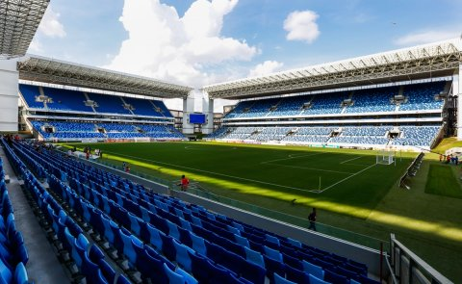

Slide 6
California Core Practice Model, Transition Practice Behaviors
Work with the family to prepare for change in advance and provide tools for managing placement changes, social worker changes, and other significant transitions.
Reduce the role of the child welfare and professional services over time and facilitate an increased role for the family’s network and natural supports to help the family build an on-going support system.
Coordinate with the family’s formal and informal advocates to help the family find solutions and provide on-going support after the child welfare agency is no longer involved.

Slide 7
From Place to Place
https://www.youtube.com/watch?v=98UIV-gsE2I

Slide 8
Video From Place to Place
Plus/Delta
What in your position can you do to impact better outcomes for youth?
Core Practice Model, Standards of Practice
Self-Care

Slide 9
Table Group Activity Instructions
As a table group, list the types of potential case transitions and other transitions related to child welfare services that may affect the lives of children and youth in out-of-home care and/or their families.

Slide 10
Transition Points
Case Transitions:
Hotline-Community
Hotline-ER
ER-Referral Closure
ER-Family Maintenance
ER-Court Case
Court Case to FM/FR
FM-Case Closure
FR-Permanency
Personal Transitions:
Placement Changes
Social Worker Changes
Team Changes
Therapist Changes
School Changes
Community Changes

Slide 11
Trauma-informed Practice
Complex trauma arises from on-going events
Personally impacting the individual
Can also include harmful social environments, such as hunger, homelessness, racism, sexism, and violent neighborhoods

Slide 12
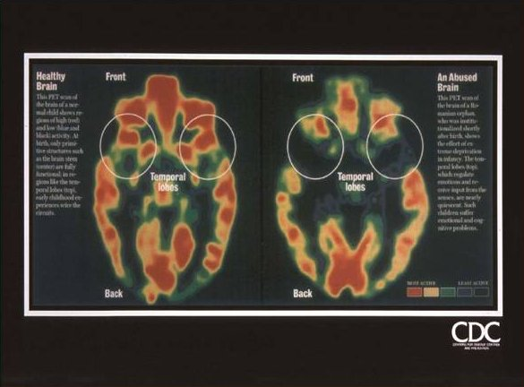

Slide 13
Trauma Suitcase

Slide 14
Trauma Exposure Continues
Removal
Placement changes
School changes
Social worker changes
Points of transitioning

Slide 15
Terminating/Transitioning Cases 10 Tips
1. Understand the process
2. Bring it up early
3. Pick the final date
4. Let it out
5. Anger and anxiety are normal
6. Allow for questions
7. Knowing if the family, youth NMD is ready
8. It’s done face to face
9. Final sessions
10. Termination is not the end

Slide 16
Activity 2B
Pick one transition point: social worker, therapist, school, or team change.
Develop one activity you can do with a child, youth, or young adult to help them transition.
Chart the activity on chart paper.
Be prepared to share with the group.

Slide 17
Emotional Response Transitions
Read the vignette assigned to your table;
Develop a list of emotions that could arise for each vignette;
Be prepared to share with the larger group.

Slide 18
Self-Care
Develop a support group of co-workers
Talk to your supervisor
Take a break
Leave work at work
Laugh often
Exercise
Eat healthy
Spend time with family/friends
Employee Assistance Programs (EAP)

Slide 19
Take a Stand
TAKE A
STAND

Slide 20
Review Key Concepts Case Closure
ASFA & CFSR Goals
Safe and Timely Reunification
Prevent Re-entry into care

Slide 21
Strategies for Successful Case Closure
Use of SDM tools: Safety Assessment, Risk Reassessment –with possibility of after care planning
Develop Circles of Support, Safety Networks, and Child and Family Teams
Plan for Aftercare Services
Provide post-reunification services to address children, youth, NMD needs
Social Worker and Child Visits

Slide 22
Teaming
Collaborate throughout the life of a case.
Unified service planning, evaluating results, and planning for case closure.
The right mix is key to define strengths and needs.
Help child and family transition to life after child welfare services.
Flexible and supportive.

Slide 23
Aftercare Planning
Empower youth, young adults or parents, to co-facilitate the meeting.
Keep the reason the family entered the child welfare system in mind.

Slide 24
Developing Aftercare Plans
Soft Services
Complicating Factors
Concrete Services
Child/Youth Needs
Adoption/Legal Guardianship

Slide 25
Skill Practice
Read the Jefferson Baxter vignette in the Trainee Guide in “SDM In-home Reassessment and Safety Assessment Completion.”
Read instructions “Conversation/Role Play” in the Trainee Guide.
Refer to the SDM Family Risk Reassessment for In-Home cases.
Form Triads; there will be 3 rounds of role plays.
Engage the father to score item R10 of the SDM tool.
Observers provide strengths-based feedback.

Slide 26
Staffing Risk Reassessment
Individually read the vignette.
Individually list biases, assumptions, conclusions, and feelings that can impact decisions.
Report out.

Slide 27
Jefferson Baxter Aftercare Plan
Form groups of 6 trainees
Each group will select a role
Read the vignette of the role selected
Complete the aftercare plan
Don’t forget the strengths and needs discovered when engaging the father around R10
Report out on the aftercare plan developed

Slide 28
After 18 Review
California Fostering Connections to Success Act, 2010, also known as AB 12 Criteria:
Enrolled in high school or equivalent,
Enrolled in college, community college, or vocational education program,
Employed 80 hours a month,
Participating in a program designed to remove barriers of employment
Being unable to do any of the above because of medical conditions.

Slide 29
AB 12 Goals
Shift to autonomy
Engage in mutual agreements
Permanent connections
Develop independent living plans

Slide 30
90-Day Transition Plan minimum items covered
Housing
Education
Health Insurance
Mentor/Continued Support Services
Workforce Support/Employment Services
Inform the youth about the power of attorney for health care

Slide 31
After 18, 90-Day Transition/Aftercare Plan
Form groups of 4 trainees
Each trainee will select a role
Read the vignette of the role selected
Complete the aftercare plan
Report out on the aftercare plan developed

Slide 32
Voices for Youth: Supporting Adolescents in Foster Care
https://www.youtube.com/watch?v=vu_BAayToJA

Slide 33
Closure
Questions
Participant Satisfaction Survey

