Slide 1
BIOLOGY
Chapter 7 CELLULAR RESPIRATION
PowerPoint Image Slideshow

Slide 2
Hypothetical situation :
A couple failed to respond to calls from family and friends. Upon entering the dwelling both were found dead. The culprit--carbon monoxide. A multitude of problems contributed to the deaths, including a high capacity water heater located in a small space without sufficient combustion air.
So, what does this have to do with cellular respiration?

Slide 3
CO -colorless, tasteless, odorless gas generated when carbon based material undergoes incomplete combustion
CO competes for oxygen binding sites thus inhibiting transport/delivery/utilization of oxygen
So, what is the connection between CO and cellular respiration?

Slide 4
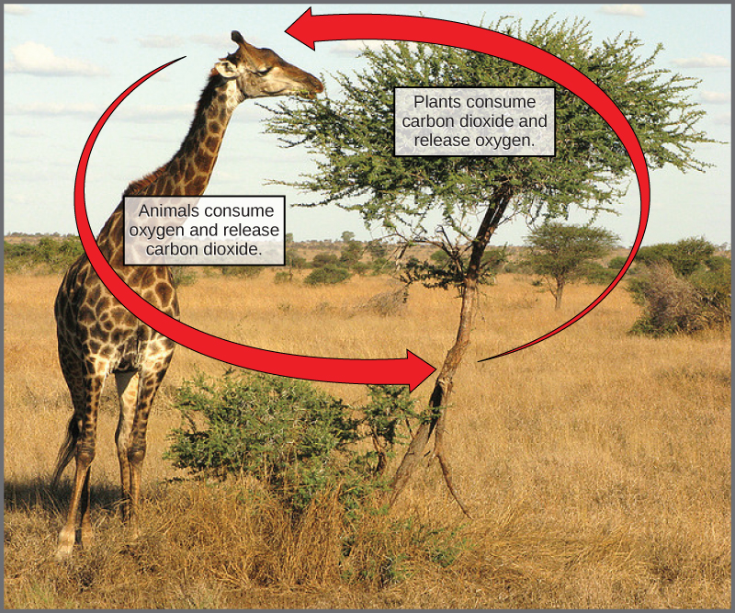
Connections between pathways
The following animation shows how the life cycles of cellular respiration and photosynthesis are connected.
http://vcell.ndsu.nodak.edu/animations/energyconsumption/movie-flash.htm
(Credit: Figure 08 03 04 by CNX OpenStax; CC-BY-4.0)

Slide 5
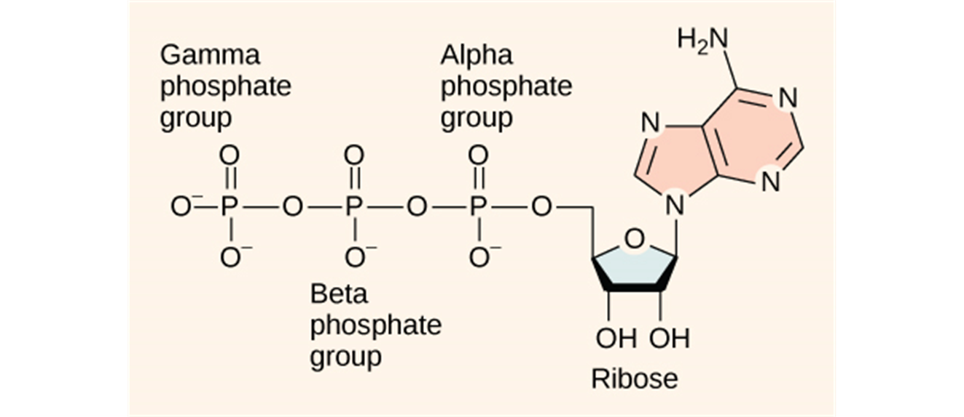
Cellular respiration
exergonic reaction
transfers energy from the bonds in glucose
ATP
Figure 7.3 ATP (adenosine triphosphate) has three phosphate groups that can be removed by hydrolysis (addition of H2O) to form ADP (adenosine diphosphate) or AMP (adenosine monophosphate)
Notes:
5
Student Misconceptions and Concerns
• Students should be cautioned against the assumption that energy is created when it is converted from one form to another. This might be a good time to review the principle of conservation of energy (the first law of thermodynamics, addressed in Module 5.10).
• Students often fail to realize that aerobic metabolism is a process generally similar to the burning of wood or the burning of gasoline in an automobile engine. Noting these general similarities can help students comprehend the overall reaction and heat generation associated with these processes.
Teaching Tips
• Energy coupling at the cellular level may be new to many students, but it is a familiar concept when related to the use of money in our society. Students might be discouraged if the only benefit of work was the ability to make purchases from the employer. (We all might soon tire of a fast-food job that only paid its employees in food!) Money permits the coupling of a generation of value (a paycheck, analogous to an energy-releasing reaction) to an energy-consuming reaction (money, which allows us to make purchases in distant locations). This idea of earning and spending is a common concept we all know well.
• During cellular respiration, our cells convert about 34% of our food energy to useful work (Module 6.3). The other 66% of the energy is released as heat. We use this heat to maintain a relatively steady body temperature near 37°C (98–99°F). This is about the same amount of heat generated by a 75-watt incandescent lightbulb. If you choose to include a discussion of heat generation from aerobic metabolism, consider the following.
• Share this calculation with your students. Depending upon a person’s size and level of activity, a human might burn 2,000 dietary calories (kilocalories) a day. This is enough energy to raise the temperature of 20 liters of liquid water from 0 to 100°C. This is something to think about the next time you heat water on the stove! (Note: Consider bringing a 2-liter bottle as a visual aid, or ten 2-liter bottles to make the point above. It takes 100 calories to raise 1 liter of water 100°C; it takes much more energy to melt ice or evaporate water as steam.)
Active Lecture Tips
• Ask your students why they feel warm when it is 30°C (86°F) outside, if their core body temperature is about 37°C (98.6°F). Shouldn’t they feel cold? Have students discuss ideas with others seated near them. (The answer is, our bodies are always producing heat. At these higher temperatures, we are producing more heat than we need to maintain a body temperature around 37°C. Thus, we sweat and behave in ways that help us get rid of the extra heat from cellular respiration.)

Slide 6
An overview of cellular respiration
http://vcell.ndsu.nodak.edu/animations/citricacid_overview/movie-flash.htm

Slide 7
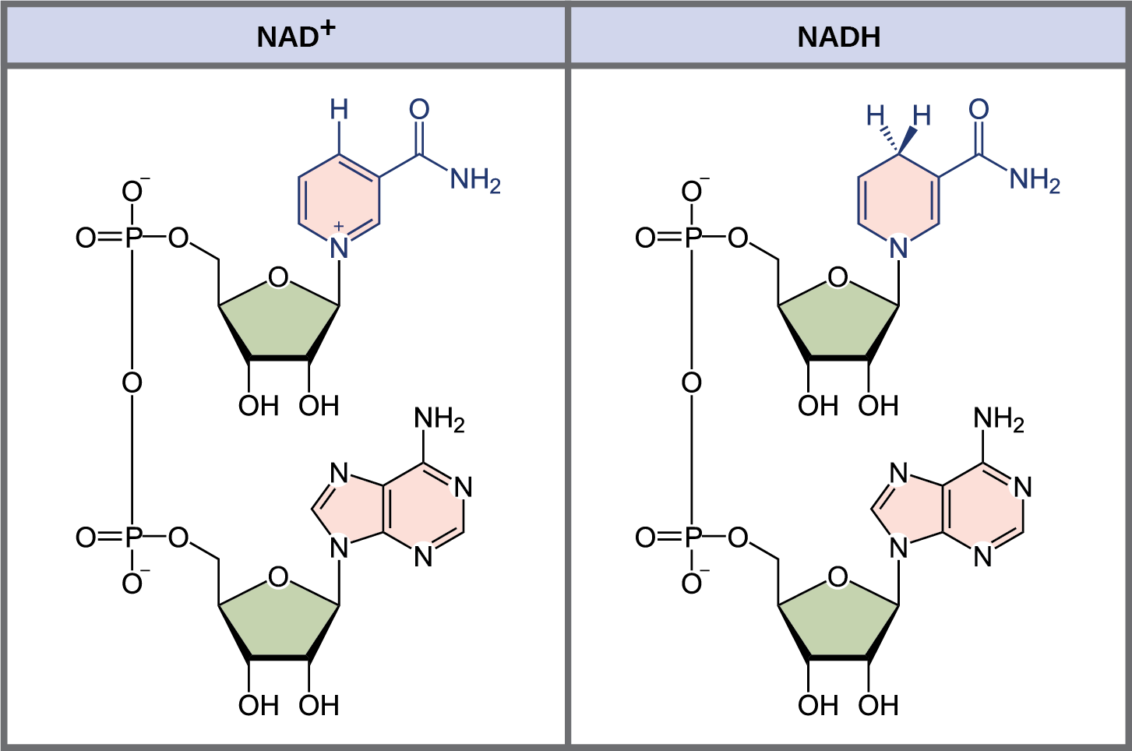
coenzyme NAD⁺ - important for oxidizing glucose
accepts electrons
reduced to NADH.
Figure 7.2 The oxidized form of the electron carrier (NAD+) is shown on the left, and the reduced form (NADH) is shown on the right.
Notes:
Figure 6.5b A pair of redox reactions occurring simultaneously

Slide 8
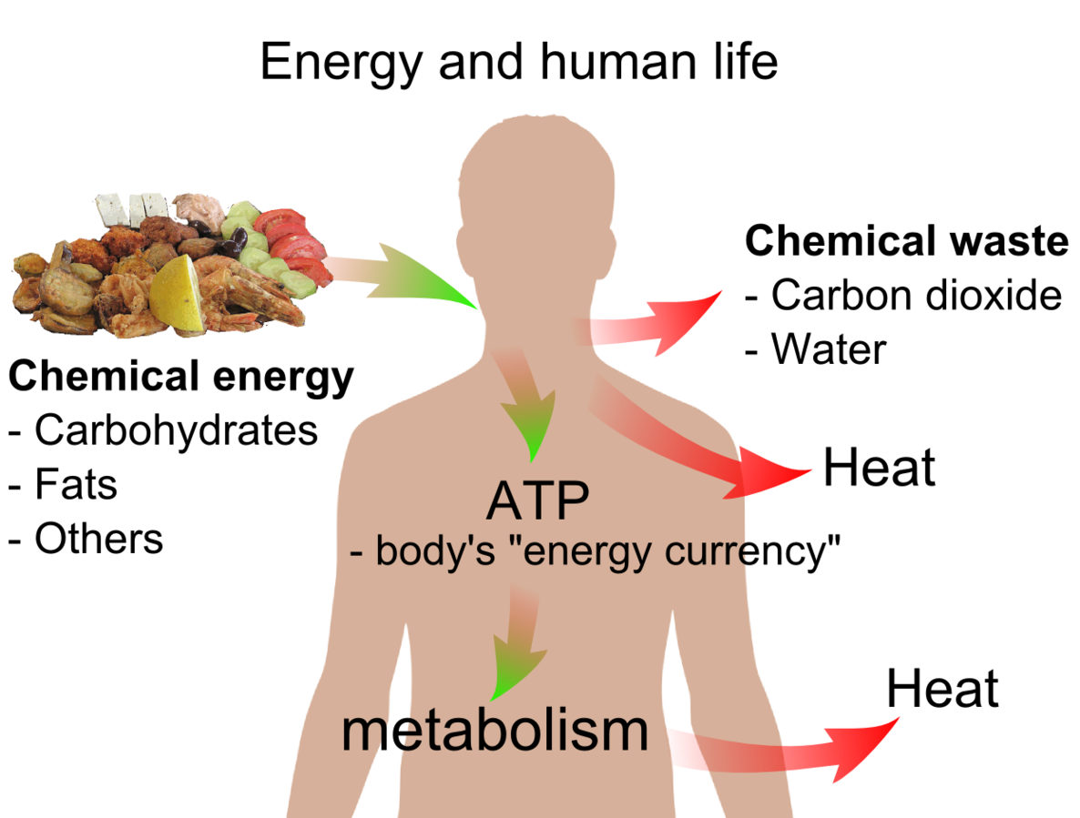
Cellular respiration produces up to 32 ATP molecules per glucose
uses approximately 34% of the energy originally stored in glucose
releases the other 66% as heat
Energy and Life by Mikael Häggström, Public Domain
Notes:
8
Student Misconceptions and Concerns
• Students should be cautioned against the assumption that energy is created when it is converted from one form to another. This might be a good time to review the principle of conservation of energy (the first law of thermodynamics, addressed in Module 5.10).
• Students often fail to realize that aerobic metabolism is a process generally similar to the burning of wood or the burning of gasoline in an automobile engine. Noting these general similarities can help students comprehend the overall reaction and heat generation associated with these processes.
Teaching Tips
• Energy coupling at the cellular level may be new to many students, but it is a familiar concept when related to the use of money in our society. Students might be discouraged if the only benefit of work was the ability to make purchases from the employer. (We all might soon tire of a fast-food job that only paid its employees in food!) Money permits the coupling of a generation of value (a paycheck, analogous to an energy-releasing reaction) to an energy-consuming reaction (money, which allows us to make purchases in distant locations). This idea of earning and spending is a common concept we all know well.
• During cellular respiration, our cells convert about 34% of our food energy to useful work (Module 6.3). The other 66% of the energy is released as heat. We use this heat to maintain a relatively steady body temperature near 37°C (98–99°F). This is about the same amount of heat generated by a 75-watt incandescent lightbulb. If you choose to include a discussion of heat generation from aerobic metabolism, consider the following.
• Share this calculation with your students. Depending upon a person’s size and level of activity, a human might burn 2,000 dietary calories (kilocalories) a day. This is enough energy to raise the temperature of 20 liters of liquid water from 0 to 100°C. This is something to think about the next time you heat water on the stove! (Note: Consider bringing a 2-liter bottle as a visual aid, or ten 2-liter bottles to make the point above. It takes 100 calories to raise 1 liter of water 100°C; it takes much more energy to melt ice or evaporate water as steam.)
Active Lecture Tips
• Ask your students why they feel warm when it is 30°C (86°F) outside, if their core body temperature is about 37°C (98.6°F). Shouldn’t they feel cold? Have students discuss ideas with others seated near them. (The answer is, our bodies are always producing heat. At these higher temperatures, we are producing more heat than we need to maintain a body temperature around 37°C. Thus, we sweat and behave in ways that help us get rid of the extra heat from cellular respiration.)

Slide 9
redox reaction
oxidation: refers to the loss of electrons
reduction: refers to the addition of electrons
NAD+ can accept electrons from an organic molecule according to the general equation:
RH
Reducing
agent
NAD+
Oxidizing
agent
NADH
Reduced
R
Oxidized
In the above equation, RH is a reducing agent, and NAD+ is reduced to NADH; NAD+ is an oxidizing agent, and RH is oxidized to R. (Credit: derived from OpenStax Biology 2e; adapted by Matthew Aderholt)
Notes:
9
Student Misconceptions and Concerns
• Students should be cautioned against the assumption that energy is created when it is converted from one form to another. This might be a good time to review the principle of conservation of energy (the first law of thermodynamics, addressed in Module 5.10).
• The advantage of the gradual degradation of glucose may not be obvious to some students. Many analogies exist that reveal the advantages of a gradual process. Fuel in an automobile is burned slowly to best utilize the energy released from the fuel. A few fireplace logs release gradual heat to keep a room’s temperature steady. In both situations, excessive use of fuel becomes wasteful, reducing the efficiencies of the systems.
Teaching Tips
• The use of the word “falling” when discussing the movement of electrons in a redox reaction can be confusing. Consider explaining the use of the term falling, in reference to potential energy of a falling object.
Active Lecture Tips
• Ask your students why they feel warm when it is 30°C (86°F) outside, if their core body temperature is about 37°C (98.6°F). Shouldn’t they feel cold? Have students discuss ideas with others seated near them. (The answer is, our bodies are always producing heat. At these higher temperatures, we are producing more heat than we need to maintain a body temperature around 37°C. Thus, we sweat and behave in ways that help us get rid of the extra heat from cellular respiration.)
• See the Activity Demonstration of Electron Transport and ATP Production in Aerobic Respiration Using Students and Balloons on the Instructor Exchange. Visit the Instructor Exchange in the MasteringBiology instructor resource area for a description of this activity.

Slide 10
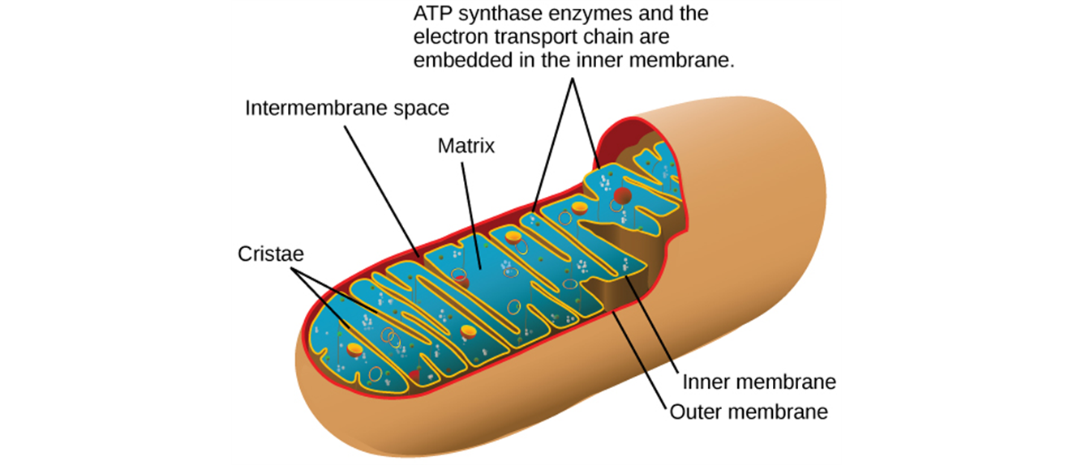
sequence of 3 stages
Stage 1: Glycolysis
Stage 2: Pyruvate oxidation & citric acid cycle
Stage 3: Oxidative phosphorylation
Figure 7.5 In eukaryotes, oxidative phosphorylation takes place in mitochondria. In prokaryotes, this process takes place in the plasma membrane. (Credit: modification of work by Mariana Ruiz Villareal)
Notes:
10
Student Misconceptions and Concerns
• Perhaps more than anywhere else in general biology, students studying aerobic metabolism may fail to see the forest for the trees. Students may focus on the details of each stage of aerobic metabolism and devote little attention to the overall process and products. Consider emphasizing the products and energy yields associated with glycolysis, the citric acid cycle, and oxidative phosphorylation before detailing the specifics of each reaction.
• The location within a cell in which each reaction takes place is often forgotten in the details of the chemical processes, but it is important to emphasize. Consider using Figure 6.12 as a common reference to locate each stage as you discuss the details of cellular respiration.
• Students frequently think that plants have chloroplasts instead of mitochondria. Take care to point out the need for mitochondria in plants when photosynthesis is not efficient or possible (such as during the night).
Active Lecture Tips
• See the Activity Cell Respiration: Pair and Share on the Instructor Exchange. Visit the Instructor Exchange in the MasteringBiology instructor resource area for a description of this activity.

Slide 11
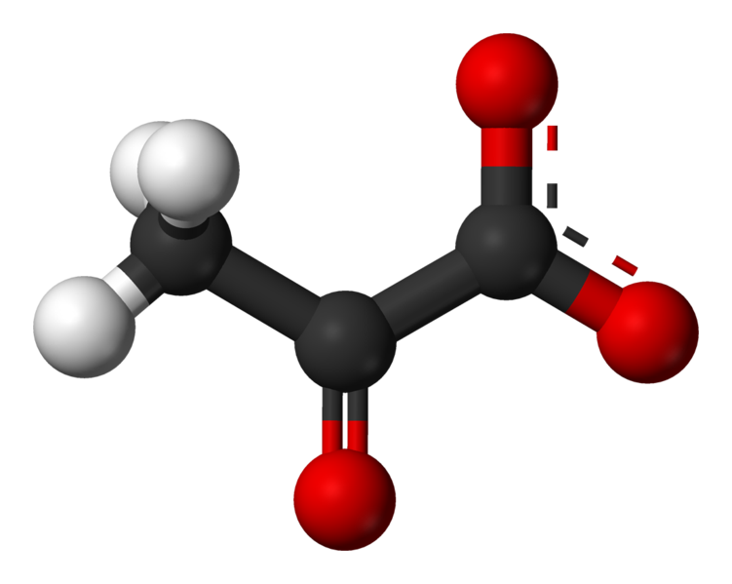
Stage 1: Glycolysis
Occurs in cytosol
Splits glucose (6 carbons) into two molecules of pyruvate (3 carbons).
3D model of pyruvate produced by glycolysis. (Credit: Pyruvate 3D by Benjah BMM, Public Domain)
Notes:
11
Student Misconceptions and Concerns
• Perhaps more than anywhere else in general biology, students studying aerobic metabolism may fail to see the forest for the trees. Students may focus on the details of each stage of aerobic metabolism and devote little attention to the overall process and products. Consider emphasizing the products and energy yields associated with glycolysis, the citric acid cycle, and oxidative phosphorylation before detailing the specifics of each reaction.
• The location within a cell in which each reaction takes place is often forgotten in the details of the chemical processes, but it is important to emphasize. Consider using Figure 6.12 as a common reference to locate each stage as you discuss the details of cellular respiration.
• Students frequently think that plants have chloroplasts instead of mitochondria. Take care to point out the need for mitochondria in plants when photosynthesis is not efficient or possible (such as during the night).
Active Lecture Tips
• See the Activity Cell Respiration: Pair and Share on the Instructor Exchange. Visit the Instructor Exchange in the MasteringBiology instructor resource area for a description of this activity.

Slide 12
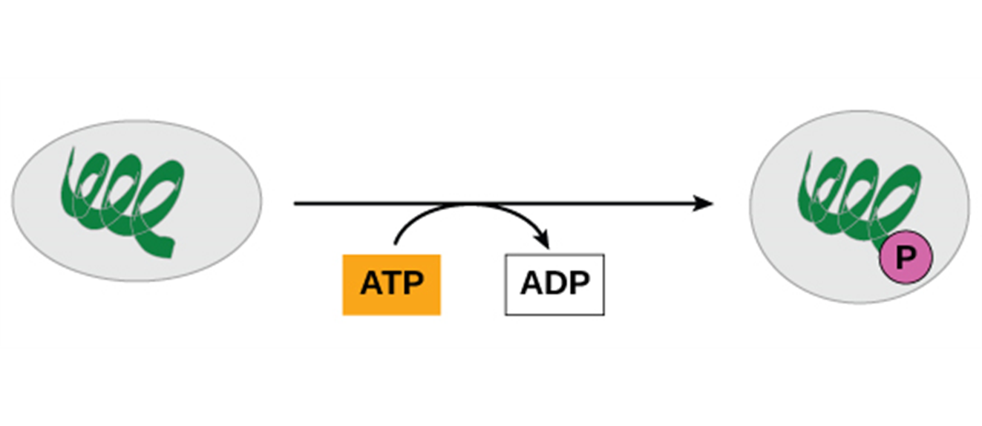
ATP is formed by substrate-level phosphorylation
enzyme transfers a phosphate group from a substrate molecule to ADP
Figure 7.4 In phosphorylation reactions, the gamma (third) phosphate of ATP is attached to a protein.
Notes:
12
Student Misconceptions and Concerns
• Perhaps more than anywhere else in general biology, students studying aerobic metabolism may fail to see the forest for the trees. Students may focus on the details of each stage of aerobic metabolism and devote little attention to the overall process and products. Consider emphasizing the products and energy yields associated with glycolysis, the citric acid cycle, and oxidative phosphorylation before detailing the specifics of each reaction.
• The location within a cell in which each reaction takes place is often forgotten in the details of the chemical processes, but it is important to emphasize. Consider using Figure 6.12 as a common reference to locate each stage as you discuss the details of cellular respiration.
• Students frequently think that plants have chloroplasts instead of mitochondria. Take care to point out the need for mitochondria in plants when photosynthesis is not efficient or possible (such as during the night).
Teaching Tips
• The production of NADH through glycolysis and the citric acid cycle, as compared to the direct production of ATP, can get confusing for students. Help students understand that NADH molecules have value to be cashed in by the electron transport chain. The NADH can therefore be thought of as casino chips, accumulated along the way to be cashed in at the electron transport cashier.
Active Lecture Tips
• See the Activity Cell Respiration: Pair and Share on the Instructor Exchange. Visit the Instructor Exchange in the MasteringBiology instructor resource area for a description of this activity.

Slide 13
2 main phases
steps 1–4
energy investment phase
two ATP molecules are used to energize a glucose molecule
split into two small sugars.
Figure 7.6 The first half of glycolysis uses two ATP molecules in the phosphorylation of glucose, which is then split into two three-carbon molecules
Notes:
13
Student Misconceptions and Concerns
• Perhaps more than anywhere else in general biology, students studying aerobic metabolism may fail to see the forest for the trees. Students may focus on the details of each stage of aerobic metabolism and devote little attention to the overall process and products. Consider emphasizing the products and energy yields associated with glycolysis, the citric acid cycle, and oxidative phosphorylation before detailing the specifics of each reaction.
• The location within a cell in which each reaction takes place is often forgotten in the details of the chemical processes, but it is important to emphasize. Consider using Figure 6.12 as a common reference to locate each stage as you discuss the details of cellular respiration.
• Students frequently think that plants have chloroplasts instead of mitochondria. Take care to point out the need for mitochondria in plants when photosynthesis is not efficient or possible (such as during the night).
Teaching Tips
• The production of NADH through glycolysis and the citric acid cycle, as compared to the direct production of ATP, can get confusing for students. Help students understand that NADH molecules have value to be cashed in by the electron transport chain. The NADH can therefore be thought of as casino chips, accumulated along the way to be cashed in at the electron transport cashier.
Active Lecture Tips
• See the Activity Cell Respiration: Pair and Share on the Instructor Exchange. Visit the Instructor Exchange in the MasteringBiology instructor resource area for a description of this activity.

Slide 14
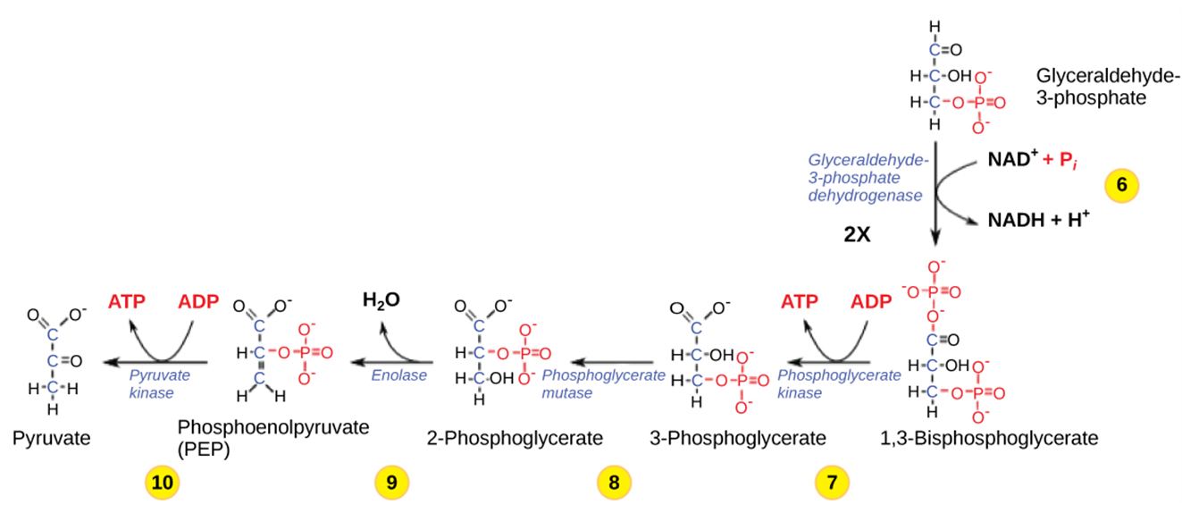
steps 5–9
energy payoff phase
two NADH molecules are produced for each initial glucose molecule
four ATP molecules are generated.
net gain of two ATP molecules for each glucose molecule that enters glycolysis.
Figure 7.7 The second half of glycolysis involves phosphorylation without ATP investment (step 6) and produces two NADH and four ATP molecules per glucose.

Slide 15
glycolysis in summary:
Produces 2 molecules of pyruvate
2 NAD⁺ are reduced to 2 NADH
net gain of 2ATP.
Video Animation: http://vcell.ndsu.nodak.edu/animations/glycolysis_overview/movie-flash.htm
Notes:
15
Student Misconceptions and Concerns
• Perhaps more than anywhere else in general biology, students studying aerobic metabolism may fail to see the forest for the trees. Students may focus on the details of each stage of aerobic metabolism and devote little attention to the overall process and products. Consider emphasizing the products and energy yields associated with glycolysis, the citric acid cycle, and oxidative phosphorylation before detailing the specifics of each reaction.
• The location within a cell in which each reaction takes place is often forgotten in the details of the chemical processes, but it is important to emphasize. Consider using Figure 6.12 as a common reference to locate each stage as you discuss the details of cellular respiration.
• Students frequently think that plants have chloroplasts instead of mitochondria. Take care to point out the need for mitochondria in plants when photosynthesis is not efficient or possible (such as during the night).
Teaching Tips
• The production of NADH through glycolysis and the citric acid cycle, as compared to the direct production of ATP, can get confusing for students. Help students understand that NADH molecules have value to be cashed in by the electron transport chain. The NADH can therefore be thought of as casino chips, accumulated along the way to be cashed in at the electron transport cashier.
Active Lecture Tips
• See the Activity Cell Respiration: Pair and Share on the Instructor Exchange. Visit the Instructor Exchange in the MasteringBiology instructor resource area for a description of this activity.

Slide 16
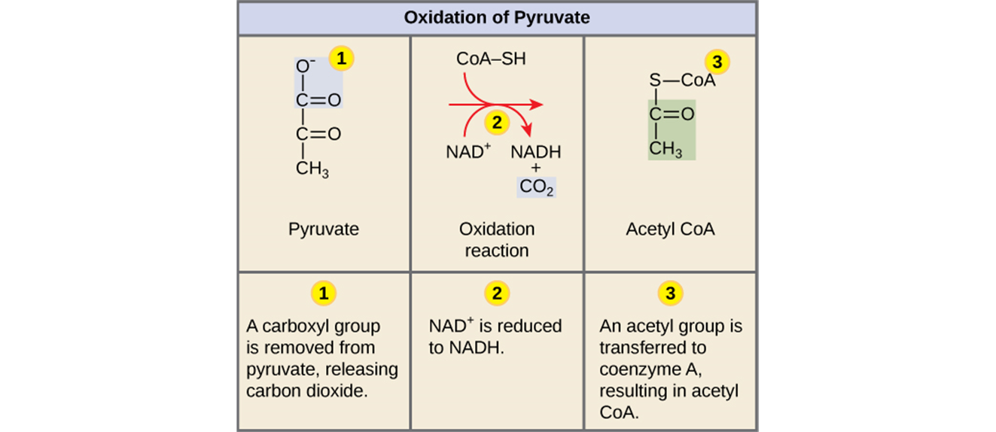
Stage 2: Pyruvate oxidation & Citric Acid Cycle
mitochondria
oxidizes pyruvate to a two-carbon compound
Supplies electrons.
Figure 7.8 Upon entering the mitochondrial matrix, a multienzyme complex converts pyruvate into acetyl CoA. In the process, carbon dioxide is released, and one molecule of NADH is formed.
Notes:
16
Student Misconceptions and Concerns
• Perhaps more than anywhere else in general biology, students studying aerobic metabolism may fail to see the forest for the trees. Students may focus on the details of each stage of aerobic metabolism and devote little attention to the overall process and products. Consider emphasizing the products and energy yields associated with glycolysis, the citric acid cycle, and oxidative phosphorylation before detailing the specifics of each reaction.
• The location within a cell in which each reaction takes place is often forgotten in the details of the chemical processes, but it is important to emphasize. Consider using Figure 6.12 as a common reference to locate each stage as you discuss the details of cellular respiration.
• Students frequently think that plants have chloroplasts instead of mitochondria. Take care to point out the need for mitochondria in plants when photosynthesis is not efficient or possible (such as during the night).
Active Lecture Tips
• See the Activity Cell Respiration: Pair and Share on the Instructor Exchange. Visit the Instructor Exchange in the MasteringBiology instructor resource area for a description of this activity.

Slide 17
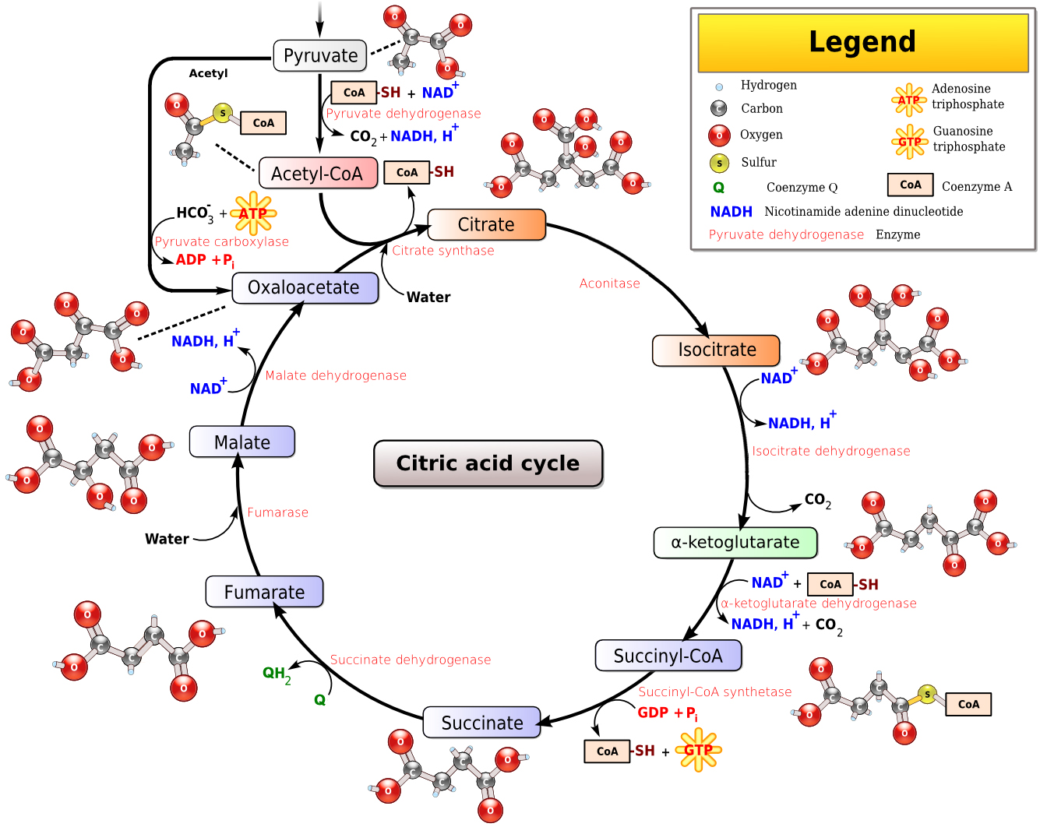
citric acid cycle (krebs cycle)
completes oxidation of organic molecules
generates NADH and FADH₂ molecules.
Citric Acid Cycle by Narayanese, CC-BY-SA-3.0
Notes:
17
Student Misconceptions and Concerns
• Perhaps more than anywhere else in general biology, students studying aerobic metabolism may fail to see the forest for the trees. Students may focus on the details of each stage of aerobic metabolism and devote little attention to the overall process and products. Consider emphasizing the products and energy yields associated with glycolysis, the citric acid cycle, and oxidative phosphorylation before detailing the specifics of each reaction.
• The location within a cell in which each reaction takes place is often forgotten in the details of the chemical processes, but it is important to emphasize. Consider using Figure 6.12 as a common reference to locate each stage as you discuss the details of cellular respiration.
• Students frequently think that plants have chloroplasts instead of mitochondria. Take care to point out the need for mitochondria in plants when photosynthesis is not efficient or possible (such as during the night).
Teaching Tips
• The production of NADH through glycolysis and the citric acid cycle, as compared to the direct production of ATP, can get confusing for students. Help students understand that NADH molecules have value to be cashed in by the electron transport chain. The NADH can therefore be thought of as casino chips, accumulated along the way to be cashed in at the electron transport cashier.
Active Lecture Tips
• See the Activity Cell Respiration: Pair and Share on the Instructor Exchange. Visit the Instructor Exchange in the MasteringBiology instructor resource area for a description of this activity.

Slide 18
Remember the citric acid cycle processes two acetyl CoA molecules for each glucose.
Thus the overall yield per glucose molecule is:
2 ATP,
6 NADH
2 FADH₂.
Notes:
18
Student Misconceptions and Concerns
• Perhaps more than anywhere else in general biology, students studying aerobic metabolism may fail to see the forest for the trees. Students may focus on the details of each stage of aerobic metabolism and devote little attention to the overall process and products. Consider emphasizing the products and energy yields associated with glycolysis, the citric acid cycle, and oxidative phosphorylation before detailing the specifics of each reaction.
• The location within a cell in which each reaction takes place is often forgotten in the details of the chemical processes, but it is important to emphasize. Consider using Figure 6.12 as a common reference to locate each stage as you discuss the details of cellular respiration.
• Students frequently think that plants have chloroplasts instead of mitochondria. Take care to point out the need for mitochondria in plants when photosynthesis is not efficient or possible (such as during the night).
Teaching Tips
• The production of NADH through glycolysis and the citric acid cycle, as compared to the direct production of ATP, can get confusing for students. Help students understand that NADH molecules have value to be cashed in by the electron transport chain. The NADH can therefore be thought of as casino chips, accumulated along the way to be cashed in at the electron transport cashier.
Active Lecture Tips
• See the Activity Cell Respiration: Pair and Share on the Instructor Exchange. Visit the Instructor Exchange in the MasteringBiology instructor resource area for a description of this activity.

Slide 19
Thus, after glycolysis AND the citric acid cycle, the cell has gained
4 ATP,
10 NADH
2 FADH₂.
NADH and FADH₂,
ETC
Notes:
19
Student Misconceptions and Concerns
• Perhaps more than anywhere else in general biology, students studying aerobic metabolism may fail to see the forest for the trees. Students may focus on the details of each stage of aerobic metabolism and devote little attention to the overall process and products. Consider emphasizing the products and energy yields associated with glycolysis, the citric acid cycle, and oxidative phosphorylation before detailing the specifics of each reaction.
• The location within a cell in which each reaction takes place is often forgotten in the details of the chemical processes, but it is important to emphasize. Consider using Figure 6.12 as a common reference to locate each stage as you discuss the details of cellular respiration.
• Students frequently think that plants have chloroplasts instead of mitochondria. Take care to point out the need for mitochondria in plants when photosynthesis is not efficient or possible (such as during the night).
Teaching Tips
• The production of NADH through glycolysis and the citric acid cycle, as compared to the direct production of ATP, can get confusing for students. Help students understand that NADH molecules have value to be cashed in by the electron transport chain. The NADH can therefore be thought of as casino chips, accumulated along the way to be cashed in at the electron transport cashier.
Active Lecture Tips
• See the Activity Cell Respiration: Pair and Share on the Instructor Exchange. Visit the Instructor Exchange in the MasteringBiology instructor resource area for a description of this activity.

Slide 20
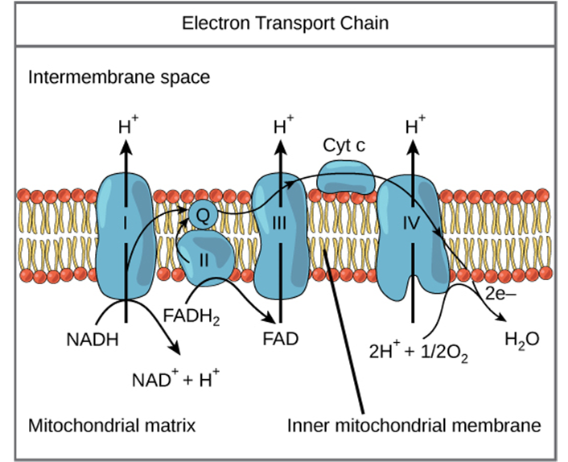
Electron Transport Chain
Pumps protons from the matrix to intermembrane space
http://vcell.ndsu.nodak.edu/animations/etc/movie-flash.htm
oxygen accepts 2 electrons
picks up 2 H⁺
Becomes reduced to water.
Figure 7.10 The electron transport chain is a series of electron transporters embedded in the inner mitochondrial membrane that shuttles electrons from NADH and FADH2 to molecular oxygen.
Notes:
20
Student Misconceptions and Concerns
• Students should be cautioned against the assumption that energy is created when it is converted from one form to another. This might be a good time to review the principle of conservation of energy (the first law of thermodynamics, addressed in Module 5.10).
• The advantage of the gradual degradation of glucose may not be obvious to some students. Many analogies exist that reveal the advantages of a gradual process. Fuel in an automobile is burned slowly to best utilize the energy released from the fuel. A few fireplace logs release gradual heat to keep a room’s temperature steady. In both situations, excessive use of fuel becomes wasteful, reducing the efficiencies of the systems.
Teaching Tips
• The use of the word “falling” when discussing the movement of electrons in a redox reaction can be confusing. Consider explaining the use of the term falling, in reference to potential energy of a falling object.
Active Lecture Tips
• Ask your students why they feel warm when it is 30°C (86°F) outside, if their core body temperature is about 37°C (98.6°F). Shouldn’t they feel cold? Have students discuss ideas with others seated near them. (The answer is, our bodies are always producing heat. At these higher temperatures, we are producing more heat than we need to maintain a body temperature around 37°C. Thus, we sweat and behave in ways that help us get rid of the extra heat from cellular respiration.)
• See the Activity Demonstration of Electron Transport and ATP Production in Aerobic Respiration Using Students and Balloons on the Instructor Exchange. Visit the Instructor Exchange in the MasteringBiology instructor resource area for a description of this activity.

Slide 21
Hypothetical Case Study: CO displaces oxygen from receptors of the cytochrome oxidase system in the ETC (particularly cytochrome a3 and cytochrome P-450)
Figure 7.10 The electron transport chain is a series of electron transporters embedded in the inner mitochondrial membrane that shuttles electrons from NADH and FADH2 to molecular oxygen.
Notes:
21
Student Misconceptions and Concerns
• Students should be cautioned against the assumption that energy is created when it is converted from one form to another. This might be a good time to review the principle of conservation of energy (the first law of thermodynamics, addressed in Module 5.10).
• The advantage of the gradual degradation of glucose may not be obvious to some students. Many analogies exist that reveal the advantages of a gradual process. Fuel in an automobile is burned slowly to best utilize the energy released from the fuel. A few fireplace logs release gradual heat to keep a room’s temperature steady. In both situations, excessive use of fuel becomes wasteful, reducing the efficiencies of the systems.
Teaching Tips
• The use of the word “falling” when discussing the movement of electrons in a redox reaction can be confusing. Consider explaining the use of the term falling, in reference to potential energy of a falling object.
Active Lecture Tips
• Ask your students why they feel warm when it is 30°C (86°F) outside, if their core body temperature is about 37°C (98.6°F). Shouldn’t they feel cold? Have students discuss ideas with others seated near them. (The answer is, our bodies are always producing heat. At these higher temperatures, we are producing more heat than we need to maintain a body temperature around 37°C. Thus, we sweat and behave in ways that help us get rid of the extra heat from cellular respiration.)
• See the Activity Demonstration of Electron Transport and ATP Production in Aerobic Respiration Using Students and Balloons on the Instructor Exchange. Visit the Instructor Exchange in the MasteringBiology instructor resource area for a description of this activity.

Slide 22
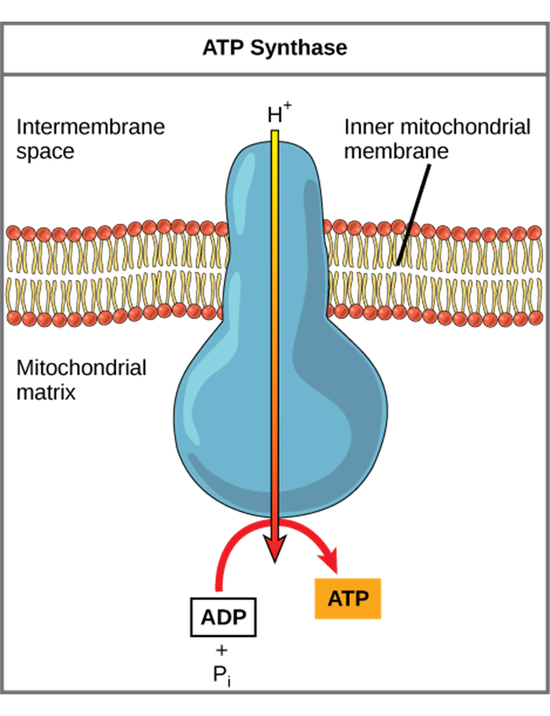
Stage 3: Oxidative Phosphorylation
In chemiosmosis, the potential energy of this concentration gradient is used to make ATP.
ATP Synthase
Figure 7.11 ATP synthase is a complex, molecular machine that uses a proton (H+) gradient to form ATP from ADP and inorganic phosphate (Pi). (Credit: modification of work by Klaus Hoffmeier)

Slide 23
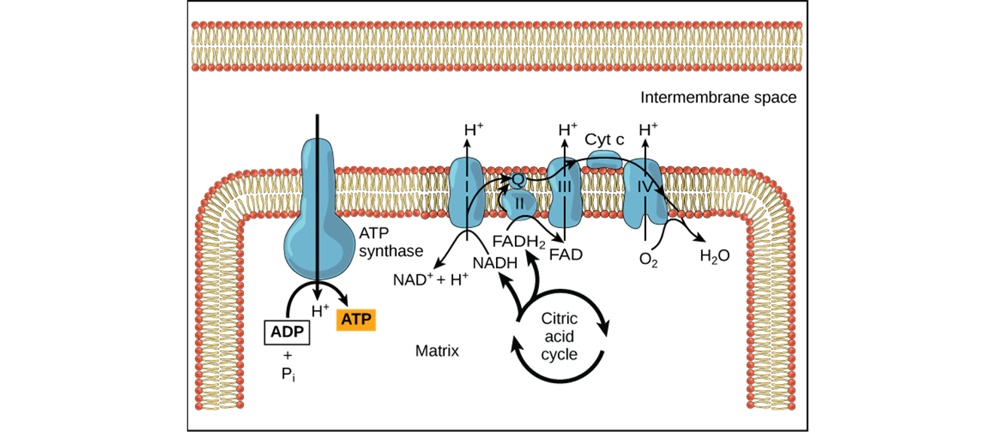
ETC pumps hydrogen ions (H⁺) across the inner mitochondrial membrane,
produces a concentration gradient of H⁺
Figure 7.12 In oxidative phosphorylation, the pH gradient formed by the electron transport chain is used by ATP synthase to form ATP.
Notes:
23
Student Misconceptions and Concerns
• Perhaps more than anywhere else in general biology, students studying aerobic metabolism may fail to see the forest for the trees. Students may focus on the details of each stage of aerobic metabolism and devote little attention to the overall process and products. Consider emphasizing the products and energy yields associated with glycolysis, the citric acid cycle, and oxidative phosphorylation before detailing the specifics of each reaction.
• The location within a cell in which each reaction takes place is often forgotten in the details of the chemical processes, but it is important to emphasize. Consider using Figure 6.12 as a common reference to locate each stage as you discuss the details of cellular respiration.
• Students frequently think that plants have chloroplasts instead of mitochondria. Take care to point out the need for mitochondria in plants when photosynthesis is not efficient or possible (such as during the night).
Active Lecture Tips
• See the Activity Cell Respiration: Pair and Share on the Instructor Exchange. Visit the Instructor Exchange in the MasteringBiology instructor resource area for a description of this activity.

Slide 24
Anaerobic Cellular Respiration
Fermentation:
does not require oxygen
Utilizes glycolysis
produces two ATP molecules for each molecule of glucose
Provides an anaerobic pathway for recycling NADH back to NAD⁺.
Notes:
24
Student Misconceptions and Concerns
• Students may expect that fermentation will produce alcohol and maybe even carbon dioxide. Take the time to clarify the different possible products of fermentation and correct this general misconception.
Teaching Tips
• The text notes that some microbes are useful in the dairy industry because they produce lactic acid. However, the impact of acids on milk may not be obvious to many students. Consider a simple demonstration mixing about equal portions of milk (skim or 2%) with some acid (vinegar will work). Notice the accumulation of strands of milk curd (protein) on the side of the container and stirring device.
• Dry wines are produced when the yeast cells use up all or most of the sugar available. Sweet wines result when the alcohol accumulates enough to inhibit fermentation before the sugar is depleted.
• Exposing fermenting yeast to oxygen will slow or stop the process, because the yeast will switch back to aerobic respiration. When fermentation is rapid, the carbon dioxide produced drives away the oxygen immediately above the wine. However, as fermentation slows down, the wine must be sealed to prevent oxygen exposure and permit the fermentation process to finish.

Slide 25
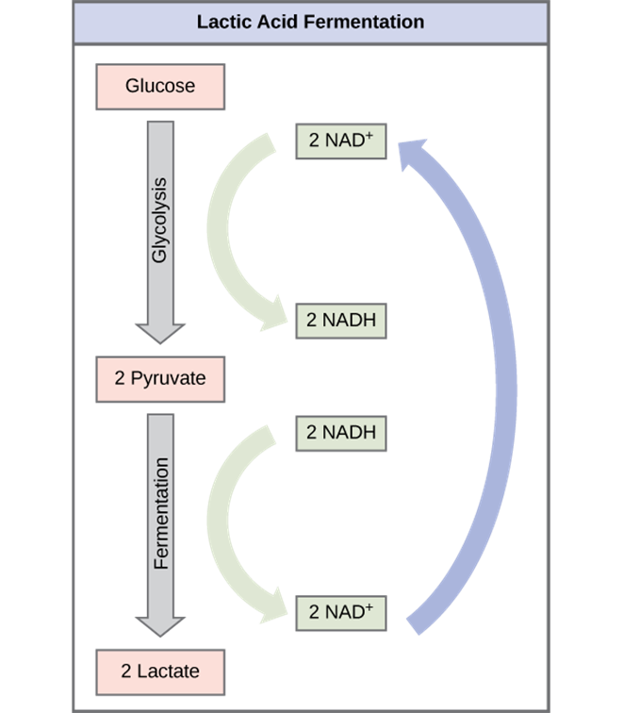
muscle cells and certain bacteria can regenerate NAD⁺ from NADH through lactic acid fermentation
pyruvate is reduced to lactate.
converted to pyruvate & oxidized in the mitochondria of liver
lactic acid fermentation by bacteria is used to make cheese and yogurt.
Figure 7.14 Lactic acid fermentation is common in muscle cells that have run out of oxygen.
Notes:
25
Student Misconceptions and Concerns
• Students may expect that fermentation will produce alcohol and maybe even carbon dioxide. Take the time to clarify the different possible products of fermentation and correct this general misconception.
Teaching Tips
• The text notes that some microbes are useful in the dairy industry because they produce lactic acid. However, the impact of acids on milk may not be obvious to many students. Consider a simple demonstration mixing about equal portions of milk (skim or 2%) with some acid (vinegar will work). Notice the accumulation of strands of milk curd (protein) on the side of the container and stirring device.
• Dry wines are produced when the yeast cells use up all or most of the sugar available. Sweet wines result when the alcohol accumulates enough to inhibit fermentation before the sugar is depleted.
• Exposing fermenting yeast to oxygen will slow or stop the process, because the yeast will switch back to aerobic respiration. When fermentation is rapid, the carbon dioxide produced drives away the oxygen immediately above the wine. However, as fermentation slows down, the wine must be sealed to prevent oxygen exposure and permit the fermentation process to finish.

Slide 26
Alcohol fermentation
Produces ethanol and CO₂
catalyzed by pyruvate decarboxylase
A carboxyl group is removed from pyruvic acid, releasing carbon dioxide
(Pyruvate decarb 1 by Cwernert CC-BY-SA-3.0)

Slide 27
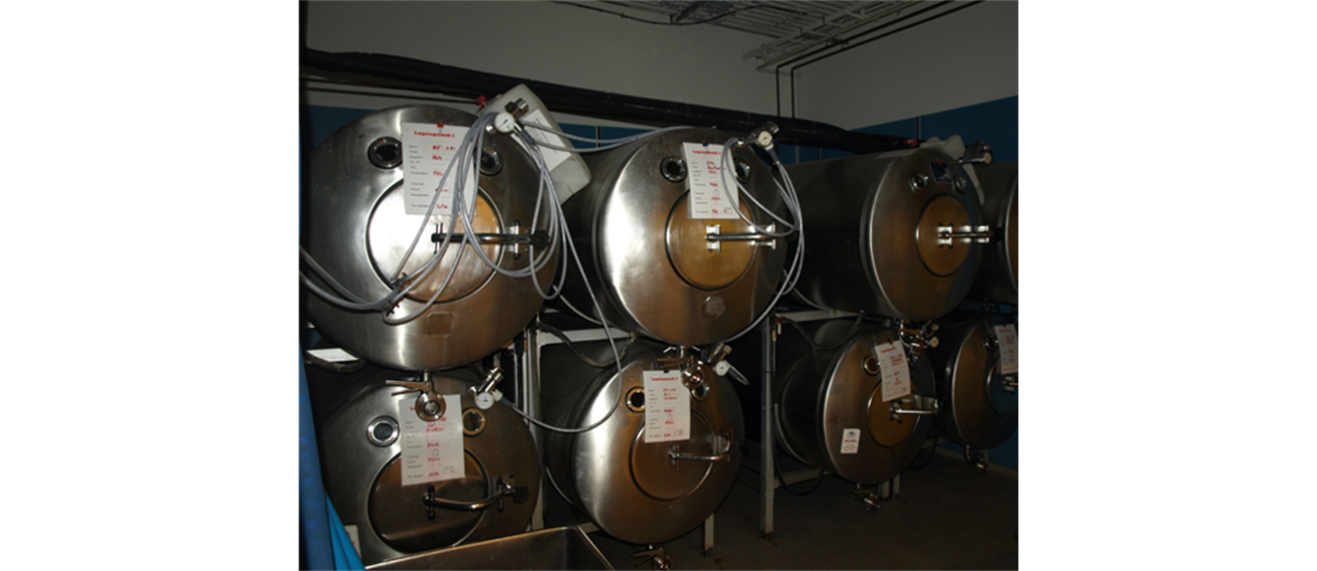
baking & winemaking industries
yeast
oxidize NADH back to NAD⁺
convert pyruvate to CO₂ and ethanol.
Figure 7.15 Fermentation of grape juice into wine produces CO2 as a byproduct. Fermentation tanks have valves so that the pressure inside the tanks created by the carbon dioxide produced can be released.
Notes:
27
Student Misconceptions and Concerns
• Students may expect that fermentation will produce alcohol and maybe even carbon dioxide. Take the time to clarify the different possible products of fermentation and correct this general misconception.
Teaching Tips
• The text notes that some microbes are useful in the dairy industry because they produce lactic acid. However, the impact of acids on milk may not be obvious to many students. Consider a simple demonstration mixing about equal portions of milk (skim or 2%) with some acid (vinegar will work). Notice the accumulation of strands of milk curd (protein) on the side of the container and stirring device.
• Dry wines are produced when the yeast cells use up all or most of the sugar available. Sweet wines result when the alcohol accumulates enough to inhibit fermentation before the sugar is depleted.
• Exposing fermenting yeast to oxygen will slow or stop the process, because the yeast will switch back to aerobic respiration. When fermentation is rapid, the carbon dioxide produced drives away the oxygen immediately above the wine. However, as fermentation slows down, the wine must be sealed to prevent oxygen exposure and permit the fermentation process to finish.

Slide 28
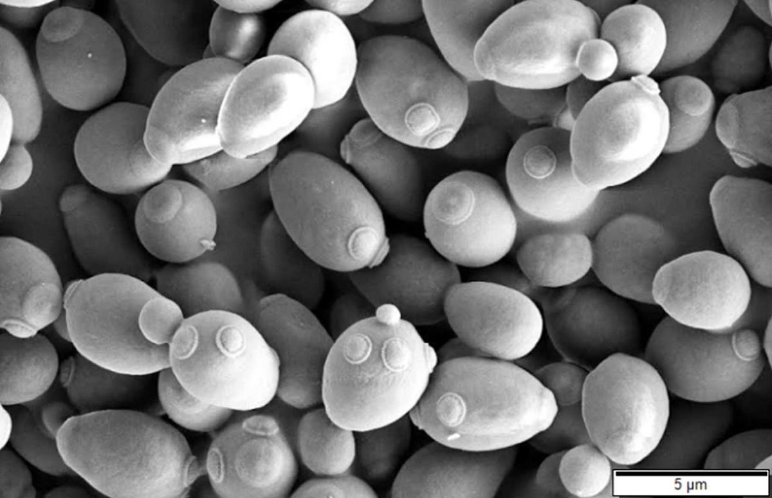
Obligate anaerobes
require anaerobic conditions; poisoned by oxygen
live in stagnant water and deep soils.
Facultative anaerobes
make ATP in aerobic or anaerobic conditions
Include some yeasts & many bacteria.
Saccharomyces cerevisiae seen here under a SEM is a species of fungi that is an example of a facultative anaerobe. (Saccharomyces cerevisiae SEM by Mogana Das Murtey and Patchamuthu Ramasamy, CC-BY-SA-3.0)
Notes:
28
Student Misconceptions and Concerns
• Students may expect that fermentation will produce alcohol and maybe even carbon dioxide. Take the time to clarify the different possible products of fermentation and correct this general misconception.
Teaching Tips
• The text notes that some microbes are useful in the dairy industry because they produce lactic acid. However, the impact of acids on milk may not be obvious to many students. Consider a simple demonstration mixing about equal portions of milk (skim or 2%) with some acid (vinegar will work). Notice the accumulation of strands of milk curd (protein) on the side of the container and stirring device.
• Dry wines are produced when the yeast cells use up all or most of the sugar available. Sweet wines result when the alcohol accumulates enough to inhibit fermentation before the sugar is depleted.
• Exposing fermenting yeast to oxygen will slow or stop the process, because the yeast will switch back to aerobic respiration. When fermentation is rapid, the carbon dioxide produced drives away the oxygen immediately above the wine. However, as fermentation slows down, the wine must be sealed to prevent oxygen exposure and permit the fermentation process to finish.

Slide 29
Glucose- primary source of sugar for respiration and fermentation, ATP is also generated using:
Other carbohydrates
fats
proteins.
Figure 7.17 Glycogen from the liver and muscles, as well as other carbohydrates, hydrolyzed into glucose-1-phosphate, together with fats and proteins, can feed into the catabolic pathways for carbohydrates.
Notes:
29
Teaching Tips
• Figure 6.15 is an important visual synthesis of the diverse fuels that can enter into cellular respiration and the various stages of this process. Figures such as this can serve as a visual anchor to integrate the many aspects of this chapter.
• The final modules in this chapter may raise questions about obesity and proper diet. The Centers for Disease Control and Prevention website, www.cdc.gov/nccdphp/dnpao/index.html, discusses many aspects of nutrition, obesity, and general physical fitness and is a useful reference for teachers and students.
Active Lecture Tips
• Challenge your students to explain why most extra energy in the human body is stored as fat and not sugars or proteins. Have students visit with others seated nearby to discuss. The general answer is this. The same mass of fat stores nearly twice as many calories (about 9 kcal per gram) as an equivalent mass of protein or carbohydrates (about 4.5–5 kcal per gram). Fat is therefore an efficient way to store energy in animals and many plants. To store an equivalent amount of energy in the form of carbohydrates or proteins would require about twice the mass, adding a significant burden to the organism’s structure. (For example, if you were 20 lb overweight, you would be nearly 40 lb overweight if the same energy were stored as carbohydrates or proteins instead of fat.)

Slide 30
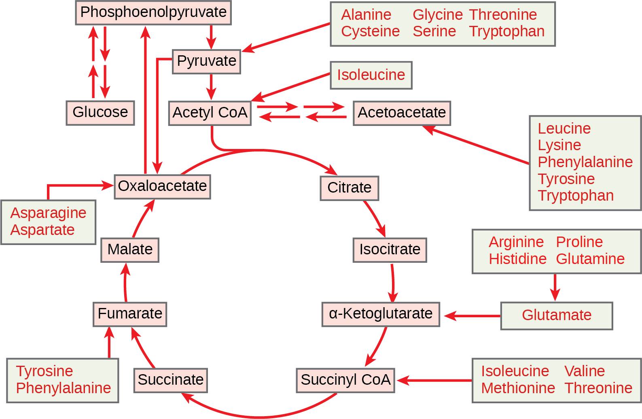
Amino acids enter the metabolic pathway as shown below.
Figure 7.16 The carbon skeletons of certain amino acids (indicated in boxes) derived from proteins can feed into the citric acid cycle. (credit: modification of work by Mikael Häggström)

Slide 31
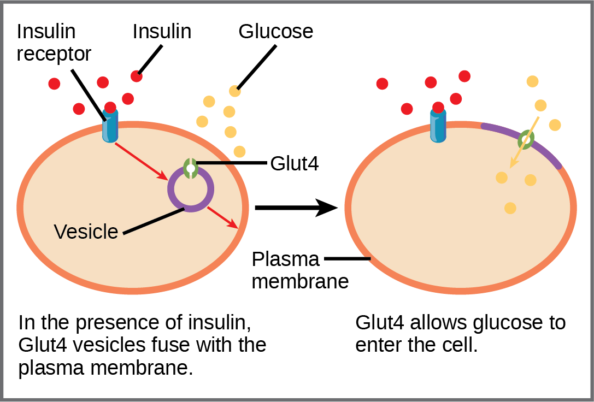
Regulatory Mechanisms
GLUT (glucose transporter) proteins- regulates glucose entry into the cell.
Figure 7.18 GLUT4 is a glucose transporter that is stored in vesicles. A cascade of events that occurs upon insulin binding to a receptor in the plasma membrane causes GLUT4-containing vesicles to fuse with the plasma membrane so that glucose may be transported into the cell.
Notes:
31
Teaching Tips
• Figure 6.15 is an important visual synthesis of the diverse fuels that can enter into cellular respiration and the various stages of this process. Figures such as this can serve as a visual anchor to integrate the many aspects of this chapter.
• The final modules in this chapter may raise questions about obesity and proper diet. The Centers for Disease Control and Prevention website, www.cdc.gov/nccdphp/dnpao/index.html, discusses many aspects of nutrition, obesity, and general physical fitness and is a useful reference for teachers and students.
Active Lecture Tips
• Challenge your students to explain why most extra energy in the human body is stored as fat and not sugars or proteins. Have students visit with others seated nearby to discuss. The general answer is this. The same mass of fat stores nearly twice as many calories (about 9 kcal per gram) as an equivalent mass of protein or carbohydrates (about 4.5–5 kcal per gram). Fat is therefore an efficient way to store energy in animals and many plants. To store an equivalent amount of energy in the form of carbohydrates or proteins would require about twice the mass, adding a significant burden to the organism’s structure. (For example, if you were 20 lb overweight, you would be nearly 40 lb overweight if the same energy were stored as carbohydrates or proteins instead of fat.)

Slide 32
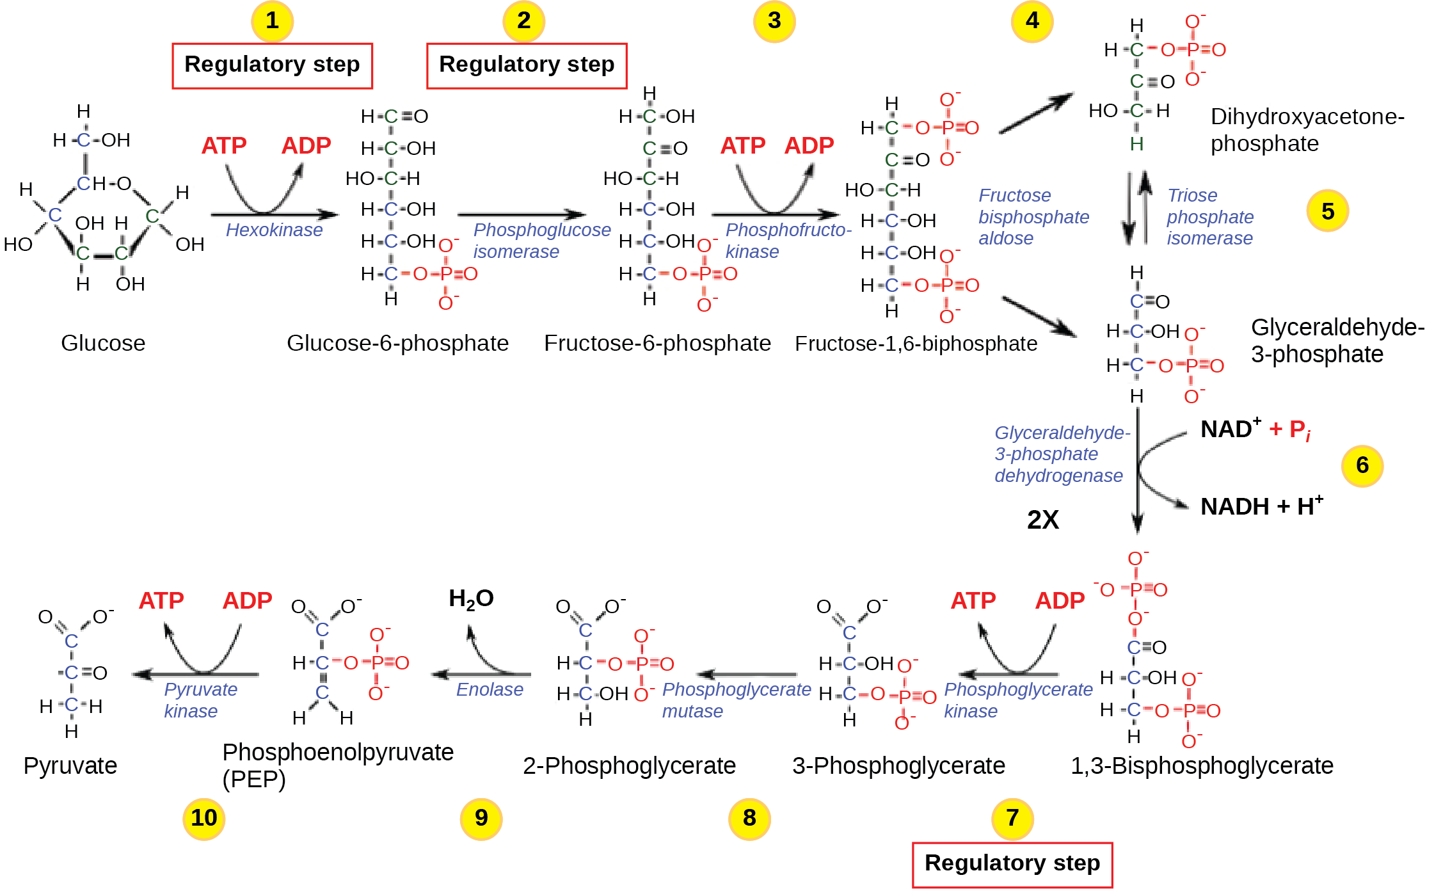
alteration of the enzyme’s structure either increases or decreases its affinity for its substrate, with the effect of increasing or decreasing the rate of the reaction

Slide 33
This OpenStax ancillary resource is © Rice University under a CC-BY 4.0 International license; it may be reproduced or modified but must be attributed to OpenStax, Rice University and any changes must be noted.
Contributors:
Asha Rao; Texas A&M University
Matthew Aderholt; Abraham Baldwin Agricultural College
Veronica Amaku; Houston Community College
(images updated to 2e versions)

