Slide 1
Crete Label Security

Slide 2
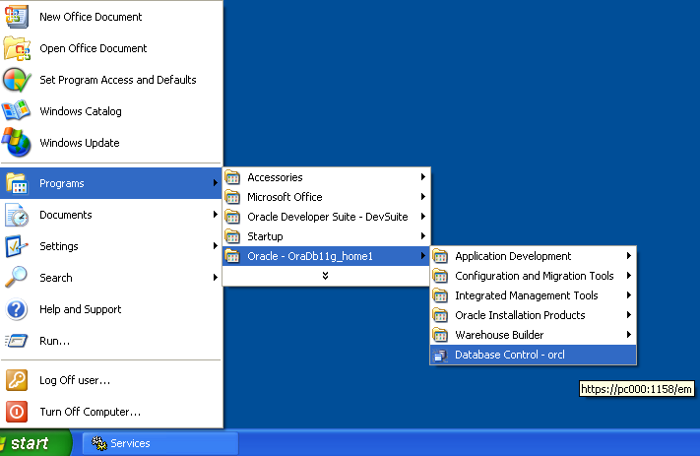

Slide 3
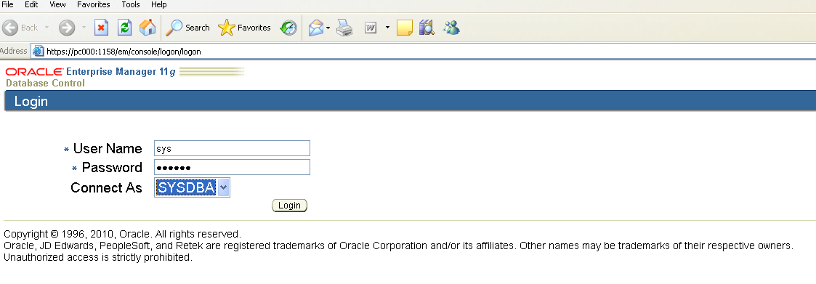
User name = sys
Password = system
Connect As = sysdba

Slide 4
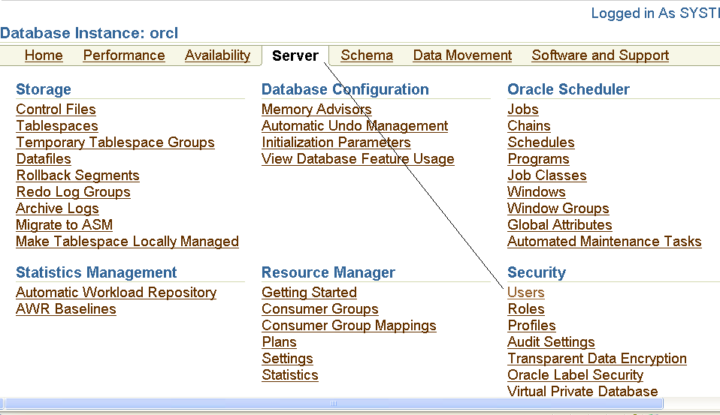
CLICK→SERVER→USERS

Slide 5
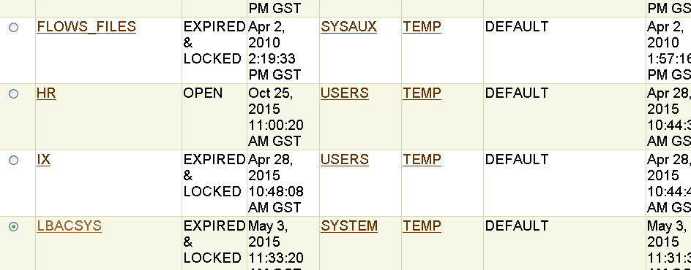
LBACSYS→CLICK RADIO BUTTON→ENABLE →EXPIRED & LOCK (ACCOUNT STATUS)→CLICK LBACSYS(UNDERLINE)

Slide 6
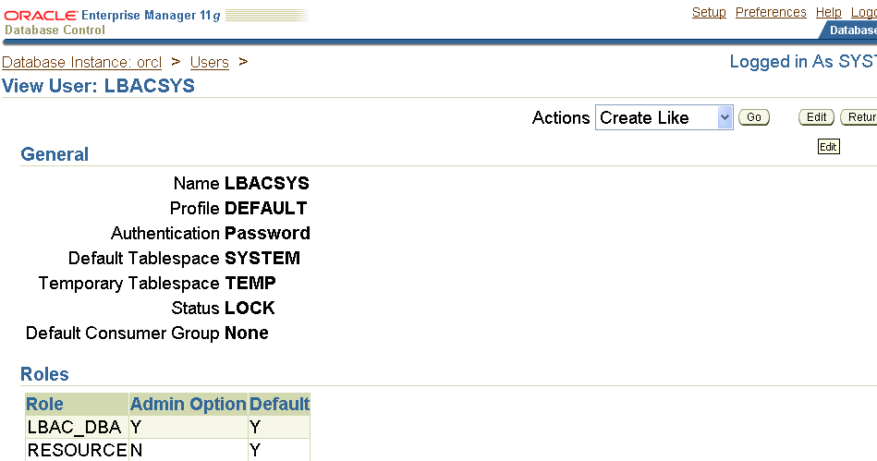
Click the edit button

Slide 7
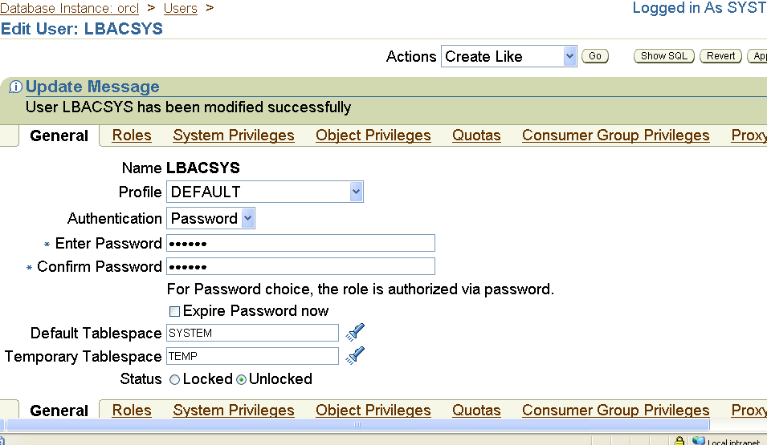
Change the password, because it is expired
Password “LBACSYS” – case sensitive
Select “unlock” radio button
Click system privileges

Slide 8
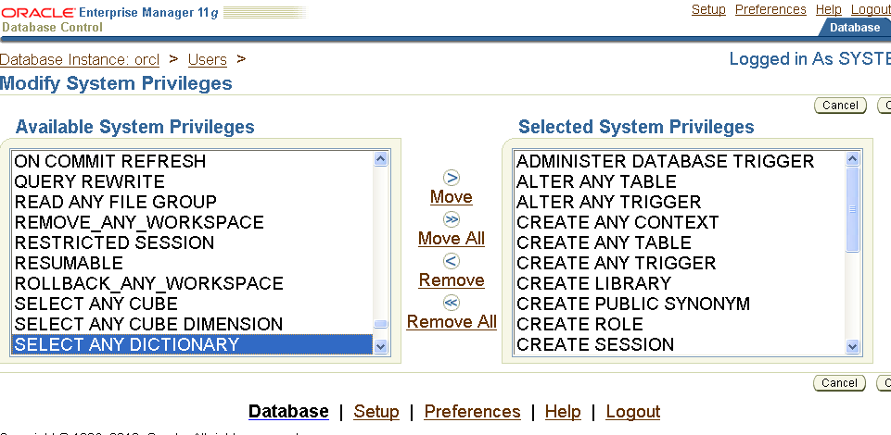
System privileges → edit→ select any dictionary → move
Press “Apply” Button
Logout “sys”

Slide 9
Restart these two services again i.e restart the database instance and login LBACSYS

Slide 10
Again restart →service →

Slide 12
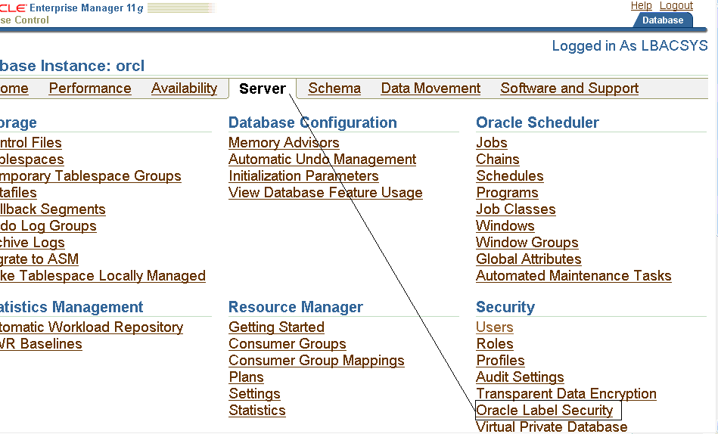
Server→ oracle label security

Slide 13
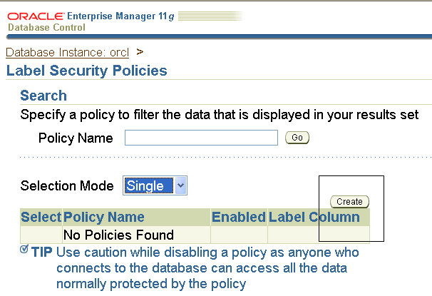
Click “create” button for creating new policy

Slide 14
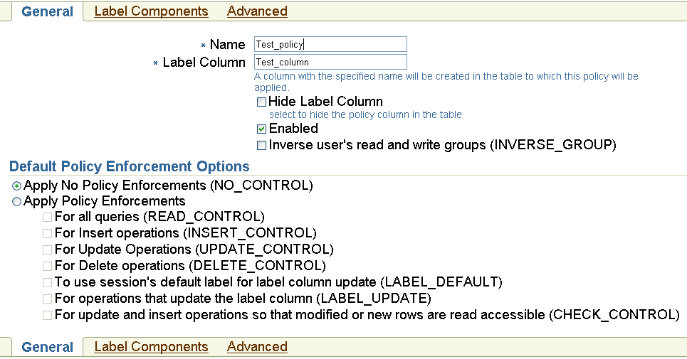
Name =Test_policy
Label Column =Test_column

Slide 15
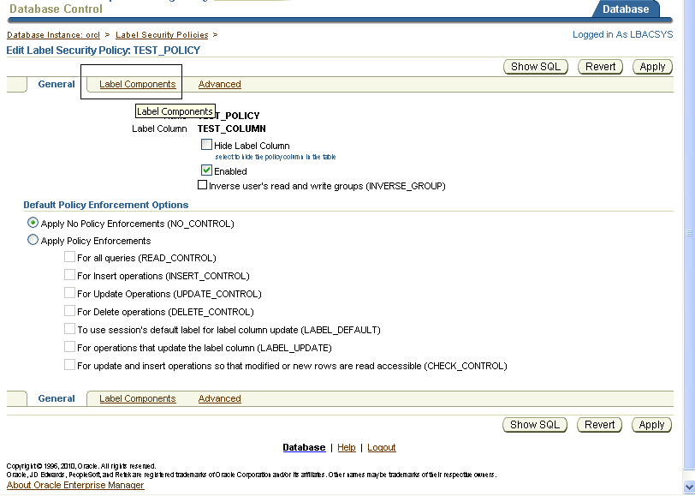
Policy-→ label components→

Slide 16
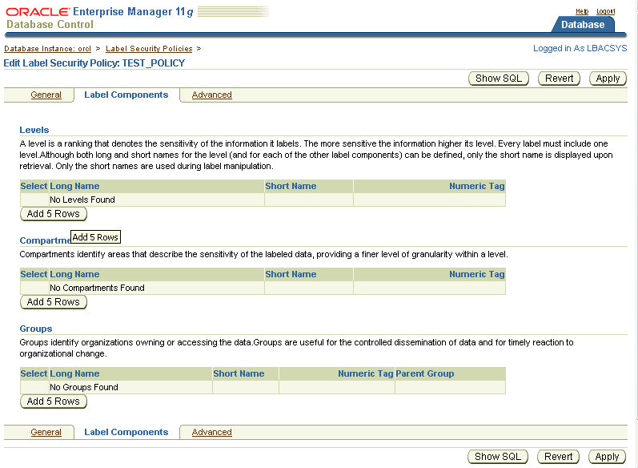
Click→ levels → add 5 rows

Slide 17
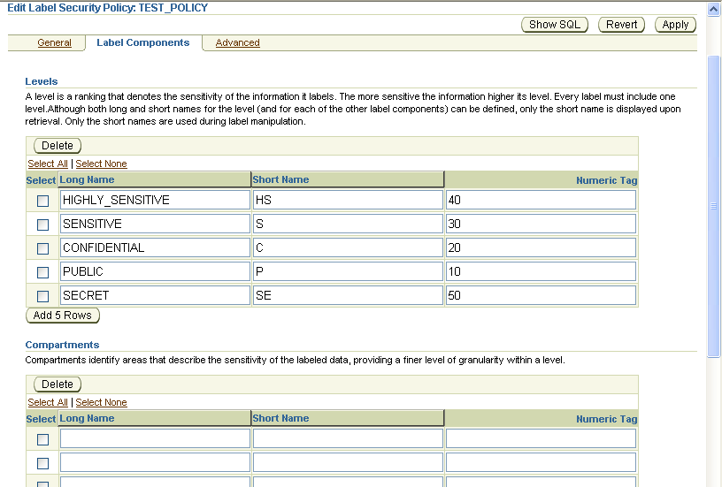
Type → long_name, short name, numeric tag → select all

Slide 18
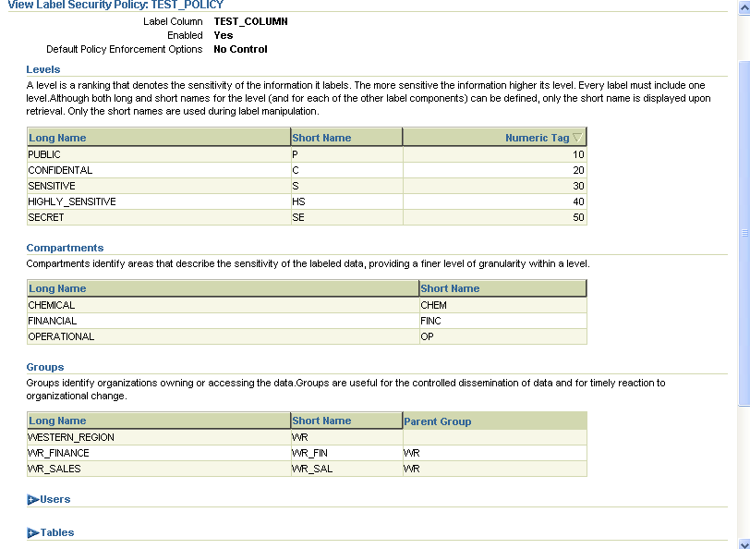
Once type level, compartment, group →click “apply” button
Descending order like 40,30 while Assigning
Ascending Order like 10,20
Parent Group followed by child group

Slide 19
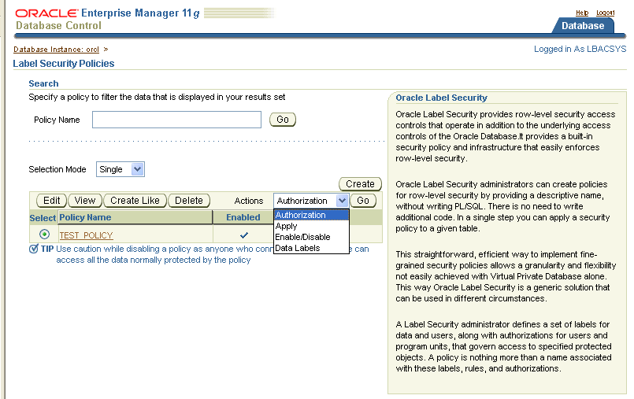
Action →Click “Authorization” and click “Go” button

Slide 20
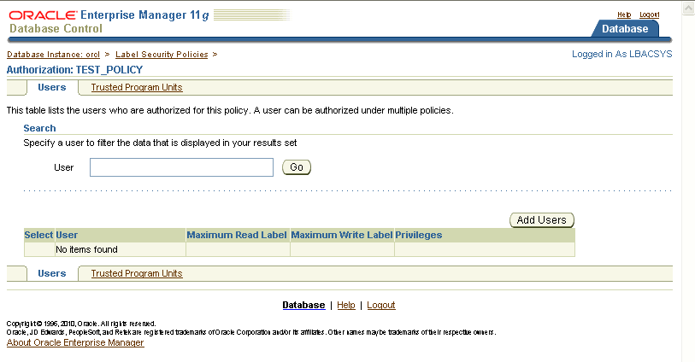
Click→ add users→ it will display the database user

Slide 21
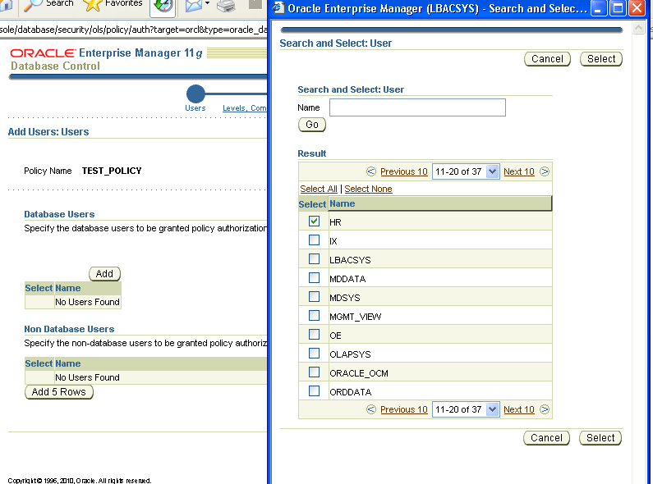
Select the “HR” user or any user

Slide 22
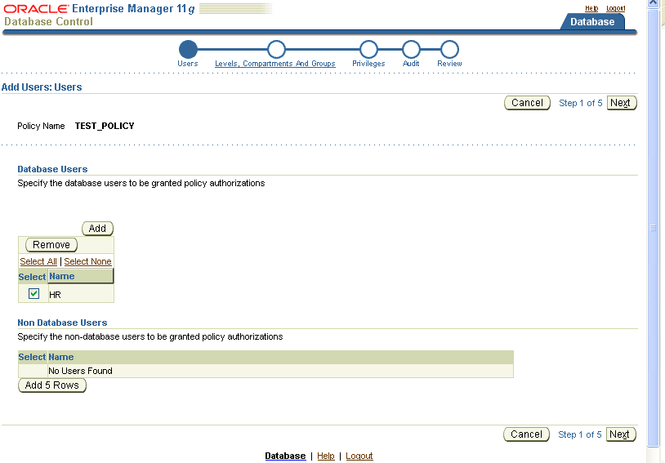
Here add “HR” user
Press “next” button

Slide 23
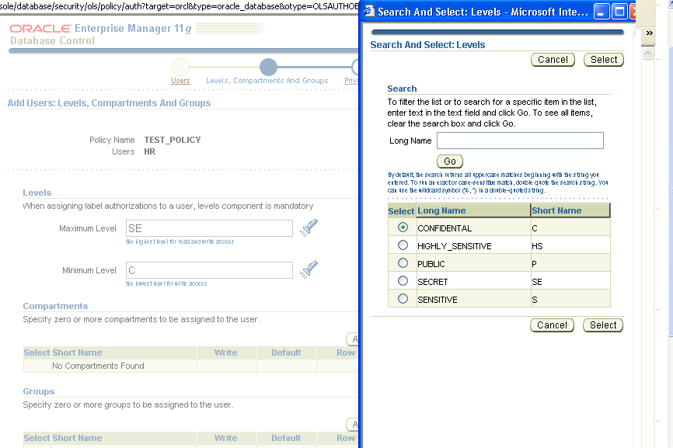
click

Slide 24
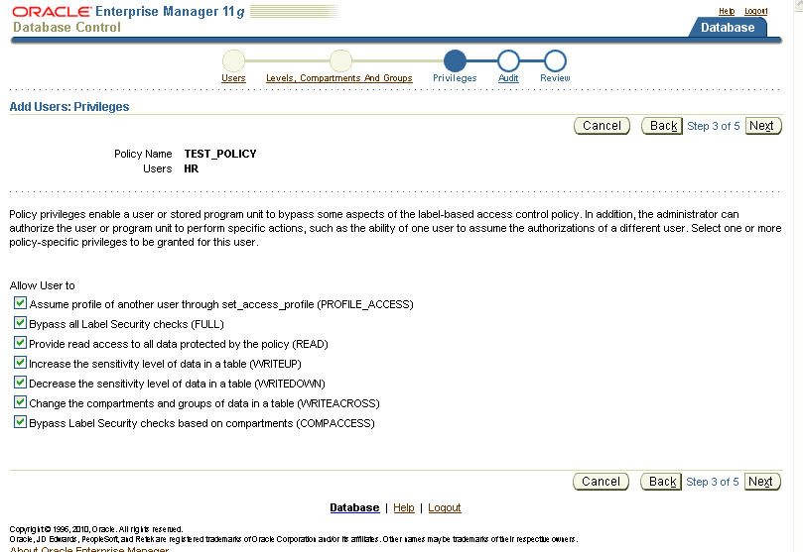
Whichever relevant select “policy privileges”

Slide 25
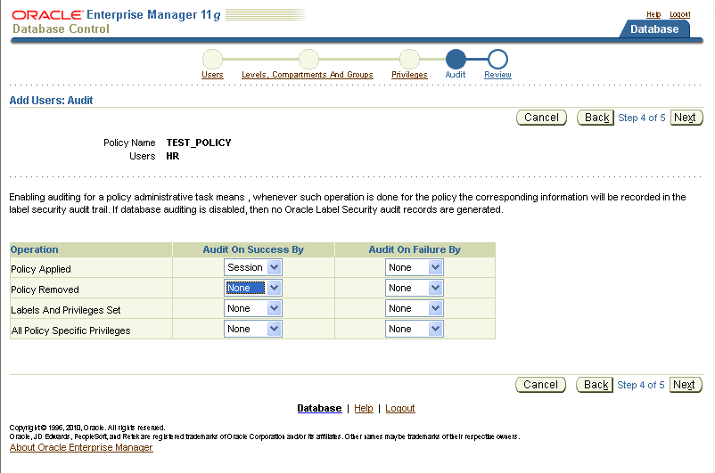
Enable the Audit operation

Slide 26
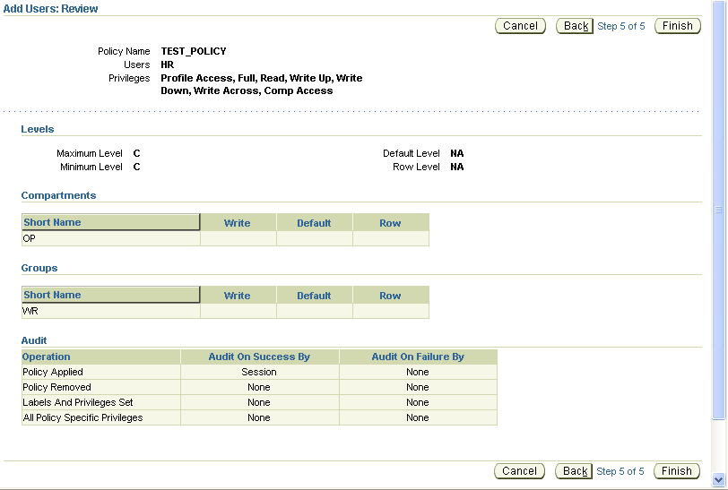

Slide 27
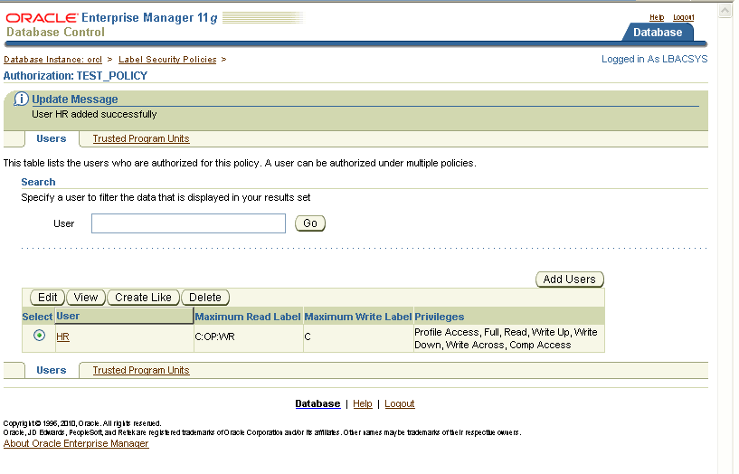
Data label created for user “HR”

