Slide 1
BASIC COMPUTER LITERACY ESL LEVEL – 1&2
WELCOME

Slide 2
BASIC COMPUTER LITERACY ESL LEVEL – 1&2
Computer Basics
Identify different computers
Know what the parts of a computer are
Get to know the keyboard
How the Mouse works
Connect to a Printer
Computer ports

Slide 3
BASIC COMPUTER LITERACY ESL LEVEL – 1&2
Types of computer!
Desktop computer
Consists of a system unit; a monitor; a mouse and a keyboard.

Slide 4
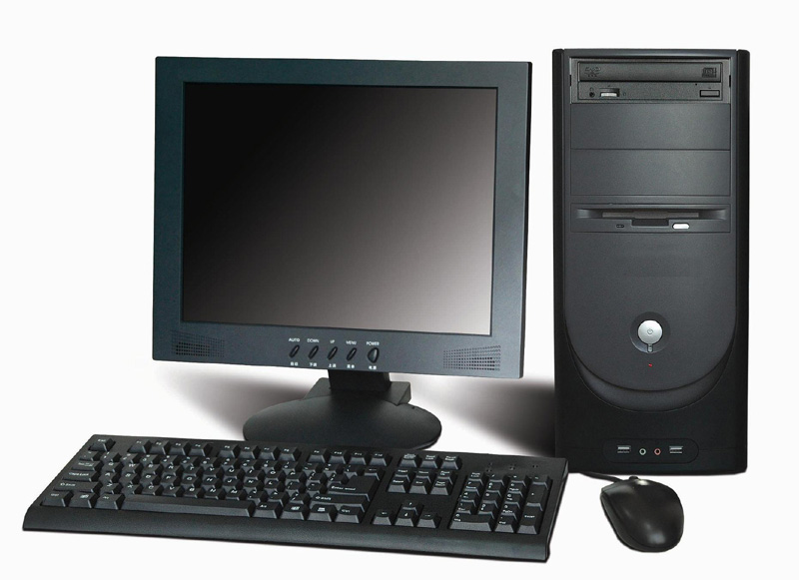
BASIC COMPUTER LITERACY ESL LEVEL – 1&2
SYSTEM
UNIT
MONITOR
KEYBOARD
MOUSE

Slide 5
BASIC COMPUTER LITERACY ESL LEVEL – 1&2
Types of computer!
Laptop Computer
All components in one device!!

Slide 6
BASIC COMPUTER LITERACY ESL LEVEL – 1&2
MONITOR
KEYBOARD
KEYPAD

Slide 7
BASIC COMPUTER LITERACY ESL LEVEL – 1&2
TYPES OF COMPUTER!
TABLET COMPUTER
MORE PORTABLE THAT A LAPTOP.
TOUCH SCREEN (no keyboard, no mouse)

Slide 8
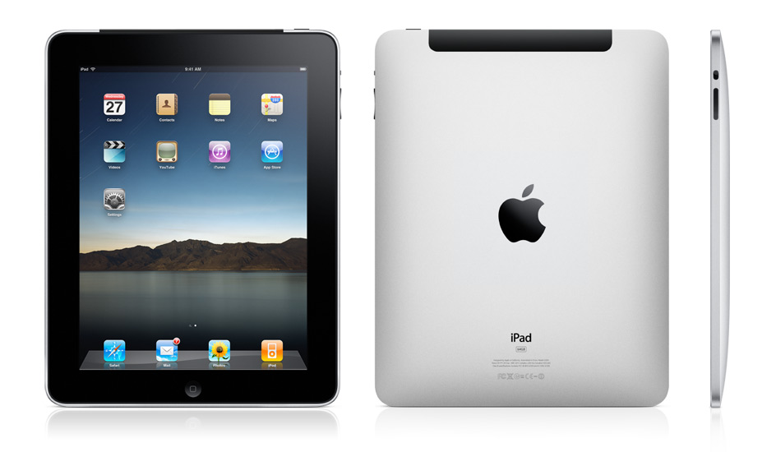
BASIC COMPUTER LITERACY ESL LEVEL – 1&2

Slide 9
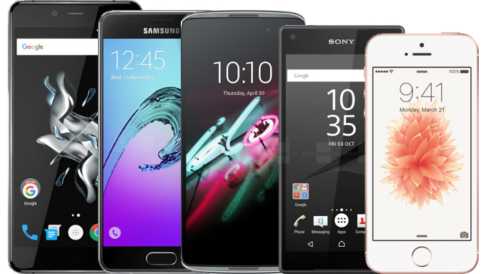
BASIC COMPUTER LITERACY ESL LEVEL – 1&2
YOUR SMARTPHONE IS ALSO A COMPUTER!!

Slide 10
BASIC COMPUTER LITERACY ESL LEVEL 1&2
INPUT DEVICES:
KEYBOARD; MOUSE; TOUCH SCREEN
OUTPUT DEVICES:
MONITOR; PRINTER
STORAGE DEVICES;
HARD DISK DRIVE; USB DRIVE; CD-ROM;
DVD

Slide 11
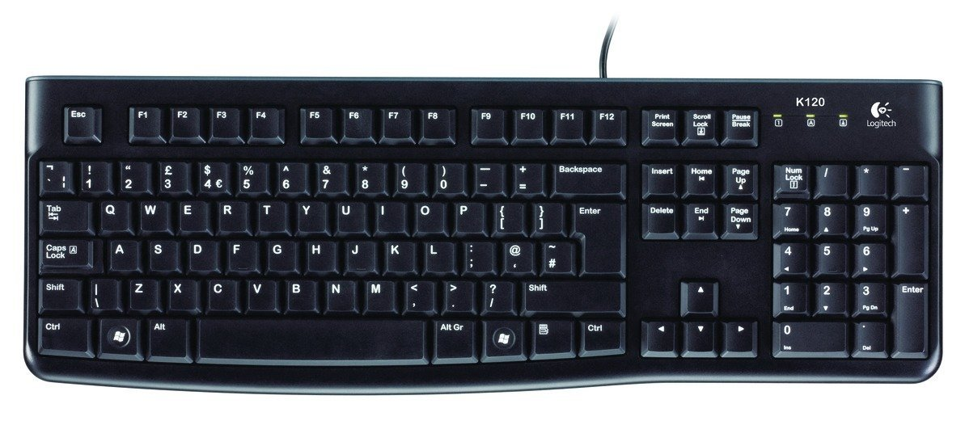
BASIC COMPUTER LITERACY ESL LEVEL 1&2
Input Device – Keyboard
(Show Functions of Keys)

Slide 12
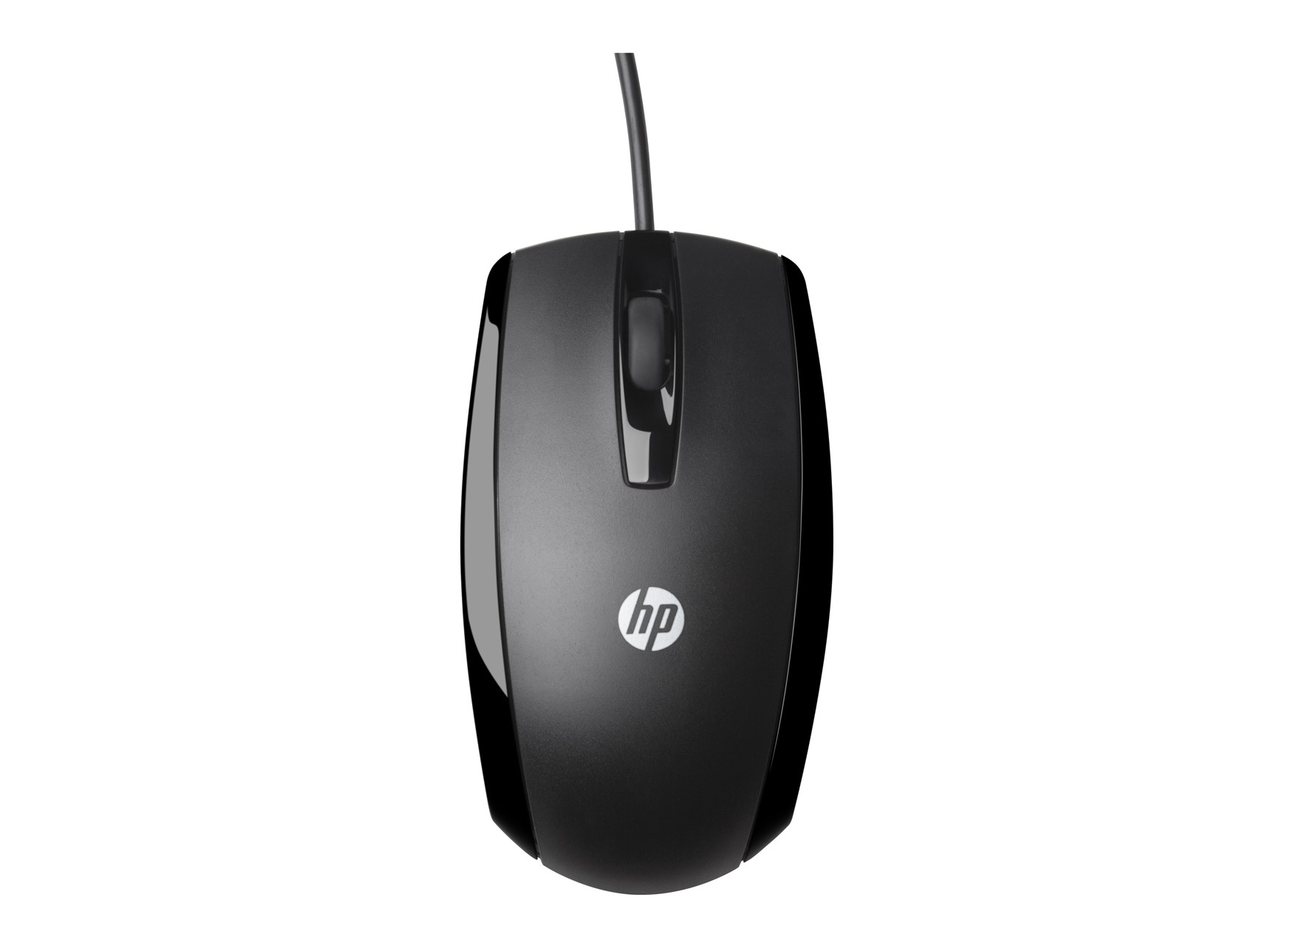
BASIC COMPUTER LITERACY ESL LEVEL 1&2
INPUT DEVICES:
MOUSE
Explain Left & Right Clicks
Explain Scroll

Slide 13
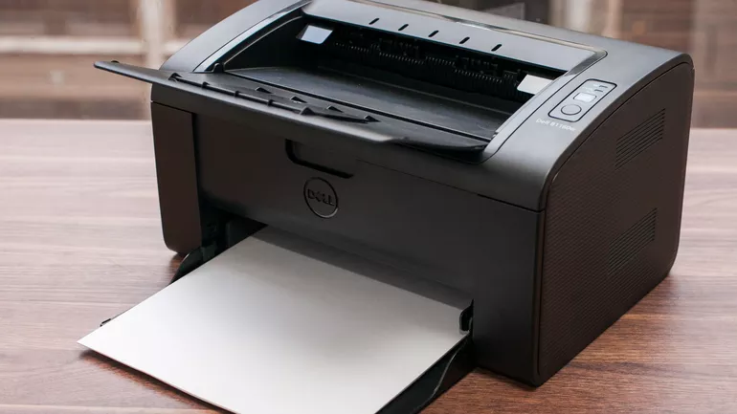
BASIC COMPUTER LITERACY ESL LEVEL 1&2
Output DEVICES:
Printer
How to Connect to Printer

Slide 14
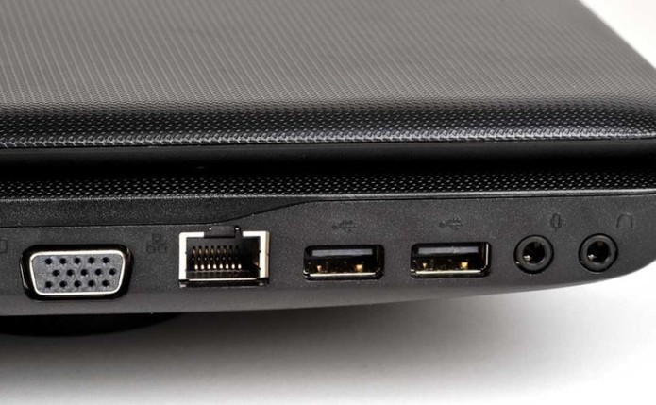
BASIC COMPUTER LITERACY ESL LEVEL 1&2
Computer Ports (Slots):
USB
Headphone (Jack)
Monitor (D connector)
Network

