Slide 1
Unit 4 SLOWLY CHANGIN DIMENSION 2 – Exercise -1 Solution (SCD2)
https://www.oercommons.org/authoring/28550-etl-using-pentaho-spoon
https://www.oercommons.org/authoring/28693-etl-using-pentaho-spoon-lecture-notes-ppt-exercise

Slide 2
Exercise:
Create table employ2(eid number(5),ename varchar2(15),salary number(5));
insert into employ2 values(1001,'Alaa',1800);
insert into employ2 values(1002,'Ravi',1500);
select * from employ2;
create table emp_dim_scd2(emp_sur_key number(5),date_from date,date_to date,version number(6),dim_eid number(5),ename varchar2(15),salary number(5));
update employ2 set salary=2500 where eid=1001;
select * from emp_dim_scd2;
insert into employ2 values(1003,'Suha',1900);

Slide 3
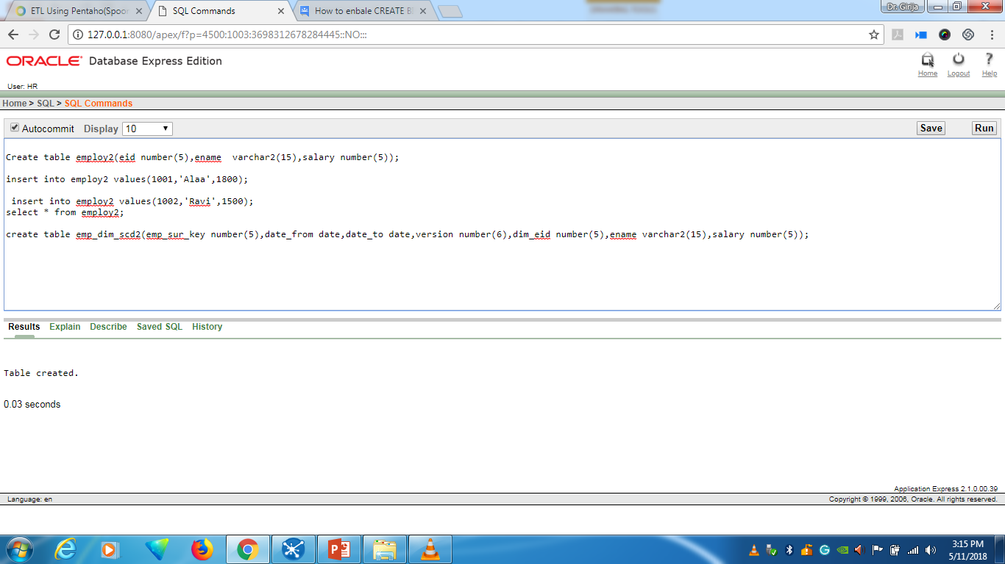
Create employ2 table and emp_dim_scd2 table

Slide 4
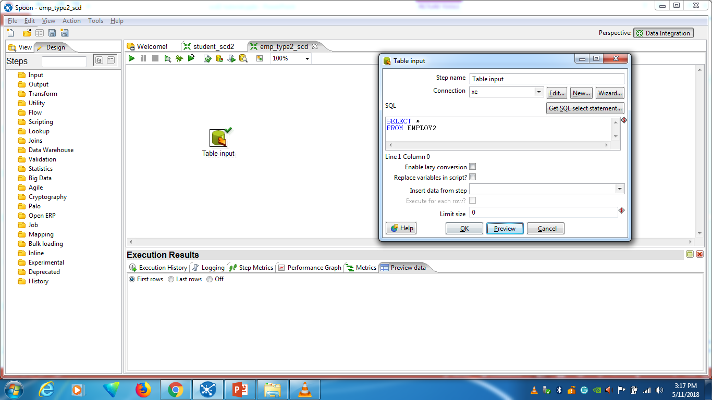
Drag and include “Table Input”

Slide 5
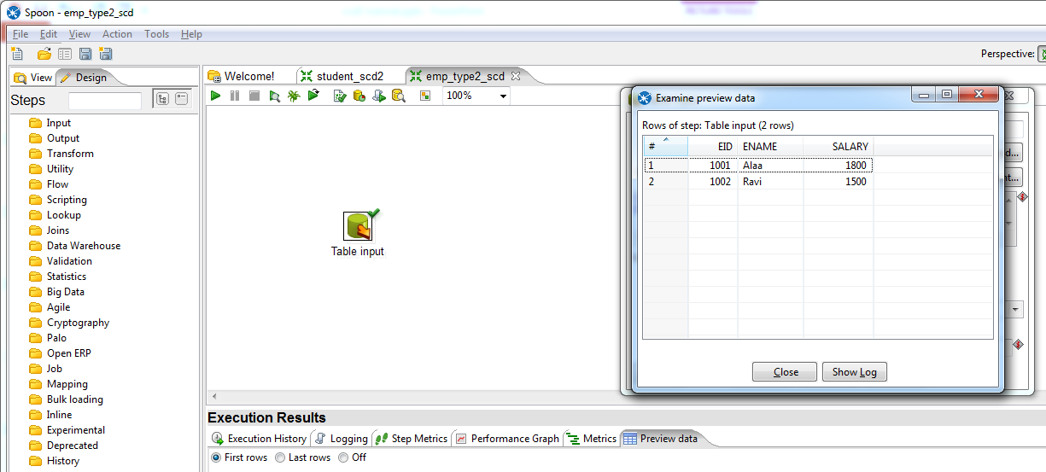
Connect the table employ2 table and preview the data

Slide 6
Drag and include dimension lookup/update
connect table input with dimension lookup/update

Slide 7
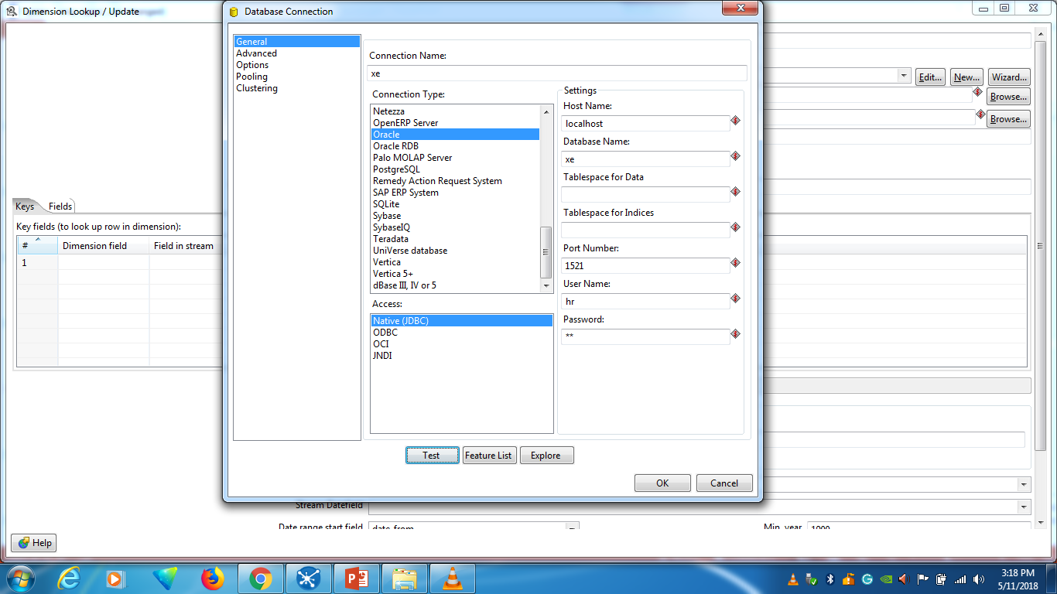
Connect the database

Slide 8
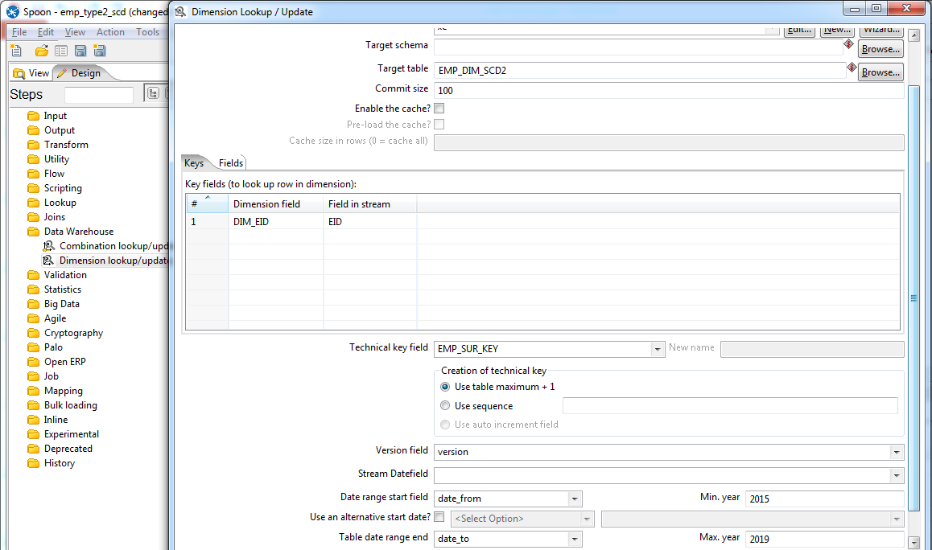
Key field
surrogate key
Date from
Date to

Slide 9
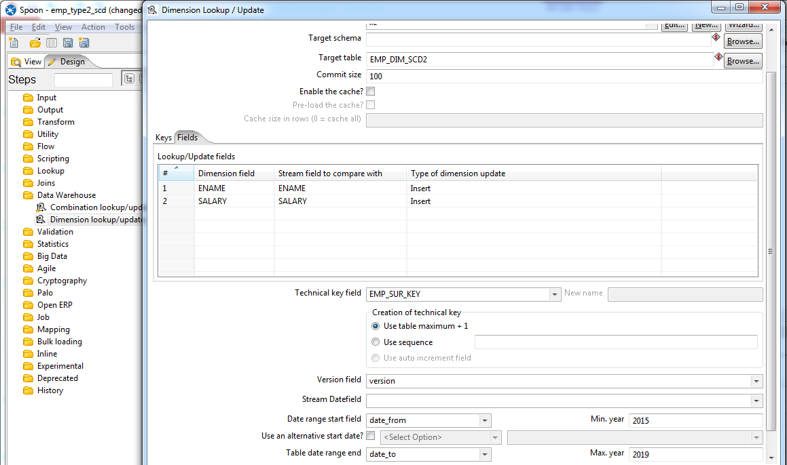
Select Fields

Slide 10
Update the eid=1001 salary as 2500 in employ2 table

Slide 11
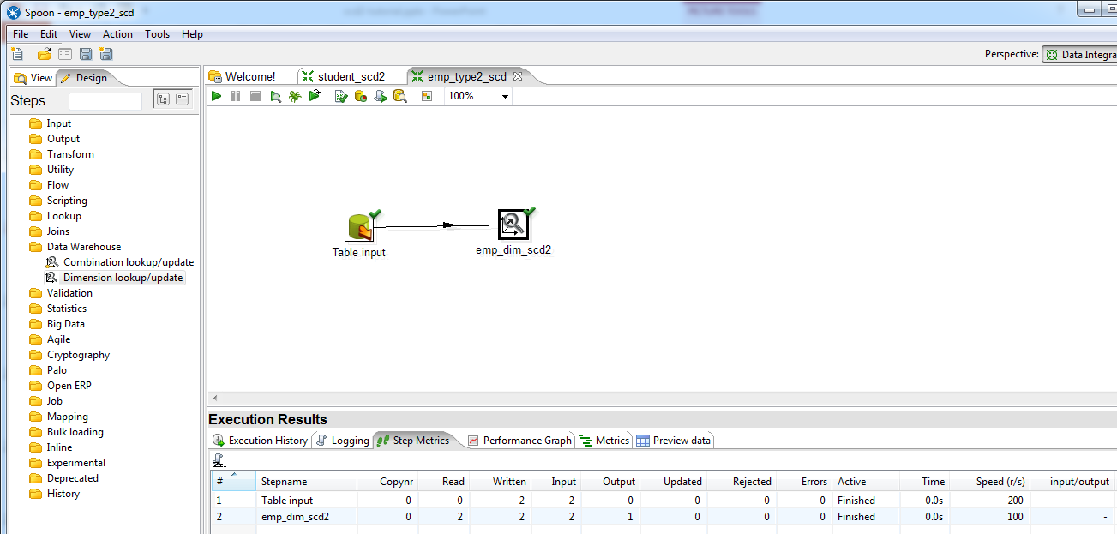
Execute the transformation

Slide 12
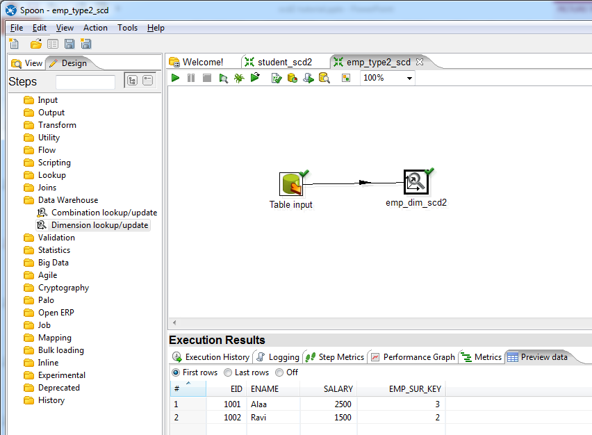
Preview data and updated record information

Slide 13
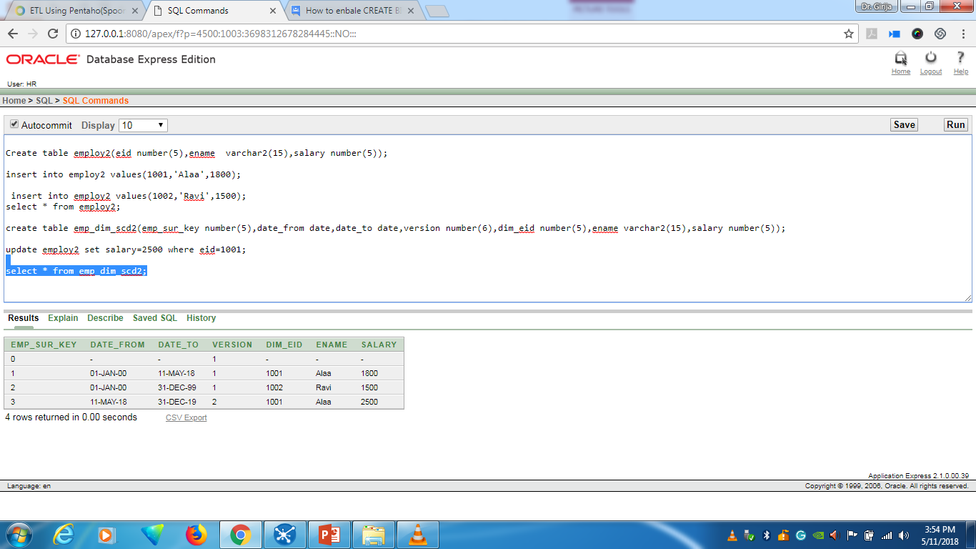
Check the emp_dim_scd1 table records updated history

Slide 14
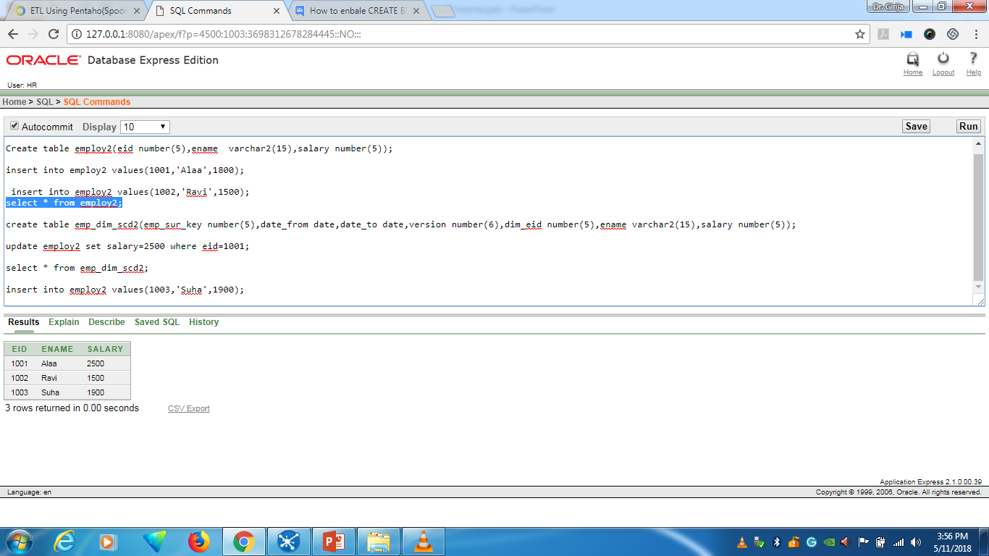
Insert new record

Slide 15
Execute the transformation

Slide 16
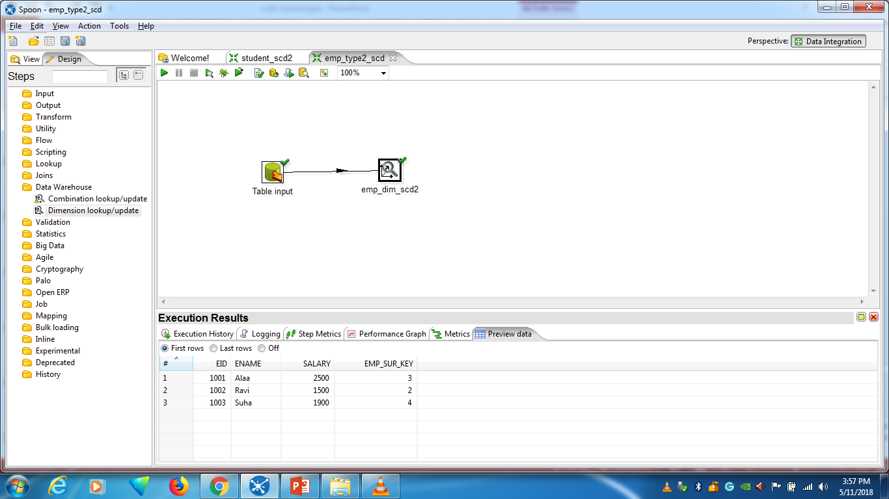
Preview the data and newly inserted record information

Slide 17
