Slide 1
Unit 4- SLOWLY CHANGING DIMENSION TYPE 2 (SCD2)

Slide 2
SLOWLY CHANGIN DIMENSION 2
This type will create a duplicate records with necessary changes without disturbing the history. For example if you update any record information, it will keep both old record information plus old record information.
It maintains full history in the target. It maintains history by inserting the new record and updating for each change. It keep version number, date from and date to changes occurred

Slide 3
create table student_scd2(sid number(5) ,sname varchar2(15),mark1 number(5));
insert into student_scd2 values(11,'Ambu',89);
insert into student_scd2 values(12,'Meenu',75);
insert into student_scd2 values(13,'Jasica',45);
select * from student_scd2;
create table student_dim_scd2(stu_sur_key number(5),date_from date, date_to date, version number(4), dim_sid number(5), sname varchar2(15),mark1 number(5));

Slide 5
Drag and place the table input

Slide 6
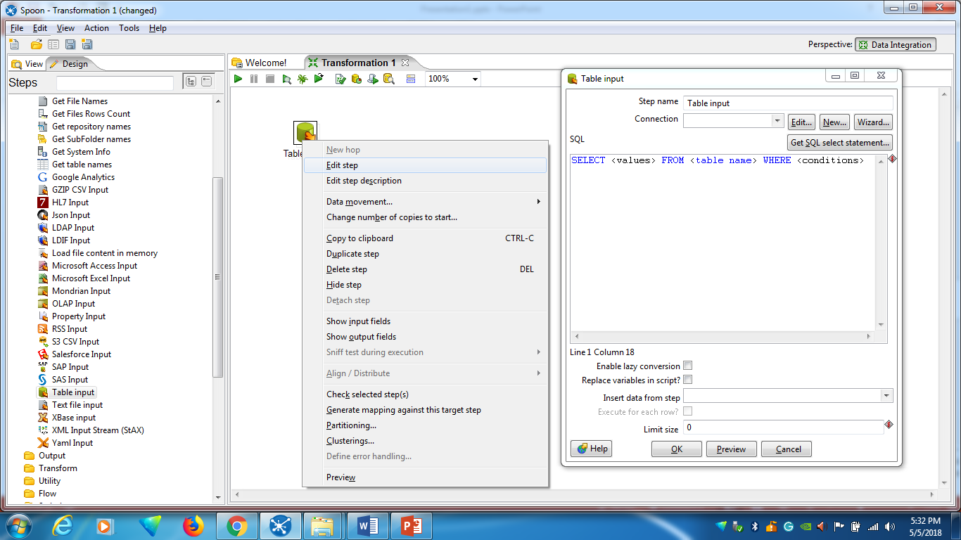
Right click the mouse in Table input and select Edit step

Slide 7
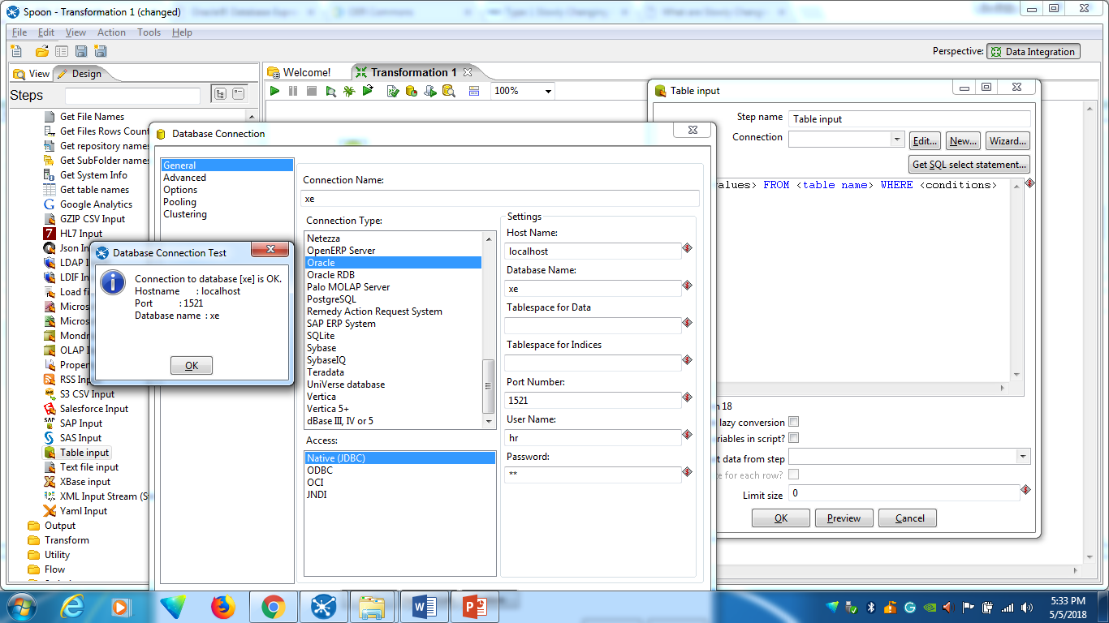
Computer name in the property of the system
3
1
2
Select “New” get Database connection details
5
4
Click the “Test” Button
Database name is “xe”, Database user name “hr” and password of the user “hr”

Slide 9
Drag and place the “dimension lookup/update” and connect with Table input

Slide 10
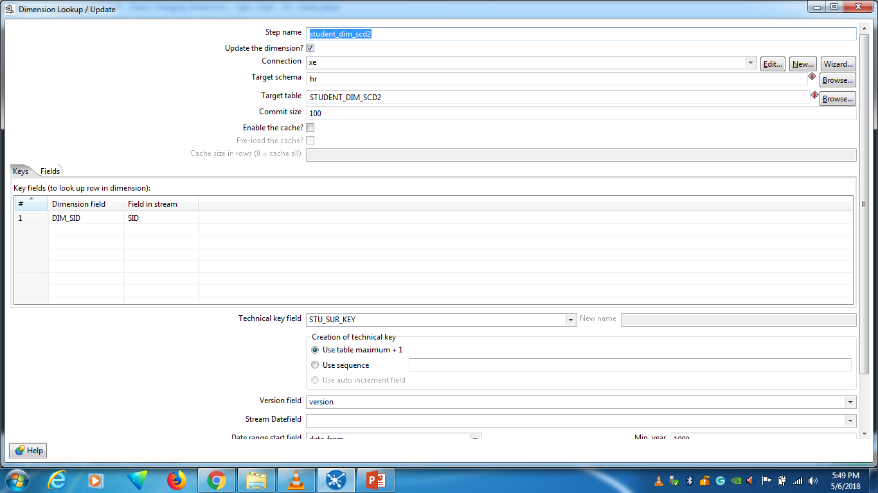
Rename “student_dim_scd2”
Right click and Edit
Disable it
Key Field
Surrogate Key

Slide 11
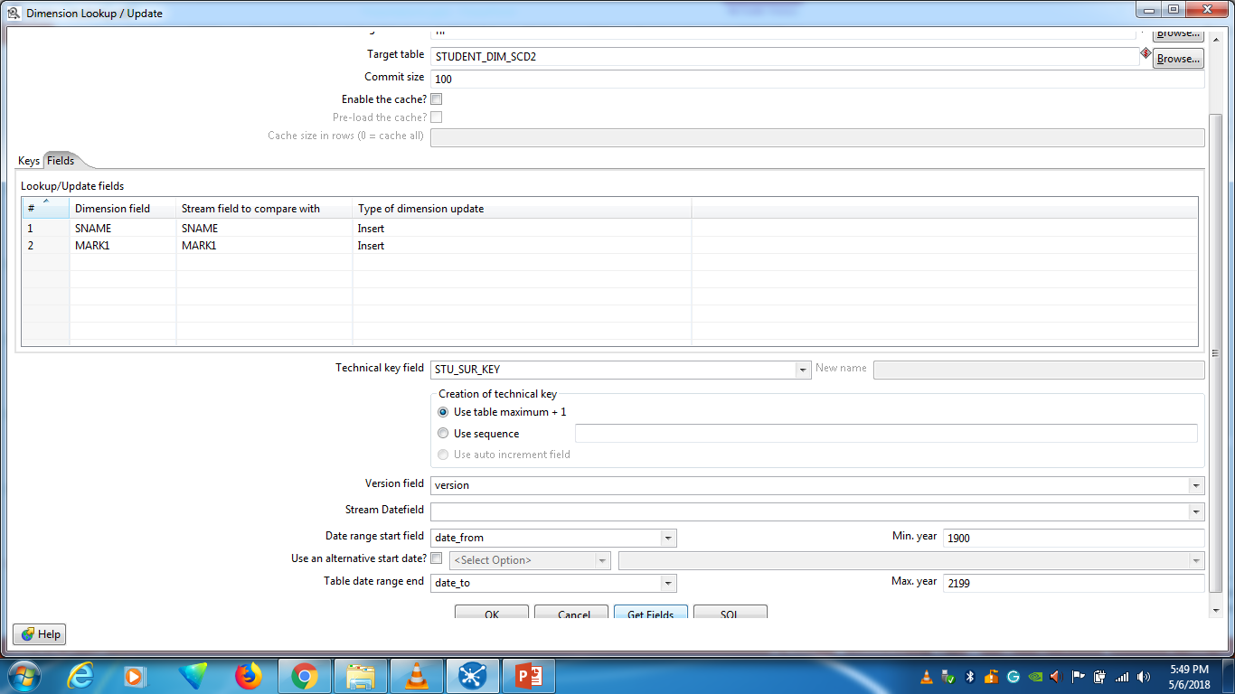
1
Select “fields”
2
Click Get Fields

Slide 12
Run Transform → launch→go back to “oracle xe”--- display the student_dim_scd2 table

Slide 13
Update the sid 11, mark as “95”

Slide 14
Execute the result, check the updated mark “95” in SID 11

Slide 15
Updated history is storing in the dimension table

Slide 16
Exercise
Create table employ2(eid number(5),ename varchar2(15),salary number(5));
insert into employ2 values(1001,'Alaa',1800);
insert into employ2 values(1002,'Ravi',1500);
select * from employ2;
create table emp_dim_scd2(emp_sur_key number(5),date_from date,date_to date,version number(6),dim_eid number(5),ename varchar2(15),salary number(5));
Instruction 1: (Update Base table)
•Create employ2, emp_dim_scd2 table and insert two records in oracle_xe.
• Using Spoon, include “table input” connect employ2 table,
•include “dimension lookup/update” tag connect emp_dim_scd2 dimension table, run the transformation and execute the result
• Check the emp_dim_scd2 records in the Oracle xe
• update the employ2 table eid 1001 salary is 2500, again execute the result in spoon
•Display emp_dim_scd2 dimension table with updated history details are included.

Slide 17
instruction 2: (Insert the New record in the Base table)
Insert the below given record in the employ2 table
insert into employ2 values(1003,'Suha',1900);
execute the result in spoon
•Display emp_dim_scd2 dimension table with updated history details are included.

