Slide 1
Using the 2014 GED Formula Sheet to Calculate Volume and Surface Area – Part 1 (Rectangular Prisms)
Notes:
Half-circle picture with accent arcs
(Basic)
To reproduce the shape effects on this slide, do the following:
On the Home tab, in the Slides group, click Layout, and then click Blank.
On the Home tab, in the Drawing group, click Shapes, and then under Basic Shapes, click Arc (third row, 12th option from the left). On the slide, drag to draw an arc.
Select the arc. Under Drawing Tools, on the Format tab, in the Size group, do the following:
In the Shape Height box, enter 7.5”.
In the Shape Width box, enter 7.5”.
Drag the right yellow diamond adjustment handle to the bottom of the slide to create a half-circle.
Under Drawing Tools, on the Format tab, in the bottom right corner of the Shape Styles group, click the Format Shape dialog box launcher. In the Format Shape dialog box, click Fill in the left pane. In the Fill pane, select Picture or texture fill, and then under Insert from, click File.
In the Insert Picture dialog box, select a picture, and then click Insert.
Also in the Format Shape dialog box, in the Fill pane, under Insert from, select Tile picture as texture.
Also in the Format Shape dialog box, click Line Color in the left pane, and then select No line in the Line Color pane.
Also in the Format Shape dialog box, click Shadow in the left pane, and then do the following in the Shadow pane:
Click the button next to Presets, and then under Inner click Inside Diagonal Top Right (first row, third option from the left).
In the Transparency box, enter 70%.
In the Blur box, enter 20 pt.
In the Distance box, enter 20 pt.
Drag the half-circle to the left until the two middle yellow adjustment diamonds are lined up with the left edge of the slide. On the Home tab, in the Drawing group, click Arrange, point to Align, and then do the following:
Click Align to Slide.
Click Align Middle.
Select the arc. On the Home tab, in the Clipboard group, click the arrow under Copy, and then click Duplicate.
Select the second arc. Under Drawing Tools, on the Format tab, in the Size group, do the following:
In the Shape Height box, enter 6.79”.
In the Shape Width box, enter 10.03”.
On the Home tab, in the bottom right corner of the Drawing group, click the Format Shape dialog box launcher. In the Format Picture dialog box, click Fill in the left pane, and then in the Fill pane, select No fill.
Also in the Format Shape dialog box, click Line Color in the left pane. In the Line Color pane, select Solid line and then do the following:
Click the button next to Color, and then under Theme Colors click White, Background 1 (first row, first option from the left).
In the Transparency box, enter 50%.
Also in the Format Shape dialog box, click Line Style in the left pane. In the Line Style pane, in the Width box, enter 1.5 pt.
Drag the second arc left on the slide until the two middle yellow adjustment diamonds are lined up with the left edge of the slide. On the Home tab, in the Drawing group, click Arrange, point to Align, and then do the following:
Click Align to Slide.
Click Align Middle.
Select the second arc. On the Home tab, in the Clipboard group, click the arrow under Copy, and then click Duplicate.
Select the third arc. Under Drawing Tools, on the Format tab, in the Size group, do the following:
In the Shape Height box, enter 6.86”.
In the Shape Width box, enter 9.98”.
On the Home tab, in the bottom right corner of the Drawing group, click the Format Shape dialog box launcher. In the Format Shape dialog box, click Line Color in the left pane, select Gradient line in the Line Color pane, and then do the following:
In the Type list, select Linear.
Click the button next to Direction, and then click Linear Down (first row, second option from the left).
Under Gradient stops, click Add gradient stop or Remove gradient stop until two stops appear in the slider.
Also under Gradient stops, customize the gradient stops that you added as follows:
Select the first stop in the slider, and then do the following:
In the Position box, enter 0%.
Click the button next to Color, and then under Theme Colors click Blue, Accent 1, Lighter 40% (fourth row, fifth option from the left).
In the Transparency box, enter 77%.
Select the second stop in the slider, and then do the following:
In the Position box, enter 100%.
Click the button next to Color, click More Colors, and then in the Colors dialog box, on the Custom tab, enter values for Red: 208, Green: 215, Blue: 222.
In the Format Shape dialog box, in the Line Style pane, in the Transparency box, enter 90%.
Also in the Format Shape dialog box, click Line Style in the left pane. In the Line Style pane, in the Width box, enter 4.25 pt.
On the Home tab, in the Drawing group, click Arrange, point to Align, and then do the following:
Click Align to Slide.
Click Align Left.
Drag the third arc left on the slide until the two middle yellow adjustment diamonds are lined up with the left edge of the slide. Drag the third arc vertically as needed to position it slightly above the second arc on the slide.
To reproduce the background on this slide, do the following:
Right-click the slide background area, and then click Format Background. In the Format Background dialog box, click Fill in the left pane, select Gradient fill in the Fill pane, and then do the following:
In the Type list, select Linear.
Click the button next to Direction, and then click Linear Up (second row, second option from the left).
In the Angle box, enter 270⁰.
Under Gradient stops, click Add gradient stop or Remove gradient stop until four stops appear in the slider
Also under Gradient stops, customize the gradient stops that you added as follows:
Select the first stop in the slider, and then do the following:
In the Position box, enter 0%.
Click the button next to Color, click More Colors, and then in the Colors dialog box, on the Custom tab, enter values for Red: 167, Green: 185, Blue: 197.
Select the second stop in the slider, and then do the following:
In the Position box, enter 30%.
Click the button next to Color, and then under Theme Colors click White, Background 1 (first row, first option from the left).
Select the third stop in the slider, and then do the following:
In the Position box, enter 70%.
Click the button next to Color, and then under Theme Colors click White, Background 1 (first row, first option from the left).
Select the fourth stop in the slider, and then do the following:
In the Position box, enter 100%.
Click the button next to Color, click More Colors, and then in the Colors dialog box, on the Custom tab, enter values for Red: 167, Green: 185, Blue: 197.

Slide 2
This is a slide show produced for adult learners in a lab setting. It was created as a project for LINCS STEM Training by Donna Parrish. Please give her feedback about this presentation.

Slide 3
Surface Area is just what it says: a measure of the total area on the outside of a three dimensional figure.
One way to think of surface area is to envision totally covering the outside of a figure with paper without any overlapping.

Slide 4
Area is always measured in square units. You might ask: Why is that?
Lots of space between the circles
No empty spaces between the squares

Slide 5
Here’s a little math shorthand:
Square inches can be written sq in or in²
Square centimeters can be written sq cm or cm²
Notice we do not usually use periods after the abbreviations – it might be bad English, but in math we try to reserve those periods for decimal points ☺

Slide 6
Square feet can be written sq ft or ft²
Square meters can be written sq m or m²

Slide 7
Square millimeters can be written sq mm or mm²
Square miles can be written sq mi or mi²
Remember: The exponent of 2 next to a measurement unit is read “square”

Slide 8
Take a moment and use scratch paper to draw a square inch and label it.

Slide 9
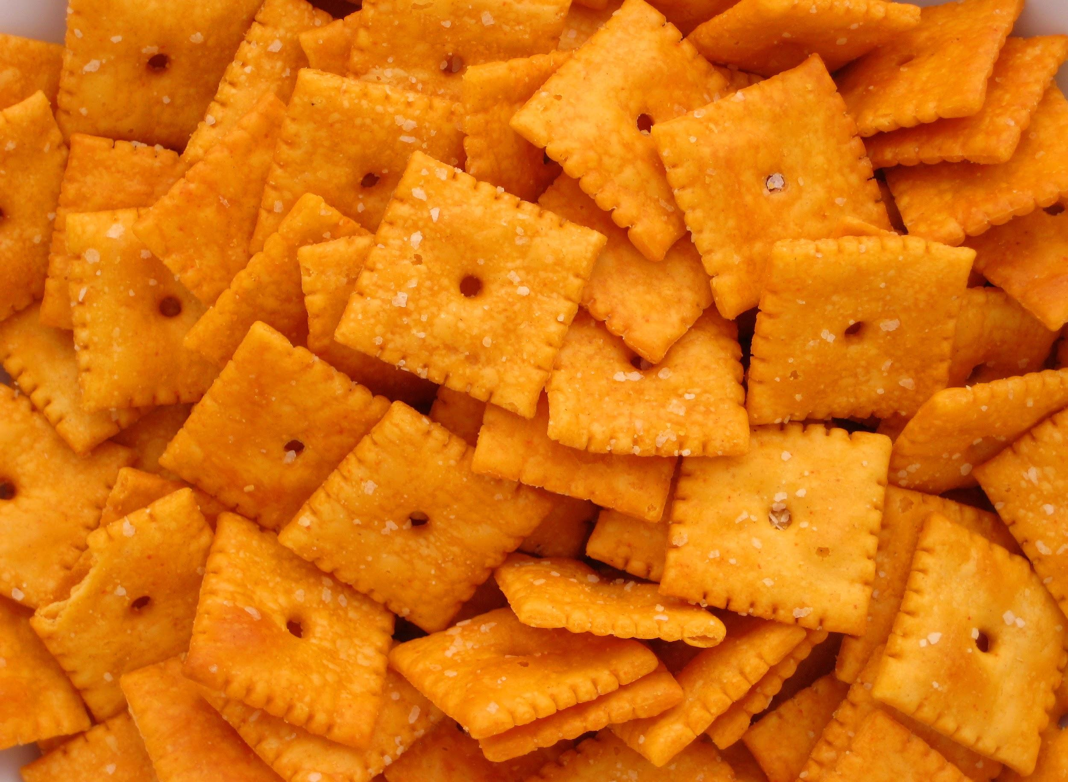
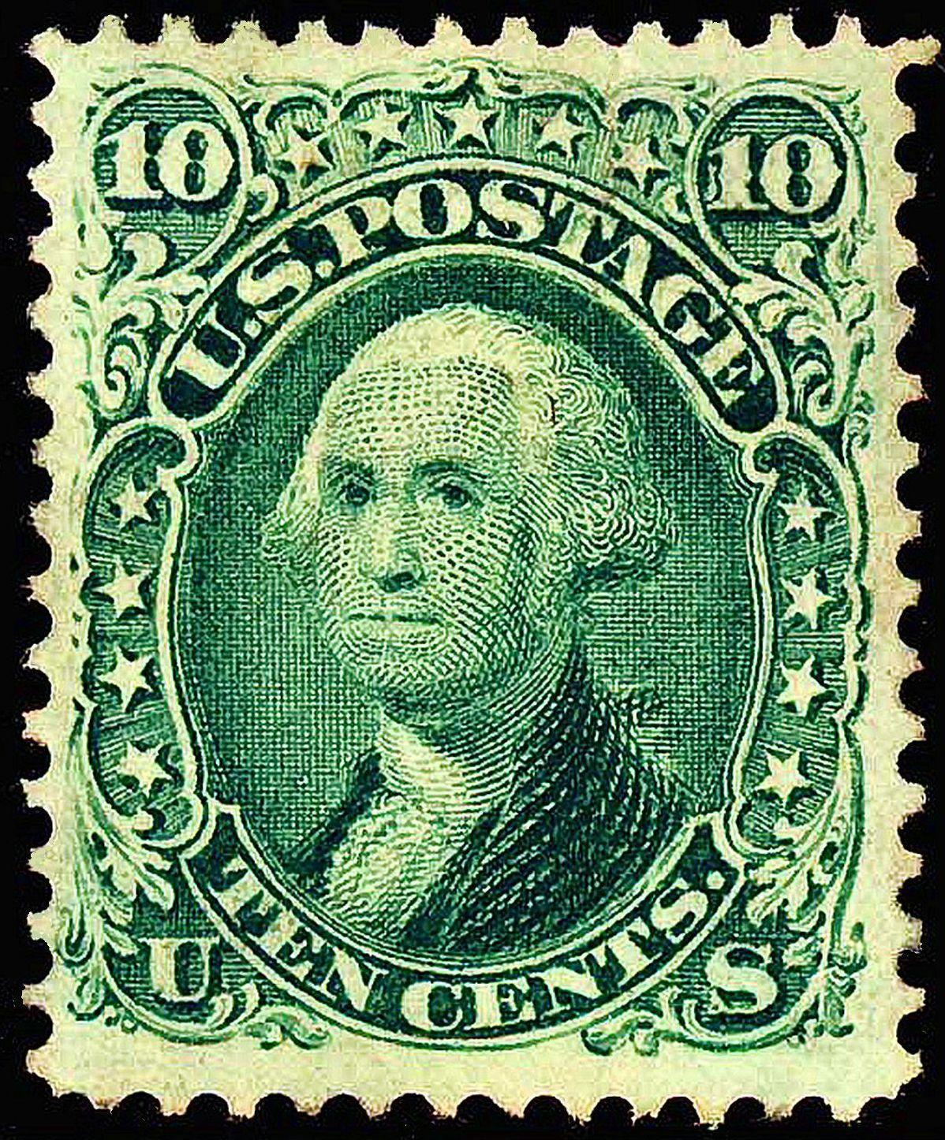
Is your drawing about the size of a square postage stamp or a Cheezit snack? If so, then WELL DONE!

Slide 10
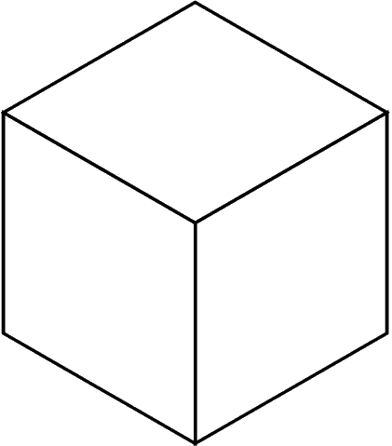
The 3-dimensional object pictured to the right is a cube. Its length, width and height are the same. Its base is a square.
Volume is expressed as cubic units representing the number of cubes that will fit inside of the object.

Slide 11
Here’s a little more math shorthand:
Cubic inches can be written cu in or in³
Cubic centimeters can be written cu cm or cm³

Slide 12
Cubic millimeters can be written cu mm or mm³
Cubic feet can be written cu ft or ft³
The exponent of 3 next to a measurement unit is read “cubic”

Slide 13
Another thing about labelling the units.
There is a BIG difference between, for example, 7² in and 7 in²
That change in placement of the exponent changes both the value and the unit of measurement.

Slide 14
The first notation (7² in) means 7x7 or 49 inches. That is a linear measurement telling how long something is.
The second notation, 7 in², means 7 one inch squares and it measures area (how many squares will fit inside a figure).

Slide 15
Even though when we read in² we say “square inches” saying the word “square” before the word “inches”, we must write the exponent of 2 AFTER the abbreviation for inches (“in”).

Slide 16
LIKEWISE…
There is a BIG difference between, for example, 7³ in and 7 in^{3.} The first notation (7³ in) means 7x7x7 or 343 inches. That is a linear measurement. The second notation, 7 in³ means 7 cubes measuring 1 inch on each side. Even though when we read in³ we say “cubic inches”, we must write the exponent of 3 AFTER the “in”.

Slide 17
Now we finally get to rectangular prisms!

Slide 18
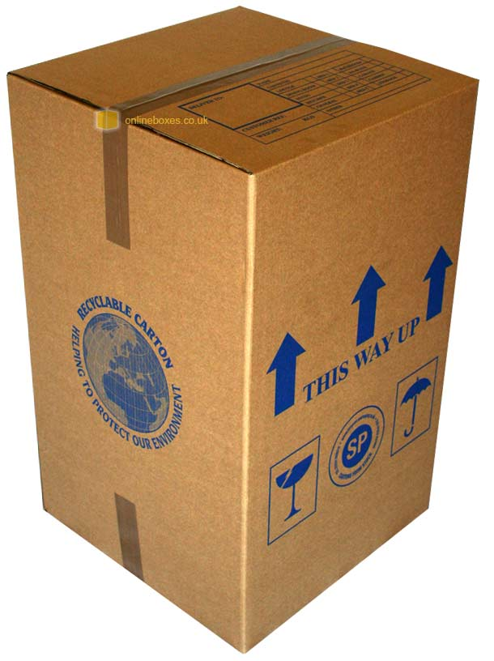
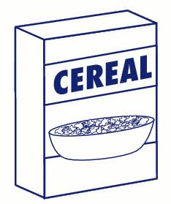
Outside of school we might think of a rectangular prism as a typical box – like a tissue box, a cereal box, or any type of packing box.

Slide 19
To be more precise and to describe a rectangular prism more fully, we first have to consider what makes a prism.

Slide 20
A more formal definition: A prism is any three dimensional figure that has two bases that are congruent polygons (triangles, parallelograms or rectangles, pentagons, hexagons, etc.) that are parallel to each other and whose sides are rectangles or parallelograms.

Slide 21
That’s a whole lot of words. Lets look at some pictures!

Slide 22
All the drawings on the next four slides are prisms. Study them carefully because there are lots of different kinds of prisms there.

Slide 24
All these are prisms…

Slide 25
Both of these are prisms, even though the second one “leans” over.

Slide 26
Here is another right prism or “non-leaning prism” (or rectangular prism) and a “leaning prism” (or oblique prism).

Slide 27
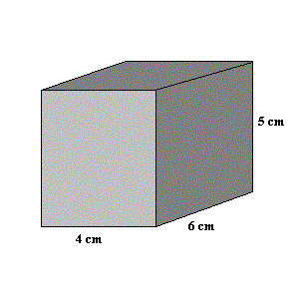
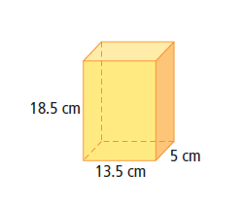
These are rectangular prisms.

Slide 28
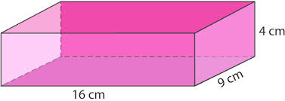
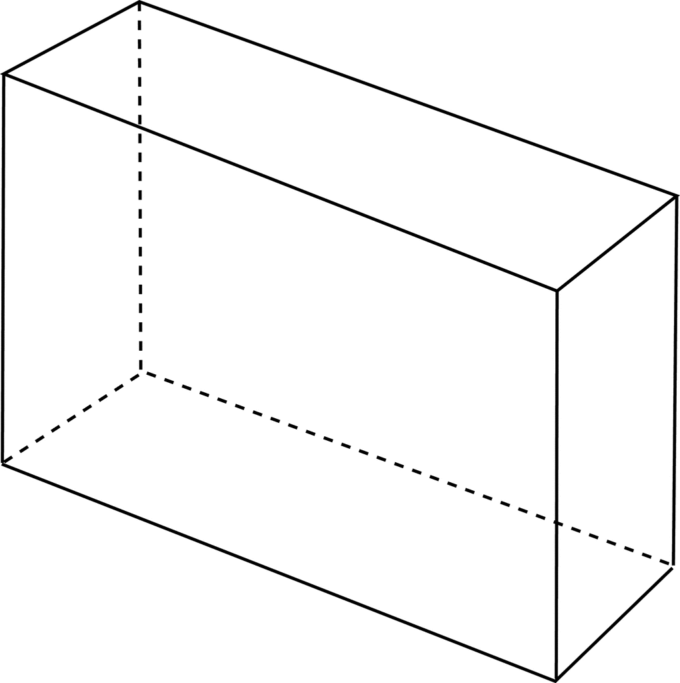
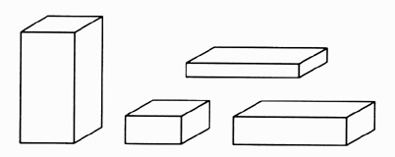
Notice that on the rectangular prisms below no matter which face the prism is sitting on, it is sitting on a rectangle - all the faces (or sides) are rectangles!

Slide 29
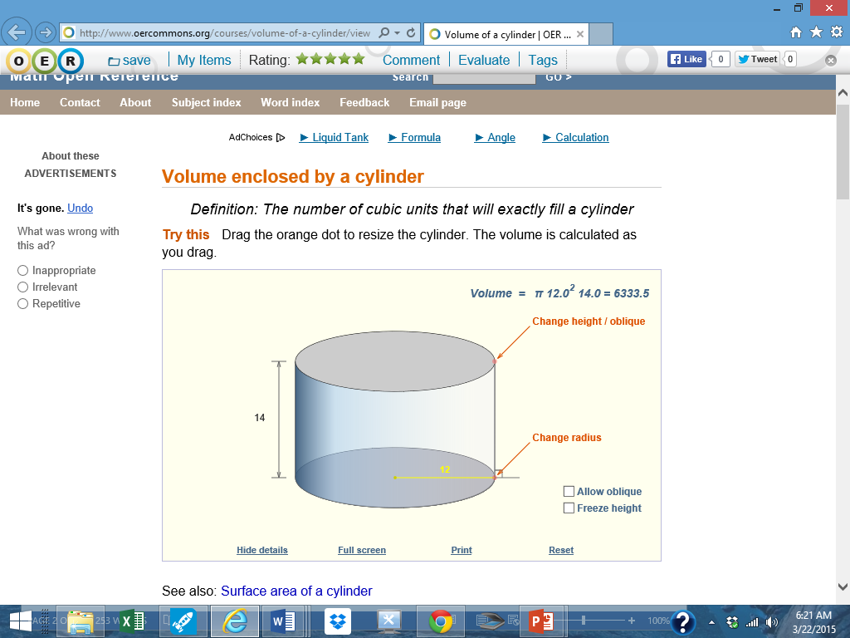
In just a few more slides you will be given a link to click on. When you click on the link, it will look like this.

Slide 30
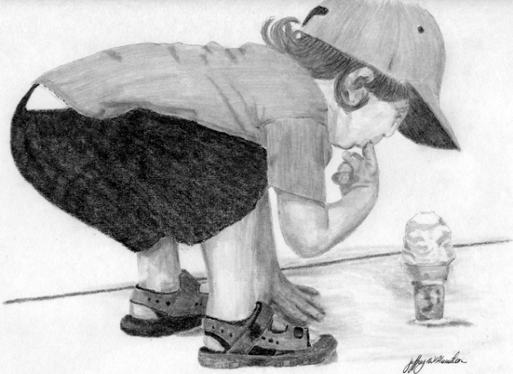
Under the section on cylinders, find the section labelled “Related Topics”. Keep scrolling down (way down) until you find the sections labelled “Prism Definitions”, “Volume of a Prism”, and “Surface Area of Prisms”. Those are the sections we will concentrate on now.
Of course you are welcome to explore the site!

Slide 31
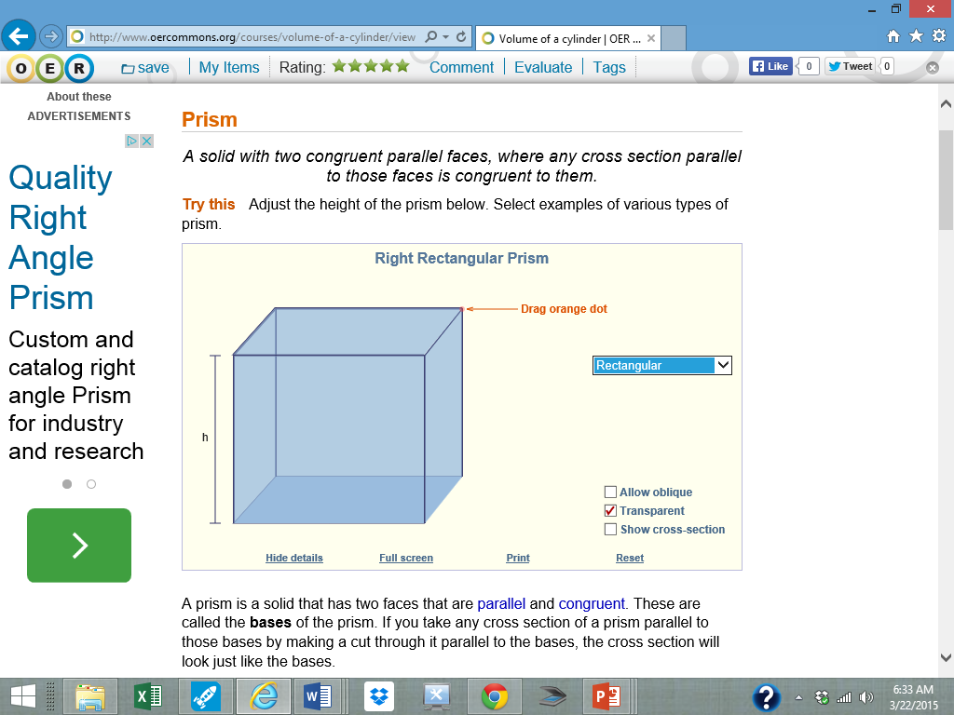
When you get to this page...
here’s where you can change the shapes!

Slide 32
Click on this link for an interactive activity that will teach you about different kinds of prisms.
If you scroll down to the bottom of the page, you may select varied solid figures but start on cubes or prisms first.

Slide 33
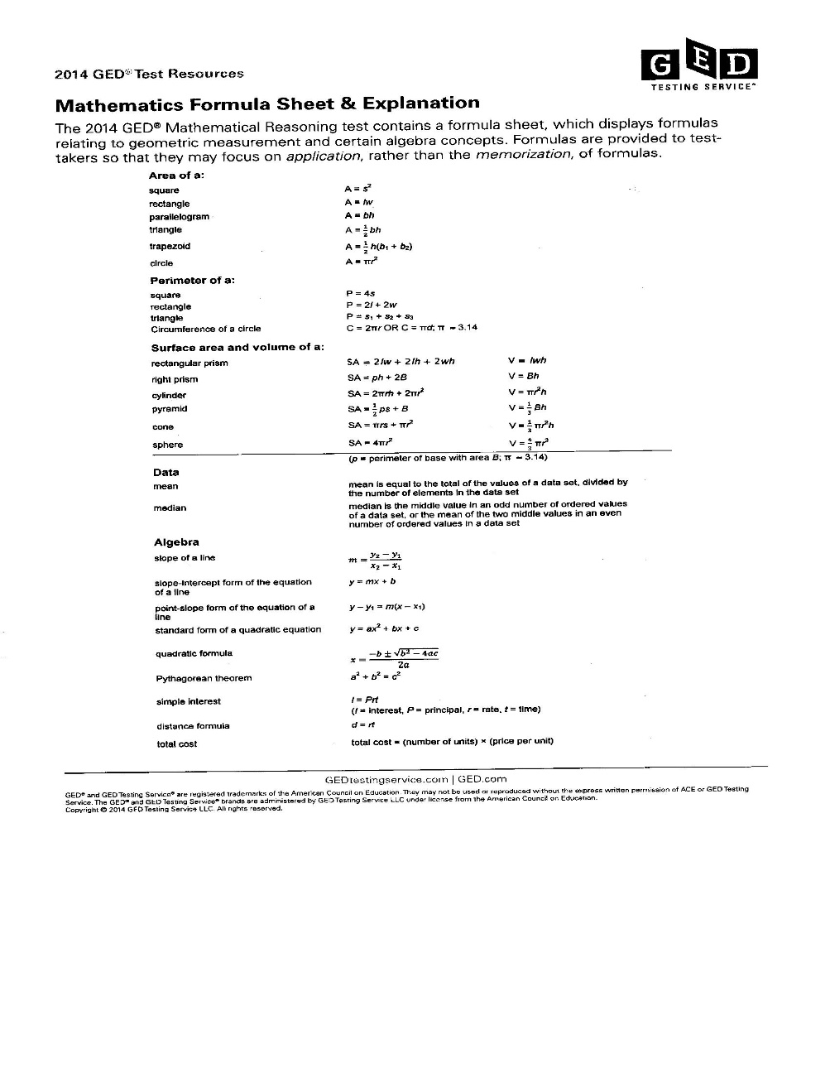
Locate a Mathematical Formula Sheet & Explanation. Copies are in the lab or you may get a copy by clicking the link.
http://www.gedtestingservice.com/uploads/files/0756c16704434ff71e43c8117a5fa738.pdf
It looks like this ☺

Slide 34
The formula page might look scary but with this presentation and the links embedded in it, you will learn how to use those formulas and you will feel your worries about them (if you have any) fading away.

Slide 35
Find the section of the formula sheet that deals with surface area and volume.
The first two formulas deal with rectangular prisms. Remember you might think of a rectangular prism as a normal box. The bottom of it is a rectangle and the top is exactly the same size rectangle. The other 4 sides are also rectangles (2 matching pairs).

Slide 36
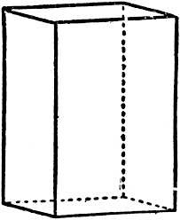
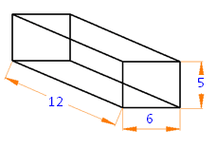
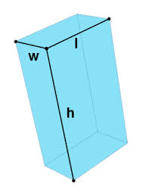
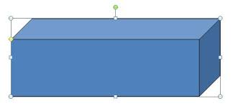
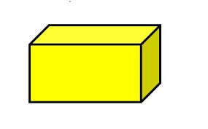
All these figures are rectangular prisms. Look around you. Do you see some other rectangular prisms?

Slide 37
Think about this: How many faces or sides does a rectangular prism have? Hint: The answer is not 4!

Slide 38
Did you say a rectangular prism has 6 faces?
Hurray for you then!

Slide 39
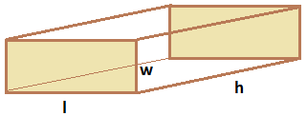
This rectangular prism is sitting on a rectangle that measures l one way and h the other way. Its height is marked w.

Slide 40
That same rectangular prism could be flipped so that is sitting on a rectangle that measures w one way and h the other way. The its height would be l.

Slide 41
Or it could sit on a base that measures l one way and w the other way. The its height would be h.

Slide 42
Changing which face the prism is sitting on does not change either the surface area or the volume.

Slide 43
. And one other “mathie” thing…
With all prisms, rectangular or not, we think about the base as being the polygon we can stack to make the prism. This little fact becomes more important with non-rectangular prisms.

Slide 44
To make the prism to the right we must stack figures shaped like the blue pentagon. If we stack figures like the orange or green rectangles we will not get the prism pictured. We say the BASE of this prism is a pentagon. The term “base” does not necessarily refer to the bottom of the figure.
We must stack blue pentagons to make this prism. We say its base is a pentagon.

Slide 45
Rectangular prisms are very special!
For the figure above we could stack pink rectangles and wind up with a figure like the given prism or we could stack blue rectangles or green ones. Regardless of the face we choose to stack, we can come up with a prism the same shape as the original. It does not matter which side we consider the BASE!
It does not matter which side or face the rectangular prism is sitting on – any one of the can be stacked to make the prism.

Slide 46
Look at the Mathematical Formulas and Explanation Sheet and find the formula for surface area of a rectangular prism. Copy it down on a sheet of paper.

Slide 47
This is the formula you should have found:
SA
=
2lw
+
2lh
+
2wh
Have you got a calculator? You might want one ☺

Slide 48
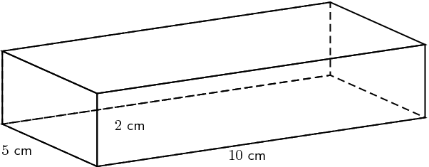
Let’s calculate the surface area of the prism below:

Slide 49
SA
=
2lw
+
2lh
+
2wh
Let’s first try this problem using 5 cm for the length (l), 10 cm for the width (w), and 2 cm for the height (h).
2lw
= 2(5 x 10) = 2 x 50 = 100
2lh
= 2(5 x 2) = 2 x 10 = 20
Add
2wh
= 2(10 x 2) = 2 x 20 = 40
SA = 100 + 20 + 40 = 160 cm²

Slide 50
What do you think would happen to the surface area if on the same figure we called the length 10, the width 2, and the height 5? Try it before you look at the next slide.

Slide 51
2lw = 2(10 x 2) = 2 x 20 = 40
2lh = 2(10 x 5) = 2 x 50 = 100
2wh = 2(2 x 5) = 2 x 10 = 20
Surface Area = 40 + 100+ 20 = 160 cm²
Is that what you got? Check with your teacher if you need help.

Slide 52
SA
=
2lw
+
2lh
+
2wh
Notice surface area does not change if we do this same problem using 2 cm for the length (l), 5 cm for the width (w), and 10 cm for the height (h) we get the same result.
2lw
= 2(2 x 5) = 2 x 10 = 20
2lh
= 2(2 x 10) = 2 x 20 = 40
Add
2wh
= 2(5 x 10) = 2 x 50 = 100
SA = 20 + 40 + 100 = 160 cm²

Slide 53
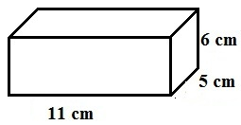
Here are a couple of problems for you to try.
Find the surface area of the rectangular prism below:
2. Find the surface area of the rectangular prism below:
3m
5 m
4m
The work and the answers are on the next slide, but do not peek until you have tried the problems☺

Slide 54
Is this similar to what you did?
SA
=
2lw
+
2lh
+
2wh
Left hand Problem
Right hand Problem
2lw= 2(4x5) = 40
2lw= 2(11 x 5) = 2 x55 = 110
2lh= 2(4x3) = 24
2lh= 2(11x 6) = 2 x 66 = 132
2wh= 2(5x3) = 30
2wh= 2(5 x 6) = 2 x 30 = 60
SA = 40 + 24 + 30 = 94 m²
SA = 110 + 132 + 60 = 302 cm²

Slide 55
For more instruction see the video below.
Yes, this is it. Click here!
This video shows a method of calculating surface area that is a bit different from the formula. The area of three different faces is calculated, then they are added and lastly multiplied by two. A formula for that would be SA = 2 (lw + lh + wh).
Do you understand why yields the same result as the “official” formula SA = 2 lw +2 lh +2wh ?

Slide 56
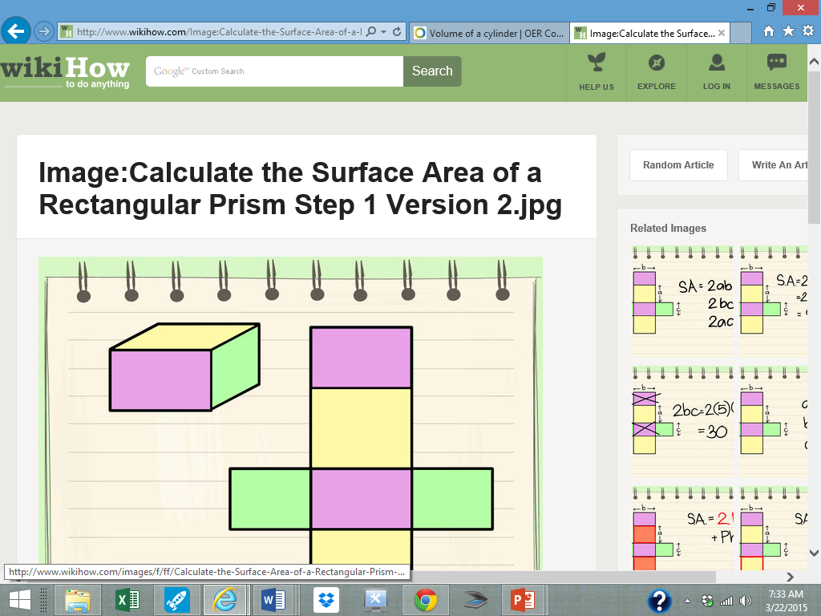
In a moment, you will go to a site where you will need to scroll down to see what is pictured below.

Slide 57
Still want more???
Here’s another look at surface area of a rectangular prism. When you get to the linked page, scroll down to the place that you see "Method 1 of 2“.
You should see something that looks like the previous slide.

Slide 58
Can you find a good video or resource to help you or others learn about surface area of rectangular prisms? Your teacher has created a Google doc and would love to have you add links to any resources you have found helpful. If you submit your email address, you will be invited to share and add to the document. We will make a class shared list and a list to post on the Open Education Commons ☺

Slide 59
More practice on surface area of prisms, if you need it, will be available when you finish this presentation. Also more “GED-ish” types of problems are available for the asking!

Slide 60
And now we are ready to consider the volume of a rectangular prism!
The formula simply means you need to multiply the length times the width times the height.
Since multiplication is associative, it does not matter what order you multiply. Look for easy multiplications ☺
Find that formula on the official GED Mathematics Formula Sheet.
You should see V = lwh

Slide 61
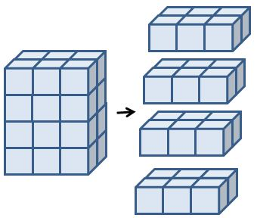
Here we see a rectangular prism that is broken down into 4 layers of 6 cubes. We say the volume of this prism is 24 cubic units or 24 units³. The units might be feet, inches, centimeters, millimeters or any measurement of length.

Slide 62
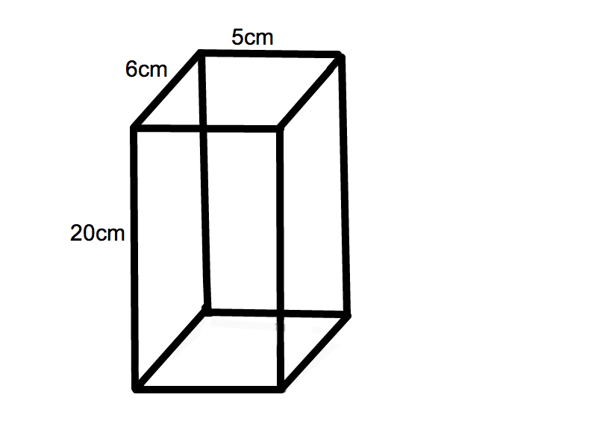
Now let’s apply that formula to some rectangular prisms.
V= lwh
V= 5 x 6 x 20
V= 30 x 20
V= 600 cm³

Slide 63
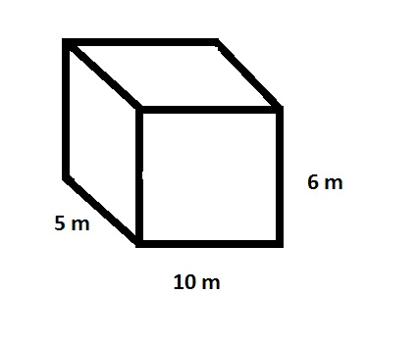
Here’s another example:
The formula is V = lwh

Slide 64
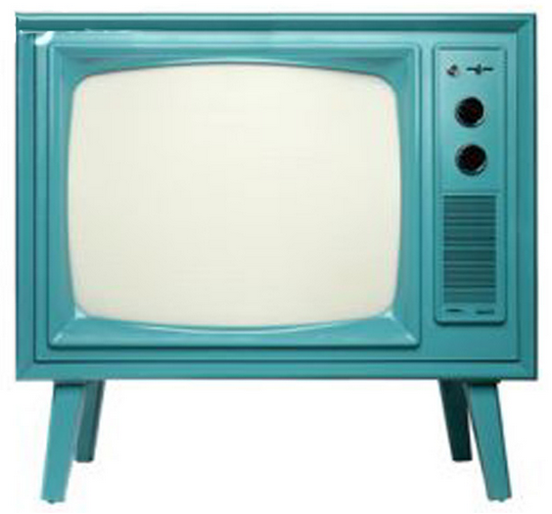
Here’s a video that might help you understand how to calculate the volume of a rectangular prism and understand what it means. Click here for video

Slide 65
Click the underlined text below for an interactive activity you might enjoy. Once you get to the page click on “View Resource” then use the tool to find some possible dimensions for a rectangular prism with a volume close to: a) 150cm³ b) 326cm³ c) 52cm³
Submit your answers to your teacher.
A volume thingie to play with

Slide 66
Here is a link to some practice problems for surface area and volume of rectangular prisms.
Click here for practice problems. You may print out the problems and the answer sheet. You will need to click on “Open/Download the PDF Worksheet” to print out the practice.

Slide 67
Here is a fun interactive activity that explores the ideas of volume and surface area of a rectangular prism.
Click here

Slide 68
Can you find a good video or resource to help you or others learn about volume of rectangular prisms? Your teacher has created a Google doc and would love you to add links to any resources you have found helpful. Click on the link to find the document that you can add to. We will make a class shared list to post on the Open Education Commons for other learners to use ☺ https://docs.google.com/document/d/1xFpz9DYJZQOx1Ofo-rbf4JcSrJZ3iygWP4Q1s68JpOA/edit

Slide 69
Congratulations!
Now you are armed to calculate surface area and volume of rectangular prisms!

Slide 70
Reflection – please use Word to answer these questions. You can copy the questions and paste them into your response paper. Print your responses and turn in your paper to your teacher.
1. What was the easiest part of this activity?
2. What was the hardest part of this activity?
Which interactives did you choose? You might need to scroll back through the slides to answer this. Please copy the url’s on your paper.
What would you add to the presentation?
What would you take away from the presentation?
Describe your learning experience with this activity.

Slide 71
Please let your teacher know that you are finished with this presentation and ask about anything you are unclear about concerning surface area and volume of rectangular solids.
Before you go to the next activity we need to do an assessment of your knowledge on this topic. Please get that assessment from your teacher and complete it, then turn it in. See the next page for the scoring rubric and specific directions.

Slide 72
On another sheet of paper show how you substituted numbers in the formulas and be sure to label the answers with the correct units. Do not turn your paper in until you believe you have a total of at least 80 points!
Assessment Scoring Rubric
 | Possible Points | Points Scored
Substitution is shown | 2 points for each of the 8 problems (total of 16 points)
Substitution is correct | 6 points for each of the 8 problems (total of 48 points)
Arithmetic (the answer) is correct | 2 points for each of the 8 problems (total of 16 points)
Answer units are labelled correctly | 2 points for each of the 8 problems (total of 16 points)
Your paper has your name on it | 4 points

Slide 73
You are free to:
Share — copy and redistribute the material in any medium or format
Adapt — remix, transform, and build upon the material
The licensor cannot revoke these freedoms as long as you follow the license terms.
Under the following terms:
Attribution — You must give appropriate credit, provide a link to the license, and indicate if changes were made. You may do so in any reasonable manner, but not in any way that suggests the licensor endorses you or your use.
NonCommercial — You may not use the material for commercial purposes.
No additional restrictions — You may not apply legal terms or technological measures that legally restrict others from doing anything the license permits.

