Slide 1
Database Security
https://www.oercommons.org/
OER- Unit 2-Profile
PART 1 – Profile

Slide 2
Part 1– Slides cover the following topics:
Resource Limits
DBA_PROFILES
DEFAULT PROFILE
CREATE Profile
Limit types
Idle_time
Connect_time
Session_per_user
Alter User
Display resource limit of the profile
Drop profile

Slide 3
2.1 User Profile
Password is a common security of all the information system. Keeping passwords always safe and secret is difficult.
Online world passwords are vulnerable to theft and misuse.
Oracle is having password Management policy called User profile.
A profile is one of the Database object.
Using CREATE PROFILE statement user can create their own profile.
Any profile can be assigned to user.
Each user has only one profile.
Create user time if profile is not assigned by default it will assign “DEFAULT” profile.
It is possible to configure database using profile connect time and idle time of the user and Disk storage space.

Slide 4
A profile has collection of parameters like
Life time of the password,
lock time of the password,
Reusing the same password.
Profile can be applied whenever RESOURCE_LIMIT initialization parameter value is TRUE, by default it is FALSE.
ALTER SYSTEM SET RESOURCE_LIMIT=TRUE;
The DBA_PROFILES Data Dictionary View lists all profiles in the database and associated settings for each limit in each profile.

Slide 5
“DEFAULT” profile
“DEFAULT” profile is assigned to user by default, suppose if no profile is assigned to user.
For example user “Arvind” still no profile is not assigned so user Arvind has DEFAULT profile.
Profile resources are useful for setting system resource to Profile with defined limited resources like
password_expiry, password_lifetime, password_lock_time, password_reuse_max, password_reuse_time etc

Slide 6
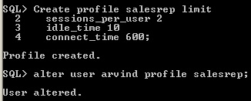
Using CREATE PROFILE statement, create profile and describe resource limits of the profile.
Suppose the user is already exist then use ALTER USER statement assign profile to user.
Otherwise use CREATE USER statement mention profile parameter to new user - in this case first create profile and then assign to new user.

Slide 7
Each resource limit has three types of values such as
DEFAULT
VALUES
UNLIMITED
Values restrict the resource limits
UNLIMITED indicates that no limit has been set for the parameter.
Specify DEFAULT to omit a limit for this resource in this profile
idel_time 10
idel_time UNLIMITED
Any user who is not explicitly assigned a profile is subject to the limits defined in the DEFAULT profile
idel_time default
Session-level limits are enforced for each connection.
When a session level limit is exceeded, only the last SQL command issued is rolled back; no further work can be performed until a commit, rollback, or exit is performed.

Slide 8
Idle_time
The idle_time parameter limits the maximum time a session can stay connected without doing anything
By reducing the period of time an inactive session stays connected, for security nobody to abuse the session.
Idle_time is useful for disconnecting user session suppose user mentioned idle_time is expired.
The idel_time assigned values are in minutes.
For example Salesrep profile "idel_time is 10" minutes.
If a user exceeds the CONNECT_TIME or IDLE_TIME session resource limit, then the database rolls back the current transaction and ends the session. When the user process next issues a call, the database returns an error
By default, idle_time is default. All the Default value is unlimited
select Resource_Name, Limit from DBA_PROFILES where resource_name = 'IDLE_TIME'
RESOURCE_NAME LIMIT
----------------------------------------
IDLE_TIME UNLIMITED

Slide 9
Connect_time
CONNECT_TIME Specify the total elapsed time limit for a user session, expressed in minutes.
if there is a limit on the maximum amount of time a user session can stay connected to the database
Allowable connect time per session in minutes, after this limit expires, the sessions are automatically disconnected the sessions.
Session_Per_user
Need to define the maximum number of concurrent sessions by account type
Unlimited concurrent connections in the database or application could allow a successful Denial of Service (DoS)
attack by exhausting connection resources

Slide 10
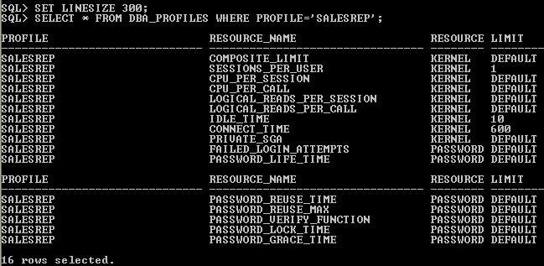
Alter Profile
Using ALTER PROFILE statement it is possible to modify resource limit values or add resource limit or remove resource limit.
Display Resource Limits of the Profile
Using select statement display the DBA_PROFILES data dictionary view to check the resource limits value of the profile.
In the Limit column the specified value of the resource limit is available.

Slide 11
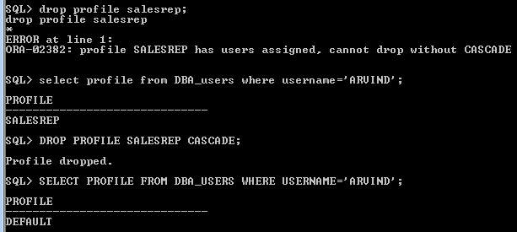
Drop Profile
Drop profile statement remove the profile.
Suppose if the profile is assigned to some user, while removing it will give error.
Avoiding error use CASCADE in the drop profile statement.
If user profile is dropped it will assign automatically DEFAULT profile to user.

Slide 12
Database Security
https://www.oercommons.org/
OER- Unit 2-Profile
PART 2 – Profile

Slide 13
Part 2– Slides cover the following topics:
Password_life_time
Account Status is Expired
Change Password Expiry date
Failed_Login_Attempts
Password_Lock_Time
Password_Grace_Time
Account Status Message
Account Status Lock
Modify profile parameter Default Value settings

Slide 14
password_life_time
If password_life_time resource limit is specified in the profile, based on the value of the resource limit the assigned user password will automatically expire.
Suppose it is specified as 3 means 3 days. By default it will consider as days.
Password life time starts which date user password is assigned to user using CREATE USER OR ALTER USER statement.
User ARVIND is created. i.e 14-APR-17 . Even though the profile salesrep is assigned to user Arvind 15-APR-17, assign password life time value in the profile it will count from 14-Apr-17 based on user created time not 15-Apr-2017 based on profile assigned time.
That is a reason next three days i.e 17-APR-17 it will expire automatically.
If value is not mentioned in the password_life_time by default setting it will take 10 days.

Slide 15
Account Status is Expired
Once password life time of the user expired if user not changed the password using ALTER USER then it will give ORA-28001 Error message. Then user should type new password for login session

Slide 16
Change Password Expiry date
it is possible change expiry date of the password using ALTER USER statement and modify the password of the user Every "alter user..identified by <password>" statement, it will start the new life time count.
Using Alter user statement even though password of the user Arvind is not changed, it will refresh the life time of the password of the user for every ALTER user statement.

Slide 17
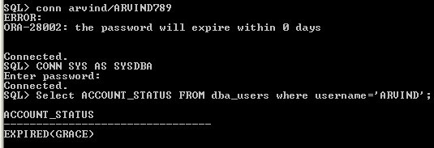
Password_Grace_Time
The purpose of Password grace time to alert or warning message to the user number of days remains for password expiry, In the grace time if the user change the password using ALTER USER statement, then password life time is renewed.
If the user is not ALTER then every user login warning message to be issued to the user but login is allowed for specific user. So password grace time and password life time are inter related.
Once profile is changed, then assign the profile to user ALTER USER ARVIND PROFILE SALESREP. Suppose if grace period is starts whenever login the warning message will display

Slide 18
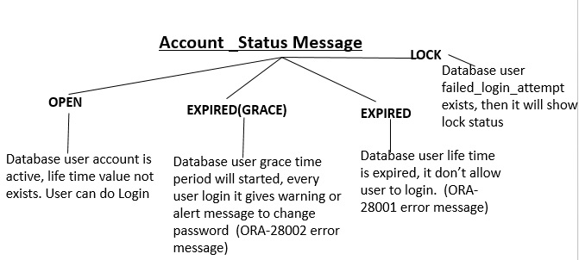
Account Status Message
There are various account status messages will intimates user based on resource limits values.

Slide 19
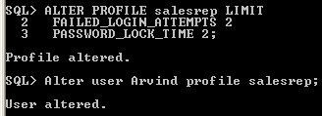
FAILED_LOGIN_ATTEMPTS and PASSWORD_LOCK_TIME
The user ARVIND password is "Arvind789", first try with wrong password as "Arvind123" it will gives warning. Check the account status of the user is "open", As mentioned two attempts are allowed. so one more attempt is remaining.

Slide 20
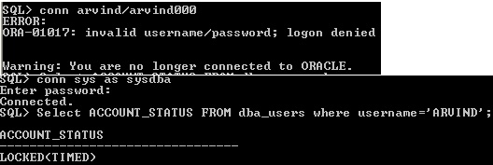
Again try with wrong password as Arvind000, it will give warning message.
As mentioned two times in the failed login attempt in profile it will allow the user to try two times incorrect password after that user account will lock automatically.
Now user account status is LOCKED. Lock time value is 2, after two days i will automatically user account to be unlocked and account status become open.

Slide 21
Suppose the user immediately want to restart or login account, then ALTER USER manually unlock the account.
Then account status become active as “OPEN”

Slide 22
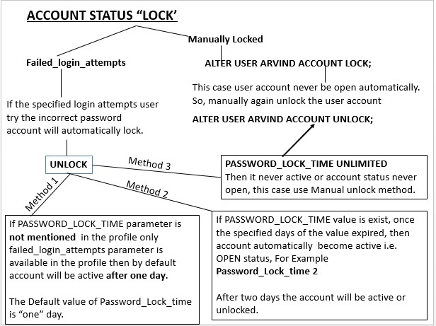
Account Status Lock
There is two way to lock the user account, one method is using Failed_login_attempts and another method is manually unlocking.

Slide 23
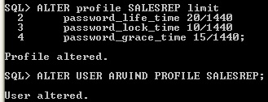
Modify profile parameter Default Value settings
By default all the parameter mentioned in the profiles are day value.
Suppose to change value from day to minutes then value to be mentioned as 20/1440. i.e 1 hour= 60 minutes.
So, one day 24 hours = 24 hours* 60 minutes = 1440 minutes/per day.
Suppose value to be mention as hours then 2/24, it means 2 hours.

Slide 24
Database Security
https://www.oercommons.org/
OER- Unit 2-Profile
PART 3 – Profile

Slide 25
Part 3– Covers
Password_Reuse_Max
Password Expire
Password_Verify_Function
Last Modified password Date/time
Password Case Sensitive
Password_Reuse_Time

Slide 26
Password_Reuse_Max
If user current password life time is expired or changing before the life time, then user new password is control by two profile parameter such as Password_Reuse_Max and Password_Reuse_Time.
The Password_Reuse_max parameter value controls current password to be reused based on value assigned to this parameter.
By default value is UNLIMITED
PASSWORD_REUSE_MAX 3;
For example, the password reuse max value is 3 means, the current or recently expired password to be reused after three times or three occurrence changing the new password to the user.
Suppose user Arvind password is ARVIND789.
Using ALTER USER statement change the password as
ALTER USER ARVIND IDENTIFIED BY ARVIND0102
ALTER USER ARVIND IDENTIFIED BY ARVIND456
ALTER USER ARVIND IDENTIFIED BY ARVIND765
Three incidence assign different passwords to the user and then reuse the password ARVIND789 to user Arvind again.

Slide 27
Password_Reuse_Time
The password_reuse_time attribute value controls the user current password to be reused after specified interval time.
By default value is UNLIMITED. For example
PASSWORD_RESUE_TIME 5
means after five days the current password to be reused and same password to be assigned to user.
ALTER USER ARVIND IDENTIFIED BY ARVIND789;
ALTER USER ARVIND IDENTIFIED BY ARVIND1009;
After five days, the user can reuse the password as ARVIND789 by the user Arvind.

Slide 28
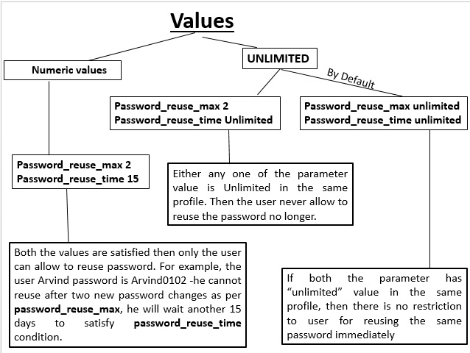
Password_Reuse_time vs. Password_Reuse_max values

Slide 29
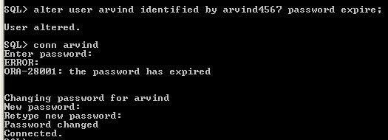
Password Expire
Using ALTER USER OR CREATE USER statement either Database Administrator(DBA) or the user whose has ALTER USER system privilege to be used explicitly.
ALTER USER ARVIND IDENTIFIED BY ARVIND789 PASSWORD EXPIRE;
The “PASSWORD EXPIRE” enforced to change the password before user log in to the database. There is no “PASSWORD UNEXPIRE” clause.

Slide 30
Password_Verify_Function
Password _verify_function parameter control the password validation in the profile.
For example length of the password and user and password should be unique not same.
By default NULL value specified in DEFAULT profile, so there is no password verification function performed by DEFAULT.

Slide 31
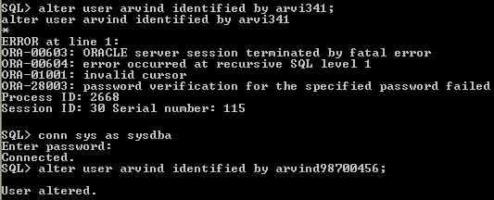
The utlpwdmg.sql Script is for DEFAULT Profile password resource limits.
C: \app\user\product\11.2.0\dbhome_1\RDBMS\ADMIN\utlpwdmg.sql (location where oracle software is running)

Slide 32
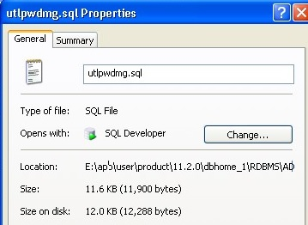
For enabling password features this script to be run and default resource parameter to be changed .
Using this script, the user can modify the code based on requirement and implement in any profile can control password validation.

Slide 33
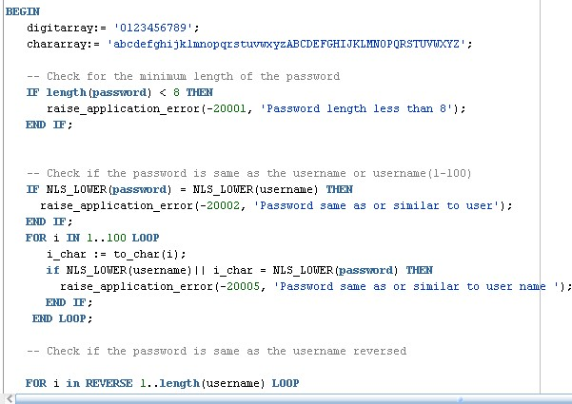

Slide 34
Last Modified password Date/time
Recently or last attempt when user changed his/her password date and time can be display using SYS.USER$ log file.
Password Case Sensitive
Before login the user session check the user password case (upper case/lower case or mixed case) which is applied in CREATE USER or ALTER USER statement. Apply same password case in connect statement.
Whenever setting user password using CREATE OR ALTER USER statement by default passwords are case sensitive.
For controlling case sensitive of the password use the ALTER SYSTEM privilege to set the SEC_CASE_SENSITIVE_LOGON initialization parameter is "TRUE" .
ALTER SYSTEM SET SEC_CASE_SENSITIVE_LOGON = TRUE
If parameter value is False then it will disable the password case sensitivity.

Slide 35
