Slide 1
Writing in a professional culture: How well do I rite? Advanced Court Report Writing May 2, 2018

Slide 2
Part l: What we will work on today…together
Examining what writing in a professional culture looks like in the 21st Century
Refreshing our understanding of the essentials of writing
Applying the principles of professional writing to the reports we prepare for court
Writing strong court reports for different stages of dependency proceedings
And, leaving the class feeling more relaxed about communicating through the written word and more confident in my ability to write a strong court report.

Slide 3
What do authors tell us about writing?
“Writing is, for most, laborious and slow.”
Know why you are writing
Know the purpose of your writing
Then, write and rewrite (Elmore Leonard)
Don't be afraid to share your writing!

Slide 4
“Good writing depends on reading.”
What do you read?
Who do you read?
Who is your favorite author?
What makes you open a book?
Do you enjoy reading?
What bugs you most about reading others’ writing?
Ever worked with someone just learning to write?

Slide 5
What we each bring to our writing capacity: Our personal history with the written word
When did we learn that writing was important?
In our family ?
At school?
What does writing mean to me?
A means of expression
A means of advocacy
A means of analyzing information
Something required
It was, always has been, and still is hard

Slide 6
As a social worker, I work with children at risk and families, how does good writing apply to me? I know how to write.
ASK YOURSELF: Good writing is important to me because
It is part of my job to write court reports
I have to sign court reports that I write
What I write gets read by others above me
My reports are read by a Judge
I am a professional
I always cover all the bases

Slide 7
Writing court reports is a special type of writing: structured, scrutinized, and always written under a deadline
How does writing the court report rank on my list of things that I must do?
More important than meeting with my 9 year old client?
More important than attending a family team meeting?
More important than the monthly meeting with parents?
More important than looking for a possible out of state relative placemnt?
Better than going to the dentist?

Slide 9
Part ll: Composition for professional writing
Show Confidence in what you have written
HOW?
Be clear, strategic, concise and “get to the point”
Use definite, specific, and concrete language
“A period of unfavorable weather set in.”
REPLACE: “It rained for every day for a week.”

Slide 10
Whenever possible, show don’t tell what happened
Use active voice rather than an impersonal and passive voice. Choose “use” rather than “utilize” and “send out” rather than “disseminate”
“Casey showed adjustment to the new visiting schedule.”
REPLACE: “Casey smiled when mother sat down, took a cookie from her, gave her mother a toy, and held her hand.”

Slide 11
Paragraphs and purpose
Know the purpose of what you are writing- where am I going with this paragraph? How does the sentence I am writing now, connect with the next sentence?
Ask: Are my words accessible and understandable?
Ask: What type of writing is this?
Is an update or progress report, cut and paste?
Just the facts?
A dump of everything I know about this family ?
A persuasive document ?

Slide 12
Give extra thought before you begin writing to where you are going in this writing
Q: How do I use paragraphing to direct the reader’s attention?
A:“Paragraphing calls for good eyes as well as a logical mind.”
Enormous blocks of print drown the eyes
Multiple small paragraphs infer lack of connection of facts and thoughts

Slide 13
Stringing words together with a period at the end does not = a sentence.
How do you understand the sentences below?
“The SW noticed a large stain in the rug that was right in the center.”
“Oregon’s first commercial human sperm bank opened Friday with samples from 18 men frozen in a stainless steel tank.”
“Smelling like rotten fish, my sister took out the trash.”

Slide 14
Sentence structure conveys meaning
Rule: Omit needless words
“A sentence should contain no unnecessary words, a paragraph should have no unnecessary sentences for the same reason that a drawing should have no unnecessary lines and a machine no unnecessary parts.” E.H
Rule: The position of words in a sentence is the principal means of showing their relationship.
HINT: When hopelessly lost in a sentence, hit delete, stretch and start again

Slide 15
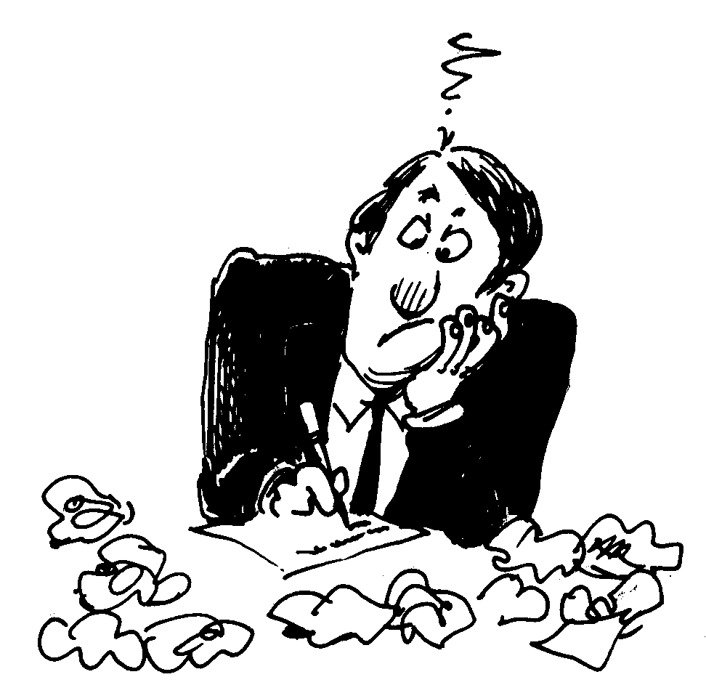
Who/what helps you write?
Who do you think is the best writer in your office?
Do you ever ask for help in writing your court report?
Are there references that you use NOT including spellcheck?
What does your supervisor tell you about your writing?
What have you learned about how you write?
Do you have a writing protocol?

Slide 16
Tips to Improve your “legal writing”
Whether you are writing a research memo, brief, or “court report”, you need an up-front summary
Put the question, the answer and the reason up front
Never open up with a full blown statement of facts. WHY? Because facts are useless to a reader who doesn’t yet understand what the issue is. Instead integrate a few key facts into your issue statement.
Organize & practice our writing

Slide 17
CONNECT WITH YOUR AUDIENCE
“Writing does not require a high I.Q. instead, it is a skill enhanced by one’s ability to connect with others…”
“…I think there is a writing genius as well as a music genius—which consists primarily of the ability to place oneself in the shoes of one’s audience; to anticipate what they anticipate; to explain what they need explained; to think what they must be thinking; to feel what they must be feeling…”
Justice Anton Scalia

Slide 18
Audiences for my writing: The Judge
Is writing the court report just another thing that social workers in child welfare have to do?
Just paperwork?
Why is it important to the family?
Do you see any relationship to the due process rights of parties? For example, why is there a deadline for filing the court report in the law?
But consider
What would be the basis for the judge’s decisions? Witnesses?
Hearsay exceptions have been created to accommodate bringing together all the types of information needed for the judge to make the best decision.

Slide 19
Key questions to ask myself before I click
What can I do through words to encourage the judge to agree with me?
A: Know exactly what I want the judge to decide/find/order at this hearing? How does this fit in with my overall vision of this case, family, etc.?
Did I link assessment(s) to my conclusions?
Did I anticipate the arguments from the other side/sides?
Did I counter those arguments?
Am I persuaded?

Slide 20
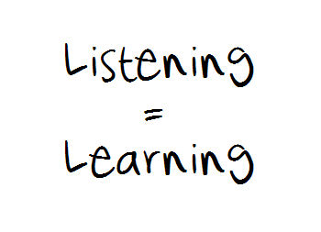
Other audiences: Parents and children
Parents and children
How can I help parents better understand my report, my thinking, and my conclusions?
Do I show how assessments are linked to my recommendations?
Do I show how their voices are included in the report?
Do my words shows that I have considered their words, concerns, needs in reporting on their progress and likeliness of reunification?
Do I clearly explain what is necessary to enable the family to reunify?

Slide 21
Other audiences: lawyers and the agency
Lawyers – Lawyers can learn, helps them better communicate with social workers, helps lawyers better advise their clients, and may reduce the number of continuances and contested hearings.
The agency – for training, policy change, system change for more support for social workers, improving child protection.
CFSR CASE REVIEW and California CQI

Slide 22
PART lll Q: How can we improve our writing to meet our duty to protect children and strengthen families through the juvenile court?
A: Write strong court reports that are accurate, clear, comprehensive, and persuasive.

Slide 23
From one of your attorneys: “Please, remind them that this is a legal document.”
While this may seem obvious, I spend far too much time correcting/editing reports that contain slang terms, opinions or casual writing.
Even MA level social workers author reports with poorly structured sentences that end in prepositions.

Slide 24
And, she had more to say
I spend too much time correcting writing that switches back and forth between tenses, with redundant words and ideas in the same sentences and paragraphs, or bounces around from idea to idea.
AND, recommendations must be linked to groundwork, evidence, analysis rather than just dropping in from outer space at the beginning of a new paragraph.

Slide 25
Issues requiring special attention in my writing and report: third party material
Statutory exceptions allow the report to include multiple levels of hearsay. (W&I 355 (b) & CRC 5.684)
Duty to Disclose (CRC 5.546)
CPS is required to disclose any favorable evidence within its possession/control
At detention: CPS must disclose at least all medical reports, police reports, and other documents offered as a basis for detention, including prior CPS history, court reports
Subsequently, all statements of witnesses, pictures, case narratives must be disclosed on an ongoing basis
And, any material, reports, evidence subject to court order

Slide 26
Issues that require special attention in my report and writing: Family history
Why is it important?
What if I am concerned about veracity of the people I have interviewed?
How to use the report to inform my work with the family?
How do I make the important aspects of family history vivid in my report to the Judge?
What about position of the agency/social workers/supervisors in previous cases relating to this family?

Slide 27
How do I best show this family to the judge?
How much is important?
How to link the facts, reports, opinions that I include in my report with child welfare assessments and decision making tools, e.g., SOP? SDM?
How do I show that I was not overly influenced by family history, especially history with CPS?
What about BYPASS recommendations? Clear and convincing evidence (W&I 361.5(b)

Slide 28
Another issue requiring special attention in your report and writing: Fathers
Although child welfare practice and the law have recognized the primary role of fathers in the wellbeing of children, report writing needs to demonstrate the agency efforts to locate, engage, and link the father to the child and family as appropriate.
How do you write about fathers?
Do you use a checklist?
Focus on due diligence requirements?
Do you understand the legal status alternatives?
Engagement
Paternal side –does your writing show an opinion about this family?

Slide 29
Another issue requiring special attention in your report and writing: ICWA
“ICWA does not apply”
What do you think is required?
Do you have standard language that you paste in for certain cases?
Reminder: Findings required to be made by the court cannot be based on conclusions-even those in your report- but must be based on specific facts.
ICWA violations are the most frequent basis for reversals in California and nationally.

Slide 30
Common errors in our thinking about writing
I can write like I talk
Email style writing is OK for the court –it’s the 21st Century, right?
Using “professional terms/jargon” as a shortcut for explaining a concept shows my professionalism
My personal style is lost if edited, no matter how big or small the edits

Slide 31
Why do I sign the court report?
What does it mean?
Who signs the reports that actually go to court?
“You changed my report and it has my name on it.”
“You changed my report and it doesn’t sound like me.”
“ I gave you the report to sign off on it and not change it.”
“Why didn’t you catch those mistakes before you filed it with the court?”
“I am the one who gets yelled at in court for your mistakes.”

Slide 32
Writing for the Detention Hearing
The court must make the following findings in order to detain any child:
There is a prima facie showing that the child comes within W&I 300
and, one of the following exists:
There is substantial danger to the child’s physical health or the child is suffering severe emotional damage, and there are no reasonable means to protect the child without removing the child from the parents.
Parent is likely to flee court’s jurisdiction.
The child has run away from a court ordered placement.
The child is unwilling to return home, after being abused by someone still living in the home.

Slide 33
Writing for the Jurisdiction/DISPO Hearing
Jurisdiction – requires that sufficient competent evidence be presented to the judge to convince the judge to find by a preponderance of evidence that the child(children) was abused or neglected under one or more sections of W&I 300.
Disposition is a best interests test, requiring the judge to make specific decisions about custody, visitation, education/behavior health rights, whether it would be possible to return the child (children) to go home safely now.

Slide 34
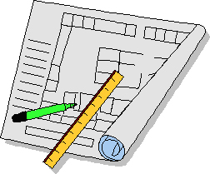
Writing for the Status Review Hearing 6 months later…
What is the purpose of this hearing?
What is the presumption about return?
BYPASS?
Protective capacity?
Likeliness of reunification in 6 months?
Fathers?
Case plan?

Slide 35
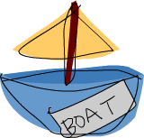
Writing for the Permanency Hearing
Shall return unless…
What does the court have to find to order a W&I 366.26 hearing?
What does the court have to find to extend reunification services?
Exceptions?
What does ‘substantial probability” mean?
What does “substantial probability” mean to you?

Slide 36
“For all the reasons listed above…the agency recommends that
How do you get here?
Cut and paste?
Do you chronicle what the parents have done to comply with their case plan over a couple of pages, supplemented by information/reports/opinions from third parties… then write a paragraph or two summarizing the above information?
Are you really using your professional knowledge and expertise and your ability to persuade?

Slide 37
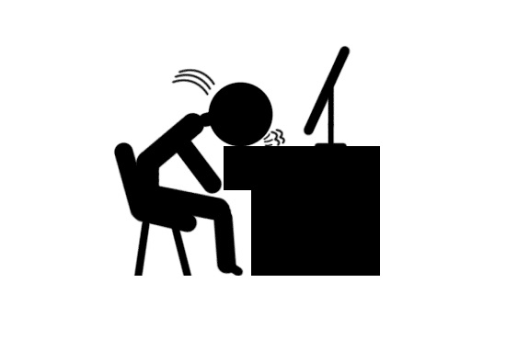
“I am pounding my head against the wall…”*
Grammar and checking your spelling are very important – a report with these kinds of easily correctable errors loses credibility
Attachments – attach only with purpose and reference in body of court report
Discovery – SW has a continuing duty to turn over report and chronological notes - failure to do so can result in continuances, appeals, reversals
Feedback is tricky: from judges – communicating clearly judge’s expectations- and other county counsel
“Assessments are underused and underexplained in reports”
* County Counsel again

Slide 38
Writing for the W&I 366.22 hearing
Q: What I need to keep in mind in my writing
A: Study the required Orders and Findings
Return UNLESS
If recommendation is not to return- clear and convincing evidence – set W&I 366.26 hearing
Substantial probability of return in 24 months
Did parent make significant & consistent progress in SA treatment?
Recently released from custody + consistent progress in establishing a safe home

Slide 39
Well written, persuasive court reports also assist the agency in meeting federal case review standards
Child and Family Services Review (CFSR and C-CFSR) has been integrated into CQI.
The foundation of the CFSR case review is the court report.
Why?
A: It is the bottom line in a dispute i.e., shows how the SW using expertise, knowledge of the parties, resolved conflicts of all types
A: It is the most definitive proof regarding adequacy of assessments and services
A: It contains recommendations that relate directly to Items on the case review, e.g. when the permanency plan was adopted, timeliness, appropriateness of permanency plan, concerted actions standard

Slide 40
Closing - a few things to take with you
You are doing special writing.
This type of writing is very important: You represent our public commitment to protect children and strengthening families through your work in each case.
Writing is a craft that requires attention, practice, and diligence.
Writing can be less stressful and help your write with more confidence:
By creating a personal “protocol” or your own personal editor.
Knowing where you want to go and keeping focused instantly reduces the tendency to throw in “everything but the kitchen sink”.

Slide 41
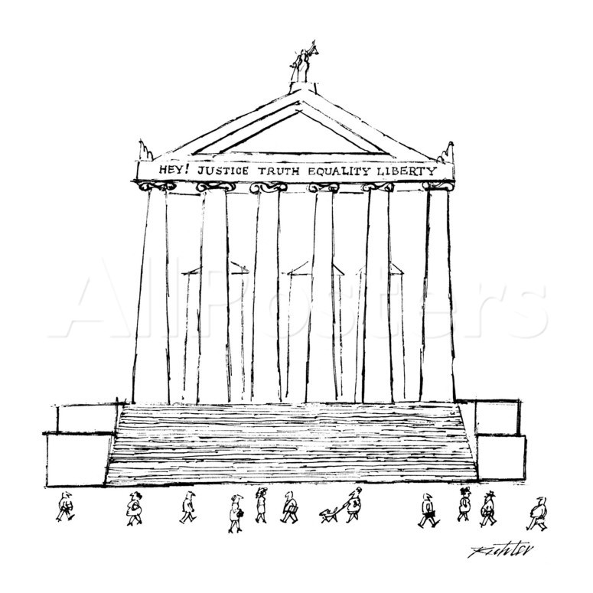
Contact Information
Joanne M. Brown, MSW, JD
Northern Training Academy
U.C. Davis
jbrownconsulting@aol.com
301-512-9427

