Slide 1
Data Curation Workshop for RPG students at HKU
THE UNIVERSITY OF HONG KONG
Faculty of Education
Supervisors: Dr. Scott Edmunds
Ms. Eleanor Dickson
Author: XU Shiyuan
E-mail: xusy@connect.hku.hk
MLIM 7350 Final Project
Notes:
This workshop was designed to serve those who enrolled in the research postgraduate program at University of Hong Kong. Research postgraduates must know the value of data management from the different perspective since they will often deal with research and data. The content of this workshop covers the relevant basic knowledge about data curation and research data management. Most importantly, this workshop is aiming to facilitate the HKU RPG students by providing more necessary information related to them, which could be the easy but proper practice they could follow.

Slide 2
Procedures of HKU RPG students*
Submit a detailed scheme of research + DMP
(if needed)
Submit theses + Research Data
Begin RPG Programme at HKU
Confirmation of Candidature
Thesis submission for examination
*Research postgraduate (RP) includes the degree of MPhil, PHD, and SJD.
Source: https://www.gradsch.hku.hk/gradsch/current-students/handbooks
Notes:
This procedure adapted from the students’ handbook shows the main steps of research postgraduate porgramme at HKU. During confirmation of candidature and thesis submission for examination stage, every student has to submit a detailed scheme of research and data management plan. Besides, they have to manage they research data for submitting them. Therefore, it is necessary for them to learn data curation.

Slide 3
Outline
1. What is Research Data?
2. Why Data Curation?
3. What is DMP?
4. How to make DMP?
5. How to Organize Data?
6. Where to Preserve and Share?
It’s time to manage your research data!
Notes:
These six questions are raised from the perspective of students and try to tackle every potential problem they will meet during they research data management in the future. Let’s begin.

Slide 4
1. What is research data?

Slide 5
What is research data?
Data are all around us everyday and the basis of our research.
Images Documents_{(text, Word)} Spreadsheets Laboratory notebooks Field notebooks Diaries Questionnaires Transcripts Codebooks Slides Audiotapes videotapes Photographs films
Artefacts Specimens Test responses Database contents video audio text Models algorithms scripts
Notes:
The slide presents various different types of data and different format as well, which we are very familiar. These data are all around us every day. When we start to do different researches, we will generate and encounter many of them.

Slide 6
What is research data?
Research data, unlike other types of information, is collected, observed, or created, for purposes of analysis to produce original research results.
How data is created?
Observations, experiments, or models
Survey results
Records (census, economic, etc.)
Digitized text and images
Kinds of data
Observational data
Experimental data
Records
Computational data
(Borgman, 2012)
Notes:
The definition of research data is shown above. Besides, according to the way data created we can get corresponding kinds of data.

Slide 7
Stages of data
Raw Data
Processed Data
Analyzed Data
Finalized/Published Data
Existing Data across Different Sources
Lamar Soutter Library, University of Massachusetts Medical School
New England Collaborative Data Management Curriculum
: http://library.umassmed.edu/necdmc
Notes:
With the progress of the research, the data processing is at different stages.

Slide 8
2. Why data curation?

Slide 9
“Data curation is the active and ongoing management of data throughout its entire lifecycle of interest and usefulness to scholarship.”
-- Cragin et al., 2007
Notes:
This definition shows the purpose of data curation. The lifecycle and usefulness to scholarship will be introduced in more details. From this two concept, students could know the value of data management in more details.

Slide 10
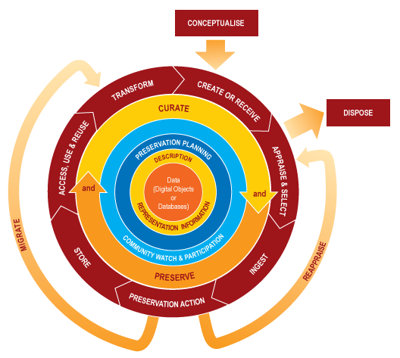
Data Curation Lifecycle Model
PLANNING RESEARCH
COLLECTING DATA
PROCESSING AND ANALYZING DATA
PUBLISHING AND SHARING DATA
PRESERVING DATA
RE-USE DATA
DCC Curation Lifecycle Model
Source: http://www.dcc.ac.uk/resources/curation-lifecycle-model https://www.ukdataservice.ac.uk/manage-data/lifecycle
UK Data Archive research data lifecycle
Notes:
This two modes are necessary for research students to know. They can follow steps to make data management plan.

Slide 11
Usefulness to scholarship
Benefits
Make research outputs more visible;
Enable collaboration;
Ensure accuracy, authenticity, reliability and integrity;
Efforts and costs saved;
Security enhanced, and risk of data loss minimized, etc.
The term “scholarship” should be construed broadly. Data curation seeks to retain the interest and usefulness of any data that has a serious purpose to fulfill.
Notes:
This paper introduces the benefits of data curation. Everyone can benefit from it, not just scholars.
Even for data created and curated within the academy, it is worth remarking that there may be potential user communities outside the academy that could provide valuable motivation and even resources for curation process.

Slide 12
Requirements for Data Curation
Compliances with policies of HKU
Requirements of funders (e.g. RGC, NSF)
"PI should assess data archive potential and opportunities for data sharing. Due additional weight will be given to an application where the applicants are willing to make research data available to others."
HONG KONG RESEARCH GRANTS COUNCIL
(http://www.ugc.edu.hk/doc/eng/rgc/form/GRF2.pdf)
Requirements of journals (e.g. Nature, Science, PLOS)
Source: http://www.sciencemag.org/authors/science-journals-editorial-policies#unpublished-data-and-personal-communications
Notes:
Research postgraduates have to manage their research data in order to meet the requirements form University, funders, and journals.

Slide 13
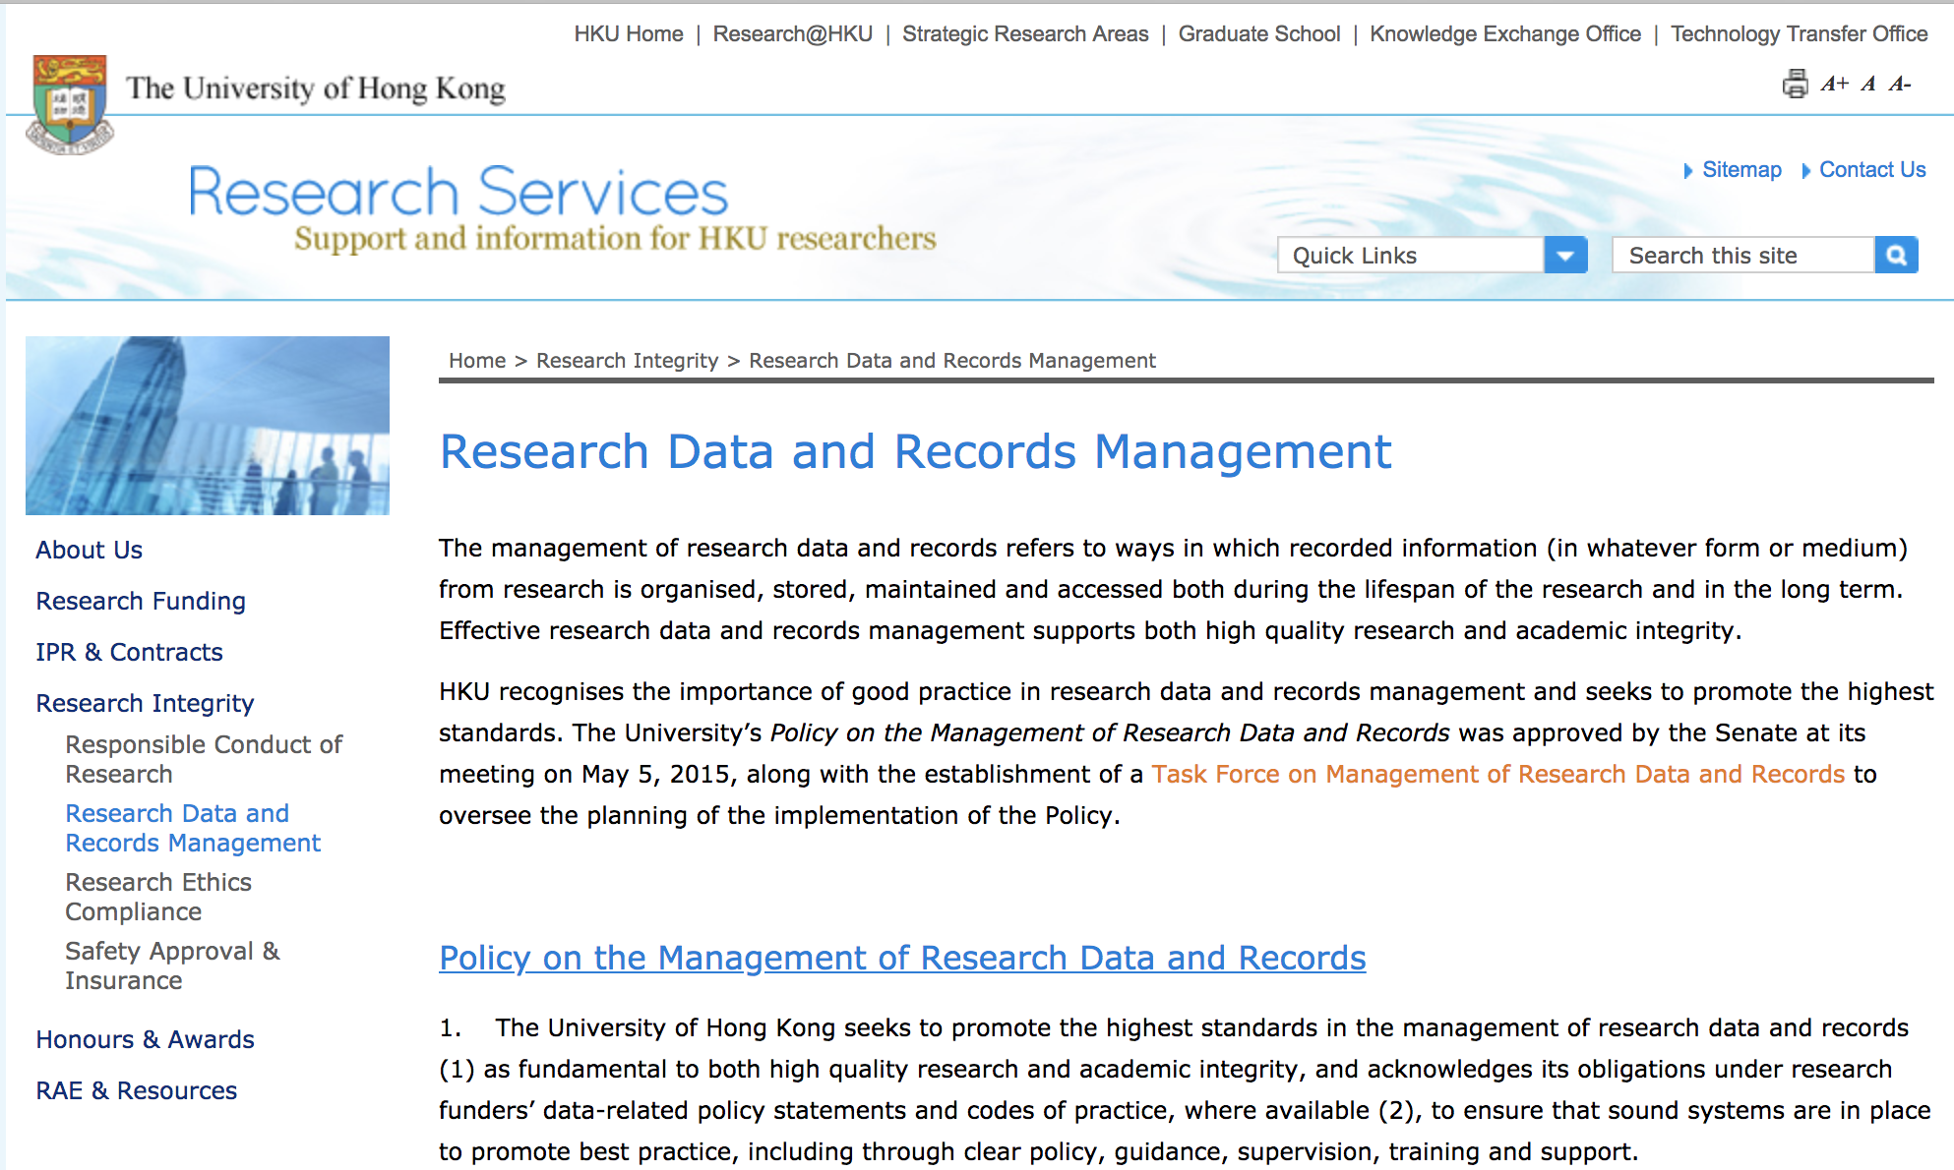
Compliances with policies of HKU
Source: http://www.rss.hku.hk/integrity/research-data-records-management
Notes:
The screenshot of HKU research policy from the school website. Students could check more information on this website.

Slide 14
3. What is DMP?

Slide 15
What is DMP?
A data management plan or DMP is a formal document that outlines how data are to be handled both during a research project, and after the project is completed.
Data Management Plan is
A digital document;
Describe your data and project;
Tell your supervisor and founder your requirements.
Notes:
The definition of data management plan.

Slide 16
What must DMP cover?
Specifics vary depending on individual requirements
Data types and formats
Plans for documenting data
Plans for securing data
Plans for sharing and preserving data
Roles responsible for implementing DMP
Notes:
General data management plan should cover these 6 parts. This is the basic format and the content could vary depending on individual requirements.

Slide 17
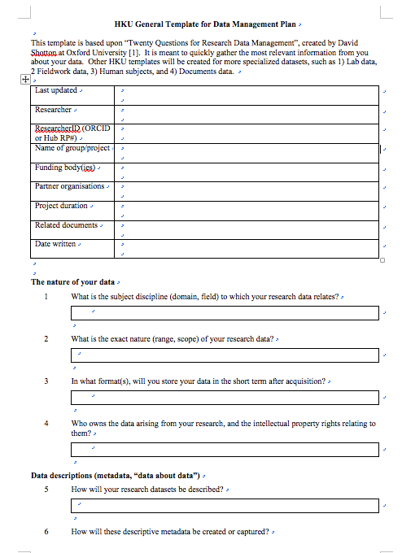
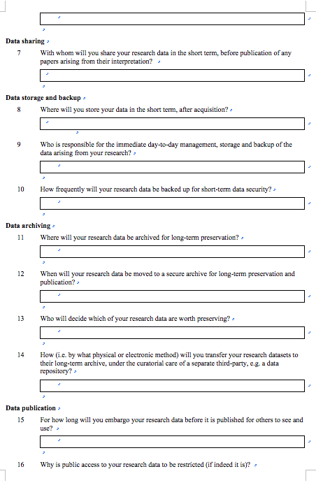
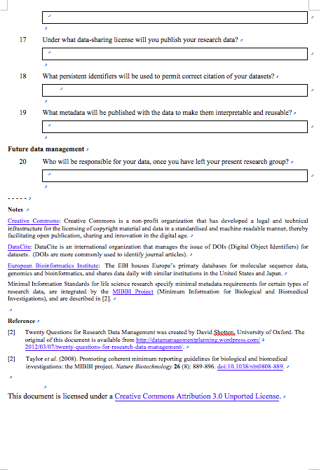
Example – HKU DMP Template
EXAMPLE

Slide 18
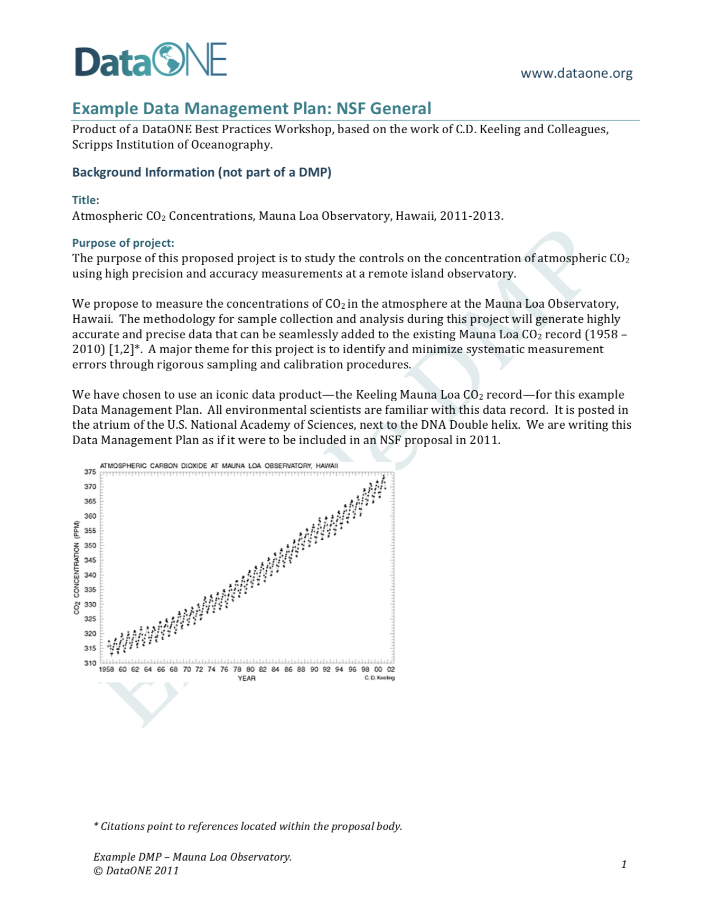
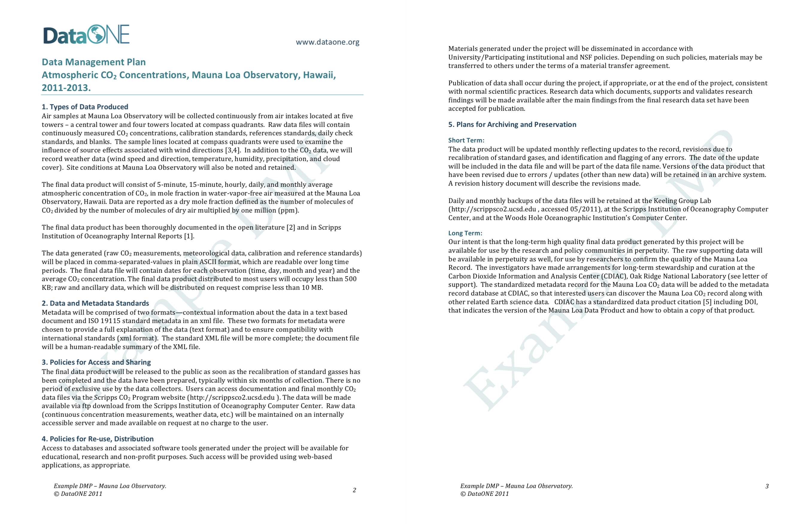
Example – NSF General DMP Template
EXAMPLE

Slide 19
4. How to make DMP?

Slide 20
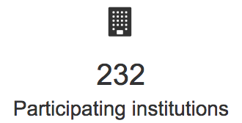
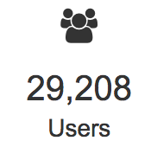
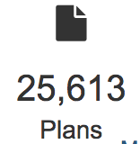
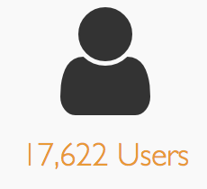
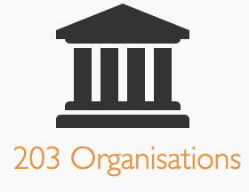
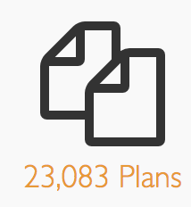
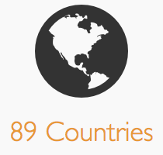
Tools for Data Management Plan
DMP Tool (US) https://dmp.cdlib.org/ | Create, review, and share data management plans that meet institutional and funder requirements.
DMP Online (UK) https://dmponline.dcc.ac.uk/ | Developed by the Digital Curation Centre to help you write data management plans.
Notes:
This slide chose two popular data management plan tools to make DMP. Taking DMP Tool as an example and instruct students step by step.

Slide 21
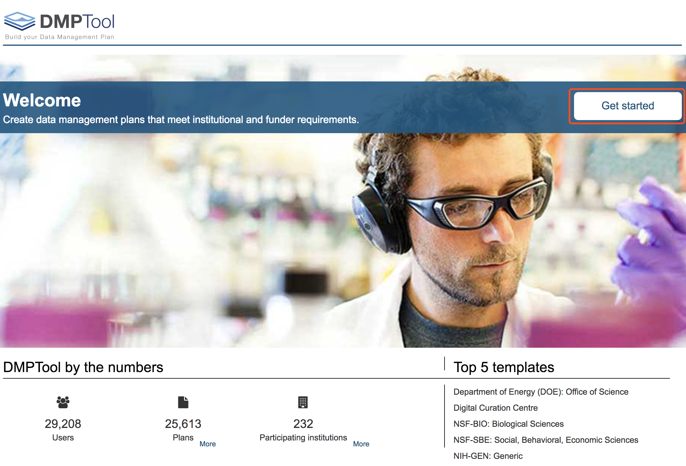
Example - Use DMP Tool to make your DMP
Source: https://dmptool.org/ or https://dmp.cdlib.org/

Slide 22
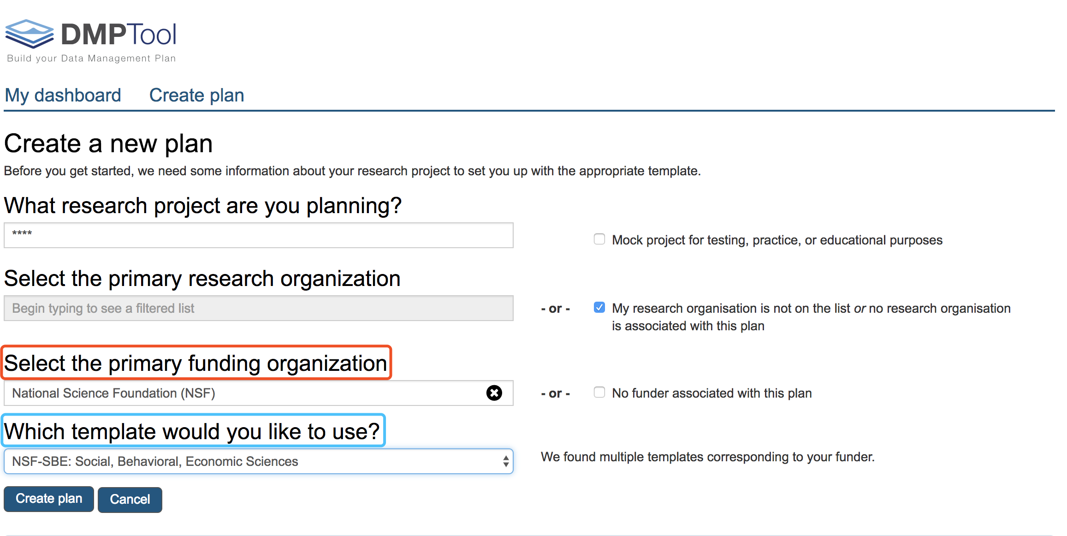
Select a funding organization and then you can choose a template from recommendation list
Select the funder
Select the template

Slide 23
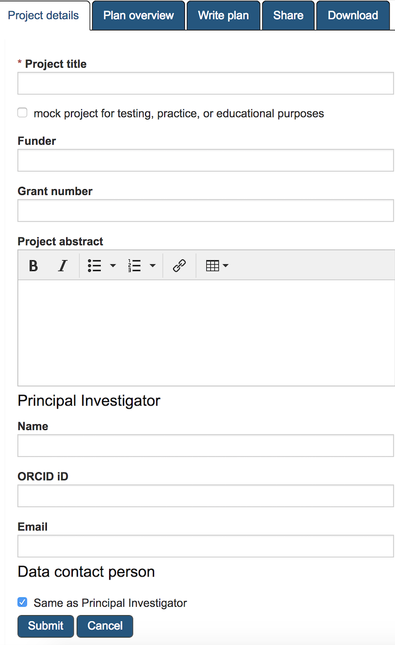
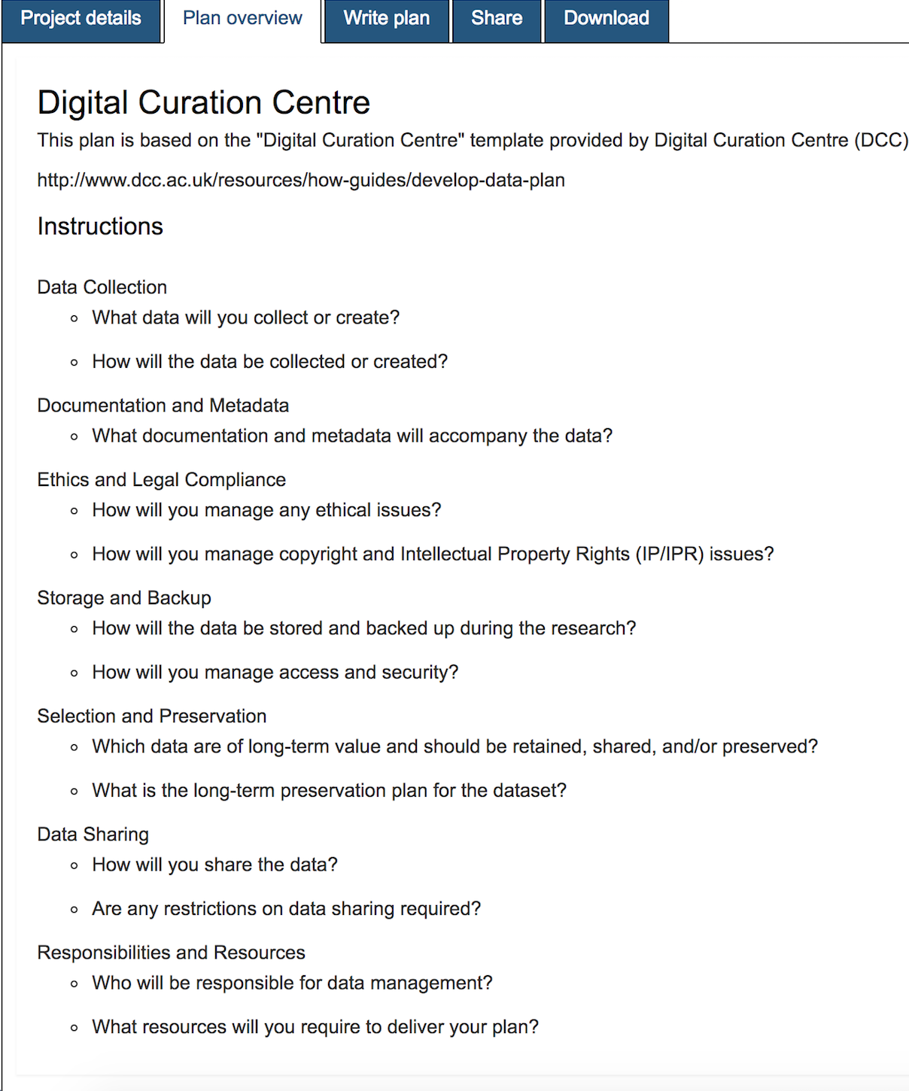
Project details and Plan overview

Slide 24
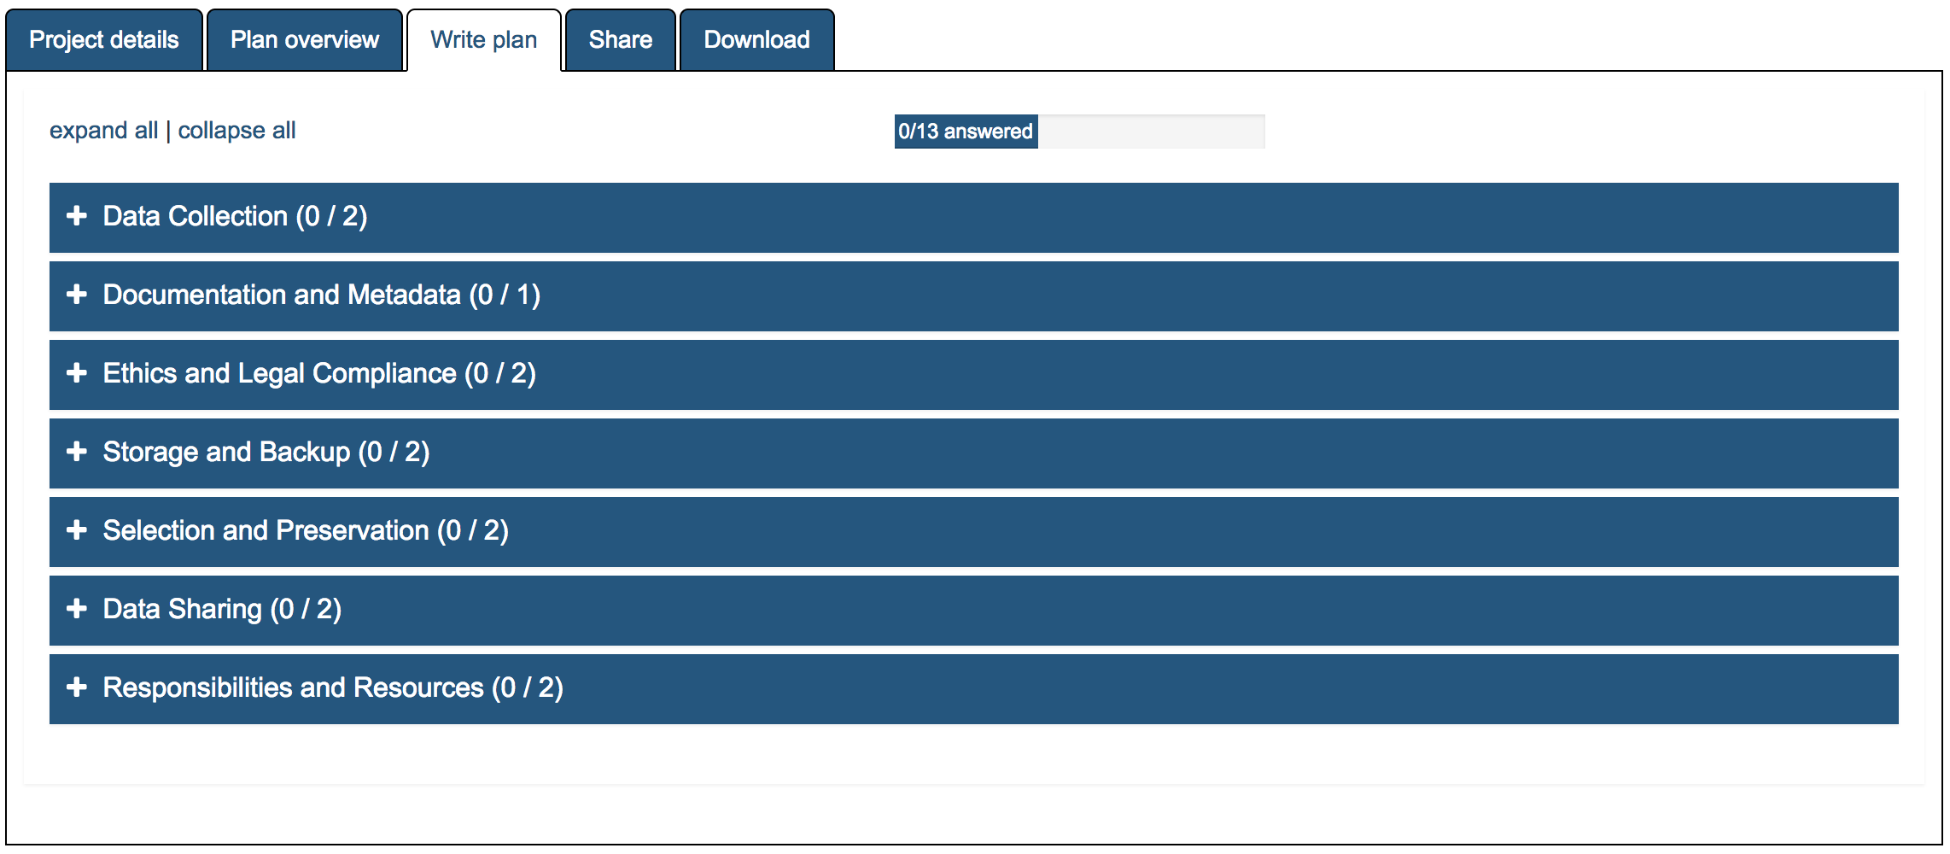
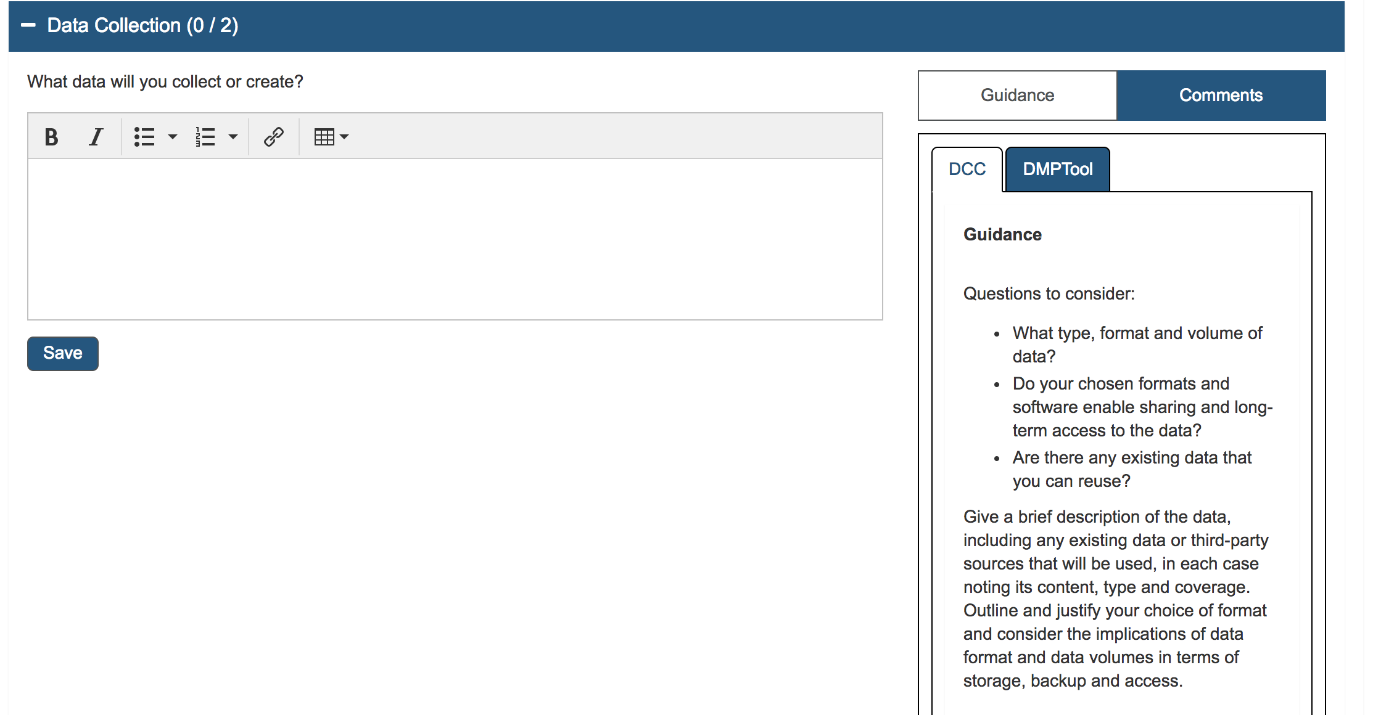
Write plan and Guidance

Slide 25
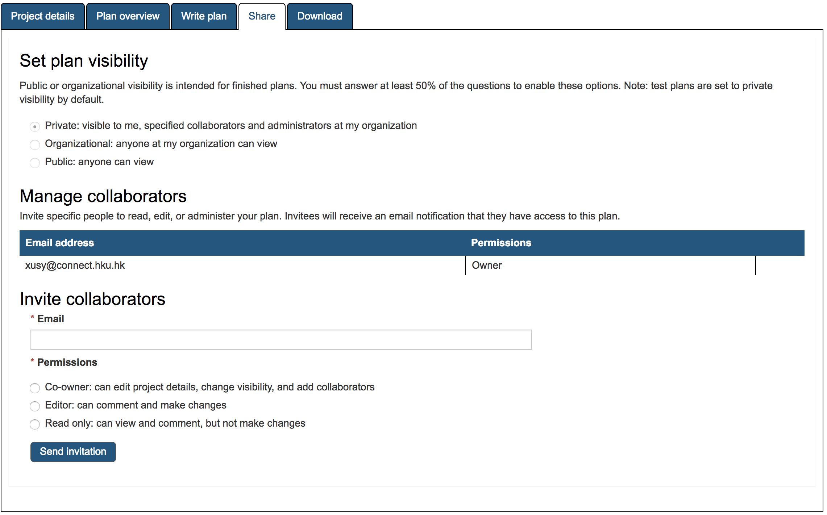
DMP Share
Visibility Setting: Private, Organizational, or Public
Co-worker to view, edit, and download;
Editor to comment and edit;
Read only

Slide 26
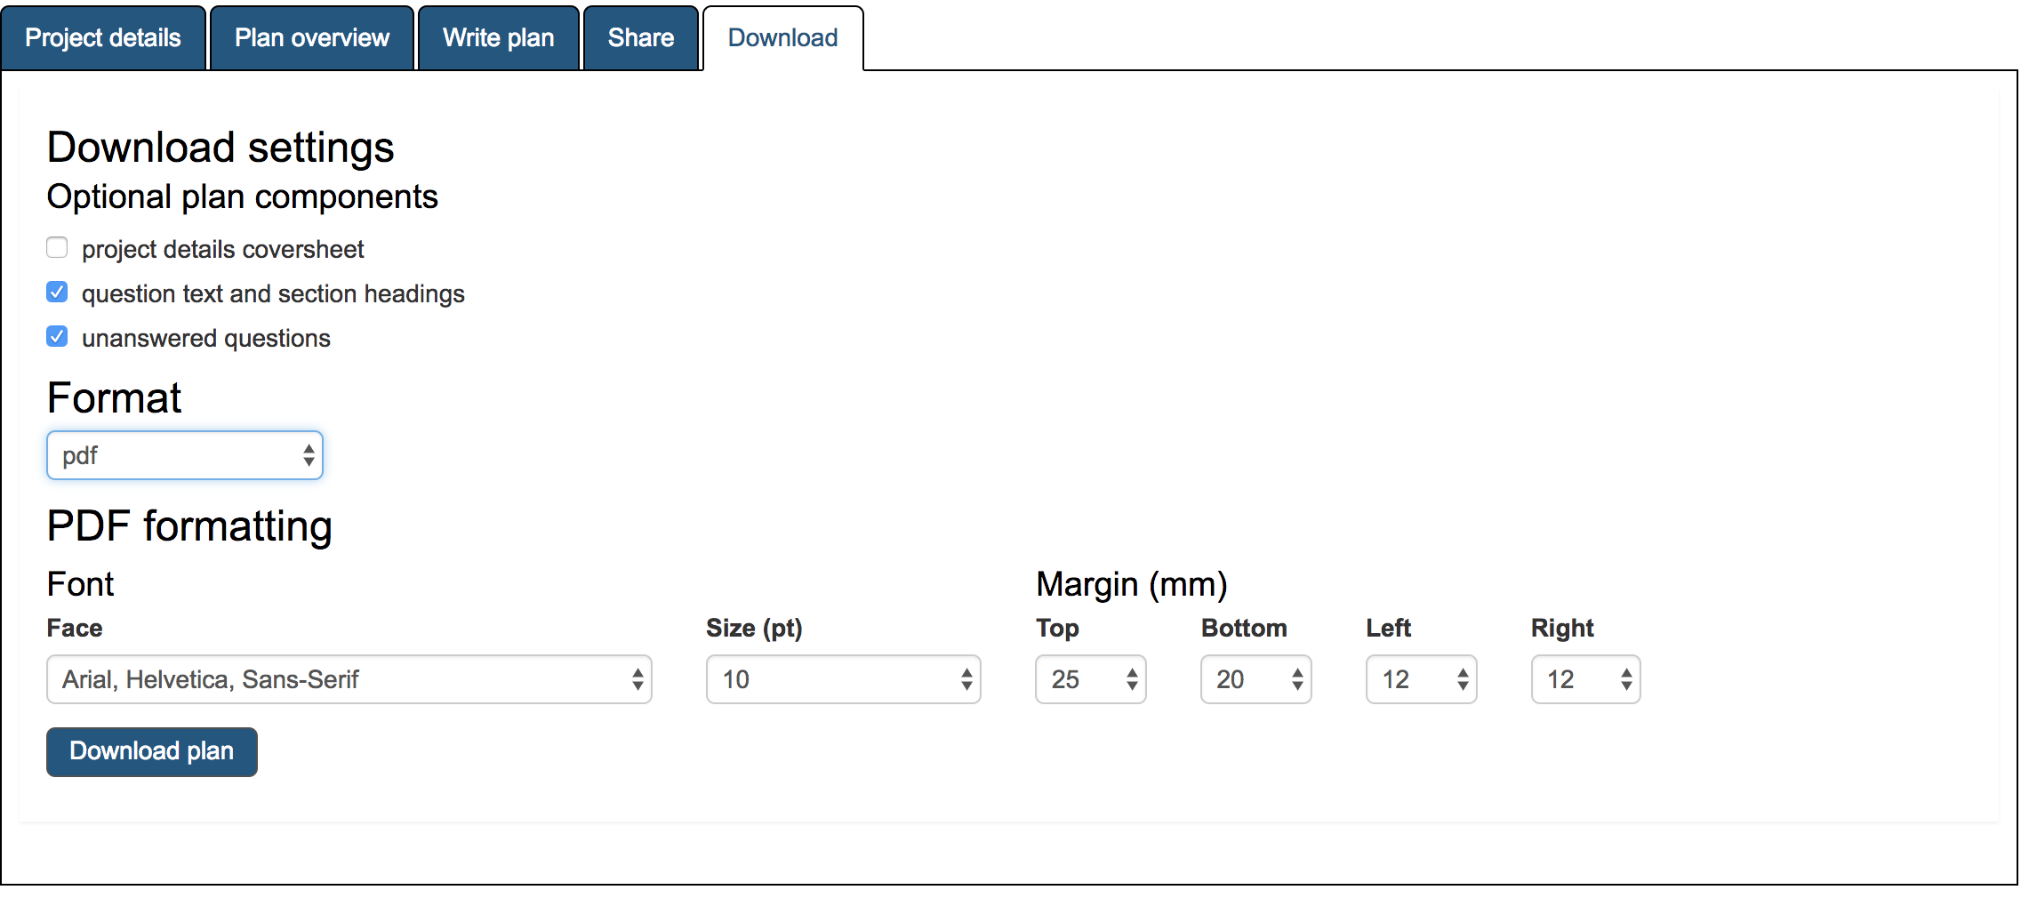
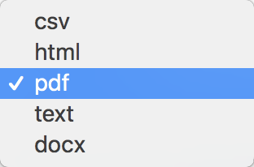
Choose a proper format to Download

Slide 27
5. How to organize data?

Slide 28
How to organize your data?
Make your file name organized
Is this your style? - Wrong! 🙅🙅‍♂️
MLIM7350 draft.docx
MLIM7350 draft2.docx
MLIM7350 draftupdated.docx
MLIM7350 draft final.docx
MLIM7350 final.docx
MLIM7350 final draft.docx
MLIM7350 finalfinal.docx
MLIM7350 lastone!!.docx
Use too long file name;
Use spaces;
Use special characters
(~ ! @ # $ % ^ & * ( ) ` ; < > ? , [ ] { } ' " | ).
Notes:
This section deals with the way in which data and documents are organized in the daily life and recommend useful tips they can follow.

Slide 29
File Naming
Date format – YYYYMMDD or YYMMDD
Underscores, e.g. file_name.xxx
Dashes, e.g. file-name.xxx
No separation, e.g. filename.xxx
Camel case, e.g. FileName.xxx
E.g.
Date created YYYMMDD
Creator
20180420_DMIdata_DMI_XU.xlsx
Content
Project acronym
Source: https://library.stanford.edu/research/data-management-services/data-best-practices/best-practices-file-naming
Notes:
The useful tips for file naming.

Slide 30
Organize data in spreadsheet
Be consistent
Write dates as YYYY-MM-DD
Fill in all of the cells
Put just one thing in a cell
Create (or use) a data dictionary (like a CV)
No calculations in the raw data files
Don’t use font colour or highlighting as data
Choose good names for things
Make backups
Save the data in plain text files
Source: http://kbroman.org/dataorg/
Notes:
Most of our quantitative research data is stored in the spreadsheet. These tips are necessary for them to follow to reduce the time of data processing in the nest stages.

Slide 31
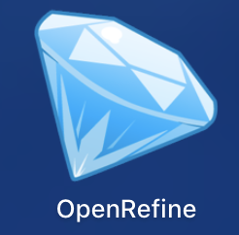
Data cleaning tool: OpenRefine
“OpenRefine (formerly Google Refine) is a powerful tool for working with messy data: cleaning it; transforming it from one format into another; and extending it with web services and external data.”
E.g.
Common transformations
-- Cells to numbers
-- Remove trailing white space
Text Facet
Merge clusters
Download:
http://openrefine.org/
https://github.com/OpenRefine
Useful Video:
7 minutes demo of OpenRefine
https://www.youtube.com/watch?v=B70J_H_zAWM
Notes:
Data cleaning software recommendation.

Slide 32
Metadata
Categorize resources, e.g. image, audio and video;
Metadata is core of any information retrieval system;
Facilitate searching for and browsing information.
EXAMPLE
Source: http://www.dublincore.org/usage/meetings/2002/05/citdcsv/
Notes:
Before data is published and shared, the metadata is necessary for searching and discovering.

Slide 33
Dublin Core
A very popular metadata standard
Can be used in all domains
Can be used for any type of resource
Flexible and adaptable
Source: https://seopressor.com/blog/dublin-core-vs-schemaorg-metadata-comparison/
Notes:
The most popular and common metadata standard.

Slide 34
Other Issues
Ethics and legal compliance
Every researcher is expected to respect ethical and legal obligations and has high responsibility of confidentiality towards informants and participants.
Intellectual Property Rights (IPR)
In HKU, all researchers are supposed to ensure research data and records
Accurate, complete, authentic and reliable;
Identifiable, retrievable, and available when needed;
Secure and safe;
Kept in a manner that is compliant with legal obligations;
Able to be made available to others in line with appropriate ethical, data sharing and open access principles.
Source: http://www.rss.hku.hk/integrity/ethics-compliance
Notes:
If you want to preserve and share your data, the confidential policy and Intellectual property rights are the last but not least thing you have to comply with.

Slide 35
6. Where to preserve and share?

Slide 36
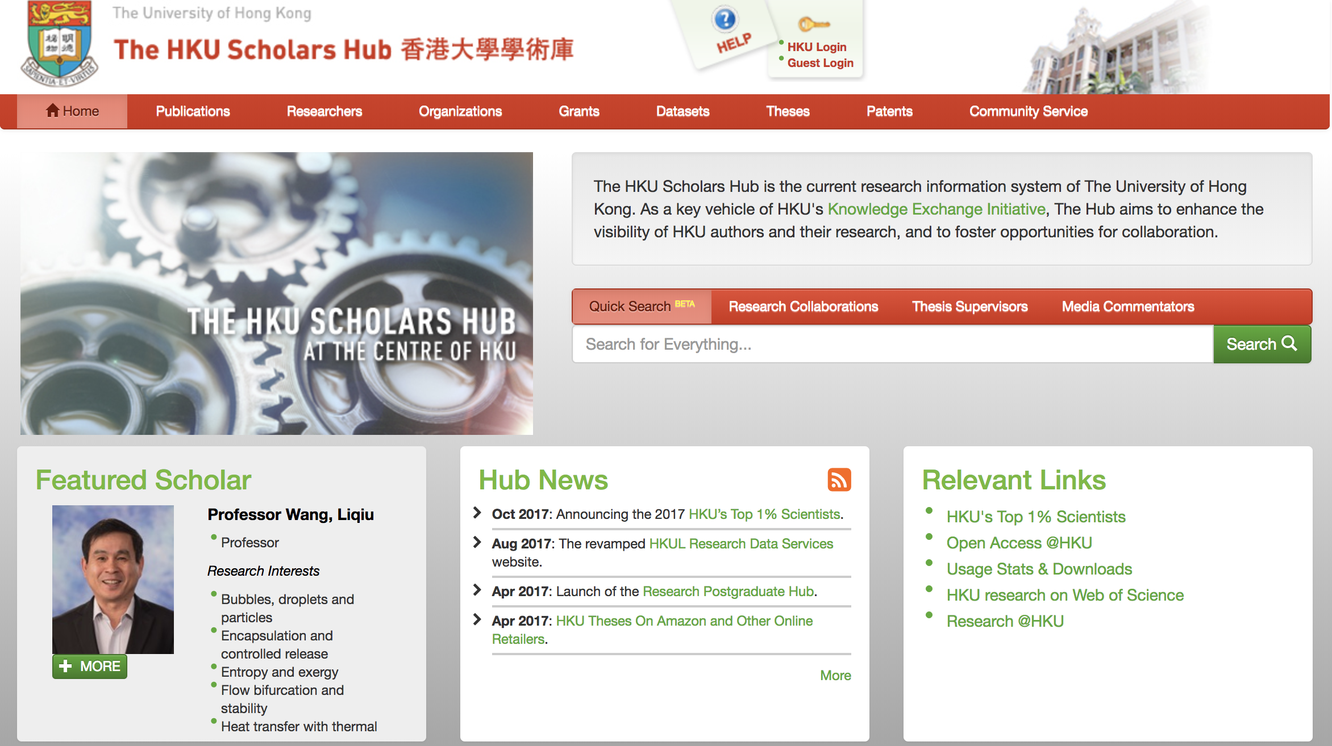
Institutional Repository
HKU Scholars Hub
http://hub.hku.hk/
Preservation:
→ Datasets
→ Deposit Data
→ Fill out the form
Place your screenshot here
Notes:
The introduction of HKU Scholars hub and the steps of depositing data.

Slide 37
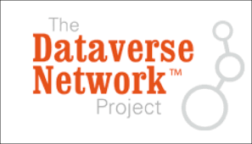
Disciplinary Repository
 | The largest repository for open source code and software. https://github.com
 | Reserve DOI for publication. https://figshare.com
 | Research data with biology and biomedical. http://gigadb.org/site/index
 | Largest collection of science dataset . http://dataverse.org
 | Research data with science and medicine. http://datadryad.org
 | Open educational resources. https://www.oercommons.org/
Notes:
The recommendation of other repositories.

Slide 38
References
[1] Borgman, C. L., Wallis, J. C., & Mayernik, M. S. (2012). Who’s got the data? Interdependencies in science and technology collaborations. Computer Supported Cooperative Work (CSCW), 21(6), 485-523.
[2] Cragin, M. H., Heidorn, P. B., Palmer, C. L., & Smith, L. C. (2007). An educational program on data curation.
[3] Goodman, A., Pepe, A., Blocker, A. W., Borgman, C. L., Cranmer, K., Crosas, M., . Hedstrom, M. Simple Rules for the Care and Feeding of Scientific Data. PLOS Computational Biology.
[4] Mallery, M. (2014). Dmptool: Guidance and Resources for Your Data Management Plan; https://dmp.cdlib.org. Technical Services Quarterly, 31(2), 197-199.
[5] Wilkinson, M. D., Dumontier, M., Aalbersberg, I. J., Appleton, G., Axton, M., Baak, A., Bourne, P. E. (2016). The FAIR Guiding Principles for scientific data management and stewardship. Scientific data, 3.

Slide 39
THANKS!
Any questions?
You can find me at
xusy@connect.hku.hk

Slide 40
Credits
Special thanks to all the people who made and released these awesome resources for free:
Presentation template by SlidesCarnival
Photographs by Unsplash
Icons by Iconfont

