Slide 1
CHEMISTRY
Chapter 11
Solutions and Colloids
Slides by Montgomery College licensed under CC BY 4.0.

Slide 2
chapter 11: Solutions and Colloids
11.1 The Dissolution Process
11.2 Electrolytes
11.3 Solubility
11.4 Colligative Properties
11.5 Colloids

Slide 3
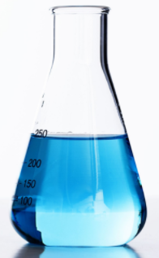
11.1 The Dissolution Process
Solutions
Homogeneous mixtures or two or more substances are called solutions.
The substance present in the larger amount is the solvent.
The substance present in the smaller amount is the solute.
Copper(II) sulfate dissolved in water forms a homogeneous solution.
CuSO₄(s) → Cu²⁺(aq) + SO₄²⁻(aq)
The solute is copper(II) sulfate.
The solvent is water.

Slide 4
11.1 The Dissolution Process
Solutions
The particles in a homogeneous solution are uniformly distributed.
Pure samples gas mix when the stopcock is opened. A homogeneous solution forms upon mixing.

Slide 5
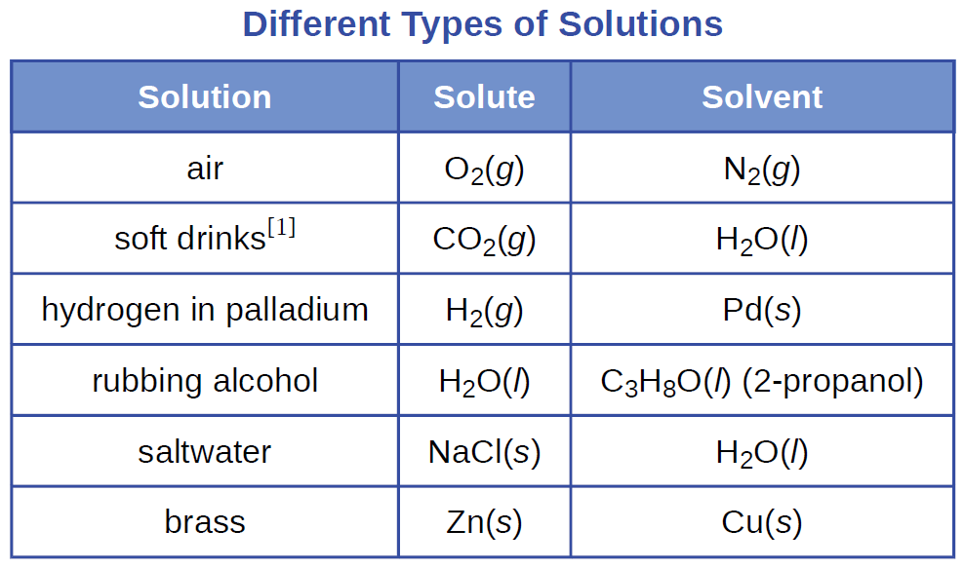
11.1 The Dissolution Process
Solutions
[1] If bubbles of gas are observed, then the mixture is
not homogeneous and therefore not a solution.

Slide 6
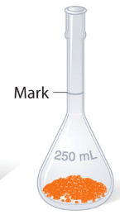
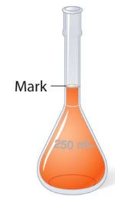
11.1 The Dissolution Process
Solutions: Defining Traits
A solution is homogeneous and has uniform composition.
The physical state of a solution (s, ℓ, g) is typically the same as that of the solvent.
The components of a solution are dispersed on a molecular scale.
The dissolved solute in a solution will not separate from the solvent.
Solutions may form in an exothermic or endothermic process.
add
solvent
solute + solvent
= solution
solute

Slide 7
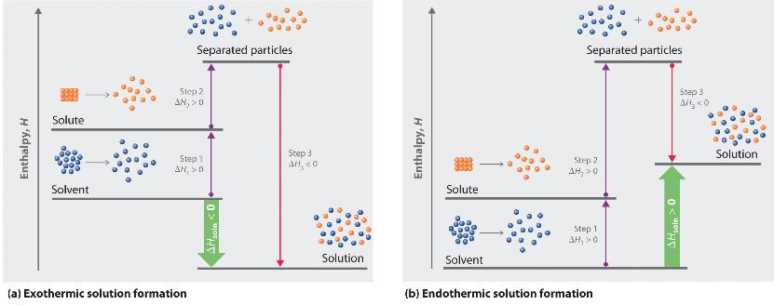
11.1 The Dissolution Process
The Formation of Solutions
The formation of a solution is a spontaneous process.
  No energy input is required.
  Stirring simply speeds up the process.
Solution formation is favored if:
  there is a decrease in internal energy of the system (exothermic).
  there is an increase in dispersion of matter.

Slide 8
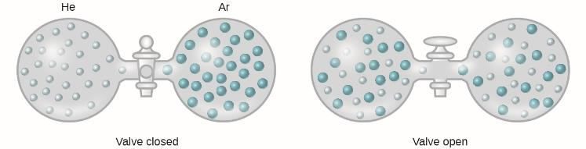
11.1 The Dissolution Process
Intermolecular Forces in Solutions
An ideal solution has intermolecular forces that are similar to those present in the separated components.
In the dissolution process:
  solute-solute and solvent-solvent forces must be overcome
  solute-solvent attractions are established during solvation.
  the relative energies determine if dissolution occurs.

Slide 9
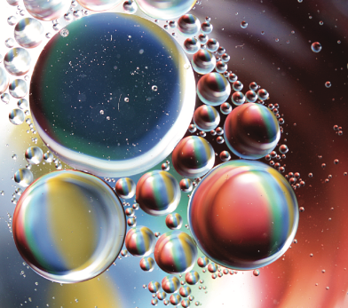
11.1 The Dissolution Process
A mixture of cooking oil and water does not yield a solution.
Consider the intermolecular forces involved and explain.

Slide 10
11.2 Electrolytes
Solutions Containing Electrolytes
If an ionic compound is able to dissolve in water, a solution containing ions is generated.
These solutions are electrolytes.
  a high percentage of ions yields a strong electrolyte.
  few ions yields a weak electrolyte.
Substances can be identified as strong or weak electrolytes by measuring conductivity.

Slide 11

11.2 Electrolytes
Ionic Electrolytes
The electrostatic attraction between polar water molecules and particles from an ionic compound such as KCl are ion-dipole interactions.
The K⁺ ions are attracted to the $δ−$part of water molecules.
The Cl- ions are attracted to the $δ+$ of water molecules.
The water molecules form hydration shells around each dissolved cation or anion.
Solutions of strong electrolytes conduct electricity easily.

Slide 12
11.2 Electrolytes
Covalent Electrolytes
Pure water is a poor conductor because it only slightly ionizes to yield hydronium ions and hydroxide ions.
2H₂O(ℓ) → 2OH⎯(aq) + H₃O⁺(g)
HCl is a covalently bonded compound in the gas phase.
HCl in water, however, is a very good conductor.
  HCl transfers H⁺ to H₂O to form H₃O⁺ and Cl⎯.
hydronium ion

Slide 13
11.3 Solubility
Solutions
The solubility of a compound in a particular solvent is the maximum concentration in solution that can be achieved.
  solvent and temperature are important
  saturated: [solute] = solubility
  unsaturated: [solute] < solubility
  supersaturated: [solute] > solubility
NaCl(s) → Na⁺(aq) + Cl⎯(aq)
At 25 °C, the solubility of NaCl in water is 359 kg/m³.
  What is the solubility in g/mL?
  What is the solubility in mol/L?

Slide 14
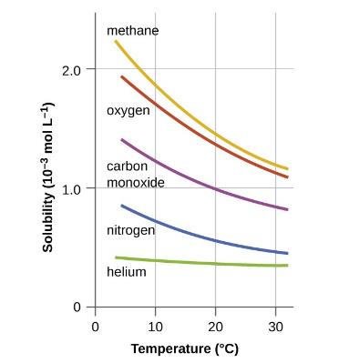
11.3 Solubility
Solutions: Gases in Liquids
Temperature is one of major factors affecting solubility.
At higher temperatures, the solubility of gases in water decreases.
Carbonated water quickly loses CO₂ at warmer temperatures
Decreased oxygen solubility in natural waters can lead to large-scale fish kills
All solubilities displayed were measured at a constant gas pressure of 1 atm.

Slide 15
Decompression Sickness: The Bends
Decompression sickness (DCS), or “the bends,” is an effect of the increased pressure of the air inhaled when swimming at considerable depths.
Divers are subjected to atmospheric pressure as well as additional pressure due to the water The air inhaled by a diver while submerged contains gases at the corresponding higher ambient pressure, and the concentrations of the gases dissolved in the diver’s blood are proportionally high (see gas laws).
As the diver ascends to the surface of the water, ambient pressure decreases and the dissolved gases becomes less soluble.
Is ascent is rapid, gases escaping from the diver’s blood may form bubbles that can cause rashes, joint pain, paralysis, and death.
To avoid DCS, divers must ascend from depths at relatively slow speeds (10 or 20 m/min) or otherwise make several decompression stops, pausing for several minutes at given depths during the ascent.
When these preventive measures are unsuccessful, divers with DCS are often provided hyperbaric oxygen therapy in pressurized vessels.
US Navy divers undergo training in a recompression chamber.
Divers receive hyperbaric oxygen therapy.

Slide 16
11.3 Solubility
Solutions: Liquids in Liquids
Some liquids mix with each other completely and have mutual solubility – these liquids are miscible.
  Both components usually have the same polarity (i.e. polar/polar or nonpolar/nonpolar).
Two liquids that have low mutual solubility and do not mix are called immiscible.
  A polar and a nonpolar liquid (oil and water) do not mix to an appreciable extent.

Slide 17
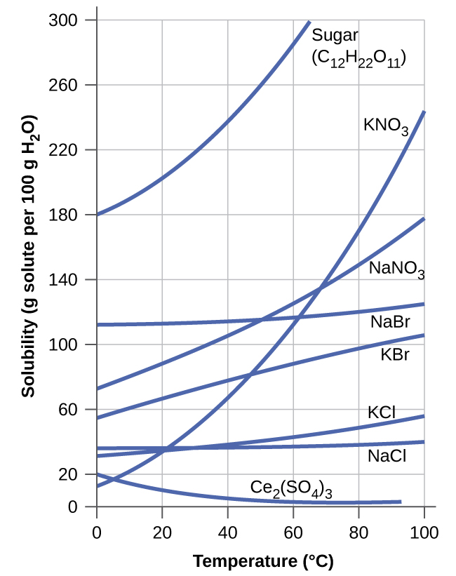
11.3 Solubility
Solutions: Solids in Liquids
Solubility usually increases with temperature.
Examine the data. Which compound is an exception?

Slide 18
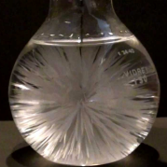
11.3 Solubility
Solutions: Solids in Liquids
Solubility can be exploited to purify substances by crystallization.
  A supersaturated solution can be made.
  Crystallization can be initiated by adding a seed crystal or by agitating the solution.
Sodium acetate crystallized from a supersaturated solution (video).

Slide 19
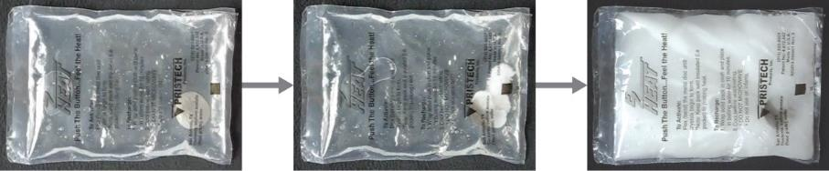
11.3 Solubility
Sodium Acetate Hand Warmers
This hand warmer produces heat when the sodium acetate in a supersaturated solution precipitates. Precipitation of the solute is initiated by a mechanical shockwave generated when the flexible metal disk within the solution is “clicked.”

Slide 20





11.4 Colligative Properties
Properties of Solutions
The properties of solutions are different from those of pure solutes or pure solvents.
Colligative properties depend solely upon the total concentration of solute particles and not the nature of those particles.
Vapor-Pressure Lowering
$$P_{1}=X_{1}P_{1}^{°}$$
Boiling-Point Elevation
$${∆T}_{b}=𝒾K_{b}𝓂$$
Freezing-Point Depression
$${∆T}_{f}=𝒾K_{f}𝓂$$
Osmotic Pressure ($Π$)
$$Π=𝒾MRT$$

Slide 21


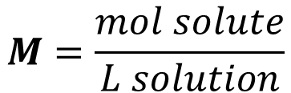
11.4 Colligative Properties
Molality
Thus far, concentration has been defined in terms of molarity.
Solution volume varies with temperature and therefore molarity varies with temperature.
Molality ($𝓂$) is more appropriate for calculations where temperature is a factor because it does not vary with temperature.
$$M=\frac{mol solute}{L solution}$$
$$m=\frac{mol solute}{kg solvent}$$

Slide 22

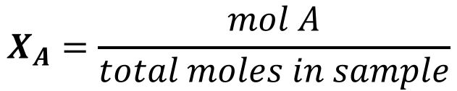



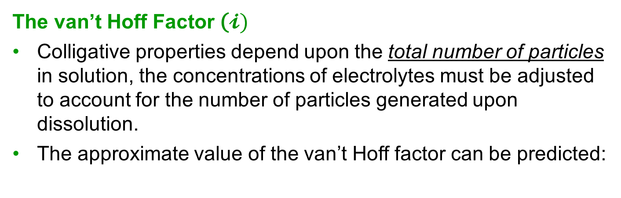
11.4 Colligative Properties
Mole Fraction
The mole fraction is also a concentration unit that is not dependent upon temperature.
$$X_{A}=\frac{mol A}{total moles in sample}$$
The van’t Hoff Factor ($𝓲)$
Colligative properties depend upon the total number of particles in solution, the concentrations of electrolytes must be adjusted to account for the number of particles generated upon dissolution.
The approximate value of the van’t Hoff factor can be predicted:
NaCl
MgCl₂
FeCl₃
C₆H₁₂O₆
glucose
$$𝒾=2$$
$$𝒾=3$$
$$𝒾=4$$
$$𝒾=?$$

Slide 23

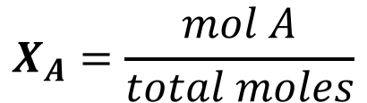

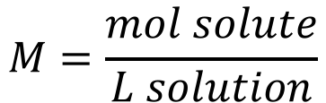
11.4 Colligative Properties
Example: Molality, Molarity, and Mole Fraction
Commercial bleach is 5.25% sodium hypochlorite by mass: 100.00 g of bleach contains 5.25 g of NaClO. Calculate the molarity (M), the molality ($𝓂$), and mole fraction (X_{NaClO}) of commercial bleach. Predict the van’t Hoff factor ($𝒾$) for commercial bleach.
The bleach solution has a density of 1.11 g/cm³.
Water has a density of 1.00 g/cm³.
$$M=\frac{mol solute}{L solution}$$
$$m=\frac{mol solute}{kg solvent}$$
$$X_{A}=\frac{mol A}{total moles}$$

Slide 24
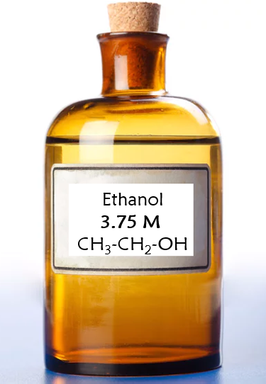
11.4 Colligative Properties
Example: Molality and Molarity
What is the molality of a 3.75 M aqueous ethanol (C₂H₅OH) solution? The density of the solution is 0.965 g/mL.
Hint: Assume that you have one liter to start.

Slide 25
11.4 Colligative Properties
Vapor Pressure Lowering
Dissolving a nonvolatile substance in a volatile liquid results in vapor pressure lowering.
Solute molecules decrease the surface area of the liquid and hinder vaporization.
This results in a lowering of the vapor pressure above the liquid.

Slide 26
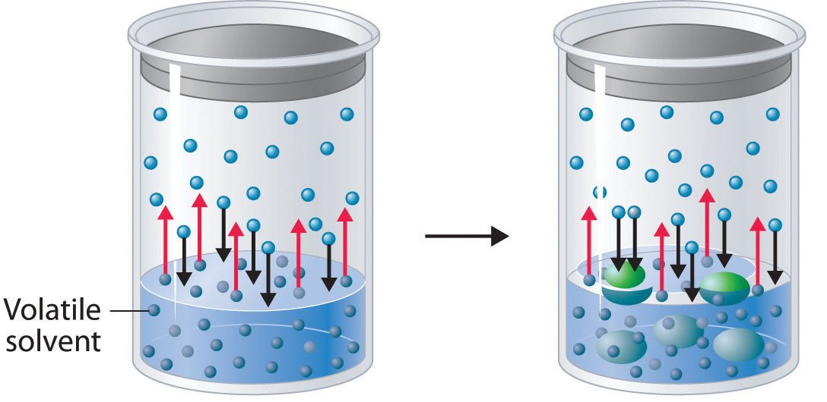

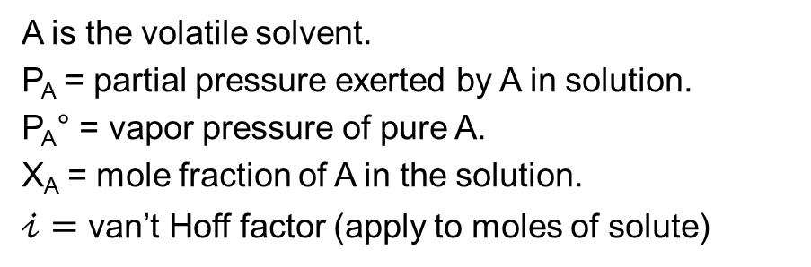
11.4 Colligative Properties
Vapor Pressure Lowering – Raoult’s Law
Vapor pressure and solute concentration are related.
$$P_{A}=X_{A}P_{A}^{°}$$
A is the volatile solvent.
P_{A} = partial pressure exerted by A in solution.
P_{A}° = vapor pressure of pure A.
X_{A} = mole fraction of A in the solution.
$𝒾=$ van’t Hoff factor (apply to moles of solute)
A vaporization blocked.
The pressure above the solution is lowered.
Solute added.
(A)

Slide 27

11.4 Colligative Properties
Example: Vapor Pressure Lowering – Antifreeze
Ethylene glycol (HOCH₂CH₂OH), the major ingredient in antifreeze, increases the boiling point of radiator fluid by lowering its vapor pressure. At 100°C, the vapor pressure of pure water is 760 mmHg. Calculate the vapor pressure of an aqueous solution containing 30.2% ethylene glycol by mass.
$$P_{solution}=X_{water}P_{water}^{°}$$
[Answer: 675 mmHg]

Slide 28

11.4 Colligative Properties
Example: Vapor Pressure Lowering – Seawater
Seawater is a solution of 3.0% NaCl along with a small number of other salts. Calculate the decrease in vapor pressure of water at 25 °C caused by the NaCl. The vapor pressure of pure water at 25 °C is 23.80 mmHg.
Note that one mole of NaCl produces two moles of solute particles.
$$P_{seawater}=X_{water}P_{water}^{°}$$
[see next slide for answer]

Slide 29
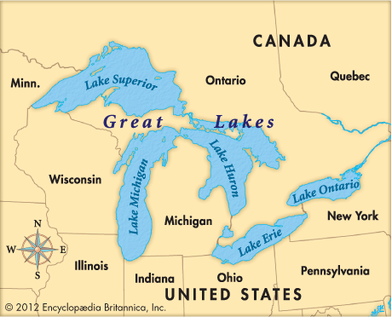
11.4 Colligative Properties
Answer:
P_{seawater} = 23.35 mmHg and ΔP = 0.45 mmHg
The change is pressure is only 0.45 mmHg, but it constitutes a 2% decrease in the vapor pressure of water.
This is part of the reason that humidity tends to be higher in states around the Great Lakes, which are freshwater lakes.
Scientists take such pressure changes into account when modeling climate change.

Slide 30
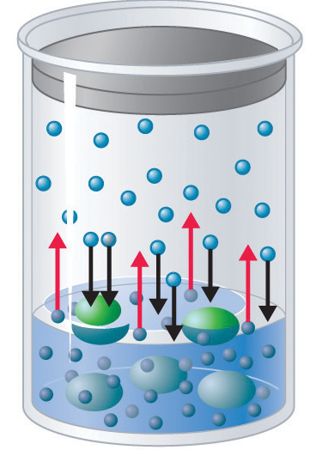


11.4 Colligative Properties
Boiling Point Elevation
The boiling point of a liquid is the temperature at which vapor pressure equals atmospheric pressure.
Because vapor pressure is lowered when nonvolatile solutes are present, the boiling point increases.
$${∆T}_{b}=𝒾K_{b}𝓂$$
ΔT_{b} = boiling point elevation
K_{b} = molal boiling point elevation constant
m = molal concentration of all solute species
$𝒾=$ van’t Hoff factor

Slide 31

11.4 Colligative Properties
Example 11.6
What is the boiling point of a solution containing 92.1 g of I₂ and 800.0 g of chloroform, CHCl₃. Assume that I₂ is non-volatile.
$${∆T}_{b}=𝒾K_{b}𝓂$$
Solvent | Boiling Point | K_{b} (°C/m) | Freezing Point | K_{f} (°C/m)
H₂O | 100.0 °C | 0.512 | 0.0 °C | 1.86
benzene | 80.1 °C | 2.53 | 5.5 °C | 5.12
chloroform | 61.26 °C | 3.63 | −63.5 °C | 4.68

Slide 32
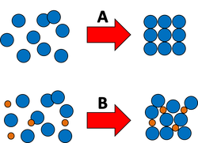



11.4 Colligative Properties
Freezing Point Depression
The boiling point of a liquid is the temperature at which vapor pressure equals atmospheric pressure.
Because vapor pressure is lowered when nonvolatile solutes are present, the boiling point increases.
$${∆T}_{f}=𝒾K_{b}𝓂$$
ΔT_{f} = freezing point depression
K_{f} = molal freezing point depression constant
m = molal concentration of all solute species
$𝒾=$ van’t Hoff factor
thinglink.com

Slide 33

11.4 Colligative Properties
Example – Sucrose in Water
What is the freezing point of a solution containing 115.0 g of sucrose dissolved in 350.0 g water?
$${∆T}_{f}=𝒾K_{f}𝓂$$
Solvent | Boiling Point | K_{b} (°C/m) | Freezing Point | K_{f} (°C/m)
H₂O | 100.0 °C | 0.512 | 0.0 °C | 1.86
benzene | 80.1 °C | 2.53 | 5.5 °C | 5.12
chloroform | 61.26 °C | 3.63 | −63.5 °C | 4.68

Slide 34
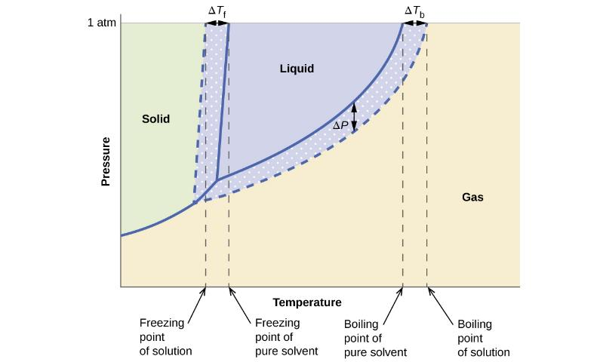

11.4 Colligative Properties
Boiling Point and Freezing Point – Phase Diagram
This phase diagram is for an aqueous solution of a nonelectrolyte (like sucrose) where $𝒾$=1.0.

Slide 35
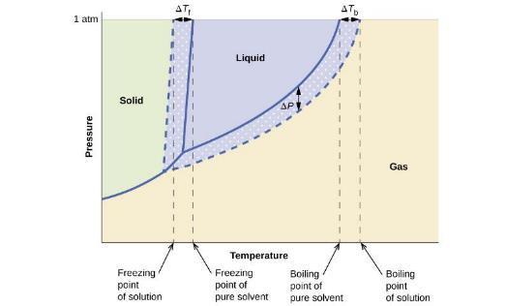
11.4 Colligative Properties
Phase Diagram Interpretation
The liquid-vapor curve is beneath the solvent curve.
  vapor pressure lowering
At any given pressure, the boiling point is higher.
  boiling point elevation
The solid-liquid curve for the solution is falls to the left of the pure solvent.
  freezing point depression
Why is the solid gas curve the same for both the pure solvent and the solution?

Slide 36
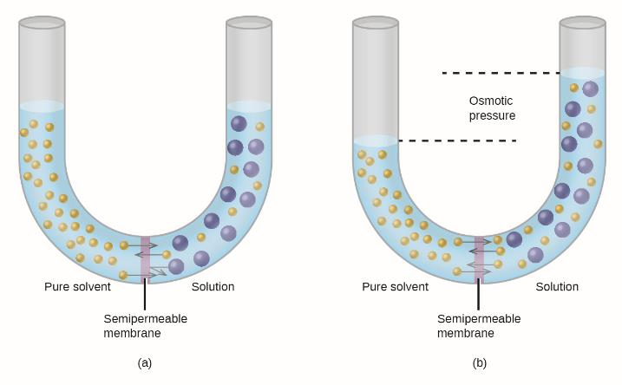
11.4 Colligative Properties
Osmotic Pressure
Osmosis is diffusion-driven transfer of solvent molecules across a semipermeable membrane.

Slide 37
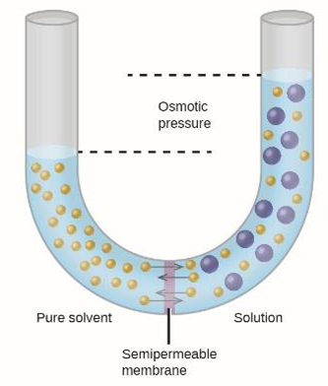

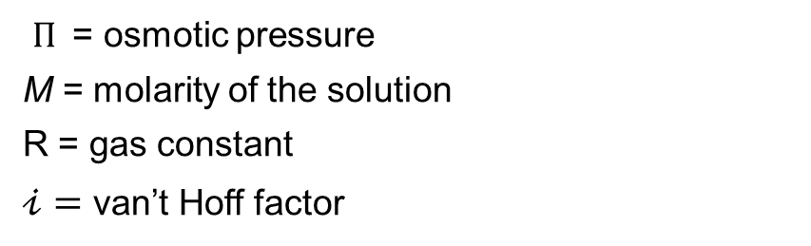
11.4 Colligative Properties
Osmotic Pressure
Osmosis in the apparatus shown, causes the volume/level of the solution to rise.
This increases the hydrostatic pressure due to the weight of the column of solution in the tube.
Solvent molecules are then pushed back into the pure solvent.
The pressure at which solvent molecules move through the membrane at the same rate in both directions is the osmotic pressure.
$Π$= osmotic pressure
M = molarity of the solution
R = gas constant
$𝒾=$ van’t Hoff factor
$$Π=𝒾MRT$$

Slide 38
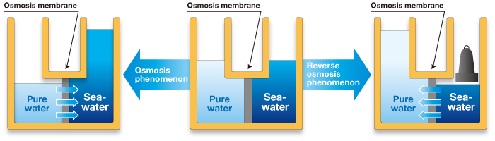
11.4 Colligative Properties
Reverse Osmosis
If pressure applied to the solution is greater than the osmotic pressure, reverse osmosis can occur.
On a large scale, this process can be used to desalinate sea water.
acewater.co.jp

Slide 39
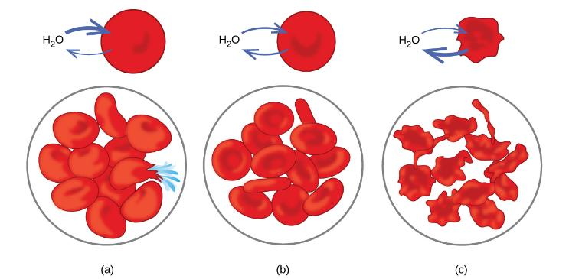
11.4 Colligative Properties
Osmosis in Biology
Red blood cells have semipermeable membranes.
Swell and burst in a hypotonic solution.
Maintain their normal shape in an isotonic solution.
Shrivel and become non-functional in a hypertonic solution.

Slide 40
end of chapter problems – chapter 11
Solutions: #1, 5, 9, 11, 15, 23
Colligative Properties: #33b, 38c, 43, 45,
For detailed solutions to these problems, go to the OpenStax Chemistry website and download the Student Solution Guide.

Slide 41
videos – chapter 11
General Explanation of Solubility
http://screencast.com/t/e6UR0YisSor4
Predicting Solubility of Compounds
http://youtu.be/UPlQ72uX_-M
Raoult’s Law (Calculating Vapor Pressure of Solution)
http://youtu.be/w8lbSyTci2Y
http://youtu.be/4e-NiMpOBQY
Freezing Point Depression Calculation
http://youtu.be/1sdAxF1eYig
Boiling Point Elevation Calculation
http://youtu.be/kIGya7eNXZo
(note: The final answer for the calculation shown in the video should be 7.04 g, not 1.76 g)
*All videos were created by MC Chemistry faculty unless otherwise indicated.

Slide 42

simulations – chapter 11
Salts & Solubility (Solubility, Solutions)
https://phet.colorado.edu/en/simulation/legacy/soluble-salts
Concentration (Solutions, Concentration, Saturation)
https://phet.colorado.edu/en/simulation/concentration

