Slide 1
Transparent Data Encryption (TDE)

Slide 2
WHY NEED Transparent Data Encryption (TDE)
Oracle Database uses authentication, authorization, and auditing mechanisms to secure data in the database, but not in the operating system data files where data is stored.
To protect these data files, Oracle Database provides Transparent Data Encryption (TDE).
Transparent Data Encryption (TDE) enables to encrypt sensitive data, such as Personally Identifiable Information (PII), Credit card number store in tables and tablespaces
After the data is encrypted, this data is transparently decrypted for authorized users or applications when they access this data.
Even if the encrypted data is retrieved, it cannot be understood until authorized decryption occurs, which is automatic for users authorized to access the table.
Both TDE column encryption and TDE tablespace encryption use a two-tiered key-based architecture.
Unauthorized users, such as intruders who are attempting security attacks, cannot read the data from storage and back up media unless they have the TDE master encryption key to decrypt it.

Slide 3
Encryption Components
Encryption key
Two-tier key architecture
Algorithm
DES (Triple Data Encryption Standard)
Both column and table space encryption keys are stored in the database but are encrypted with another key called the master key
AES (Advanced Encryption Standard)
AES128 is default for tablespace
AES192 is default for column encryption
The master key is stored outside the database in a special container called an External security module
Unless the right password is supplied, the wallet can’t be opened and the encrypted data can’t be retrieved. The wallet is automatically closed when the database instance is shut down and must be reopened by a security officer when the instance starts
Master key is stored in Oracle wallet
Thieves might be able to restore a database from tapes, without the wallet and the password, they will not be able to view the encrypted data.

Slide 4
Master encryption key – The encryption key used to encrypt secondary data encryption keys used for column encryption and table space encryption. Master encryption keys are part of the Oracle Advanced Security two-tier key architecture
Stores
Wallet – A PKCS#12 archiving file format is used to stores TDE master key. Or
PKCS #5 is the Password-Based Cryptography Specification.
Column encryption
Table space encryption
Table key – it is also referred as column key, this key is used to encrypt one or more specific columns in a given table.
The key used to encrypt a tablespace. These keys are encrypted using the master key and are stored in the tablespace header of the encrypted tablespace, as well as in the header of each operating system - file that belongs to the encrypted tablespace.
These keys are stored in the Oracle data dictionary, encrypted with the master encryption key.

Slide 5
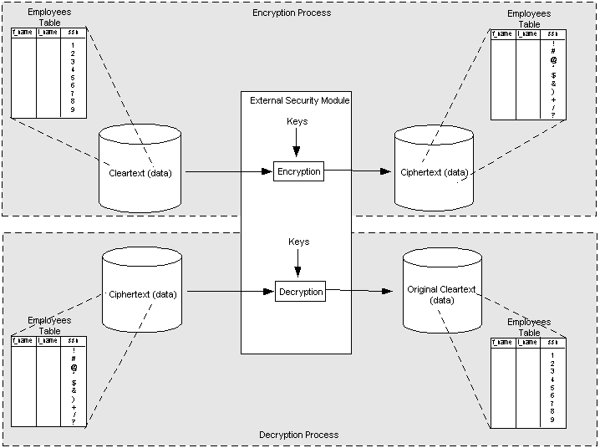
Unencrypted plain text
Message text that has been encrypted.

Slide 6
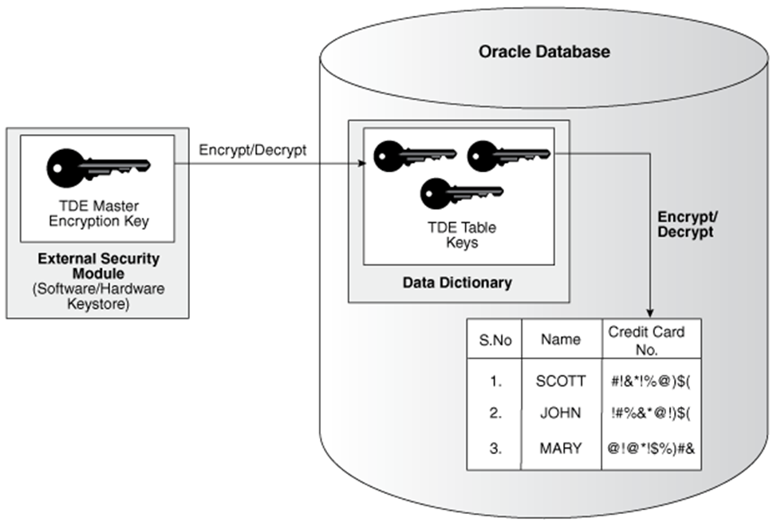
the master key of the server is stored in an external security module that is outside the database and accessible only to the security administrator.
For this external security module, Oracle uses an Oracle wallet Storing the master key in this way prevents its unauthorized use.
In addition to storing the master key, the Oracle wallet is also used to generate encryption keys and perform encryption and decryption.
When a table contains encrypted columns, a single key is used regardless of the number of encrypted columns.
The keys for all tables containing encrypted columns are encrypted with the database server master key and stored in a dictionary table in the database.

Slide 7
Specifying an Additional Wallet Location in SQLNET.ORA
By default, the external security module stores encryption keys in the Oracle wallet specified in the sqlnet.ora configuration file.
If no wallet location is specified in the sqlnet.ora file, then the default database wallet is used.
If you wish to use a wallet specifically for transparent data encryption, then you must specify a second wallet location in sqlnet.ora by using the ENCRYPTION_WALLET_LOCATION parameter.
ALTER SYSTEM SET ENCRYPTION KEY certificate_ID IDENTIFIED BY password
certificate_ID is an optional string containing the unique identifier of a certificate stored in the security module. Use this parameter if you intend to use your PKI private key as your master key. This parameter has no default setting.
You can search for a certificate_ID by querying the V$WALLET fixed view when the wallet is open. Only certificates that can be used as master keys by transparent data encryption are shown.
password is the mandatory wallet password for the security module, with no default setting. It is case sensitive; enclose it in double-quotation marks.

Slide 8
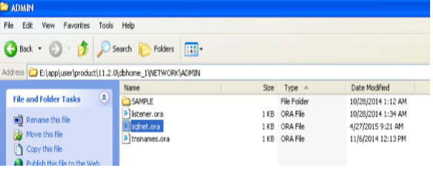
Step 1: Create Wallet E:\app\user\admin\orcl\wallet – in the orcl directory create “Wallet” directory suppose it is not available.
Step 2: insert wallet location in “sqlnet.ora”, as given below
ENCRYPTION_WALLET_LOCATION=
(SOURCE=(METHOD=FILE)(METHOD_DATA=
(DIRECTORY=E:\app\user\admin\orcl\wallet)))
In the directory give correct path where you create the wallet directory.

Slide 9
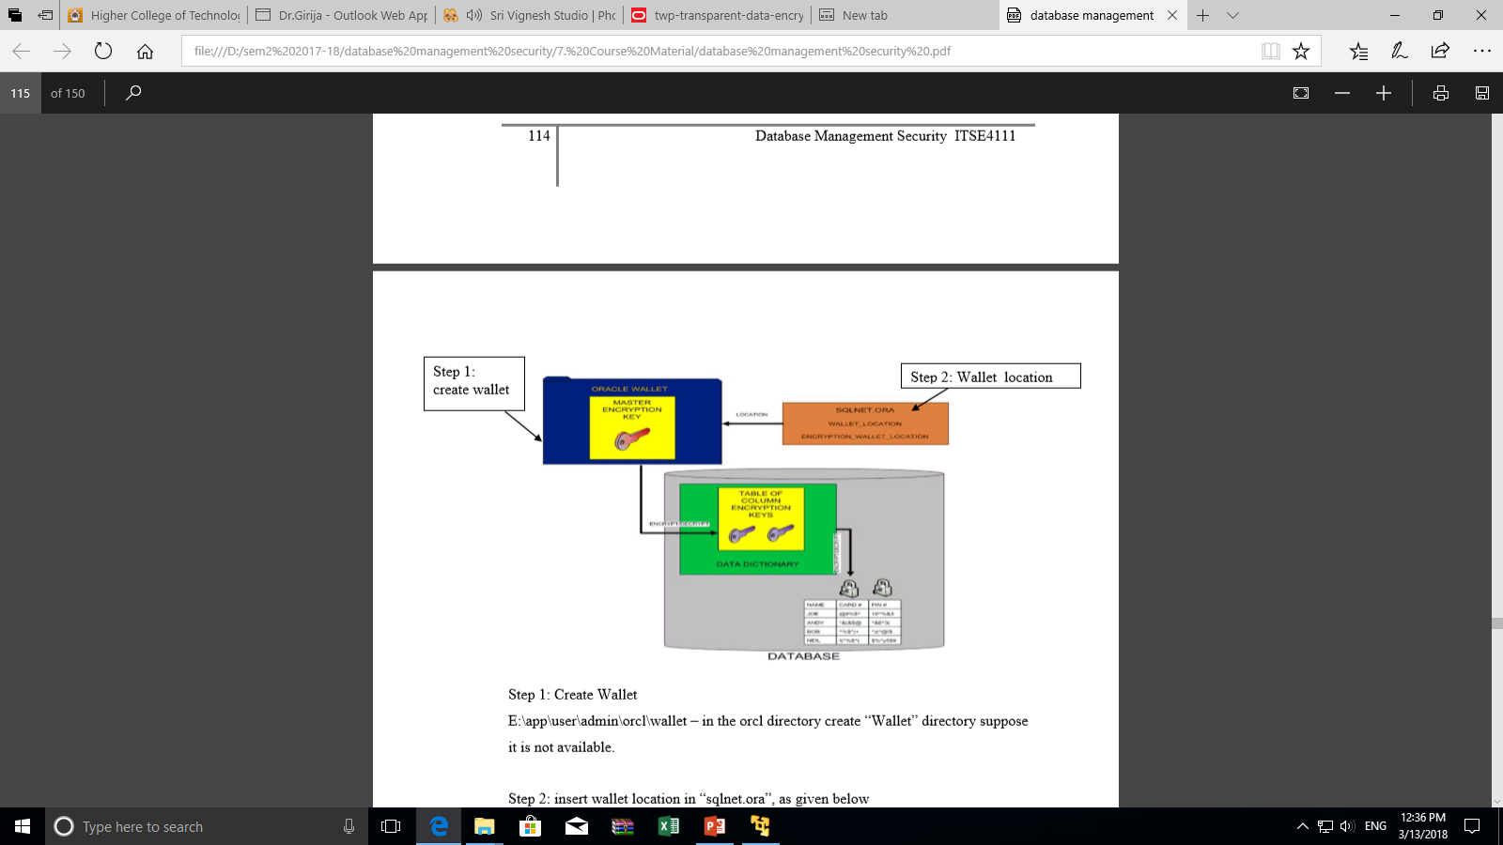

Slide 10
Create New Master key
To use transparent data encryption, it is needed ALTER SYSTEM privilege and a valid password to the Oracle wallet.
If an Oracle wallet does not exist, then a new one is created using the password specified in the SQL command.
To create a new master key and begin using transparent data encryption
ALTER SYSTEM SET ENCRYPTION KEY IDENTIFIED BY “password”;
ALTER SYSTEM SET ENCRYPTION KEY command is a DDL command requiring the ALTER SYSTEM privilege, and it automatically commits any pending transactions.

Slide 11
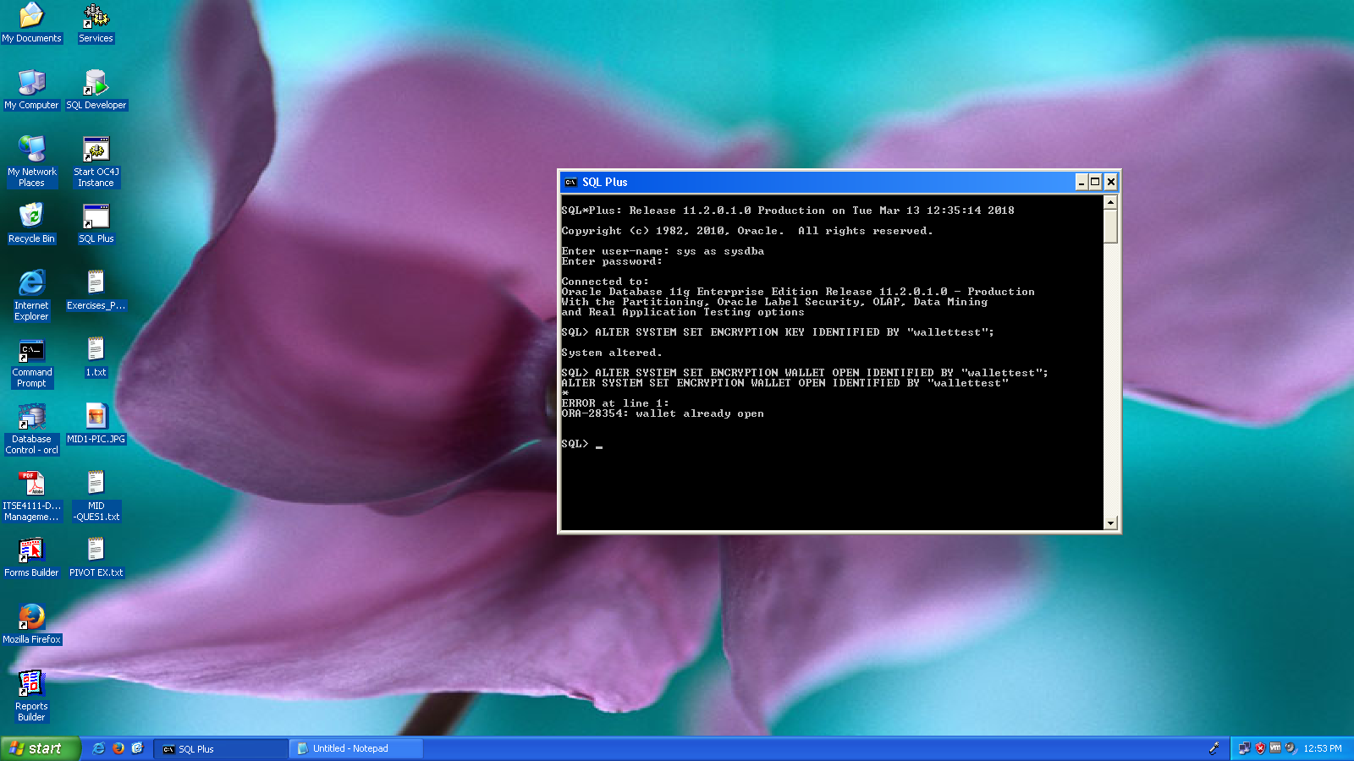

Slide 12
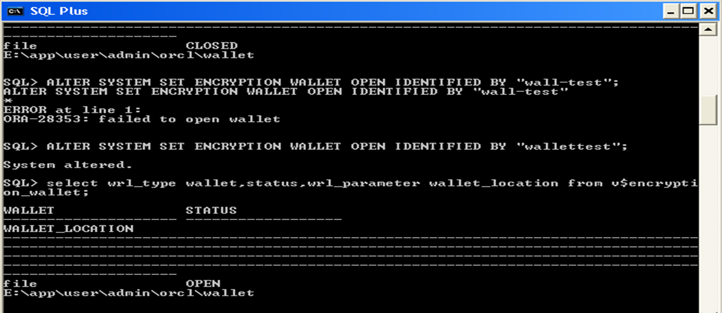
Open the Wallet
Alter system set encryption wallet open identified by "wallettest";
Once the wallet has been opened, it remains open until you shut down the database instance
or
close it explicitly by issuing an ALTER SYSTEM SET ENCRYPTION WALLET CLOSE command.
When you restart the instance, you must issue the ALTER SYSTEM SET ENCRYPTION WALLET OPEN command again.
Status of the Wallet
select wrl_type wallet,status,wrl_parameter wallet_location from v$encryption_wallet;

Slide 13
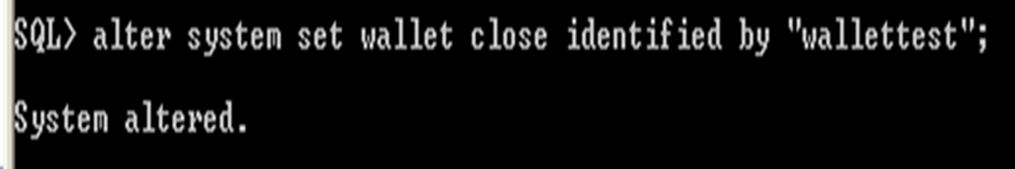
If the wallet is already open, the command returns an error and takes no action
Close the Wallet
Close the wallet using the below given command
Alter system set encryption wallet close identified by "wallettest";

Slide 14
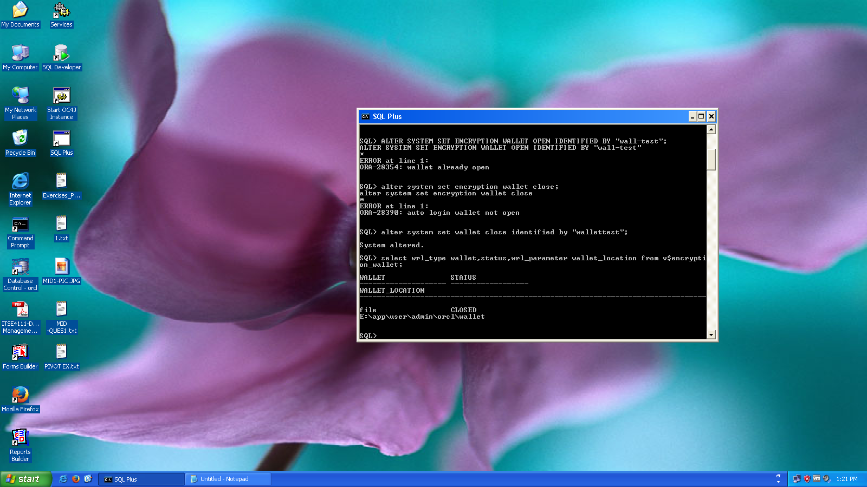

Slide 15
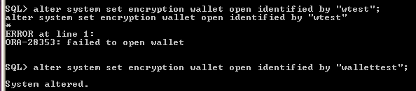
Incorrect password
If the schema does not have the ALTER SYSTEM privilege, or the wallet is unavailable, or an incorrect password is given, then the command returns an error and exits.
Instead of “wallettest” try with incorrect password “wtest”

Slide 16
Using Wallets with Automatic Login Enabled for Transparent Data Encryption
The external security module can use wallets with the automatic login feature enabled.
These wallets remain open all the time.
The security administrator does not have to reopen the wallet after a database instance has been restarted.
If your environment does not require the extra security provided by a wallet that must be explicitly opened for use, then you may use an auto login wallet.

Slide 17
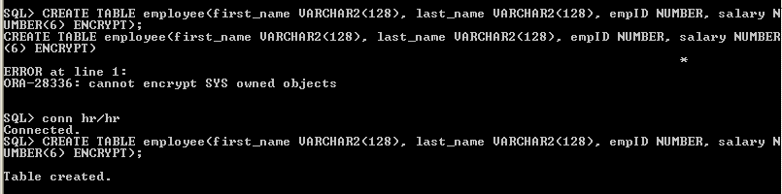
Creating a Table with an Encrypted Column
To create a new table with encrypted columns, use the CREATE TABLE command in the following form:
CREATE TABLE table_name ( column_name column_type ENCRYPT,....);
The ENCRYPT keyword against a column specifies that the column should be encrypted.
By default, transparent data encryption uses AES with a 192-bit length key (AES192).
CREATE TABLE employee
(first_name VARCHAR2(128),
last_name VARCHAR2(128),
empID NUMBER,
salary NUMBER(6) ENCRYPT );
Sys objects are not allow to encrypted.

Slide 19
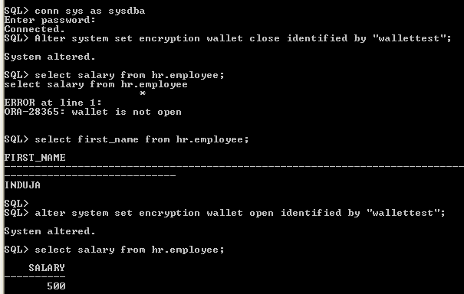
If wallet is open, then encrypted column will display.
If wallet is closed and select the encrypted column salary, it will not display the column , but other column (clear text) column same tables are displaying.

Slide 20
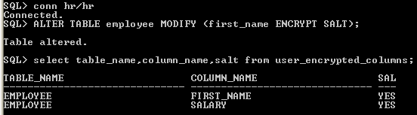
Salt
Salt is a way to strengthen the security of encrypted data.
It is a random string added to the data before it is encrypted, causing repetition of text in the clear to appear different when encrypted.
Salt thus removes one method attackers use to steal data, namely, matching patterns of encrypted text.
By default, transparent data encryption adds salt to clear text before encrypting it.
This makes it harder for attackers to steal the data through a brute force attack.
Adding Salt to an Encrypted Column
ALTER TABLE employee MODIFY (first_name ENCRYPT SALT);

Slide 21
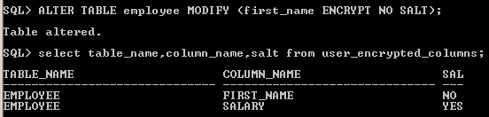
Display the salt and encrypted column details
select table_name,column_name,salt from user_encrypted_columns;
Removing Salt from an Encrypted Column
ALTER TABLE employee MODIFY (first_name ENCRYPT NO SALT);

Slide 22
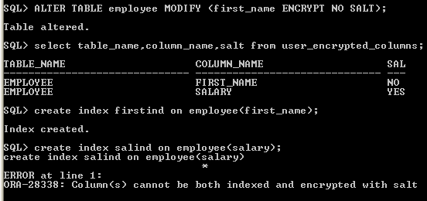
Encrypted Column Using No salt for Indexing
Index the encrypted column, must specify the NO SALT parameter with the SQL ENCRYPT clause
To remove salt from an encrypted column before indexing it,

Slide 23
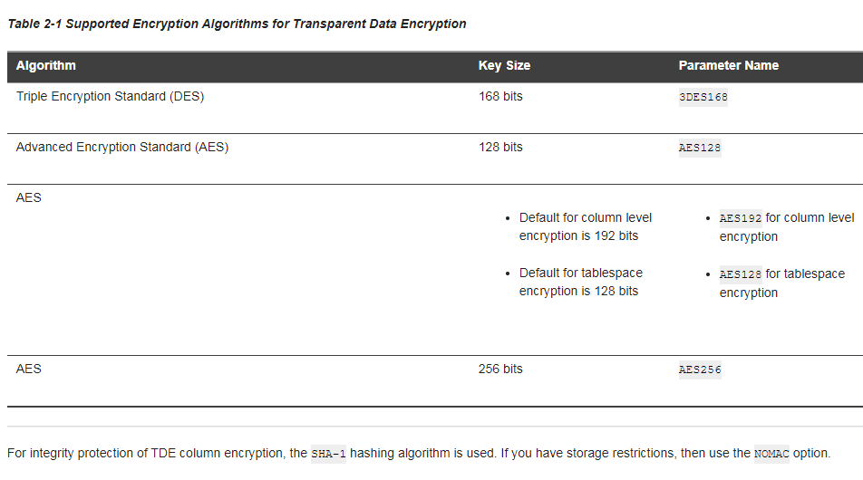
Encryption Algorithms for TDE
By default, transparent data encryption uses AES with a 192-bit length key (AES192). AES128 is default for tablespace.

Slide 24
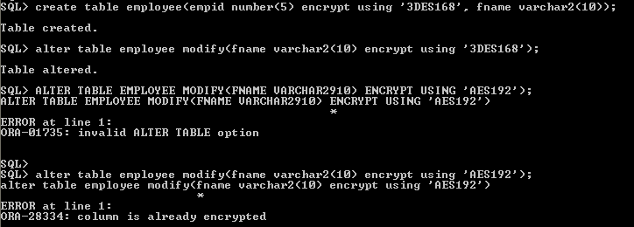
Change the different algorithm already encrypted column
Include other column also same algorithm then no problem, for example here fname also has same algorithm ‘3DES168’. if the column is already encrypted it is not possible to change the different algorithm

Slide 25
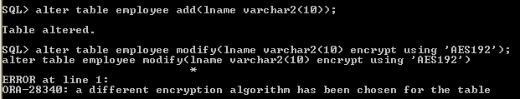
All encrypted column should be same Algorithm
In the table, all the column should be in the same algorithm

Slide 26
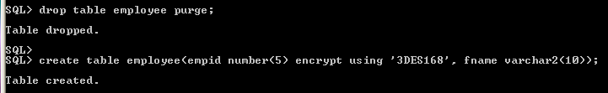
Table with an Encrypted Column Using 3DES168
create table employee(empid number(5) encrypt using '3DES168', fname varchar2(10));
It also possible to assign the syntax for specifying a different encryption algorithm.
The string which specifies the algorithm must be enclosed in single quotation marks.

Slide 27
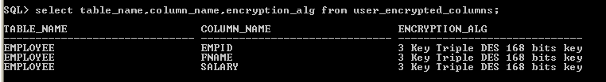
Display encrypted algorithm in the table

Slide 28
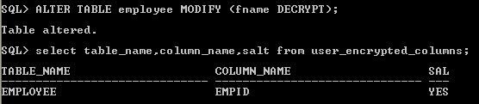
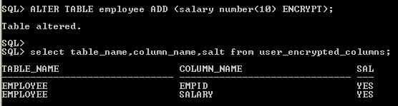
Disabling Encryption on a Column
It may be necessary to disable encryption for reasons of compatibility or performance.
To disable column encryption, use the ALTER TABLE MODIFY command with the DECRYPT clause
Adding Encrypted Columns to Existing Tables

Slide 29
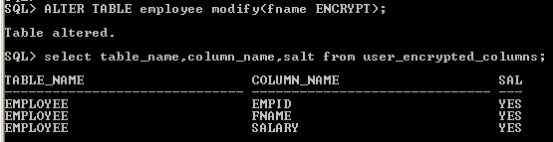
Encrypting Unencrypted Columns
To encrypt unencrypted columns, use the ALTER TABLE MODIFY command,
specifying the unencrypted column with the ENCRYPT clause

Slide 30
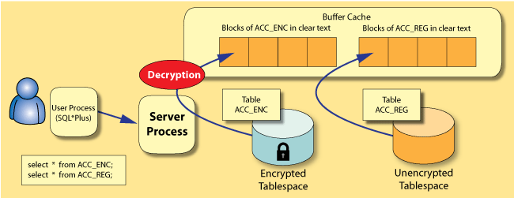
Figure 1: Loading of data buffers
Loading of data buffers

Slide 31
With tablespace encryption, before data buffers are written back to disk (as a result of the checkpoint process), they are encrypted by DB Writer processes (DBWn).
Operations, such as direct path inserts and reads that manipulate the data directly in the database, perform encryption inline.
When the log buffers are written to the redo logs by the log writer process, they are encrypted as well.
so the initial and subsequently archived redo logs contain only encrypted data.

Slide 32
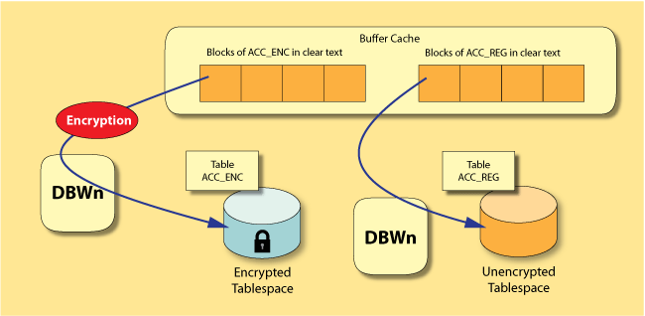
Flushing of buffers from cache to disk

Slide 33
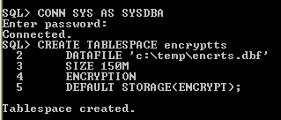
Create an Encrypted Tablespace
TDE tablespace encryption enables you to encrypt an entire tablespace.
All data stored in the tablespace is encrypted by default

Slide 34
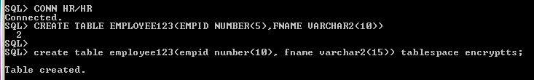
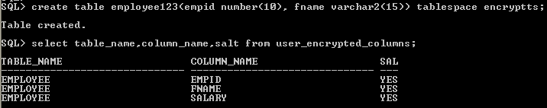
Create a Table in an Encrypted Tablespace
If we create a table in an encrypted tablespace, then all data in the table is stored in encrypted form on the disk

Slide 35
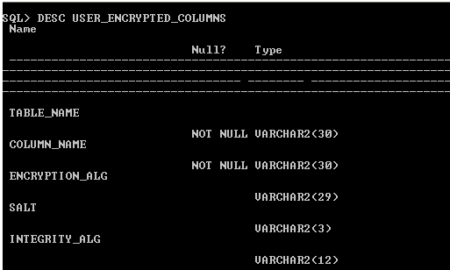

Slide 36
References
https://docs.oracle.com/cd/B19306_01/network.102/b14268/asotrans.htm#BABJJAIG
https://docs.oracle.com/cloud/latest/db121/ASOAG/asotrans.htm#ASOAG10136
http://www.oracle.com/technetwork/testcontent/o19tte-086996.html

