Slide 1
Database Security
https://www.oercommons.org/
OER- UNIT 4 Virtual Private Database
PART 1 – Row Level Security (RLS)

Slide 2
4.1 Introduction
The Virtual Private Database (VPD) is introduced in oracle 8i version.
This is special feature which will control the database access. The purpose of VPD is whenever object privilege and role is not sufficient to fulfill the requirement of the user security then VPD policy control the access.
In the VPD policy includes SELECT, INSERT, UPDATE, DELETE, INDEX statement.
It controls user directly or indirectly accessing any schema objects such as views, tables or synonyms in the database.
Using Predicate to the view it will restrict the user to access the row, it is called Row Level security as RLS.
The package name DBMS_RLS will support for implementing this feature.
VPD is not supporting TRUNCATE OR ALTER statement i.e Data Definition Language statement.
It is using Application context feature to control the user transaction views in the database.

Slide 3
4.2 Components of an Oracle Virtual Private Database Policy
There is two components, first to create function and then create policy.
For Creating a Function to generate the Dynamic WHERE Clause (predicate).
Using predicate define the restriction to apply for the policy.
The function generally created in administration own schema. (i.e. SYS).

Slide 4
4.2.1. Create Function
CREATE TABLE USER1(USERID NUMBER(4) PRIMARY KEY,USERNAME VARCHAR2(15));
INSERT INTO USER1 VALUES(11,'ARVIND');
INSERT INTO USER1 VALUES(12,'SINDUJA');
INSERT INTO USER1 VALUES(13,'RAJU');
CREATE TABLE PROJECT(USERID NUMBER(4),PROJECT_NAME VARCHAR2(20),NO_OF_HOURS NUMBER(3));
INSERT INTO PROJECT VALUES(11,'MOBILE APPLICATION',30);
INSERT INTO PROJECT VALUES(11,'ONLINE SHOPPING',40);
INSERT INTO PROJECT VALUES(12,'HR APPLICATION',25);
INSERT INTO PROJECT VALUES(12,'TELE BUY',35);
Commit;
Before creating function create two tables in HR schema USER1 and PROJECT.

Slide 5
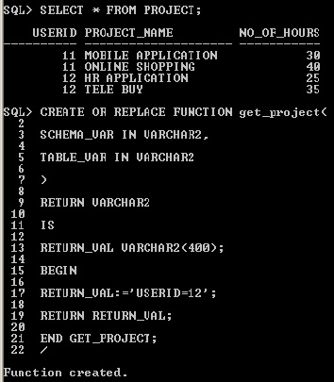

Slide 6
The function must have the following behavior
1) It must take as arguments a schema name and an object (table, view, or synonym) name as inputs.
Define input parameters to hold this information, but do not specify the schema and object name themselves within the function. The policy that you create with the DBMS_RLS package. You must create the parameter for the schema first, followed by the parameter for the object.
2) It must provide a return value for the WHERE clause predicate that will be generated.
The return value for the WHERE clause is always a VARCHAR2 data type.
3) It must generate a valid WHERE clause., in that its WHERE clause is the same for all users who log on.
But in most cases, you may want to design the WHERE clause to be different for each user, each group of users, or each application that accesses the objects you want to protect. For example, if a manager logs in, the WHERE clause can be specific to the rights of that particular manager. You can do this by incorporating an application context, which accesses user session information, into the WHERE clause generation code.
4) It must not select from a table within the associated policy function.
Although you can define a policy against a table, you cannot select that table from within the policy that was defined against the table.

Slide 7
4.3 Creating a Policy to Attach the Function to the Objects
Creating a Policy to Attach the Function to the Objects You Want to Protect object.
To attach a policy to a table, view, or synonym, you use the DBMS_RLS.ADD_POLICY procedure.
You need to specify the table, view, or synonym to which you are adding a policy, and a name for the policy.
You can also specify other information, such as the types of statements the policy controls (SELECT, INSERT, UPDATE, DELETE, CREATE INDEX, or ALTER INDEX).
You can enforce Oracle Virtual Private Database policies for SELECT, INSERT, UPDATE, INDEX, and DELETE statements.
If you do not specify a statement type, by default, Oracle Database specifies SELECT, INSERT, UPDATE, and DELETE but not Index.
Enter any combination of these statement types by using the statement_types parameter in the DBMS_RLS.ADD_POLICY procedure.
Enclose the list in a pair of single quotation marks.
In the Virtual Private Database policy, you must ensure that the statement_types parameter includes all three of the INSERT, UPDATE, and DELETE statements for the policy to succeed.
Alternatively, you can omit the statement_types parameter.
You can enforce Oracle Virtual Private Database policies on index maintenance operations by specifying INDEX with the statement_types parameter.

Slide 8
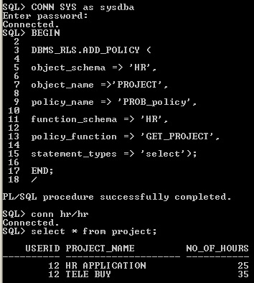
After creating policy, login HR schema using PROJECT table, it will show only USERID 12 records i.e 2 rows only.
It don‘t show all the records in the PROJECT table, once you policy is attach with the function RETURN_VAL:='USERID=12' this predicate WHERE condition is applied to the table.
That is a reason it is showing only user 12 values.

Slide 9
4.4 Drop Function
For deleting the function, write drop function statement
DROP FUNCTION <FUNCTION_NAME>
DROP FUNCTION GET_PROJECT;
4.5 Drop Policy
EXEC DBMS_RLS.DROP_POLICY ('schema name', 'object name', 'policy name');
EXEC DBMS_RLS.DROP_POLICY ('HR', 'PROJECT', 'PROB_project');
For example
HR-→schema name
PROJECT→object name
PROB_project → policy name
All parameter should be enclosed by signal quotes.

Slide 10
Database Security
https://www.oercommons.org/
OER- UNIT 4 Virtual Private Database
PART 2 – Column Masking

Slide 11
4.6 Column Masking
Set up a policy for each set of columns that has a different rule not for each user, for each set of columns.
The following considerations apply to column-masking:
* Column-masking applies only to SELECT statements.
* Column-masking conditions generated by the policy function must be simple Boolean expressions, unlike regular Oracle Virtual Private Database predicates.
* For applications that perform calculations, or do not expect NULL values, use standard column-level Oracle Virtual Private Database, specifying SEC_RELEVANT_COLS rather than the SEC_RELEVANT_COLS_OPT column-masking option.
* Do not include columns of the object data type (including the XMLtype) in the sec_relevant_cols setting. This column type is not supported for the sec_relevant_cols setting.
* Column-masking used with UPDATE AS SELECT updates only the columns that users are allowed to see.

Slide 12
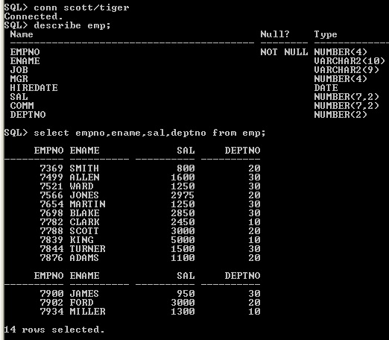
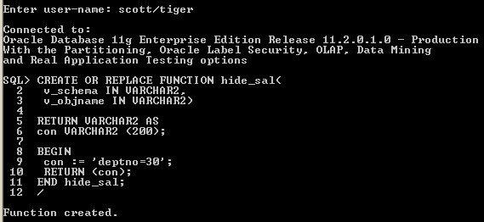

Slide 13
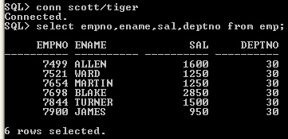
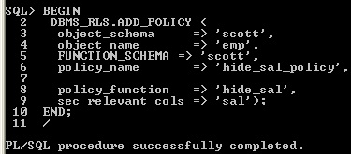
Column-level policies enforce row-level security when a query references a security-relevant column.
You can apply a column-level Oracle Virtual Private Database policy to tables and views, but not to synonyms.
To apply the policy to a column, specify the security-relevant column by using the SEC_RELEVANT_COLS parameter of the DBMS_RLS.ADD_POLICY procedure.
This parameter applies the security policy whenever the column is referenced, explicitly or implicitly, in a query.

Slide 14
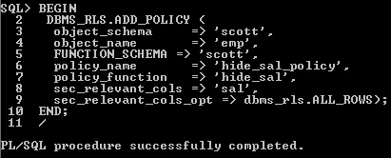
With column-masking behavior, all rows display, even those that reference sensitive columns.
The sensitive columns display as NULL values. To enable column-masking, set the SEC_RELEVANT_COLS_opt parameter of the DBMS_RLS.ADD_POLICY procedure.

Slide 15
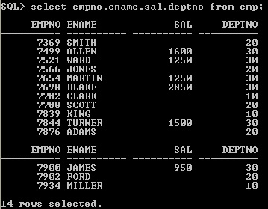
For some queries, column-masking may prevent some rows from displaying.
Because the column-masking option was set, this query may not return rows if the salary column returns a NULL value.
This example deptno 20,10 values sal column values are NULL

Slide 16
Database Security
https://www.oercommons.org/
OER- UNIT 4 Virtual Private Database
PART 3 – Application Context

Slide 17
4.7 SYS_CONTEXT
The following statement returns the name of the user who logged onto the database:
CONNECT OE/OE
SELECT SYS_CONTEXT ('USERENV', 'SESSION_USER') FROM DUAL;
SYS_CONTEXT ('USERENV', 'SESSION_USER')
------------------------------------------------------
OE
SELECT SYS_CONTEXT ('<name_space>','<parameter>', <length>) from DUAL;
SYS_CONTEXT function returns the value of parameter associated with the context namespace.
This function can be used in both SQL and PL/SQL statements. Context namespaces are always stored in the schema SYS .
If you omit schema , then Oracle Database uses the current schema. package.
To create a context namespace, you must have CREATE ANY CONTEXT system privilege.
The parameter name can be any string. It is not case sensitive, but it cannot exceed 30 bytes in length. Oracle provides a built-in namespace called USERENV, which describes the current session.

Slide 18
4.8 Oracle Virtual Private Database Policy Types
Policy types control how Oracle Database caches Oracle Virtual Private Database policy predicates.
Setting a policy type for your policies, because the execution of policy functions can use a significant amount of system resources.
Minimizing the number of times that a policy function can run optimizes database performance.
You can choose from five policy types: DYNAMIC, STATIC, SHARED_STATIC, CONTEXT_SENSITIVE, and SHARED_CONTEXT_SENSITIVE.
To specify the policy type, set the policy_ type parameter of the DBMS_RLS.ADD POLICY procedure.

Slide 19
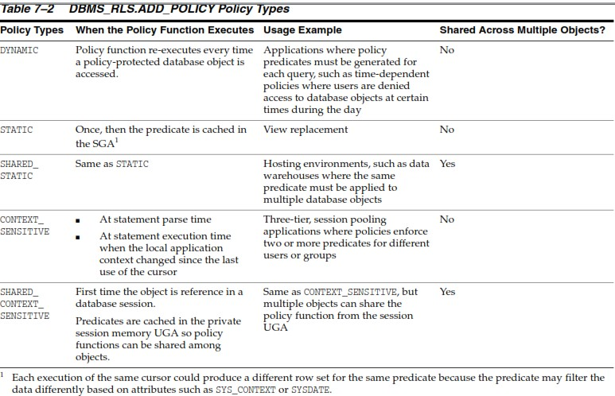

Slide 20
4.9 Application Context
Application context helps you apply fine-grained access control because you can link function-based security policies with applications.
Oracle provides a built-in application context namespace, USERENV, which provides access to predefined attributes.
These attributes are session primitives which is information that the database automatically captures about a user session.
For example, the IP address from which a user connects, the user name, and the proxy user name (in cases where a user connection is proxies through a middle tier), are all available as predefined attributes through the USERENV application context.
Such usage removes the repeated overhead of querying the database each time access to application attributes is needed.

Slide 21
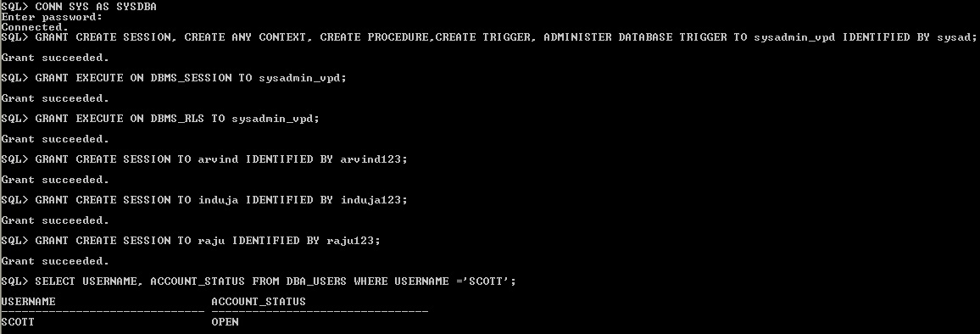

Slide 22
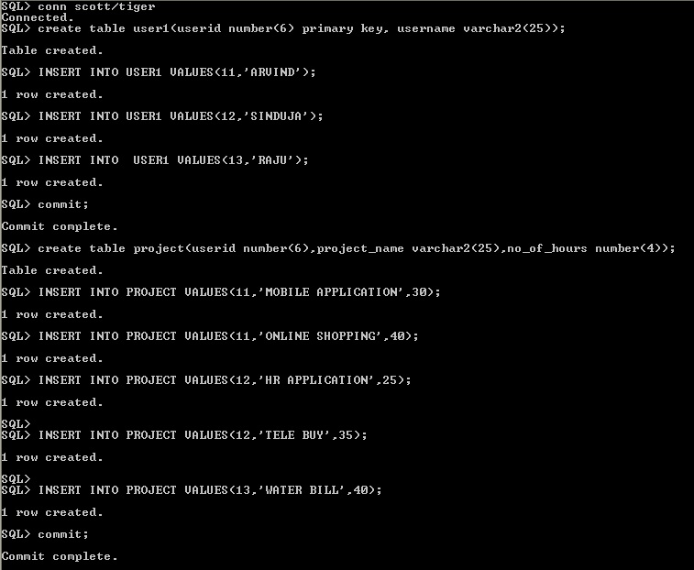

Slide 23
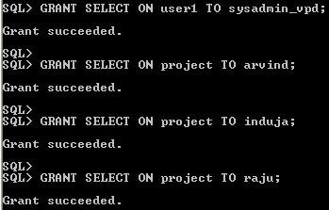

Slide 24
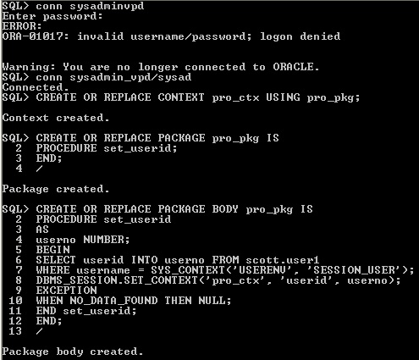
Line 4: userno variable hold the userid.
Line 6: SELECT statement to copy the userid information in the variable userno.
Line 7 : Uses a WHERE clause to find all the USERIDs that match the username of the user who is logging on. For example username of "ARVIND" userid 11 is matching.
Line 8: Sets the pro_ctx application context values by creating the userid attribute and then setting it to the value stored in the userno variable.
Line 10: Add a WHEN NO_DATA_FOUND system exception to catch any no data found errors that may result from the SELECT statement

Slide 25
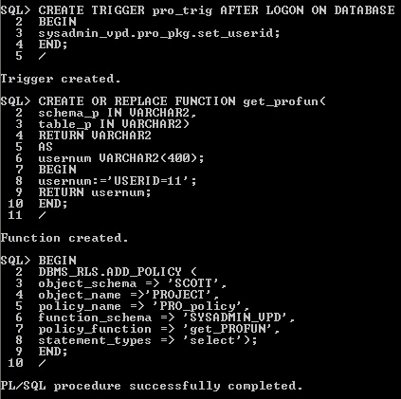

Slide 27
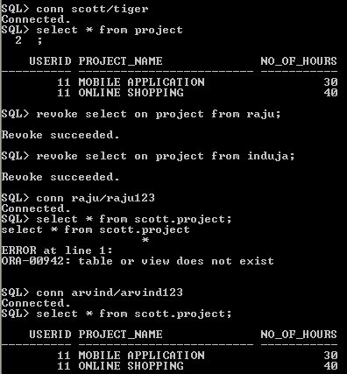

Slide 28
