Slide 1
Database Security
https://www.oercommons.org/authoring/21663-database-security
OER- UNIT 3 Authorization
PART 1

Slide 2
3.1 Authorization
The authorization gives permission to user to access database, modify the data or display the information.
It also controls user to access another user object schemas such as tables or rows or resources like connection, idle times.
There is two methods to grant privileges to user one is grant privileges to user explicitly and another method is grant privileges to a role.
And then grant role to one or group of users in the database.
The privileges are classified into two features as System privilege and Object Privilege.

Slide 3
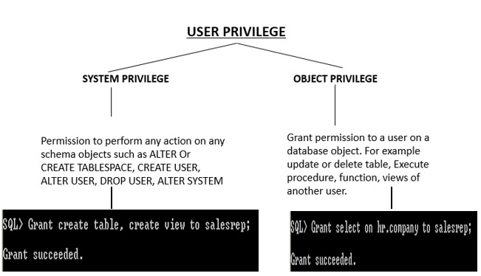

Slide 4
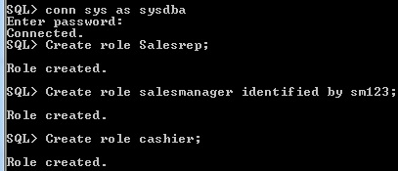
3.2 Role
In Oracle roles are created by database administrator.
The user privileges are grant permission to execute specific type of SQL statement or access another user’s database object.
The roles are storing group of privileges. The roles are assign to group of user or another roles. Roles can be created with or without password.
Assign password to a role will protect authorization in the database.
Using SET ROLE statement explicitly to role will enable the role.
For disabling the role, the user assign proper password to the role.

Slide 5
Within a database, each role name must be unique. we already created role salesrep, again create the role it will give error.
Role and User name should be unique, don’t have same name. Username arvind is exist in the database, role should be different than user name.

Slide 6
Database Security
https://www.oercommons.org/authoring/21663-database-security
OER- UNIT 3 Authorization
PART 2

Slide 7
3.3 Functionality of Roles
A role can be granted system or object privileges.
Any role can be granted to any database user.
Grant role to user
A role can be granted to other roles.

Slide 8
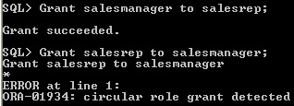
A role cannot be granted itself
A role cannot be circular
If a role is not password authenticated or a secure application role, then you can grant the role indirectly to the user. User Arvind has direct role salesrep and indirect role cashier.

Slide 9
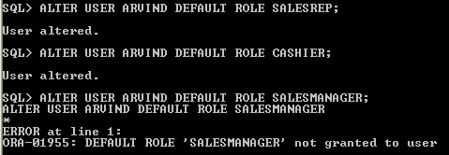
Assign directly or indirectly granted role as default role.
Before assign to user as default role, first you should grant role to user.
Here Cashier is indirect role and salesrep is direct role.
But Salesmanager is not grant to user arvind, if try to assign as default role then it will give error

Slide 10
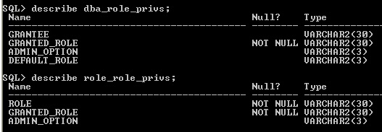
The data dictionary view DBA_ROLE_PRIVS -Lists roles granted to users and roles . The ROLE_ROLE_PRIVS -This view describes roles granted to other roles. Information is provided only about roles to which the user has access.

Slide 11
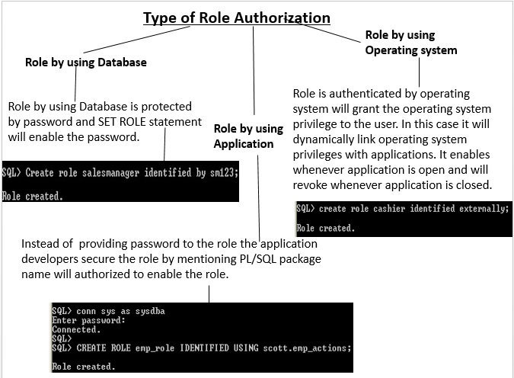

Slide 12
3.5 Change the authorization method
It is possible to shift from one type of authorization to another type of authorization.
For changing authorization the user has ALTER ANY ROLE system privilege or the user has ADMIN privilege.

Slide 13
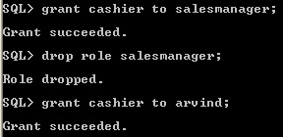
3.6 Drop Role
For dropping role the user should have DROP ANY ROLE system privilege or ADMIN option.
The dropping role has indirectly granted role, all the granted roles also be removed from dropping role.
Only privileges are removed, but indirect role is available in the database.

Slide 14
Database Security
https://www.oercommons.org/authoring/21663-database-security
OER- UNIT 3 Authorization
PART 3

Slide 15
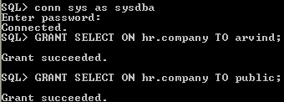
3.7 Authorization of Object privilege
The schema object are table, views, indexes, triggers and database links, dimension, materialized view etc.,
For accessing another user schema object the user need object privilege it will granted through role for user or group of users.
Every user by default has all object privileges for his/her own Schema containing objects.

Slide 16
The object privileges can be grant specifically or all the object privilege assign to user using ALL privilege, it will assign privilege select, update, debug, flashback, query rewrite, on commit refresh and delete, references etc.,

Slide 17
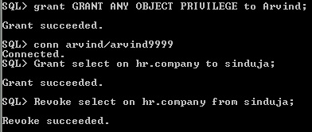
If user has GRANT ANY OBJECT PRIVILEGE , then the user can grant any specified object privilege to another user.
Using GRANT statement with or without GRANT OPTION the privilege to assign to user.
If user has GRANT ANY OBJECT PRIVILEGE by default the user has to revoke any object privilege that was granted by the owner of the object.

Slide 18
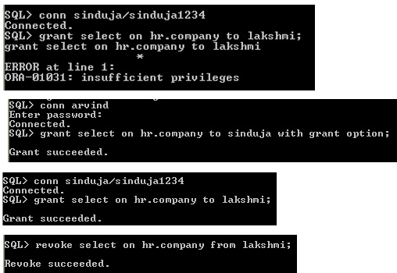
Without GRANT option means the user is having GRANT ANY OBJECT PRIVILEGE can’t pass any grant object privilege to other user, otherwise it will show ORA-01031 error.
SQL> grant insert on hr.company to lakshmi;
grant insert on hr.company to lakshmi
*
ERROR at line 1:
ORA-01031: insufficient privileges

Slide 19
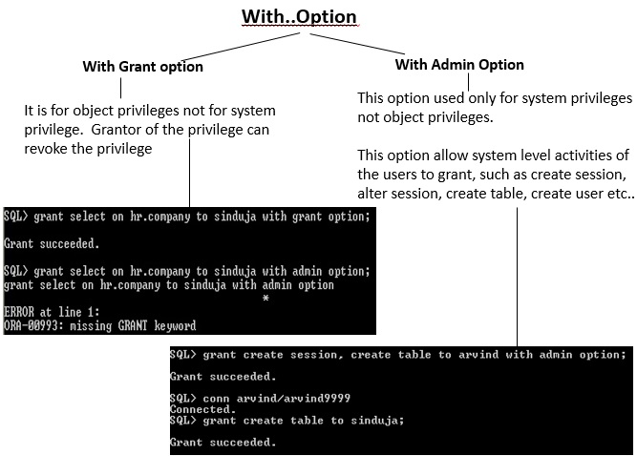
3.8 With GRANT option Vs. with ADMIN option

Slide 20
Database Security
https://www.oercommons.org/authoring/21663-database-security
OER- UNIT 3 Authorization
PART 4

Slide 21
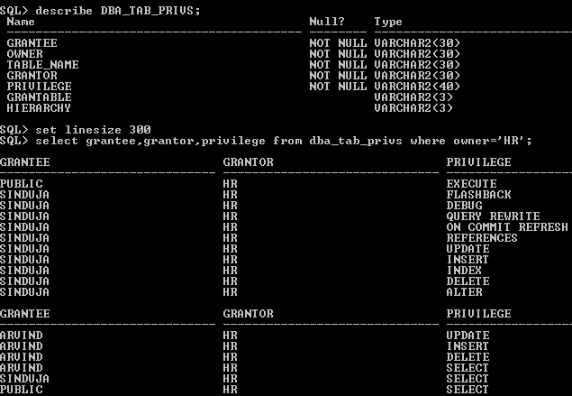
3.9 Data Dictionary view of DBA_TAB_PRIVS
DBA_TAB_PRIVS describes all object grants in the database. Object means tables, view, index, procedures and packages etc.,

Slide 22
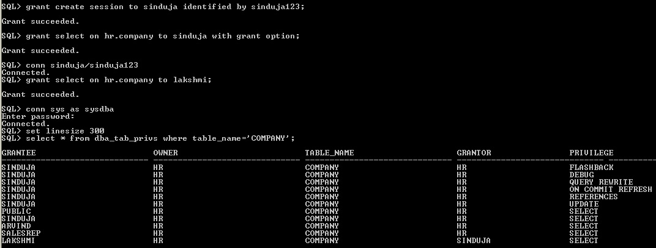
3.9.1 Grantor, Grantee and Owner
Owner - The owner of the object, in HR schema the table object COMPANY is created.
Grantor - The user who granted the privilege , the grantor is not owner of the object. The user Sinduja has Grant option privilege of HR.COMPANY.
Grantee- The Privilege is grantable by the grantee, Using grant option Sinduja grant privilege to Lakshmi then Lakshmi is Grantee and Sinduja is Grantor.

Slide 23
3.10 Granting Column Privileges
Using GRANT statement the user can apply INSERT, UPDATE and DELETE column privileges.
The ORA-00969 error will occur while grant SELECT privilege for column to the user.
Instead of SELECT privilege column, the user create VIEW for specific column of the schema object and then grant the view to the user.

Slide 24
Compview is created under "

Slide 25
Using REVOKE individually column privilege can't be revoked, revoke used only for object privilege not for column object privilege.
It display error ORA-01750. In this case revoke entire object and then grant only specific column.

Slide 26
The DBA_COL_PRIVS data dictionary view display the granted table column privilege information

Slide 27
The ROLE_ROLE_PRIVS data dictionary view display how many role granted to another role.

Slide 28
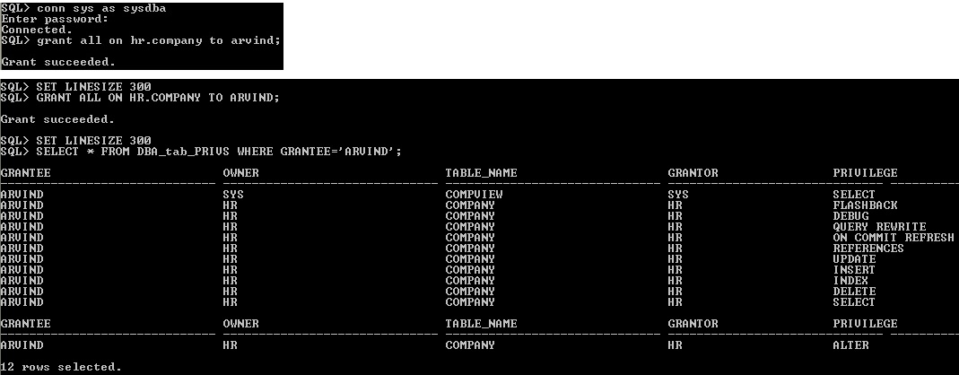
3.11 ALL Shortcut
"ALL" is a shortcut method to use single grant or revoke statement to assign privilege.

Slide 29
The REVOKE ALL privilege revoke only what all are the privilege given using GRANT ALL object privilege, it doesn't revoke already given specific privileges . still compview object privilege is available,

Slide 30
Database Security
https://www.oercommons.org/authoring/21663-database-security
OER- UNIT 3 Authorization
PART 5

Slide 31
3.12 SYNONYM Object Privilege
Crete synonym statement will create alternative name for schema objects like view, tables, sequences, procedures and packages etc.,
Like granting table object the synonym to be grant to user.
Here synonym is created in HR schema, even though synonym is granted to user ARVIND while selecting mention schema.object name HR.COMP_SYN

