Slide 1
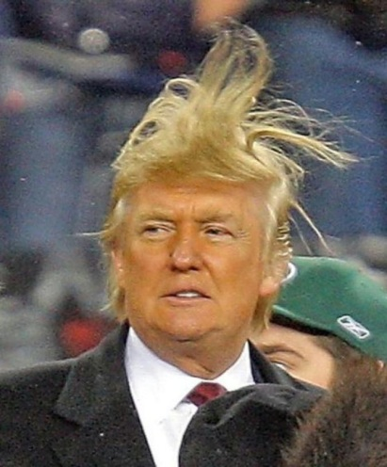
Percents and the Electoral College

Slide 2
What does this mean?
Define majority
Define popular vote
Define electoral vote
What is the Electoral College?
Who or what picks the President if there is an Electoral College tie or if no one receives a majority of the Electoral College vote?

Slide 3
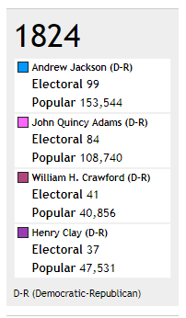
Election of 1824
What is the total number of the popular votes?
What is the total number of the electoral votes?
What number of electoral votes would give you a majority?
What percentage of the electoral vote does each candidate have?
What percentage of the popular vote does each candidate have?

Slide 4
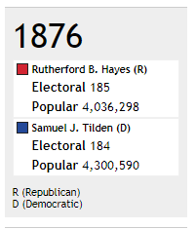
Election of 1876
What is the total number of the popular votes?
What is the total number of the electoral votes?
What number of electoral votes would give you a majority?
What percentage of the electoral vote does each candidate have?
What percentage of the popular vote does each candidate have?

Slide 5
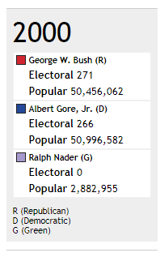
Election of 2000
What is the total number of the popular votes?
What is the total number of the electoral votes?
What number of electoral votes would give you a majority?
What percentage of the electoral vote does each candidate have?
What percentage of the popular vote does each candidate have?

Slide 6
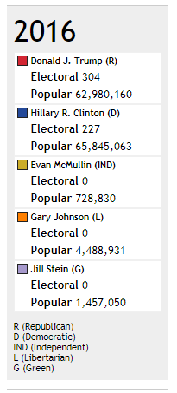
Election of 2016
What is the total number of the popular votes?
What is the total number of the electoral votes?
What number of electoral votes would give you a majority?
What percentage of the electoral vote does each candidate have?
What percentage of the popular vote does each candidate have?

