Slide 1
Tackling Basic Computer & Word-processing Skills
GED and Career Development
Instructor:

Slide 2
Objectives
To practice and demonstrate competency in applying basic computer and word-processing skills for GED testing.

Slide 3
What you will do in this lesson?
1. Observe and model the steps in opening a word-
processing application and existing documents and use
features within the document using a mouse and keyboard.
2. Follow a checklist to practice tasks.
3. Be observed and assessed in demonstrating the skills
utilizing a performance checklist.

Slide 4
Learning Outcomes
By the end of this lesson, you should be able to successfully:
open a new word-processing document and existing document
use a mouse and scroll bar within a document
use 3 basic functions of the Home Tab (copy & paste, cut & paste, undo/redo edits)
identify and use 5 basic Keyboard features(shift, delete, and , enter, backspace and spacebar)
demonstrate using the functions in writing and manipulating a short written text.

Slide 5
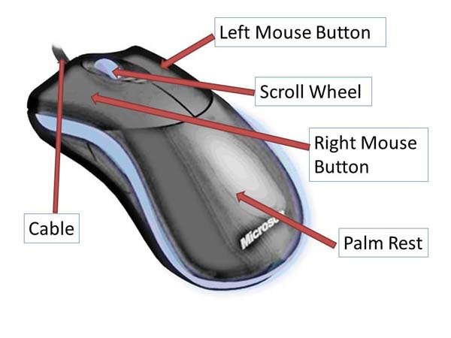
Mouse
The use of a wireless mouse is the norm for home users and the workplace (see next slide)

Slide 6
Wireless Mouse

Slide 7
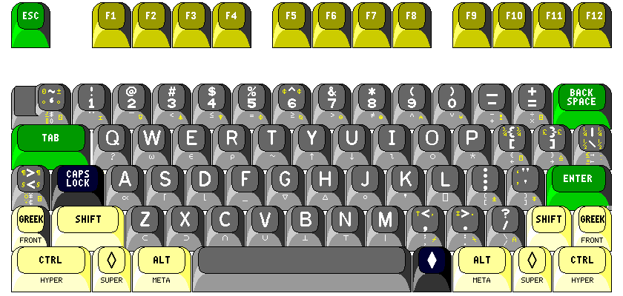
Keyboard

Slide 8
Intentionally Left Blank

