Slide 1
Homonyms, Homographs and Homophones

Slide 2
AIMS
By the end of this course you will have
Understood what homophones and homographs are
Learned to distinguish among common homophones and homographs when reading and writing
Realised why it is important to know common homophones and homographs

Slide 3
Requirements
This resource will take about an hour to complete, but this time varies based on your own speed. Feel free to spend as much time as you want.
You will also need the supplementary resources mentioned in this presentation. These will involve activities and answer sheets.
Click below to start the resource when you are ready.
START

Slide 4
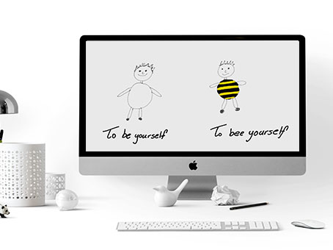
Can you help her understand?
Welcome to this course.
This is Tracey.
Tracey recently saw this picture on her computer and got confused.

Slide 5
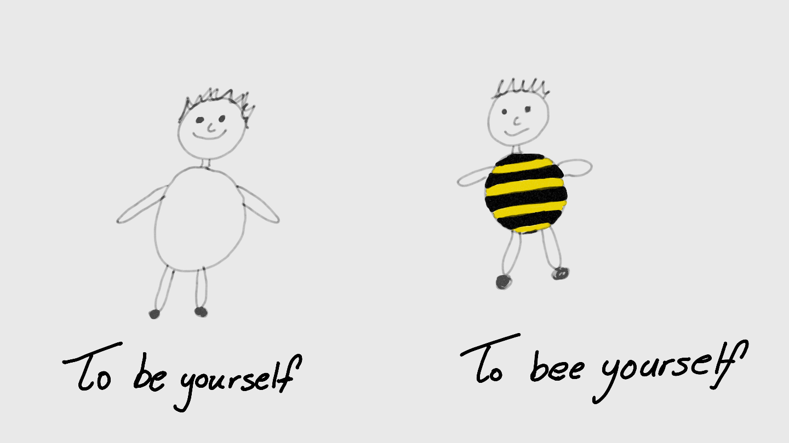
Take a moment to think about this picture.
Be and Bee are words that sound the same but mean something different. To be able to get jokes like that Tracey will need to know more about homophones and homographs.
Be = exist
Bee =

Slide 6
Why do I need to know homophones and homographs?
They are words that can be easily confused.
You need to know which one is which.
Right = Correct
Right = Direction

Slide 7
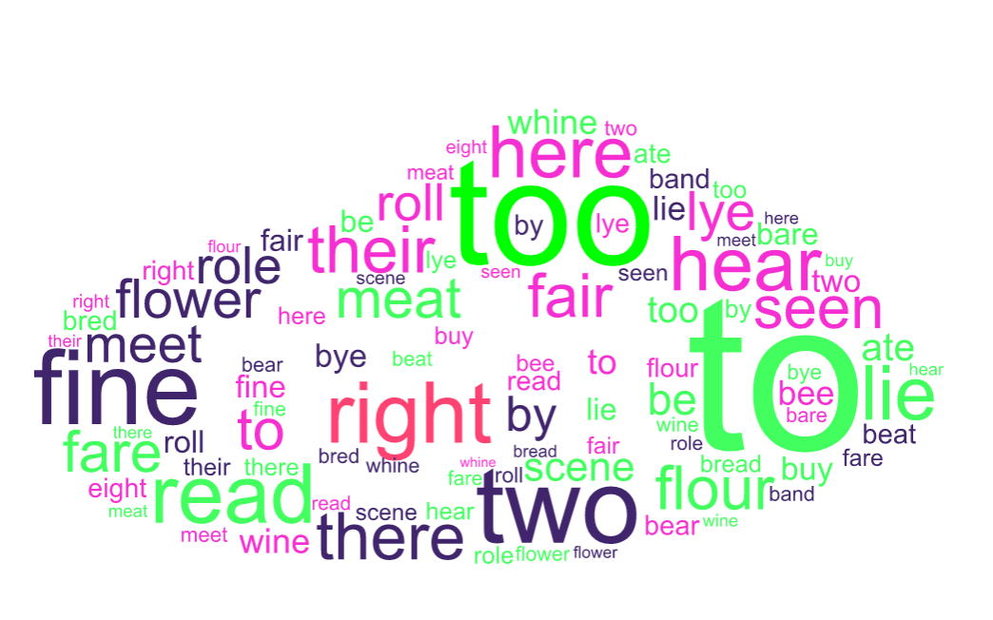
Why do I need to know homophones and homographs?
Some are high frequency words.
They appear very often in speech or writing.

Slide 8
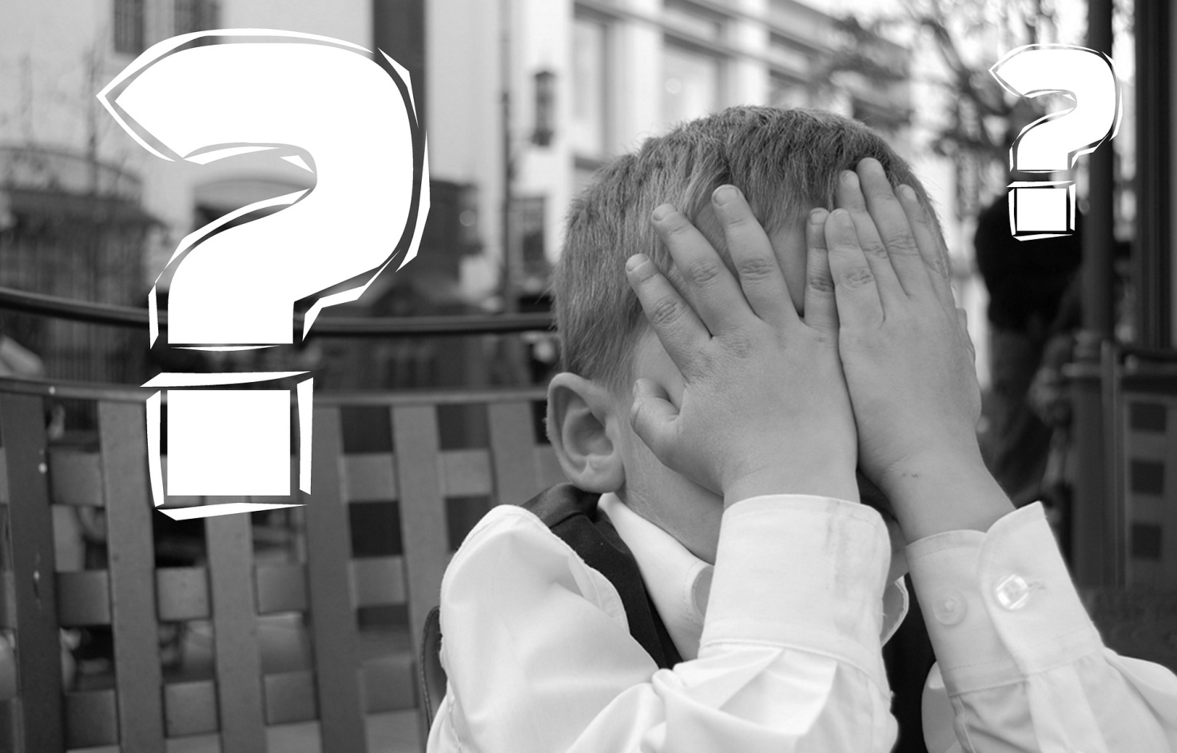
Why do I need to know homophones and homographs?
Failing to spell or recognise them can be embarrassing.
Especially if applying for a job opportunity.

Slide 9
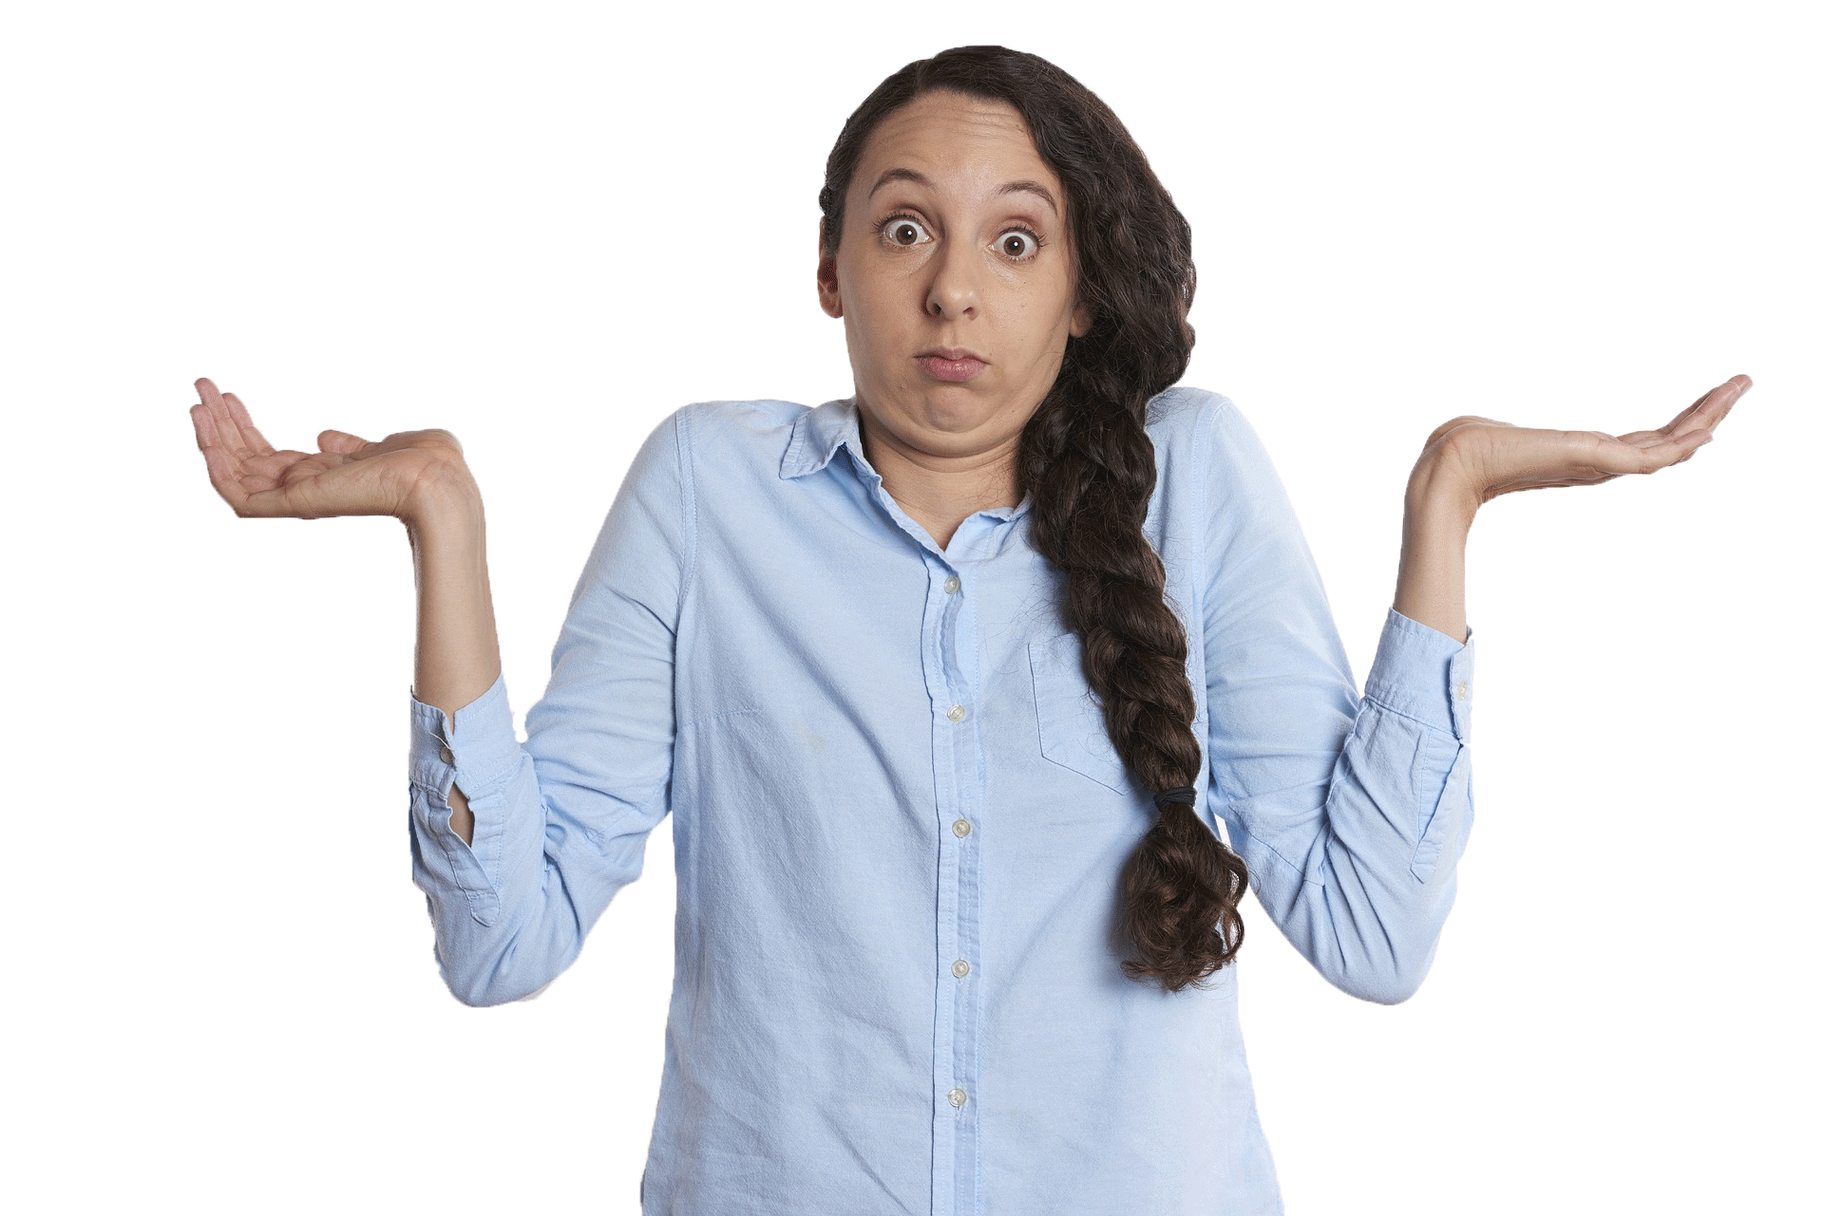
Why do I need to know homophones and homographs?
Failing to read them properly can be confusing.
And lead to the wrong outcomes.

Slide 10
Expectations from this course
At this point take a moment to think:
What do you know about homophones and homographs?
Why do you want to know more?
What will this learning help you with?
Use the Thinking Sheet resource for guidance.

Slide 11
Have you done your thinking?
If not then please go back and complete it
If you have completed it, then get ready to jump to the next stage.

Slide 13
Have a look at these…
I can see a cat on my car.
I am afraid of the sea and boats.
I ate an amazing burger yesterday.
I have eight more days of holiday until I go back to work.
What can you notice about these words?
Use the Homophones and Homographs Sheet to note your answers.

Slide 14
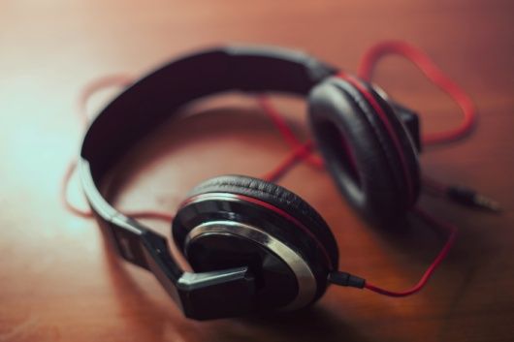
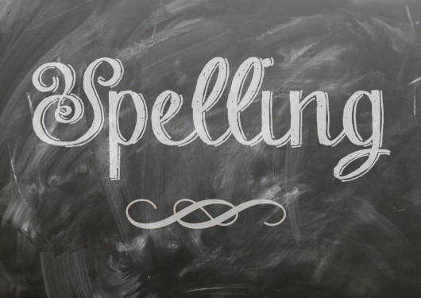
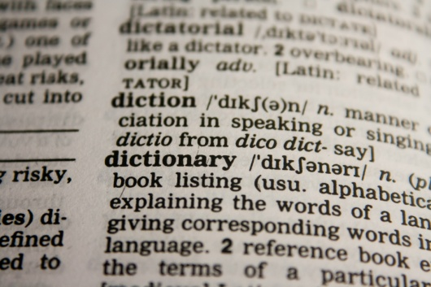
Homophones are…
Words that sound the same but have a different spelling and meaning.

Slide 15
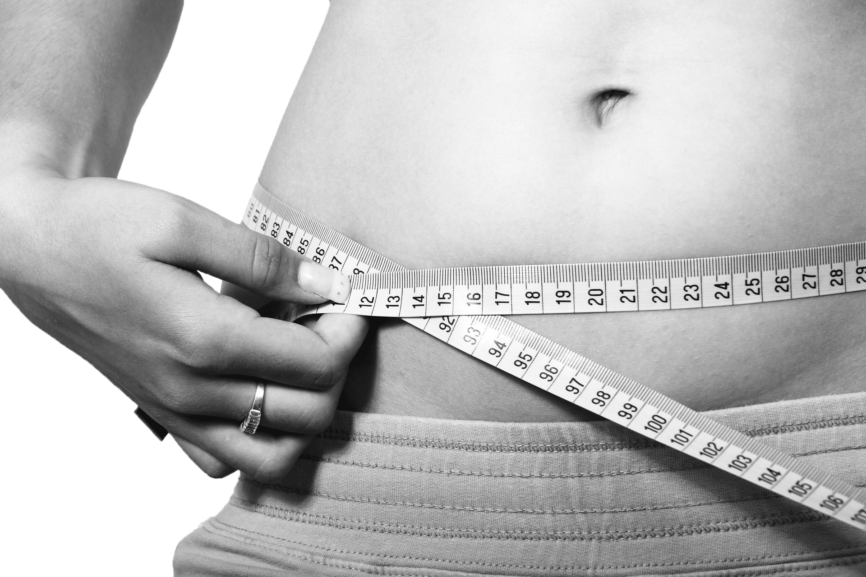
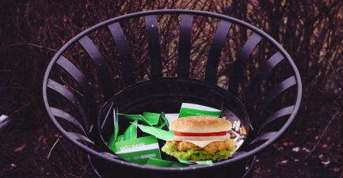
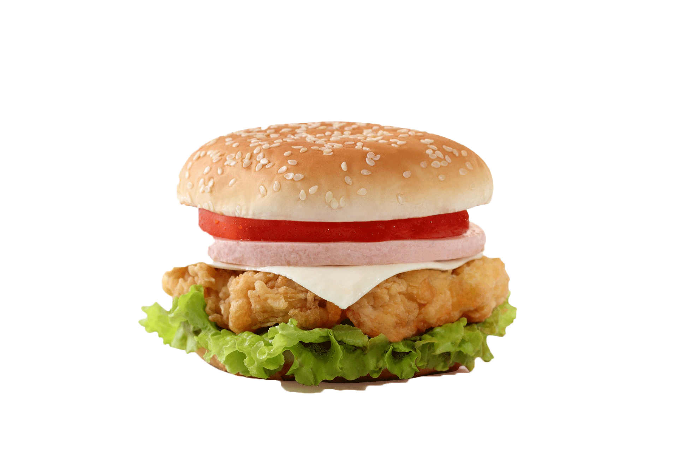
Some examples are…
Waste & Waist
Sally is so slim and has a very thin waist.
Don’t throw food in the bin, it’s a waste!

Slide 16
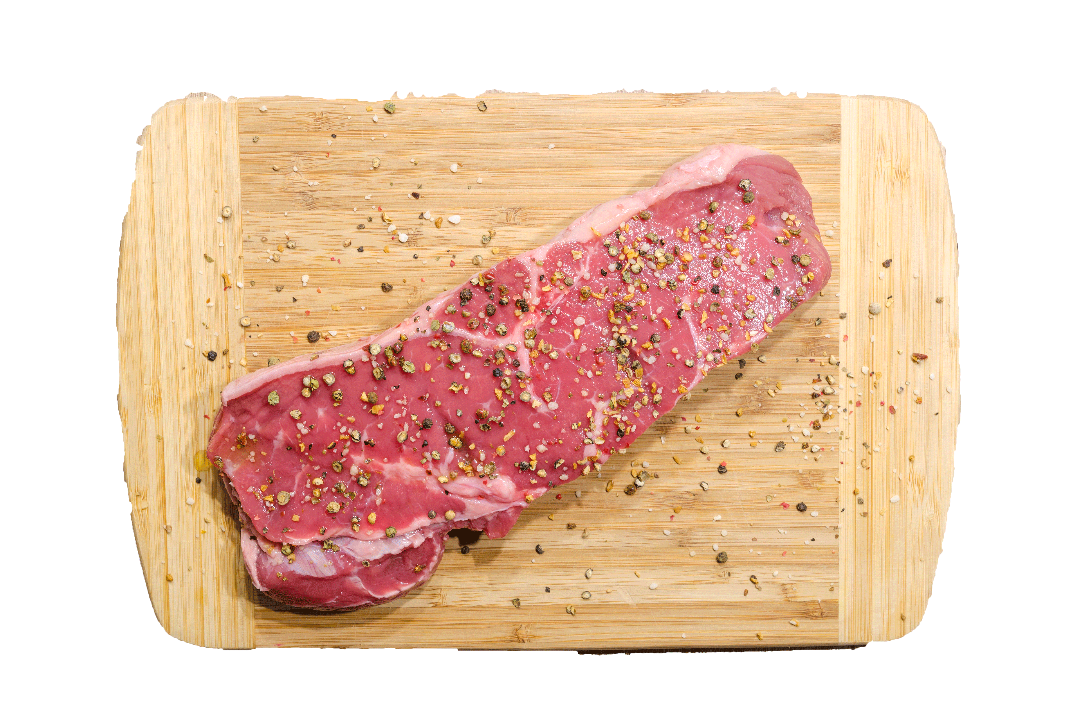
Some examples are…
Meat & Meet
I am a vegetarian. I don’t eat meat.
Nice to meet you!

Slide 17
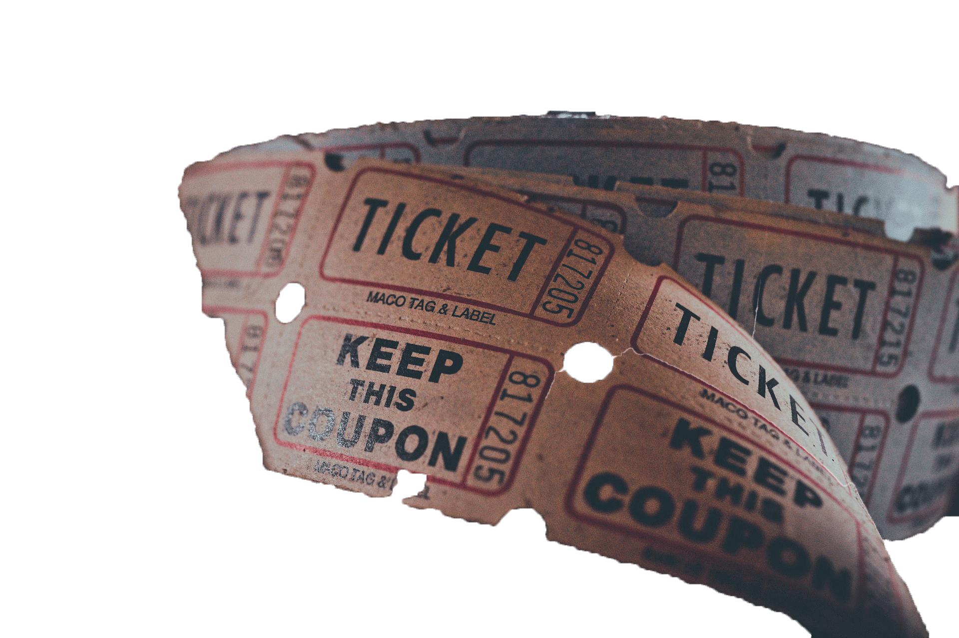
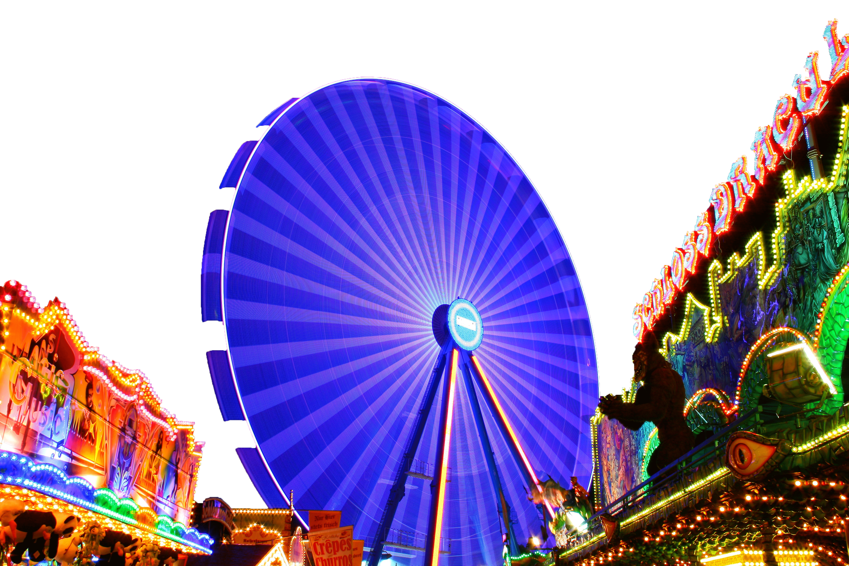
Some examples are…
Fare & Fair
I paid 5$ for my taxi fare.
I took my kids to the fair yesterday and we had lots of fun.

Slide 19
Homographs are…
Words that look the same but have a different meaning. They may or may not sound the same.

Slide 20
Have a look at these…
Ι saw a bat at the zoo yesterday.
I bought a new cricket bat.
Mary did not wear a seatbelt and got a fine.
Everything will be fine in the end.
What can you notice about these words?
Use the Homophones and Ηomographs Sheet to note your answers.

Slide 21
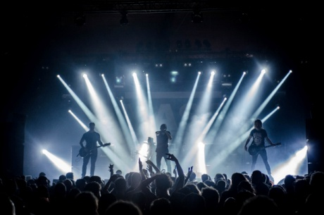
Some examples are…
Band
Linkin Park is my favourite band.
Sarah always wears a hair band.

Slide 22
Some examples are…
Right
Turn left and then right to find the exit.
UNICEF protects the rights of children in need.

Slide 23
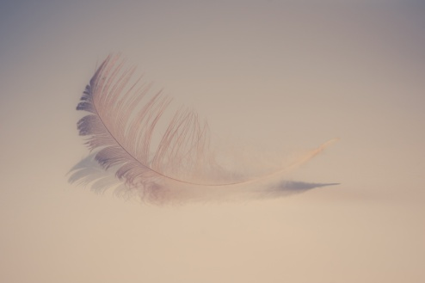
Some examples are…
Light
It’s so dark! Turn the light on!
Pack all the heavy stuff in the suitcase and keep the light ones for your backpack.

Slide 24
Time for a test…
Have a look at the following sets of words and decide whether they are homophones or homographs.
E.g. right & right → homograph
Use the Test Template to answer these and then check your answers using the Answer sheet.

Slide 25
Before you
Start.
Remember…

Slide 26
Homophones are…
Words that sound the same but have a different spelling and meaning.

Slide 27
Homographs are…
Words that look the same but have a different meaning. They may or may not sound the same.

Slide 28
Homophone or homograph?
Plain & Plane
Light & Light
Pole & Poll
Pair & Pear
Tear & Tear
Hare & Hair
Bear & Bare
Seen & Scene
Been & Bean
Beat & Beat Complete this using the Homophones or Homographs sheet (optional).

Slide 29
Now using a dictionary (if available) check the meaning of these words.
Check your answers using the Homophones or Homographs answer sheet.
Online dictionaries can be accessed from here.

Slide 30
Now use the words in the list below and group them into homograph and homophone categories. If you find this task hard, use a dictionary.
Use the Homophones and Homographs Sorting (optional).
Now check your answers using the Homophones or Homographs answer sheet.
By
Store
Lie
And
Row
Which
Air
display
Bye
End
Kind
Whole
Lye
Hole
Meat
Two
Water
Witch
Aunt
Bass
Evening
Minute
Bow
Fine
Meet
To
Ate
Heir
Wave
File
Ant
Eight

Slide 31
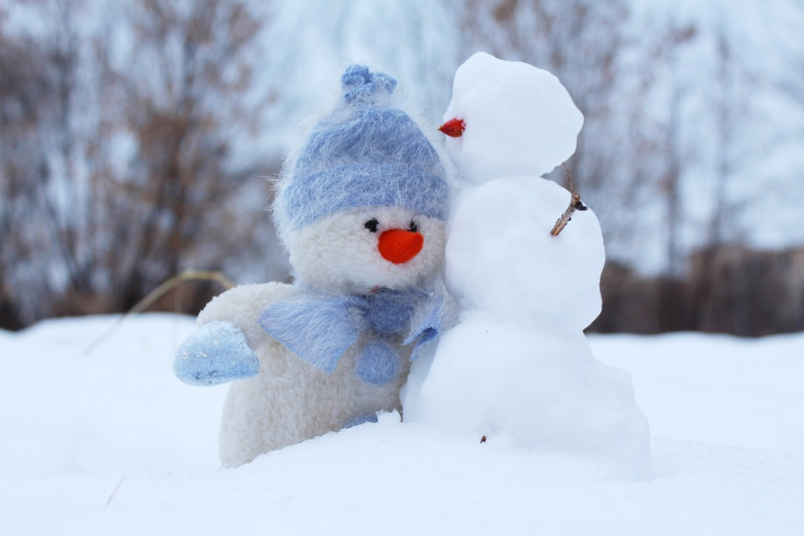
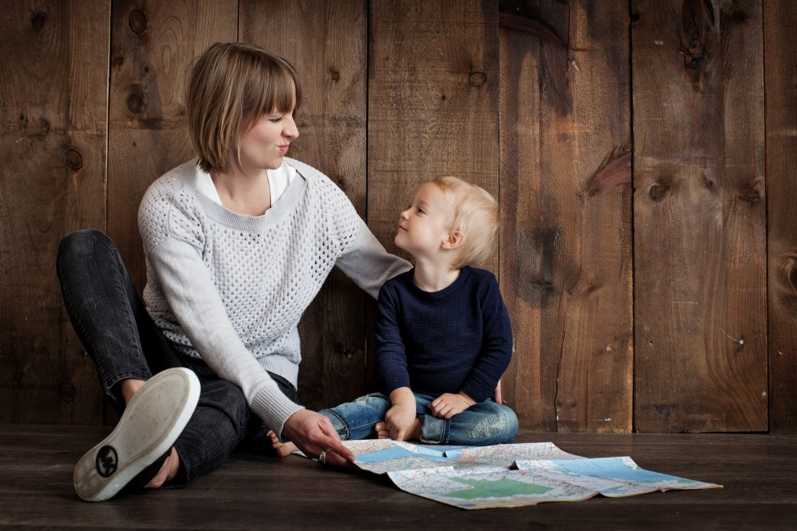
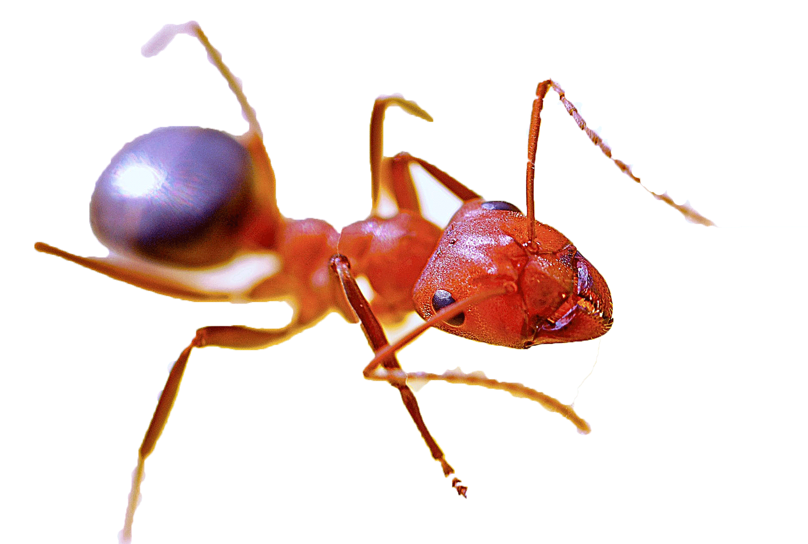
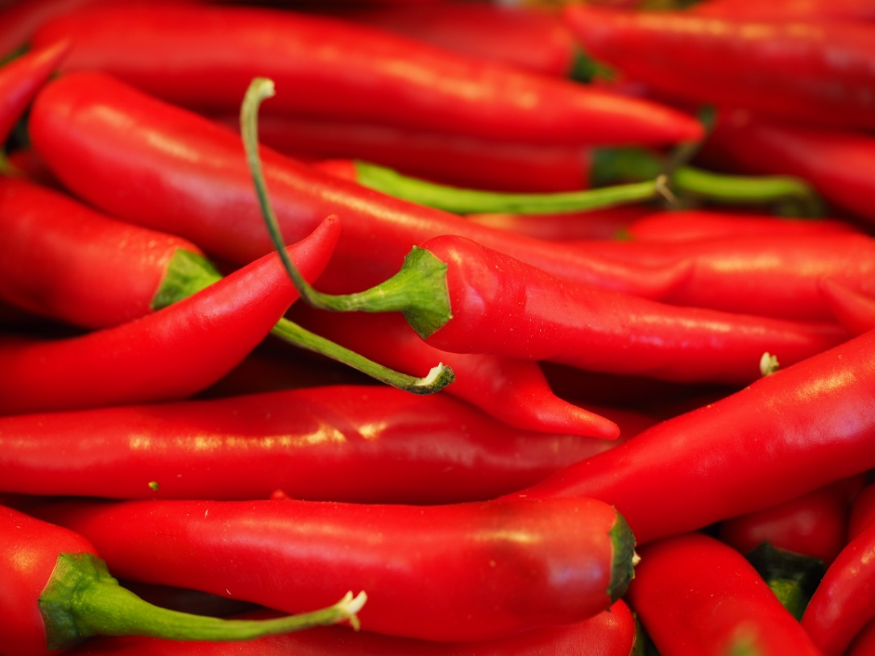
Now check your answers using the Write the Word Answer Sheet.
Look at the pictures and write the corresponding words in your Write the Word Sheet.

Slide 32
This is not the end.
That was only the beginning. There are a lot more words that look or sound the same. Make sure that when encountering them you pay attention and you remember them for future reference.

