Slide 1
LEVEL OF CARE PROTOCOL

Slide 2
WELCOME
&
HOUSEKEEPING
Notes:
.

Slide 3
Training Agenda
Introductions
Overview and Context
Level of Care Protocol Matrix Domains
Static Criteria
Scoring & Leveling Up
Feedback & Questions
County Discussions

Slide 4
Topics not Covered
The adequacy of the rate
State prescription regarding county processes

Slide 6
Overview and Context
Tool design
Not an assessment tool but is informed by standard domain found in many of them
Improve and standardize home-based family care (HBFC) rate structure
Align with CCR goals and meets legislative mandates
Shift from a behavioral deficit process to a determining the care, supervision, intensity and resources from a resource family perspective
Created using
Workgroup representatives from counties, advocates, probation, providers and other partners
Considered stakeholder input, other state models and other county specialized rate increments

Slide 7
Overview and Context (Cont’d)
Considers information gathered through CFT Meetings and team members
The voice of the family, parent/child/youth/NMD, MH assessment, and other assessment tools and resource family
Not intended for use during the CFT meeting
Standardized by categories based on services rendered in 5 domains
Supports consistent application of a rate structure
Strength-based approach, which supports a rate for caregivers
Shifts the relationship with the resource family

Slide 8
What Placements are Impacted? Any resource family providing a home-based family care
County foster homes
Foster Family Agency homes
Relative caregivers
Non-minor dependents
Medically fragile children/youth

Slide 9
Triggering Events
Initial Placement with a RF
FFA – Moving from Age-Based Rates
Other RF Placement Changes
Transition from STRTP
Requested Changes from RF
Transition from ISFC/TFC
Decreases in Rate

Slide 10
Level of Care Protocol
Protocol is comprised of a Matrix & Scoring Sheet used by case carrying Social Worker or Probation Officer
Developed to standardize expectations of RF and consider individualize care and supervision needs for youth/children

Slide 11
The 5 Level of Care Domains

Slide 12
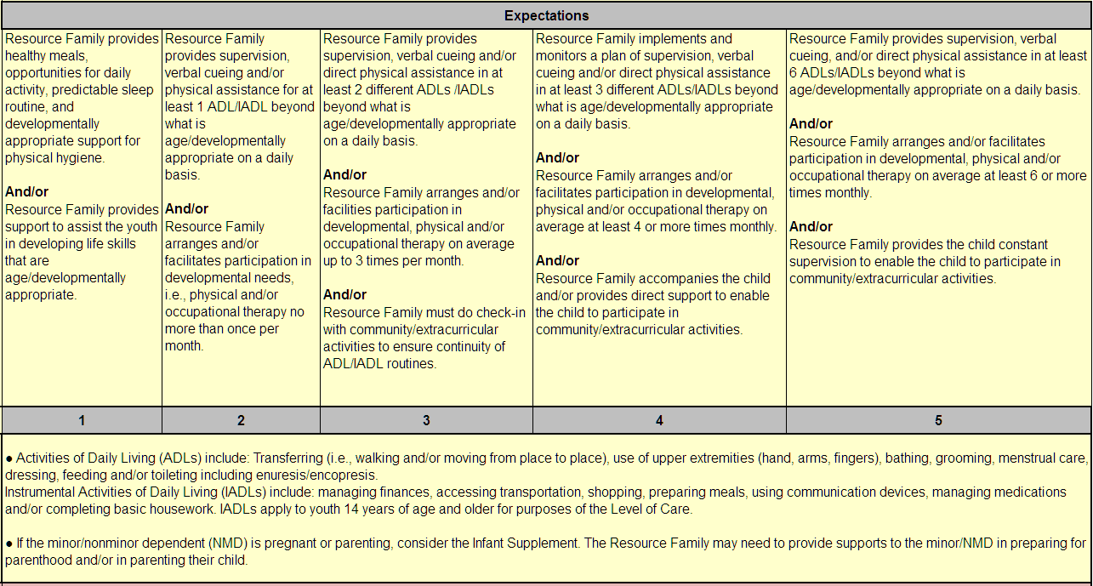
Physical Domain
Notes:
B

Slide 13
Physical Domain
Physical Domain is defined as actions in which the Resource Family must engage in or model daily living needs, such as eating, clothing, hygiene, community/social functioning, and extracurricular activities, including teaching age-appropriate life skills even when developmental delays are present. This does not include specific medical activities (see Health Domain).

Slide 14
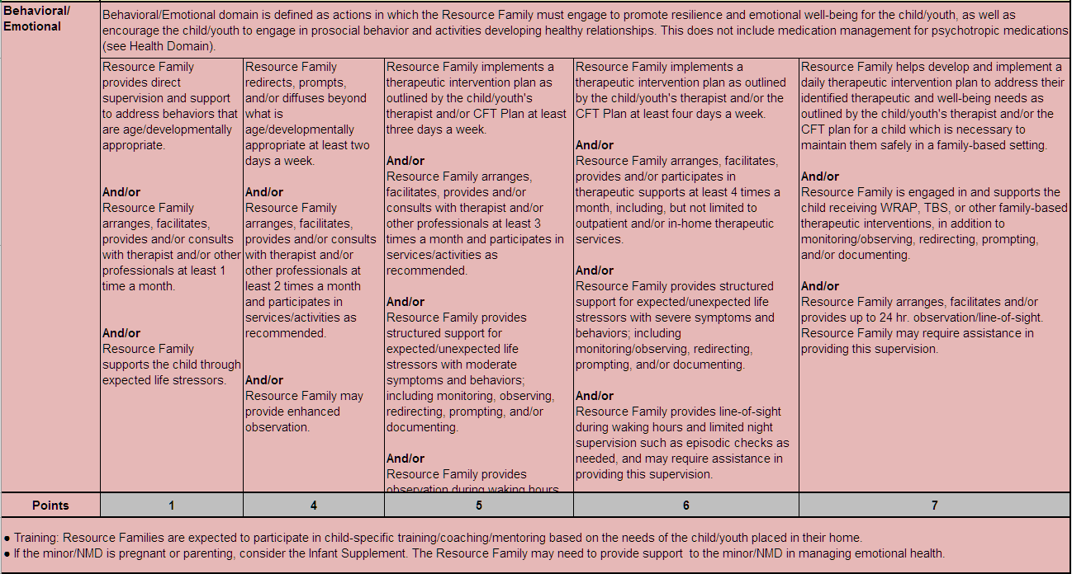
Behavioral/Emotional Domain

Slide 15
Behavioral/Emotional Domain
Behavioral/Emotional domain is defined as actions in which the Resource Family must engage to promote resilience and emotional well-being for the child/youth, as well as encourage the child/youth to engage in prosocial behavior and activities developing healthy relationships. This does not include medication management for psychotropic medications (see Health Domain).

Slide 16
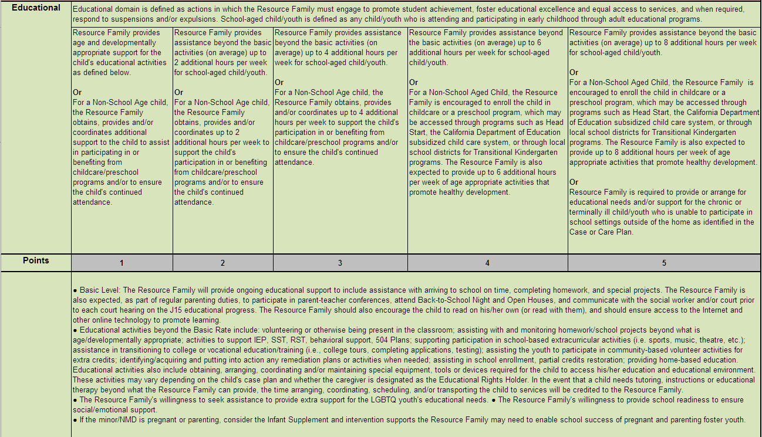
Educational Domain

Slide 17
Educational Domain
Educational domain is defined as actions in which the Resource Family must engage to promote student achievement, foster educational excellence and equal access to services, and when required, respond to suspensions and/or expulsions. School-aged child/youth is defined as any child/youth who is attending and participating in early childhood through adult educational programs.

Slide 18
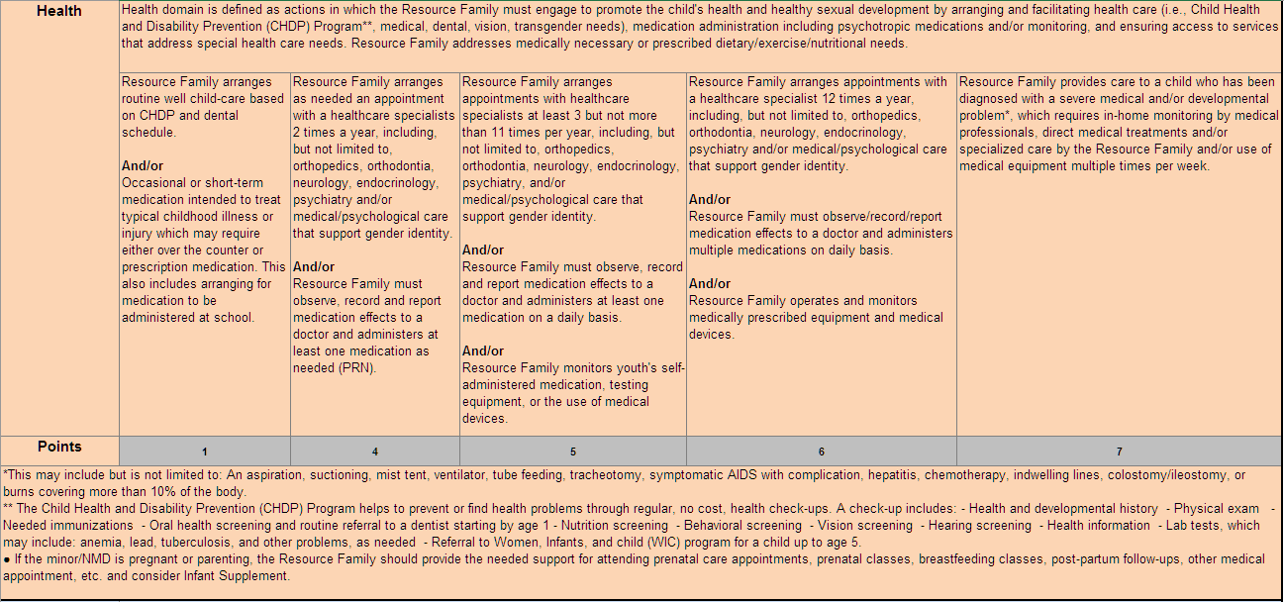
Health Domain

Slide 19
Health Domain
Health domain is defined as actions in which the Resource Family must engage to promote the child's health and healthy sexual development by arranging and facilitating health care (i.e., Child Health and Disability Prevention (CHDP) Program**, medical, dental, vision, transgender needs), medication administration including psychotropic medications and/or monitoring, and ensuring access to services that address special health care needs. Resource Family addresses medically necessary or prescribed dietary/exercise/nutritional needs.

Slide 20
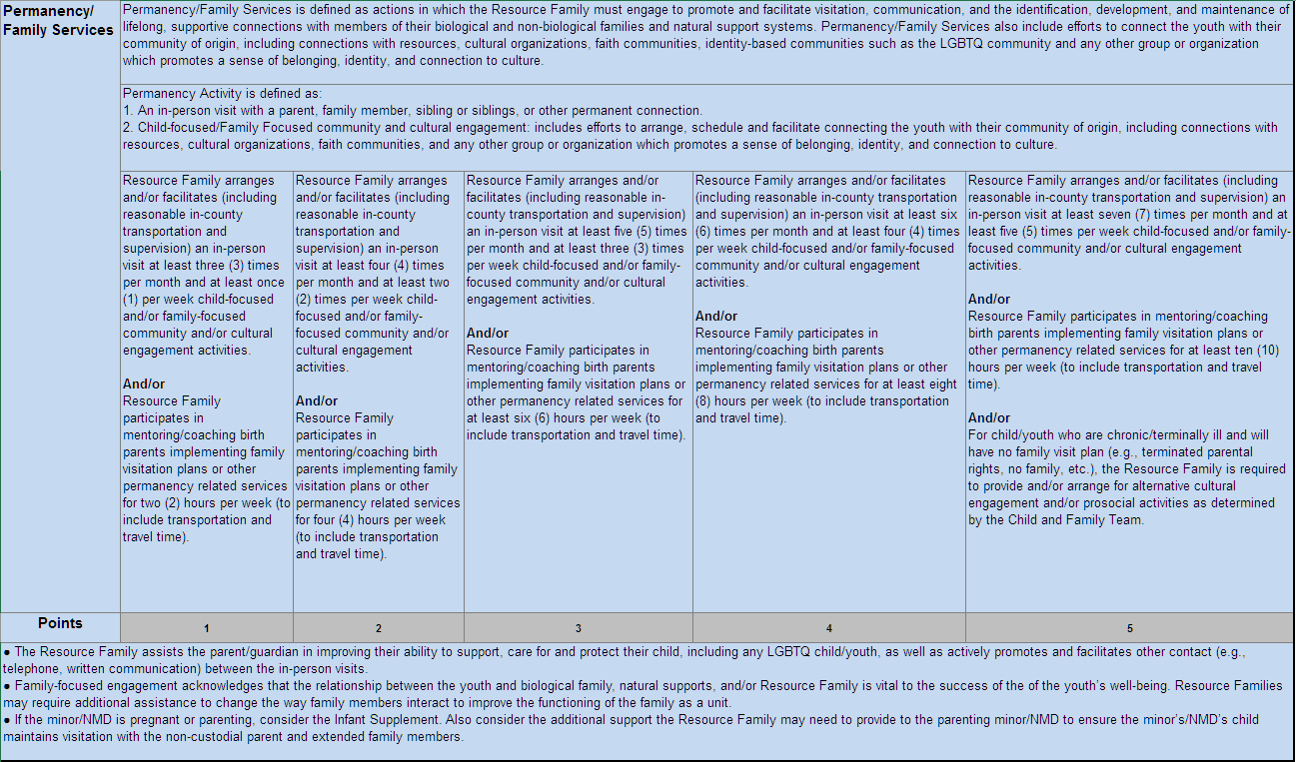
Permanency/Family Services Domain

Slide 21
Permanency/Family Services Domain
Permanency/Family Services is defined as actions in which the Resource Family must engage to promote and facilitate visitation, communication, and the identification, development, and maintenance of lifelong, supportive connections with members of their biological and non-biological families and natural support systems. Permanency/Family Services also include efforts to connect the youth with their community of origin, including connections with resources, cultural organizations, faith communities, identity-based communities such as the LGBTQ community and any other group or organization which promotes a sense of belonging, identity, and connection to culture.

Slide 22
Intensive Services
Part of the LOC Matrix
Identifies child(ren)/youth with specific needs including Multi-Dimensional Treatment Foster Care, special health care or medical placements, Therapeutic Foster Care or other special placements.
Can be time-limited based on the static criteria for urgent placement needs

Slide 23
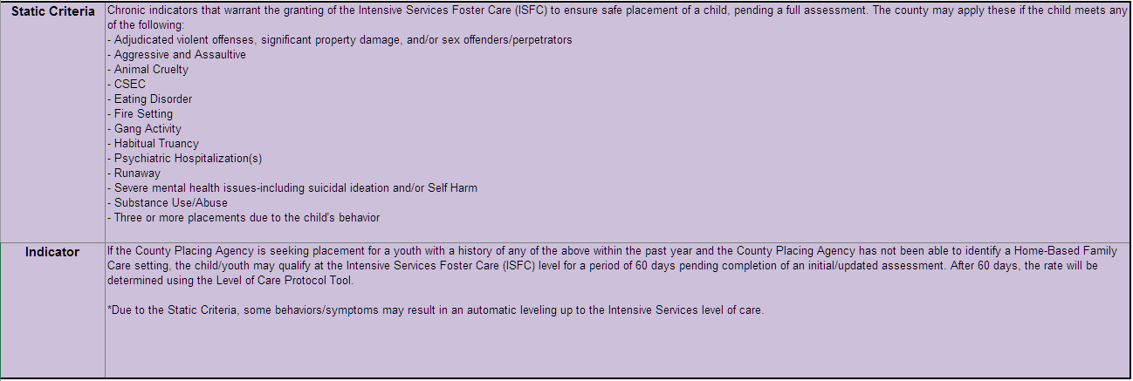
Static Criteria

Slide 24
Static Criteria
Chronic indicators that warrant the granting of the Intensive Services Foster Care (ISFC) to ensure safe placement of a child, pending a full assessment. The county may apply these if the child meets any of the following:
Adjudicated violent offenses, significant property damage, and/or sex offenders/perpetrators
Aggressive and Assaultive
Animal Cruelty

Slide 25
Static Criteria (cont’d)
CSEC
Eating Disorder
Fire Setting
Gang Activity
Habitual Truancy
Psychiatric Hospitalization(s)
Runaway
Severe mental health issues-including suicidal ideation and/or Self Harm
Substance Use/Abuse
Three or more placements due to the child's behavior

Slide 26
Probation Officer Perspective
Applying the LOC Tool with a Juvenile/Probationary Youth
Application of static criteria
Probation specific information gathering
Utilizing Child and Family Team members
Common triggering events for LOC evaluation for probationary youth

Slide 27
Pairing with Existing Assessment Tools
Specialized Care Increment (SCI)
Child and Family Team (CFT) Process
Risk and Needs
Other

Slide 28
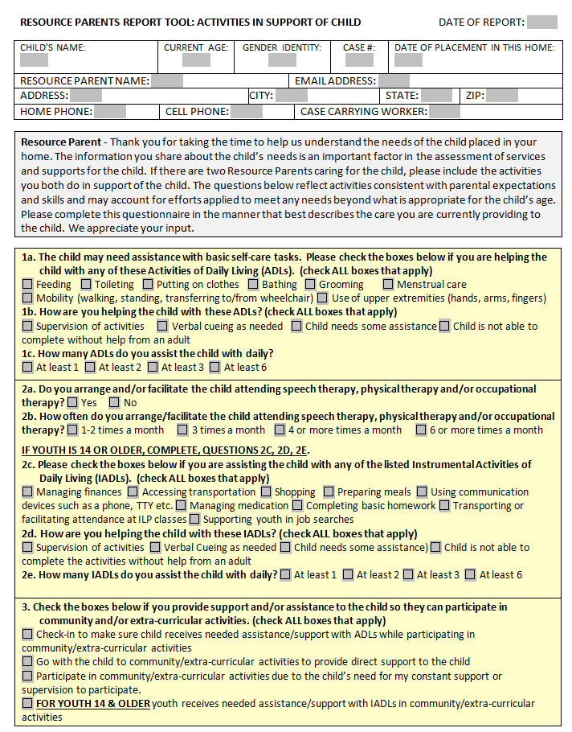
Resource Parent Tool

Slide 29
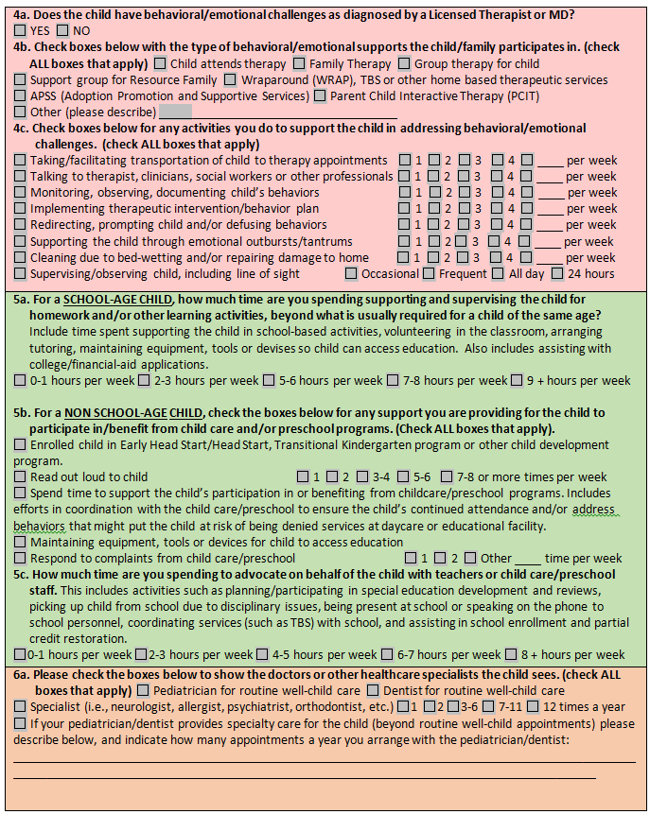
Resource Parent Tool (Cont’d)

Slide 30
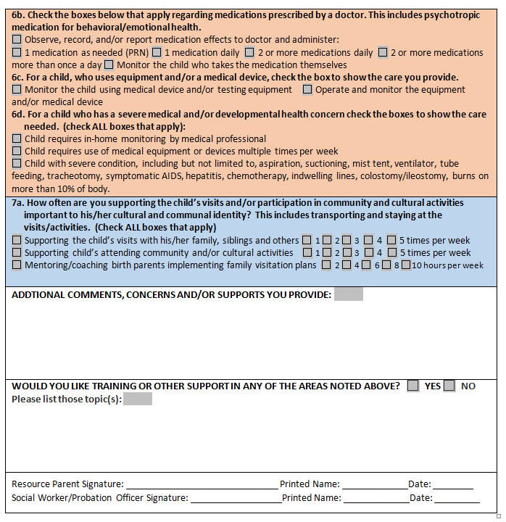
Resource Parent Tool (Cont’d)

Slide 31
County Practice
County practice
How to process the rate once determined?
Who approves the rate?
Who notifies the resource parent or family?
What triggers a fair hearing?
How will LOC impact the role of the case carrying Probation Officer, Social Worker and eligibility worker?

Slide 32
LOC Scoring System
Manual Scoring Sheets
Form
Instructions
Digital Scoring Sheet
Form
Instructions

Slide 33
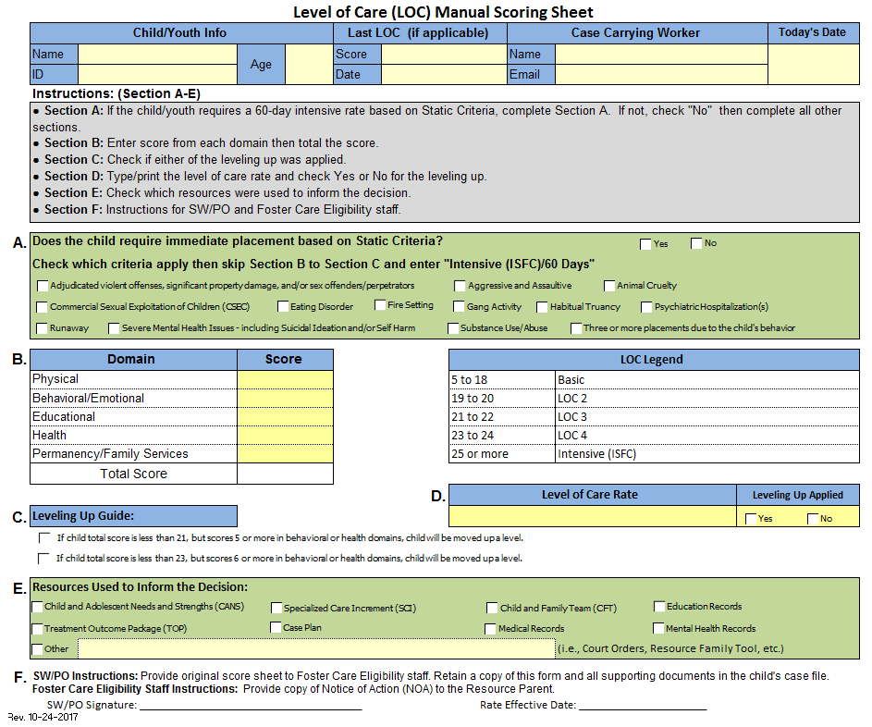

Slide 34
LOC Manual Scoring Sheet (Cont’d)
General Instructions 1. Complete this form after reviewing and determining the level of intensity/expectation in each domain of the Level of Care Rate Determination Matrix.
2. Print clearly or type all information requested.
3. Child ID: This would be either the CWS/CMS ID number or as defined by your county.
4. Age: Child age in years only.
5. Case Carrying Worker: This would be either the social worker, probation officer or a county designee. You may change the title as needed.
6. Sections A-F: Please follow the instruction guide in the grey box.
7. Leveling up Guide: Scores less than 21 means 20 or less and Scores less than 23 means 22 or less. Child has to score 5 or more in Behavioral or Health in order to move up a level.
8. Verify that the form is complete and correct, once printed no corrections may be made. If any error has been made, complete a new form.
9. Sign the form in the designated signature area based on your role. You may change the title as needed.
10. Effective date: Which is the date that the Resource Family will start the new rate.
11. Keep a copy of this form and all other supporting documents in the child case file or as directed by your county.

Slide 35
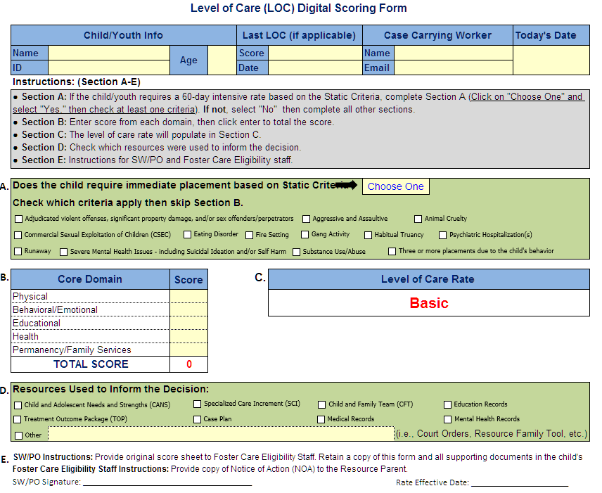
Notes:
.

Slide 36
LOC Digital Scoring Sheet (Cont’d)
General Instructions 1. Complete this form after reviewing and determining the level of intensity/expectation in each domain of the Level of Care Rate Determination Matrix.
2. Complete all information requested.
3. Child ID: This would be either the CWS/CMS ID number or as defined by your county.
4. Age: Child age in years only.
5. Case Carrying Worker: This would be either the social worker, probation officer or a county designee. You may change the title as needed.
6. Sections A-E: Please follow the instruction guide in the grey box.
7. Verify that the form is complete and correct, once printed no corrections may be made. If any error has been made, complete a new form.
8. Sign the form in the designated signature area based on your role. You may change the title as needed.
9. Effective date: Which is the date that the Resource Family will start the new rate.
10. Keep a copy of this form and all other supporting documents in the child case file or as directed by your county.

Slide 37
Vignettes

Slide 38
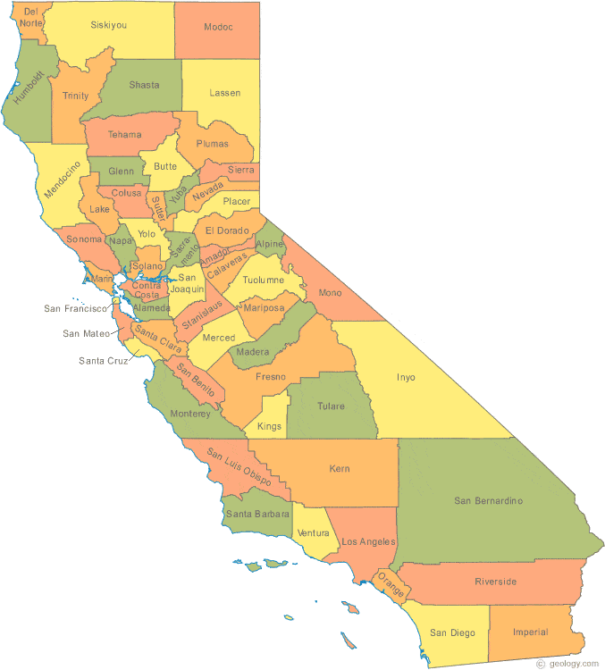
Local/County Delivery

Slide 40
Thank you for
your participation!
If you have any questions, please send to:
LOC@dss.ca.gov

