Slide 1
Overview of the California Child Welfare Core Practice Model (CPM)

Slide 2
Child Welfare Core Practice Model (CPM)
CPM is a statewide model for child welfare practice that defines and prescribes shared values, practice elements and practice behaviors for staff in all counties in California

Slide 3
Goal of CPM
To define California’s Child Welfare Services as a profession grounded in theory, with a set of core values, common elements and identified behaviors

Slide 4
Collective Effort
Statewide effort to develop shared values, practice elements and practice behaviors for child welfare staff and leaders
Process began in 2012
Core Practice Model Design Team
Directors Institute Faculty
Development Circle Champions
Directors, Managers, Supervisors, Social Workers, Community Partners across the state
Notes:
Explain that this is somewhat confusing as far as names of initiatives. There is also a Core Practice Model for Katie A. and the State is developing an Integrated Core Practice Model derived from that; however, CPM is separate endeavor.

Slide 5
Builds On Many Key Initiatives
Integrates key elements of existing initiatives and practices, such as:
Katie A. (Core Practice Model)
Wraparound
Continuum of Care Reform
Child & Family Team Meetings
Safety Organized Practice

Slide 6
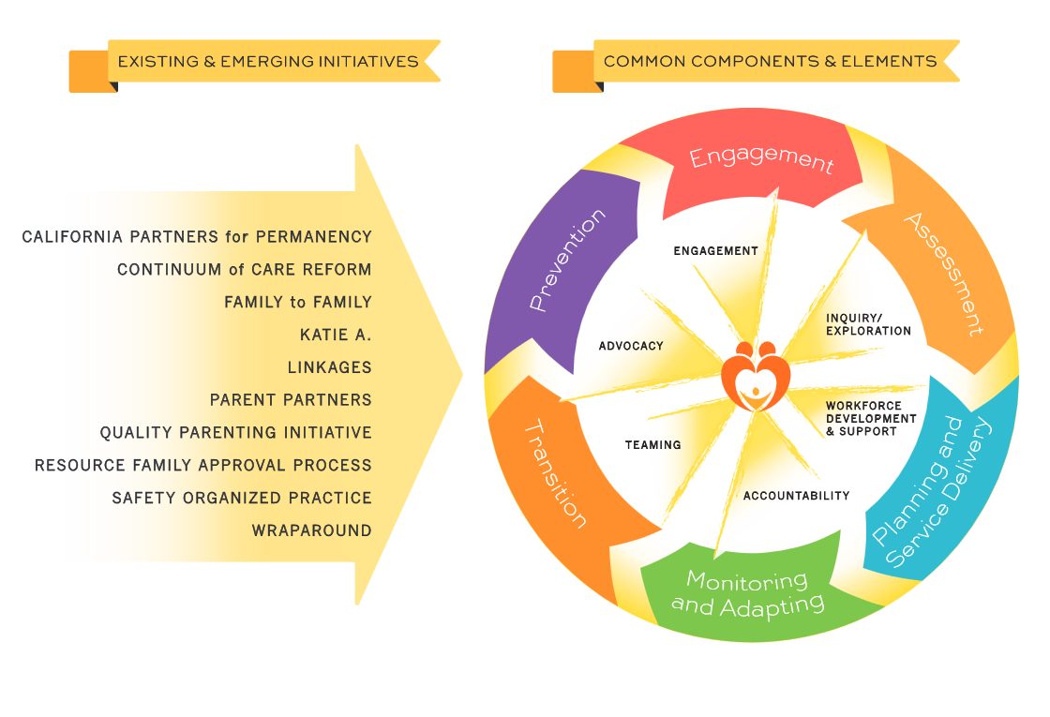

Slide 7
Values of CPM: We Believe…
Prevention & Early Intervention to Keep Children Safe
Honoring Families’ Experiences & Building Partnerships Based on Mutual Respect & Trust
Lifelong, Loving Families & Connections
Services for Youth that Support Well-Being & Full Potential
Honestly Sharing Strengths & Concerns to Engage Families
Listening to Families to Learn About Culture & Community
Families Can Grow & Change
Connecting Families with Effective, Family-Focused Strength-Based Services & Supports
Building a Competent, Professional Workforce through Quality Recruitment, Training & Support
Individual Development, Critical Thinking, Self-Reflection & Humility
Organizational Culture & Climate that Supports Learning & Development
Notes:
HANDOUT: CPM Overview Packet

Slide 8
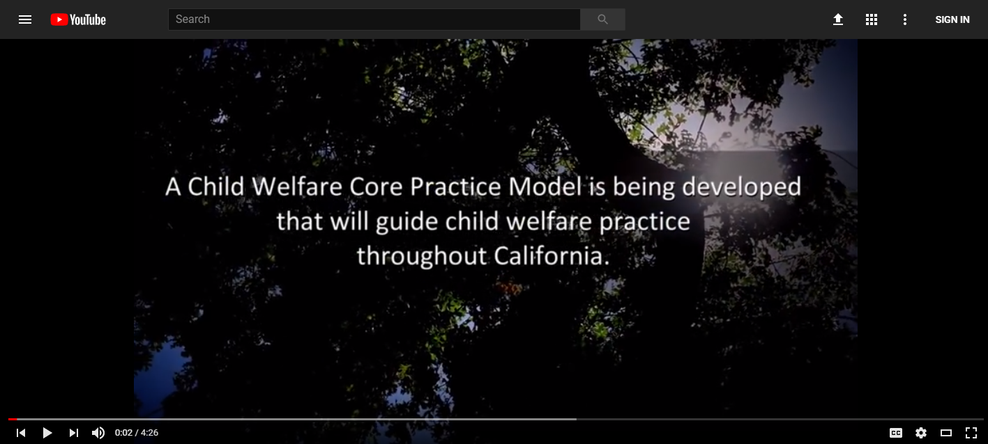
CPM Video
https://www.youtube.com/watch?v=-Vx_N29hy4k&list=UUV0YoKMl6wkbtYI1PbJXPSA

Slide 9
CPM Practice Elements
Engagement
Inquiry/Exploration
Advocacy
Teaming
Accountability
Workforce Development
Notes:
The practice elements of the CPM link the values and principles to the core aspects of practice that are essential to the model’s success. They are the broad actions essential to promoting safety, permanency, and well-being for all children and youth.
Each element is further defined and operationalized in practice behaviors that guide social workers in their practice with families, children, youth, young adults, caregivers, and communities.

Slide 10
CPM Casework Components
Prevention
Engagement
Assessment
Service Planning & Delivery
Monitoring & Adapting
Transition
Notes:
The practice components are the basic activities of collaborative work with children, youth, and families involved with child welfare. They are:
• PREVENTION – Child welfare prevention efforts focus on reducing risk factors and strengthening or increasing protective factors in families through a variety of programs and initiatives including differential response and home visiting.
• ENGAGEMENT – Family engagement is a family-centered and strengths-based approach to partnering with families in making decisions, setting goals, and achieving desired outcomes. It is founded on the principle of respect— communicating openly and honestly with families in a way that supports disclosure of preferences, family dynamics and culture, and individual experiences, so that the individual needs of every family and child can be met.
• ASSESSMENT – Assessment is a continuous process of discovery with families that leads to better understanding of the events and behaviors that brought the children and families into services, helps families identify the underlying needs that affect the safety, permanency, and well-being of the family, children, and youth.
• SERVICE PLANNING AND DELIVERY – Service planning involves working with the family and their team to create and tailor plans to build on the strengths and protective capacities of the youth and family members, in order to meet the individual needs for each child and family.
• MONITORING AND ADAPTING – Monitoring and adapting are part of the practice of continually monitoring and evaluating the effectiveness of the plan while assessing current circumstances and resources. It is the part of the planning cycle where the plan is reworked as needed.
• TRANSITION – Transition is the process of moving from formal supports and services to informal supports, when intervention by the formal systems is no longer needed. Transition also addresses issues related to changes of social worker, placement and other changes on the case that affect youth and families.

Slide 11
CPM Practice Behaviors
Foundational Behaviors
Engagement Behaviors
Assessment Behaviors
Teaming Behaviors
Service Planning & Delivery Behaviors
Transition Behaviors
Notes:
Core Practice Model behaviors are the action oriented aspect of the practice model that defines expected leadership and social work practice. For practitioners they bring the model’s theoretical framework, values, and elements to life by clearly describing the interactions between social workers and families, children, youth, young adults, communities, and tribes.
Practice behaviors provide guidance about how to use the practice model, ensuring staff and agency behavior are consistent with the practice model’s theoretical framework, values, and elements.
Leadership behaviors provide parallel guidance to Directors, Managers, Supervisors, and others in bringing the model’s theoretical framework, values, and elements to life by clearly describing the interactions between agency leadership and staff, and also between agency leadership and external stakeholders, in implementing the California Child Welfare Core Practice Model.
HANDOUT: CPM Practice Behaviors
FACILITATOR NOTE: IN SMALL GROUPS OR PAIRS, COMPLETE THE FOLLOWING ACTIVITY:
Have the small groups take turns reading the behaviors outlined in Foundational Behaviors; then on sticky notes ask individuals in each group to quickly jot down the ways in which they are already using these behaviors in practice with each other and with children and families (give them 1-2 minutes to brainstorm on sticky notes); at the end of that time ask them to spend 2-3 minutes sharing these with each other; next ask them to brainstorm on sticky notes the ways in which they might enhance the use of these behaviors in their everyday interactions with each other and with children and families (give them 1-2 minutes); once they are done with that they spend 2-3 minutes sharing with the small group – total time is about 10-15 minutes
2. Repeat the above process with each of the behavioral approaches (Engagement, Assessment, Teaming, Service Planing & Delivery, Transition) giving the same times for each one – total for all areas will be about 60-90 minutes depending on how much time you a lot to each one
3. Last activity is to ask folks to think across what they have learned today and pick one area to work on over the next few weeks, write it on a sticky note and post somewhere that they will see it everyday – give a minute or two.
3. Enhancement is to have each group have a table flip chart page where each of the behavioral categories is written and they post their sticky notes to the flip chart page they worked on – then someone types up and gives back to the group involved so that they can see how they are already using these behaviors

Slide 12
CPM Rollout
March-December 2017 - Directors’ Institute
April-December 2017 - Development Circles
Engagement, Relationships & Partnership
Organizational Readiness
Quality, Outcomes & System Improvement
Workforce Development
Bringing It to Life
Recruitment & Selection
Training & Coaching
January 2018 – Rollout in all counties
Notes:
The Directors’ Institute is a series of convenings, webinars and calls for directors to support implementation of CPM. Several directors serve as Champions for CPM implementation, taking a special role in advising the CPM process and a leadership role in the implementation effort with their peers.
Development Circles are a set of workgroups that are focused on different implementation drivers and supports for CPM implementation. The Development Circles are actively meeting and working to develop various implementation tools that will be “tested” by various counties over the next few months.

Slide 13
Questions for Discussion
What have you heard about the Core Practice Model that you value?
In what ways do you think it might lead to improved child welfare casework in California?
Do you have any worries about CPM?
Any questions about CPM?

