Slide 1
Introduction to Bioinformatics
Mohamed Nagy Saad Elziftawy
Lecturer, Biomedical Engineering Dept.
Faculty of Engineering, Minia University

Slide 2
Bioinformatics
Biology
Mathematics
Computer science
Medicine
A multifaceted discipline

Slide 3
Bioinformatics
Biologists + Clinicians collect molecular data: DNA & Protein sequences,
gene expression, mutations, etc
Bioinformaticians
Study biological questions by
analyzing molecular data with the help of computers
Computer scientists (+Mathematicians, Statisticians, etc.) Develop tools, software, algorithms to store and analyze the data.

Slide 4
Bioinformatics bag of tricks
Programming
Statistics
Databases
Algorithms
Web technologies
Creativity
Biological knowledge
Medical knowledge

Slide 5
Public Interaction with Bioinformatics
Online technologies
News/social media YouTube
Online courses Online tools
8

Slide 6
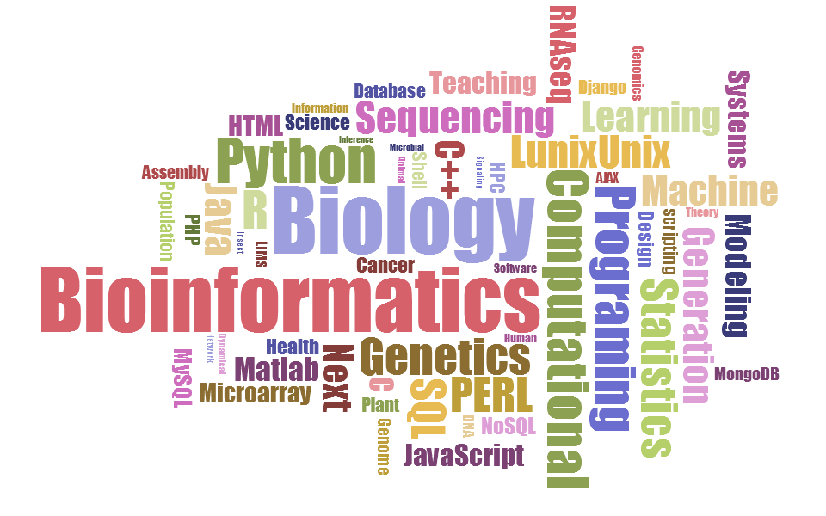
Bioinformatics Keywords

Slide 7
DNA (deoxyribonucleic acid)
DNA molecule is a double-stranded polymer composed of four basic molecular units called nucleotides.
Each nucleotide comprises a phosphate group, a deoxyribose sugar, and one of four nitrogen bases: adenine (A), guanine (G), cytosine (C), and thymine (T).
The two chains are held together by hydrogen bonds between nitrogen bases.
Base-pairing occurs according to the following rule: G pairs with C, and A pairs with T.

Slide 8
Cells and the genome
Each cell contains a complete copy of an organism’s genome, or blueprint for all cellular structures and activities.
The genome is distributed along chromosomes, which are made of compressed and entwined DNA.
Cells are of many different types (e.g. blood, skin, nerve cells), but all can be traced back to a single cell, the fertilized egg.

Slide 9
Cells and the genome
A (protein-coding) gene is a segment of chromosomal DNA that directs the synthesis of a protein
An intermediate step is the gene being transcribed or expressed
Most microarray experiments measure gene expression

Slide 10
The central dogma of biology
Gene expression experiments measure the amount of mRNA (messenger RNA) to see which genes are being expressed in (used by) the cell.
Measuring protein levels directly is also possible, but is currently harder.

Slide 11
References
https://figshare.com/articles/Bioinformatics_Introduction/1506799
(CC BY 4.0)
https://figshare.com/articles/Bioinformatics_for_the_Public_Eye/763316
(CC BY 4.0)
https://figshare.com/articles/Jobs_Posts_up_to_April_19th_2016/3185014
(CC BY 4.0)
Rafael Irizarry, Bioinformatics and Computational Biology Solutions Using R and Bioconductor, The Johns Hopkins University, 2006.
http://ocw.jhsph.edu/courses/BioinformaticsComputationalBiology/PDFs/Lecture1.pdf (CC BY NC SA)

